Slide 2
Clear as Phytoplankton: A Tale of Four Lakes
Nutrients, Genetics, and Plant Growth

Slide 3
Essential Questions
How do genetic and environmental factors influence the growth of phytoplankton?
How does phytoplankton growth affect water clarity?

Slide 4
Lesson Objectives
Construct a scientific explanation based on evidence for how environmental and genetic factors influence the growth of organisms.
Use a model to explain the relationship between the growth of organisms and their environment.

Slide 5
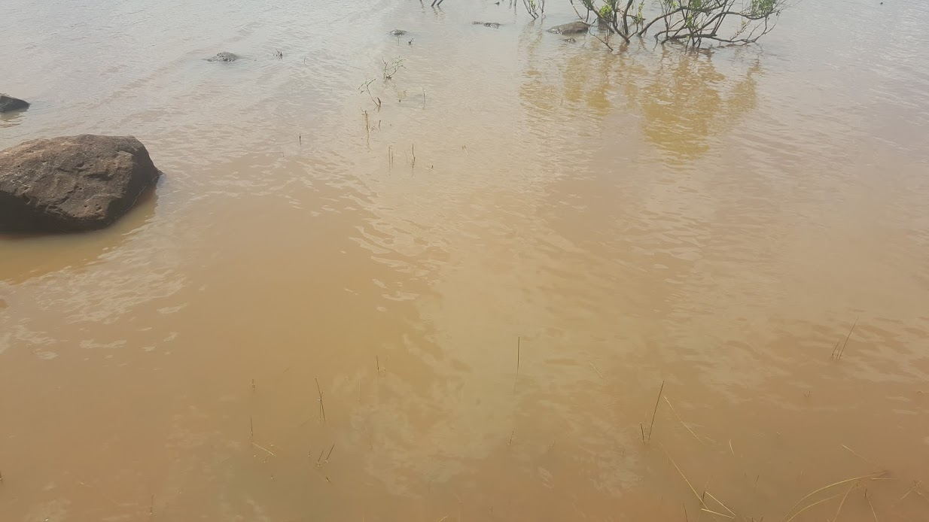
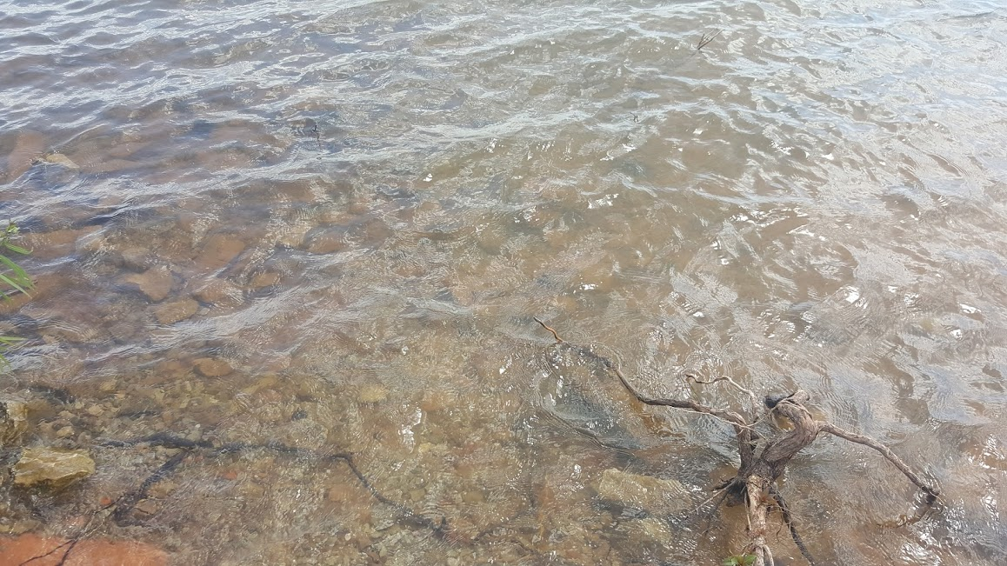
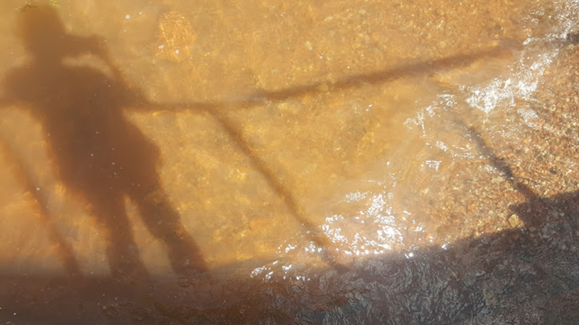
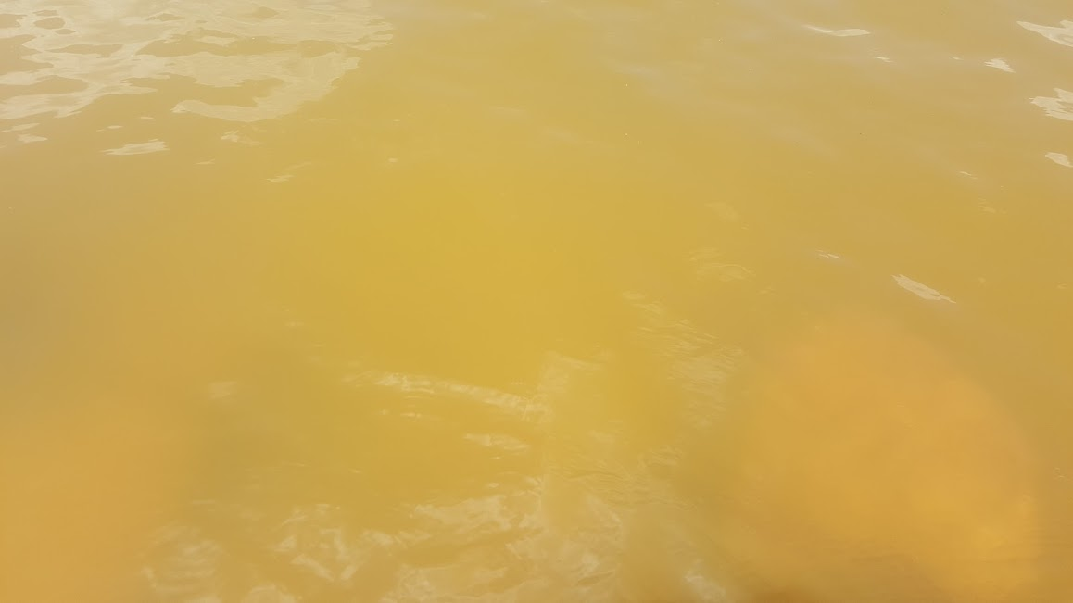
Tecumseh Lake
Shawnee Twin Lake #1
Lake Stanley Draper
Lake Thunderbird
Notes:
Miller-DeBoer, C. (2016). Tecumseh Lake [Photograph].
Miller-DeBoer, C. (2016). Shawnee Twin Lake #1 [Photograph].
Miller-DeBoer, C. (2016). Lake Stanley Draper [Photograph].
Miller-DeBoer, C. (2016). Lake Thunderbird [Photograph].

Slide 6
Tecumseh Lake Tecumseh, OK
Notes:
K20 Center. (n.d.). I notice, I wonder. Strategies. https://learn.k20center.ou.edu/strategy/180
Miller-DeBoer, C. (2016). Tecumseh Lake [Photograph].

Slide 7
Shawnee Twin Lake #1 Shawnee, OK
Notes:
K20 Center. (n.d.). I notice, I wonder. Strategies. https://learn.k20center.ou.edu/strategy/180
Miller-DeBoer, C. (2016). Shawnee Twin Lake #1 [Photograph].

Slide 8
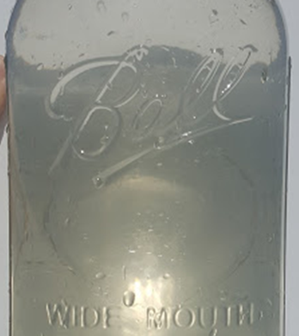
Lake Stanley Draper Oklahoma City, OK
Notes:
K20 Center. (n.d.). I notice, I wonder. Strategies. https://learn.k20center.ou.edu/strategy/180
Miller-DeBoer, C. (2016). Lake Stanley Draper [Photograph].

Slide 9
Lake Thunderbird Norman, OK
Notes:
K20 Center. (n.d.). I notice, I wonder. Strategies. https://learn.k20center.ou.edu/strategy/180
Miller-DeBoer, C. (2016). Lake Thunderbird [Photograph].

Slide 10
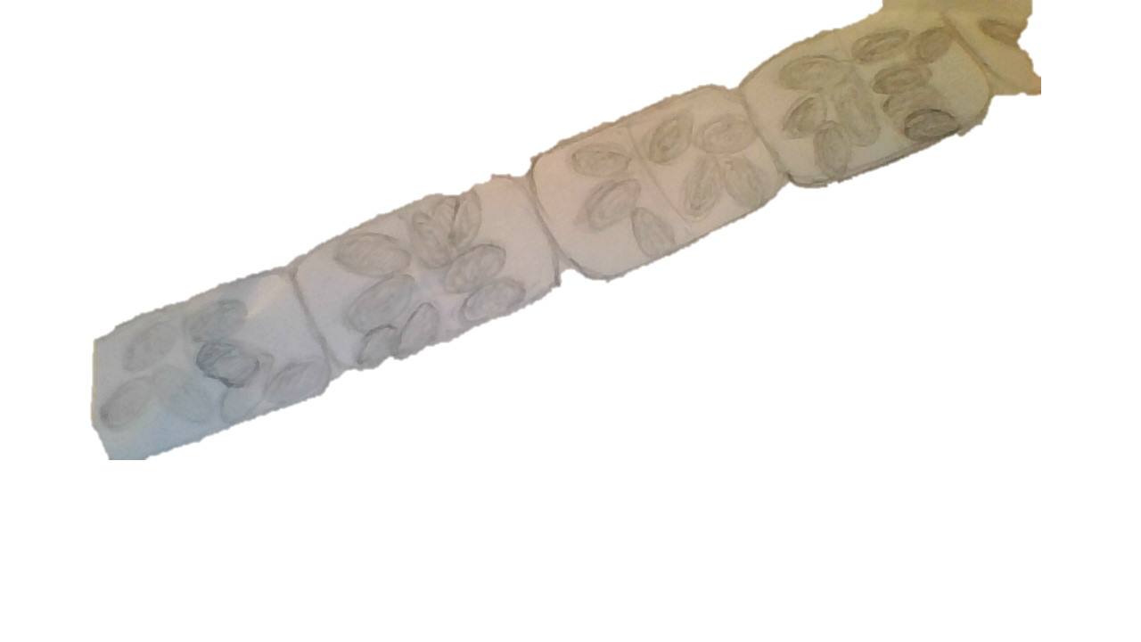
Lake Thunderbird June 3, 2016
40x
Notes:
Teacher’s Note: Data for the sample on the slide is included below.
Chlorophyll-a concentration: 21 mg/m3
Secchi depth: 52 cm (average)
Average turbidity: 14 NTU
Trophic state index: 61 (hypereutrophic)
Miller-DeBoer, C., & Shaffery, H. (2016). Lake Thunderbird 40x [Image].

Slide 11
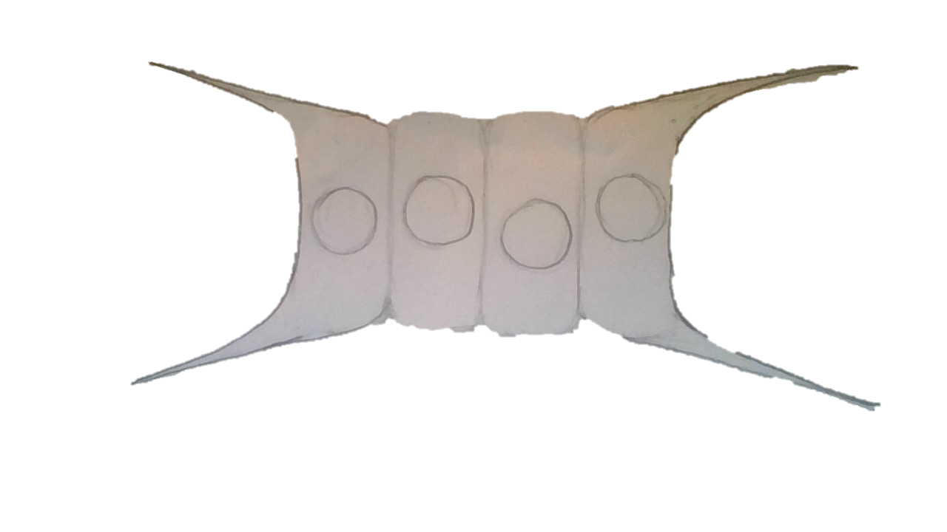
Lake Stanley Draper June 3, 2016
40x
Notes:
Teacher’s Note: Data for the sample on the slide is included below.
Chlorophyll-a concentration: 2.7 mg/m3
Secchi depth: 104 cm (excellent)
Average turbidity: 8 NTU
Trophic state index: 40 (oligotrophic)
Miller-DeBoer, C., & Shaffery, H. (2016). Lake Stanley Draper 40x [Image].

Slide 12
Shawnee Twin Lake #1 June 3, 2016
40x
Notes:
Teacher’s Note: Data for the sample on the slide is included below.
Chlorophyll-a concentration: 8.93 mg/m3
Secchi depth: 74.2 cm (good)
Average turbidity: 12 NTU
Trophic state index: 52 (eutrophic)
Miller-DeBoer, C., & Shaffery, H. (2016). Shawnee Twin Lake #1 40x [Image].

Slide 13
Tecumseh Lake June 3, 2016
40x
Notes:
Teacher’s Note: Data for the sample on the slide is included below.
Chlorophyll-a concentration: 5.5 mg/m3 (back calculated from tropic state index)
Secchi depth: 11cm (poor) [high sediment load]
Average turbidity: 132 NTU
Trophic state index: 49 (mesotrophic)
Miller-DeBoer, C., & Shaffery, H. (2016). Tecumseh Lake 40x [Image].

Slide 14
Phytoplankton are...
... also called algae.
... tiny plants that live in water.
... too small for us to see as individual cells without using a microscope.
The collection of different species in a lake is called a phytoplankton community.

Slide 15
Water Clarity
When there are lots of phytoplankton present, the water clarity changes.
Water clarity is how far you can see through the water. Water clarity depends on how many particles are suspended in the water.

Slide 16
What helps plants grow?
Notes:
Teacher’s Note: Consider using this slide to record student ideas, or as a placeholder for the question.

Slide 17
Phytoplankton Growth Model
Draw a model that explains what causes the difference in water clarity between the four lakes.
Use the information discussed in the lesson to create your model.
Your model does not have to be perfect. Make your best estimate using the knowledge you have.

Slide 18
Phytoplankton Growth Investigation
How can we test the factors that we think affect phytoplankton growth?

Slide 19
Investigating Phytoplankton Growth
Notes:
Teacher’s Note: Edit this slide to include your class-specific instructions for grouping and investigation procedures.

Slide 20
https://www.youtube.com/watch?v=du1PA0pzdnQ
Notes:
Algae Research and Supply. (2016, June 15). The dirty labcoat: The Secchi stick [Video]. YouTube. https://www.youtube.com/watch?v=du1PA0pzdnQ

Slide 21
Phytoplankton Communities
Compare your phytoplankton cards with the microscopic views of each lake.
Count the number of each type of phytoplankton found in each lake.

Slide 22
Phytoplankton Communities
Pick one of the genetic factors listed in the table on each card.
Sort the cards into at least two different groups based on the factor you picked. Record your results.
Pick a different factor and re-sort your cards. Record your results.
Pick a third factor and repeat the process. Record your results.

Slide 23
Phytoplankton Functional Groups
Compare your sorted groups with the groups of phytoplankton you counted in each lake.
What patterns do you notice?
What do these patterns mean?
In what kinds of environments would we find different functional groups?

Slide 24
Revised Phytoplankton Growth Model
Revise the model you drew earlier in the lesson to better explain what causes the differences in water clarity in the four lakes.
Add new information.
Make any corrections based on your new understanding.

Slide 25
Phytoplankton Growth Investigation
What do our data tell us about the factors that affect phytoplankton growth?

Slide 26
Factor Expert Panels
Notes:
Teacher’s Note: Edit this slide to include class-specific instructions for your factor expert panels. This could include grouping students, analyzing and graphing data, or making claims about the investigation and phytoplankton functional groups.

Slide 27
Concept Card Mapping
Notes:
Teacher’s Note: Edit this slide to include your class-specific instructions for creating the class Concept Card Map.
K20 Center. (n.d.). Concept card mapping. Strategies. https://learn.k20center.ou.edu/strategy/123

Slide 28
Revised Phytoplankton Growth Model
Revise your phytoplankton growth model to better explain the cause of the differences in water clarity between the four lakes.
Add any new information.
Make any corrections based on any new understandings.

Slide 29
Four Lakes’ Data Reports
Make a prediction about the conditions in each of the four lakes.
Use a Venn diagram to compare the factors in your model with the scientific data in the four reports.
How well do your model and predictions match the scientific data?
Notes:
K20 Center. (n.d.). Venn diagram. Strategies. https://learn.k20center.ou.edu/strategy/2918

Slide 30
Explaining Lake Water Clarity
Pick any lake except Tecumseh Lake.
Use your model to explain which factors affect phytoplankton growth.
Explain how phytoplankton affect the water clarity of your lake.

