Slide 2
A Lot of Pooping, Blooming, and Dying
Effects of Disturbance on Ecosystems

Slide 3
Essential Questions
How do disruptions to a physical component of an ecosystem lead to shifts in all its populations?
How do increases in nutrient levels change aquatic ecosystems?

Slide 4
Lesson Objectives
Construct an argument supported by evidence that changes to physical component of an ecosystem affects populations.

Slide 5
I Notice, I Wonder
Notes:
https://toxics.usgs.gov/photo_gallery/photos/emer_cont/cyanobac/dead_fish_binder_lake_iowa_7_l.jpg (Jennifer Graham, USGS)

Slide 6
What caused this?
Make a claim about what caused what you observe in this picture.
Give some evidence for why you made that claim.
Explain your reasoning.

Slide 7
What’s Blooming Investigation
[Insert your class-specific instructions for carrying out the investigation here. Make additional slides if necessary.]

Slide 8
What’s Blooming Data Analysis
Describe what happened to your jars over time.
How did the nutrient levels change over time?
How are your visual observations and nutrient levels related?
What conclusions can you draw?

Slide 9
What’s Blooming Data Analysis
Share your conclusions with your new partners.
Decide what conclusions your data support.
Add any new conclusions you learned about or created to your own list.

Slide 10
What’s Blooming?
Algal bloom: a quick increase in algae growing in an aquatic environment
Eutrophication: happens when an environment gains too many nutrients and stops working normally
Algal blooms are a common feature of eutrophic environments

Slide 11
What happens during a bloom?
An algal bloom occurs, and some plants underwater also grow quickly.
Sunlight is blocked from reaching deep into the water.
A lack of sunlight kills some underwater plants. Algae also dies quickly.
Dead plants and algae create a perfect environment for decomposers.
As decomposer activity increases, the amount of oxygen in the water decreases quickly.
Organisms in the water that need oxygen die.

Slide 12
What happens during a bloom?
Do we have enough information yet to explain how nutrients contribute to the algal bloom?

Slide 13
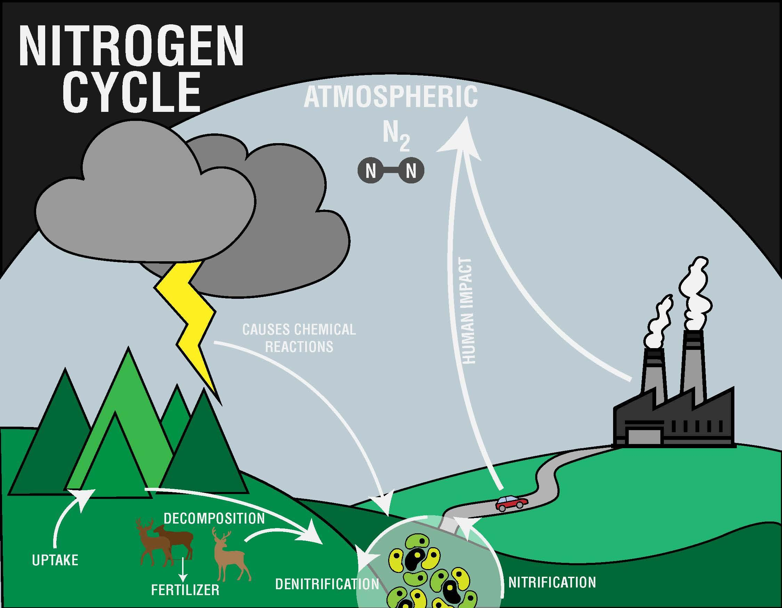

Slide 14
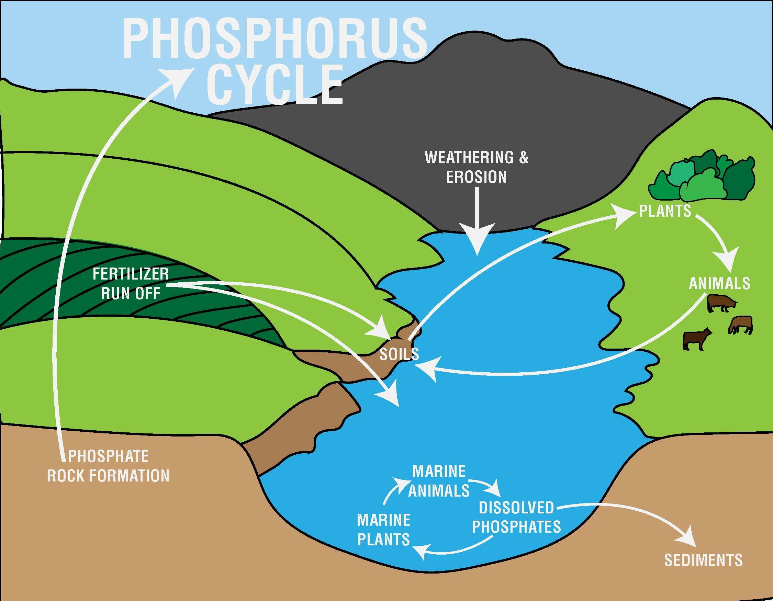

Slide 15
Nutrient Cycles
Draw one model that shows how nitrogen and phosphorus enter aquatic ecosystems.
Where in the cycles are extra nutrients most likely to enter the aquatic ecosystem?
Why are these parts of the cycle more likely to produce extra nutrients?

Slide 16
What caused this?
Revise your original Claim-Evidence-Reasoning statement.
Include data from your investigation as evidence.
Explain your reasoning based on the scientific ideas we’ve learned so far.

Slide 17
How do populations change?
Complete the eutrophication reading
Create a comic that describes how nutrient inputs change population sizes of organisms during an algal bloom.
Notes:
https://web.archive.org/web/20180601155801/https://www.storyboardthat.com/storyboards/bkbostro/eutrophication
Made with Storyboard That (https://www.storyboardthat.com)

Slide 18
Final Explanation: What caused this?
Write a final Claim-Evidence-Reasoning statement.
Include any evidence you’ve collected and scientific ideas you’ve learned during this lesson to support your claim.
Make sure your explanation includes why the water is green and why the fish is dead.

