Slide 2
Conflict and Choice in Tangerine
Character Development

Slide 3

I Notice, I Wonder
You are about to watch a video clip.
As you watch, consider:
  What observations you can make about the characters’ choices?
  What questions do you have?
Notes:
K20 Center. (n.d.). I notice, I wonder. Strategies. https://learn.k20center.ou.edu/strategy/180

Slide 4
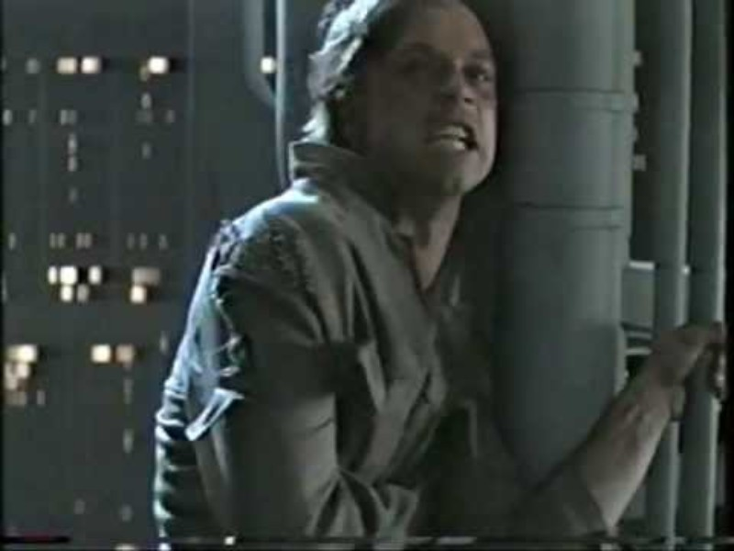
Star Wars “I Am Your Father” Scene
Notes:
YouTube. (n.d.-c). Star Wars “I am your father” Scene Full - UNEDITED 2000 vhs. YouTube. https://www.youtube.com/watch?v=Lbjru5CQIW4

Slide 5


Five-Minute Writing Prompt
Has one of your family members ever done something bad or something you thought was wrong?
How did it make you feel? How did you react?
How did other members of your family react?
Did they tell them they were wrong, or did they try to help?
Notes:
K20 Center. (2021, September 21). K20 Center 5 minute timer [Video]. YouTube. https://www.youtube.com/watch?v=EVS_yYQoLJg

Slide 6
Essential Question
How do a character’s choices affect the development of that character?

Slide 7
Learning Objectives
Understand how authors use character choices to create more realistic and engaging characters.
Make predictions of what characters will do in a novel.

Slide 8
Character Development
What does it mean when a character develops in a story?
Do characters always develop in a story?
What can affect character development?

Slide 9
Trip to Florida
Go to https://www.google.com/maps.
Type in “Tangerine, Florida.”
Select satellite mode in the bottom-left corner of the map.
Notes:
Google. (n.d.). Google maps. https://www.google.com/maps

Slide 10
Reflection
What did you find out about the city of Tangerine?
How would you feel if you had to move there?

Slide 11
Tangerine by Edward Bloor
As you read Schmoop’s introduction to Tangerine by Edward Bloor, annotate the text for:
specific information about character development in the story
clues about character development in the story

Slide 12
Predictions: What is the main problem?
On your handout, write a 1–2 paragraph answer for the following questions:
What do you predict the main problem in the novel Tangerine will be?
What makes you think this? Refer to the introduction we read for support.

Slide 13
Trade Predictions
Trade papers with a partner.
Read your partner's prediction
Flip over the handout and add your name to the partner spot.
Answer the questions on the back of the handout referring to your partner’s prediction.

Slide 14

Predictions: Peer Review
On the Anchor Chart, post your predictions.
We will refer to your predictions throughout reading the novel.
Notes:
K20 Center. (n.d.). Anchor charts. Strategies. https://learn.k20center.ou.edu/strategy/58

