Slide 2
Beyond the Slinky®, Part 2
Quantitative Characteristics of Waves

Slide 3
Essential Question
How do you measure a wave?

Slide 4
Lesson Objectives
We will use mathematical representations:
to support a claim regarding relationships among the frequency, wavelength, and speed of waves traveling in various media; and
to describe a simple model for waves that includes how a wave’s amplitude is related to its energy.

Slide 5

Bell Ringer
Stand up.
Listen carefully to the audio.
Sit down once you hear the tones.
Write your answer to this question:
Why do the tones sound different?
Notes:
Video links:
https://www.youtube.com/embed/iN3PBpInNJM?start=60&end=91 (snipped)
https://www.youtube.com/watch?v=iN3PBpInNJM (original—unsnipped)
Strategy: K20 Center. (n.d.). Bell Ringers and Exit Tickets. Strategies. https://learn.k20center.ou.edu/strategy/125

Slide 6
Exploring Waves
In groups, work through the prompts on the Wave Activities handout.
Try to problem-solve with your group members first, but if you get stuck, I’m here to help.

Slide 7
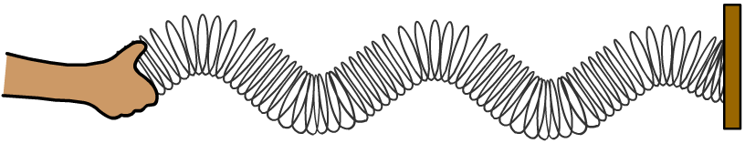
Modeling Waves
The wave travels away from the source at a right angle (perpendicular) to the movement of the source.
In a transverse wave, the coils do not travel horizontally; each coil simply vibrates up and down.
Source moves
up and down
Coils vibrate
up and down
Direction of wave

Slide 8
Draw This Wave

Slide 9
Wave Terminology
Crest
Wavelength
Amplitude
Crest | The highest point of the wave.
Trough | The lowest point of the wave.
Amplitude | The height of the wave above the zero line.
Wavelength | The distance from crest to crest or trough to trough.
Frequency | The number of waves per second, measured in hertz (Hz).
Trough

Slide 10
Wavelength, Frequency, and Velocity
Based on your findings:
What is the relationship between wavelength and frequency—is it proportional or inversely proportional?
What is the relationship between frequency and velocity—
is it proportional or inversely proportional?
Can you write a formula connecting wavelength,
frequency, and velocity?

Slide 11
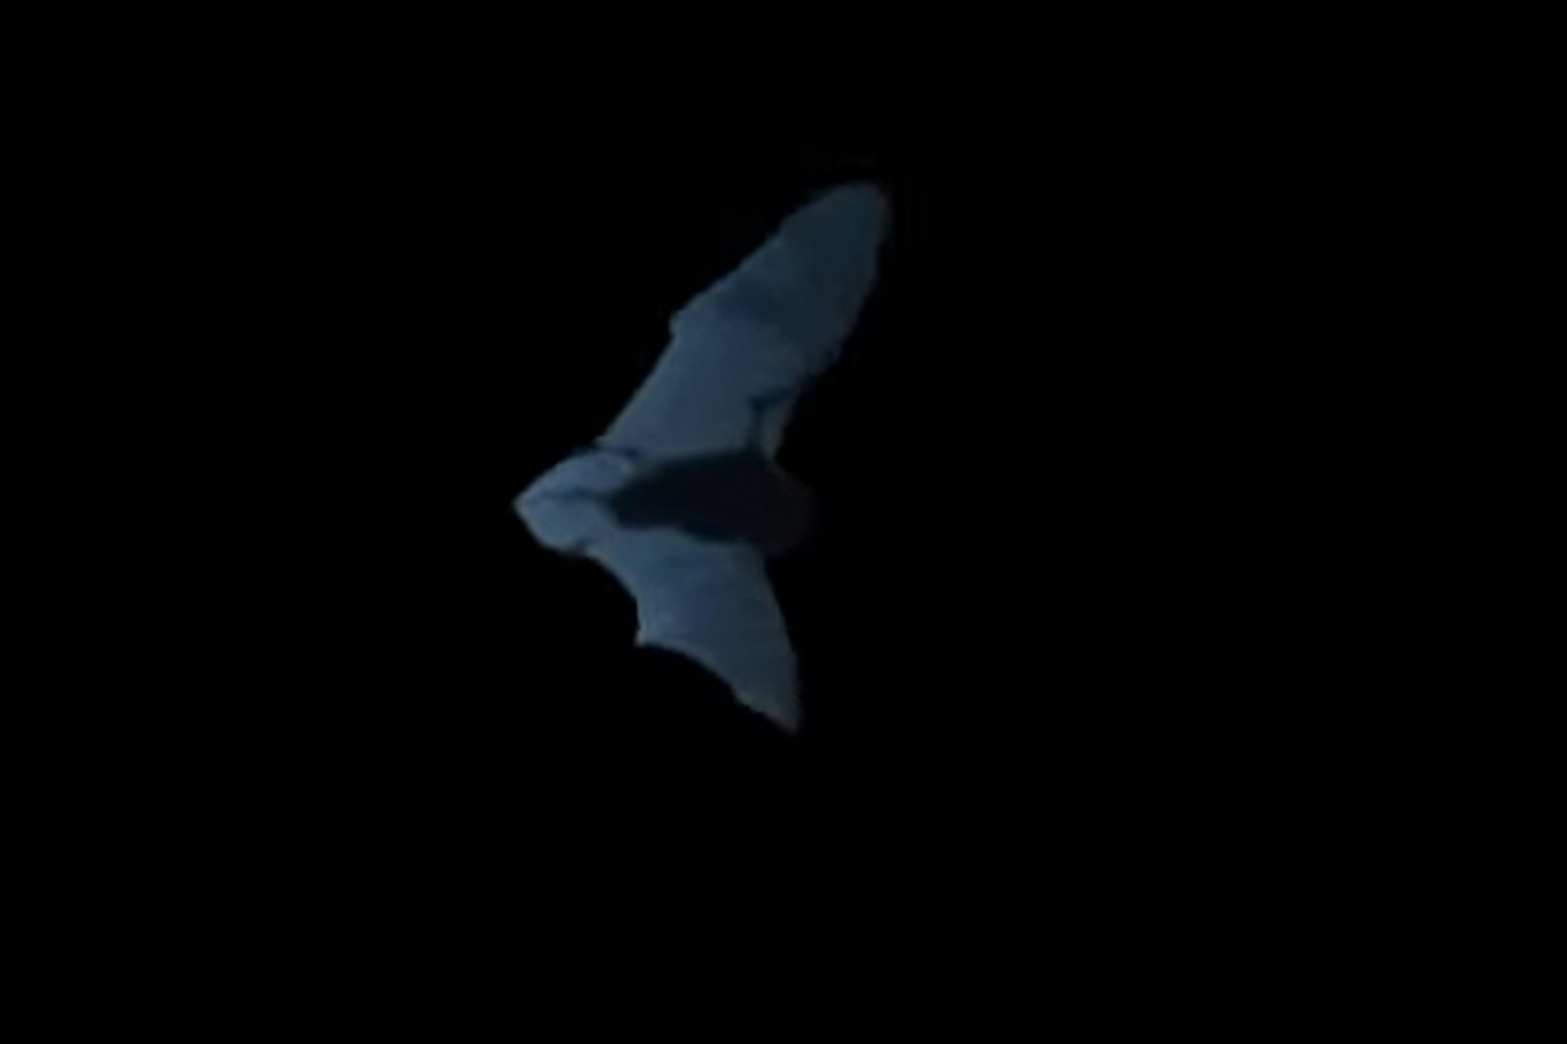
Be the Moth!
You are a tiger moth, trying to survive…
You know a bat is coming for you—
what do you do?
Notes:
To play the video, click on the image or paste this link into your browser: https://youtu.be/GZxK_0OSoFk
Video source:
Corcoran, A. (2013, September 23). Moth jamming bat — National Geographic Untamed Americas [Video]. YouTube. https://www.youtube.com/watch?v=GZxK_0OSoFk

Slide 12
Be the Moth!
Work out how you would determine the wavelength needed for your survival.
Once you have the answer, try to replicate that wavelength with your spring.
Was it too hard/fast? Are there ways to scale your answer so you can replicate it?

Slide 13
Exit Ticket
Get out your handout from the beginning of the lesson. Remember the tones and your response for the Bell Ringer?
Based on what you’ve learned since then, describe the relationship between wavelength, frequency, and velocity and explain how that relationship reveals why the tones sound different.
Notes:
Strategy: K20 Center. (n.d.). Bell Ringers and Exit Tickets. Strategies. https://learn.k20center.ou.edu/strategy/125

