Slide 2
Criminal Motivations
Irony and Characterization in “The Cask of Amontillado”

Slide 3
Essential Question
How do a character’s motivations affect their actions?

Slide 4
Lesson Objectives
We will be able to:
analyze how authors use key literary elements to contribute to meaning and interpret how themes are connected across texts: character development.
evaluate literary devices to support interpretations of texts, including comparisons across texts: irony.
make connections (e.g., thematic links, literary analysis) between and across multiple texts and provide textual evidence to support their inferences.

Slide 5
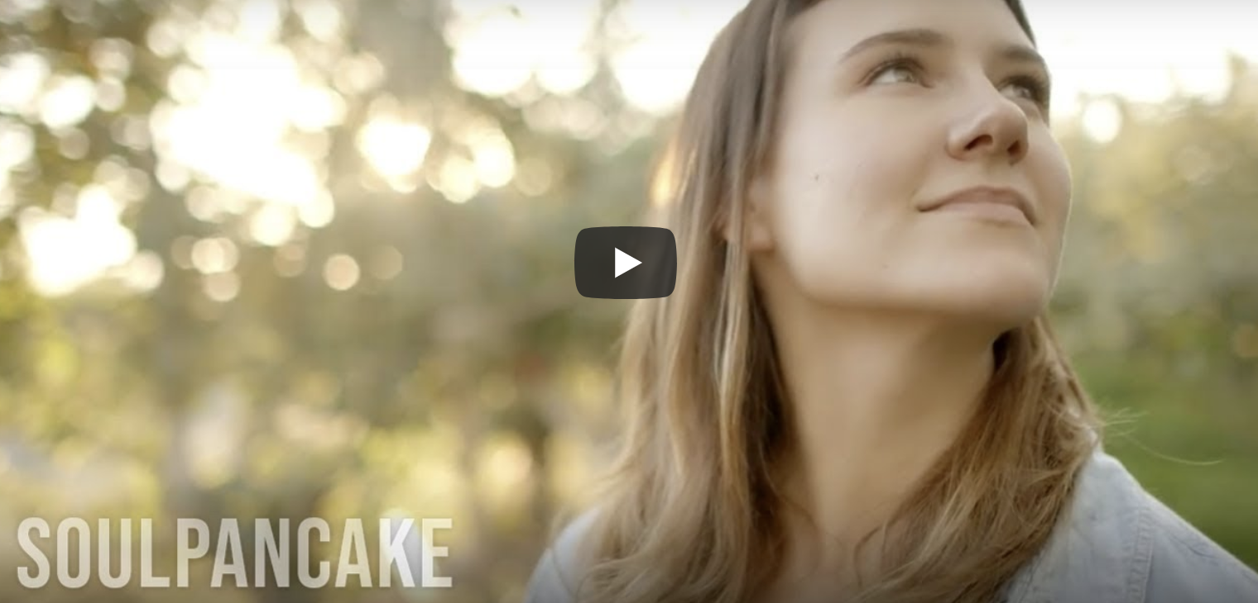
What Motivates You?
What motivates you to be successful?
What keeps you going?
Video: What’s stopping you from achieving your goals?
Notes:
SoulPancake. (2015, March 5). What’s stopping you from achieving your goals? [Video]. YouTube. https://www.youtube.com/watch?v=XZRw91uNMq0

Slide 6
Sometimes our actions are opposite of our words and intent.
This is one form of irony.

Slide 7
Three Types of Irony
When what is said is in opposition to what is meant.
When the audience knows what is happening, but some or all characters do not.
When what happens is not what was expected.
Notes:
Source: Erin, M. 9-3-R-4. Elaokframework.pbworks.com. http://elaokframework.pbworks.com/w/page/120909798/9-3-R-4

Slide 8
Group Posters
What is an everyday situation that represents your type of irony?
Plan out and discuss your poster with your group members.
Title your poster with the type of irony you were assigned.
Draw an image that reflects the irony you were given.

Slide 9
Spend a Buck
Take a Gallery Walk of the posters, looking at each poster to determine which you think best depicts the irony they were assigned.
Using sticky notes, decide as a group how you will spend your imaginary 100 pennies (or $1.00) on the posters hanging around the room.
For each amount you spend, put it on the sticky note as well as a brief sentence explaining why you gave that amount.

Slide 10
Categorical Highlighting
While reading, look for and highlight:
Explain why in the margin:
What is Montresor’s purpose in using this irony?
When what is said is in opposition to what is meant.
When the audience knows what is happening, but some or all characters do not.
When what happens is not what was expected.

Slide 11
Categorical Highlighting
Look for and highlight:
Explain why:
VERBAL IRONY: When what is said is in opposition to what is meant.
DRAMATIC IRONY: When the audience knows what is happening, but some or all characters do not.
SITUATIONAL IRONY: When what happens is not what was expected.
What is Montresor’s purpose in using this irony?

Slide 12
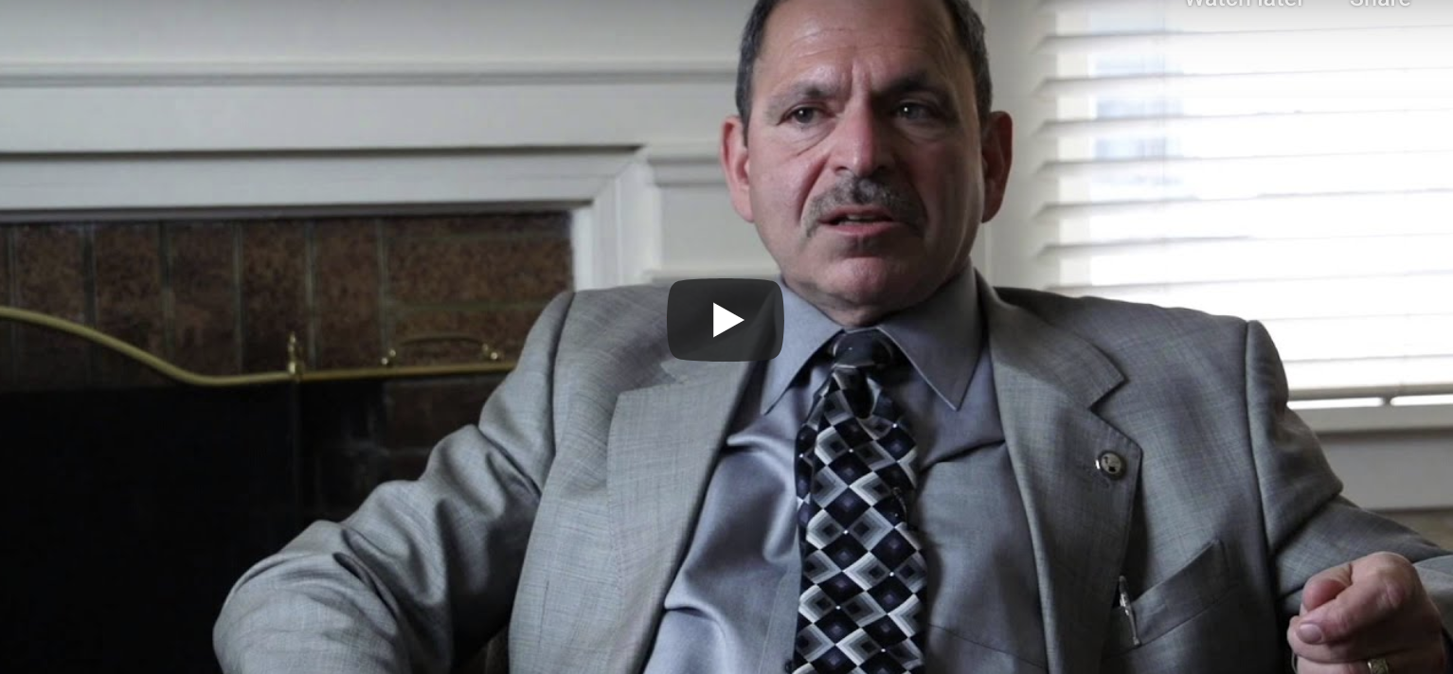
What Is a Forensic Psychologist?
Notes:
Portland Community College (2014, March 27). What is a forensic psychologist? [Video]. YouTube. https://www.youtube.com/watch?v=H3-p1QnHrVk

Slide 13
Montresor Is in the Hot Seat...
Think Like a Forensic Psychologist
Expectations for small group discussion:
Look at the evidence.
Plan out your questions.
Interview the defendant (Montresor).
Take turns in your group playing the role of Montresor.
Each group member should have a turn asking a question before the role is changed.

Slide 14
Create a Clinical Evaluation
Remember to include the following in your Flipgrid video:
one form of irony
text evidence
You are now called to the stand to provide your opinion as an expert witness in the case. What do you think? Does Montresor have the mental stability to stand trial?
Does Montresor understand the crime which he is accused of committing? Why or why not?
What is his current mental functioning?
What is his version of the alleged offense?
What is your impression regarding Montresor's capacity to understand his actions and his conduct?

