Slide 2
It’s a Balancing Act
Personal Financial Literacy

Slide 3
Essential Questions
Why is managing a bank account important?
What are the consequences of mismanagement?

Slide 4
Lesson Objectives
Investigate the aspects of managing a bank account.
Describe the financial and material consequences of mismanaging an account.
Analyze which banking services offer the best customer opportunities.

Slide 5
Scenario
Your friend needs a loan for lunch at fast-food restaurant Burger Boy, but your friend doesn’t have Venmo. Luckily, you have a checking account and can give them a check to help them get lunch!
Fill out the blank check with a dollar amount of your choice that would be enough for your friend’s lunch.
Notes:
Pass out one of the attached Blank Checks to each student.

Slide 6

I Notice
As you watch the video, write at least three (3) things you learn or observe.
Notes:
To play the video, paste this link into your browser: https://www.youtube.com/watch?v=z7AS_6RhxiU
Video source:
SchoolsFirst FCU. (2016, February 22). It’s a Money Thing: Checking Account Basics [Video]. YouTube. https://www.youtube.com/watch?v=z7AS_6RhxiU
Strategy:
K20 Center (n.d.). I Notice, I Wonder. Strategies. https://learn.k20center.ou.edu/strategy/180

Slide 7
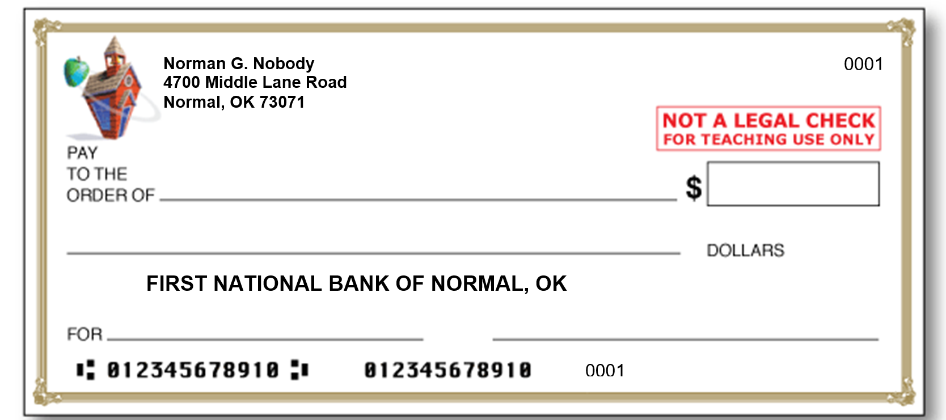
Is your check correct?
Sheila Sanders
25.00
Twenty – five and no / 100
Lunch money
Norman G. Nobody
Notes:
Image source:
Education World. (n.d.). Blank check template [Image]. Education World. https://www.educationworld.com/tools_templates/template_kid_check.doc

Slide 8
I Wonder
With your partner, discuss and write at least two (2) questions you have about checking accounts.
Notes:
Strategy:
K20 Center (n.d.). I Notice, I Wonder. Strategies. https://learn.k20center.ou.edu/strategy/180

Slide 9

CUS and Discuss
As you read,
Circle the main ideas,
Underline any supporting details, and
Star one statement that you believe is the most important information in the reading.
Notes:
Strategy:
K20 Center (n.d.). CUS and Discuss. Strategies. https://learn.k20center.ou.edu/strategy/162

Slide 10
Example
John goes to the ATM to withdraw money two or three times a week from his bank account. His bank charges $1 for each transaction or use of the ATM (Automatic Teller Machine). While two or three dollars is not a large amount, by the end of the year John has spent almost $156 in ATM fees. John could consider finding a new bank that has no ATM fees, but he might not be aware that different banks have different checking account policies.

Slide 11
Balancing a Checking Account
Prevents your account from being overdrawn and any fees associated with that.
Helps you understand how your money is spent.
Keeps you informed of the amount of money you currently have (the balance).

Slide 12
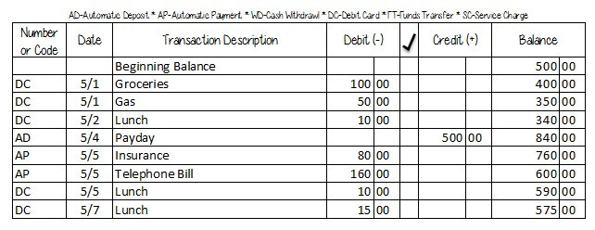
Amount of money you started with
An entry for each deposit or added money
How the money was withdrawn or deposited
An entry for each item you spent money on
Current or latest balance
Notes:
Image source:
DayCreates. (2015, May 8). Financial Tip Friday: Balance Your Checkbook [Image]. WordPress. https://daycreates.wordpress.com/2015/05/08/financial-tip-friday/

Slide 13
Mismanagement
What would be the consequences of NOT managing your checking account?

Slide 14

Checking Account Checklist
Using information from your assigned bank, investigate which benefits they offer to customers who open a checking account.
Complete the checklist for opening a bank account.
Notes:
Pass out the attached Checklist for Opening a Bank Account.

Slide 15
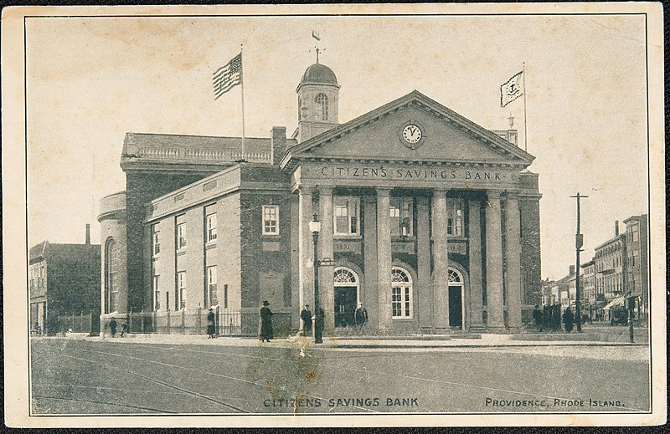
Bank Resource List
Bank of America
Chase Bank
MidFirst Bank
Bank of Oklahoma
First Fidelity Bank
Sooner State Bank
Notes:
Image source:
Mitchell, H. T. (1915). Citizens Savings Bank, Providence, Rhode Island [Image]. Wikimedia Commons. https://commons.wikimedia.org/wiki/File:Islandora_21104-Citizens_Savings_Bank,_Providence,_Rhode_Island_OBJ.jpg

Slide 16
Checking Account Advertisement
With your group, create a rap, chant, commercial jingle, song, poster, or elevator speech to advertise the best features of your bank’s checking account.
Notes:
Strategies:
K20 Center (n.d.). Chant it, Sing it, Rap it. Strategies. https://learn.k20center.ou.edu/strategy/143
K20 Center (n.d.). Elevator Speech. Strategies. https://learn.k20center.ou.edu/strategy/57

