Slide 2
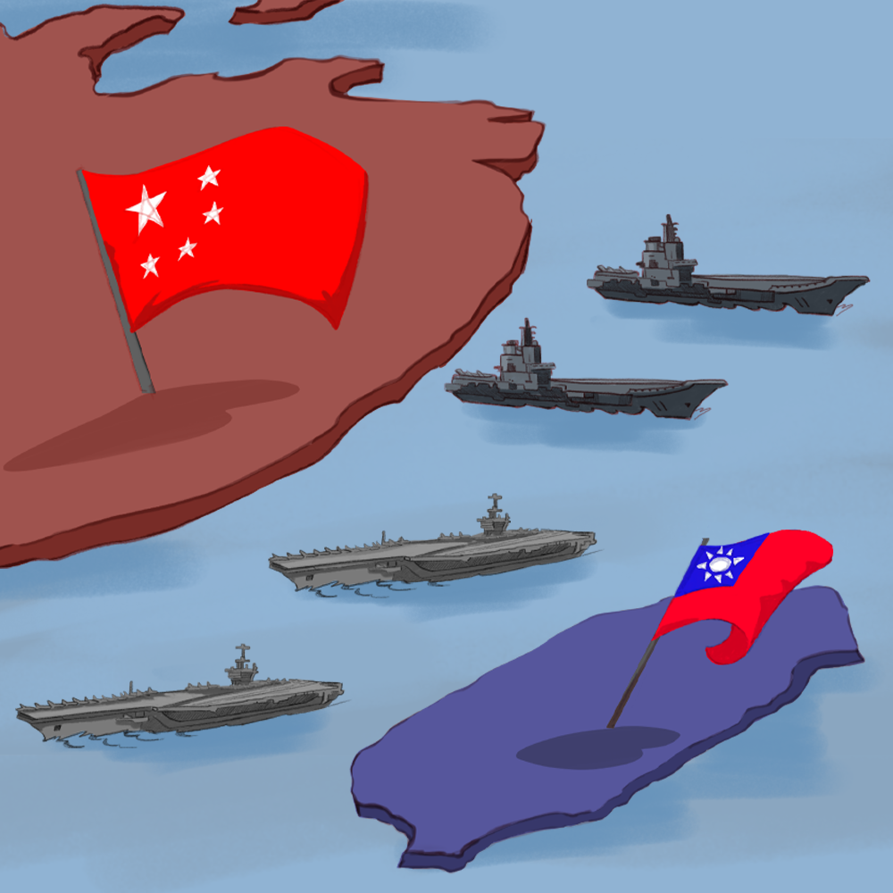
When Conflict Creates Countries
China and Taiwan

Slide 3

Tell Me Everything
What do you already know about China’s history?
  Include everything you know about the history of China and China’s government.
Notes:
K20 Center. (n.d.). Tell me everything. Strategies. https://learn.k20center.ou.edu/strategy/107

Slide 4
Essential Question
How did the Chinese Civil War create two societies?

Slide 5
Learning Objective
Explain the relationship between China and Taiwan.

Slide 6

I Think, We Think
What are the differences between China and Taiwan?
Notes:
K20 Center. (n.d.). I think / we think. Strategies. https://learn.k20center.ou.edu/strategy/141

Slide 7
China and Taiwan
Read the information about China and Taiwan.
Complete the handout with a partner.

Slide 8

SIT
As you watch the video, identify things you find to be…
  Surprising
  Interesting
  Troubling
Notes:
K20 Center. (n.d.). S-I-T (Surprising, interesting, troubling). Strategies. https://learn.k20center.ou.edu/strategy/926

Slide 9
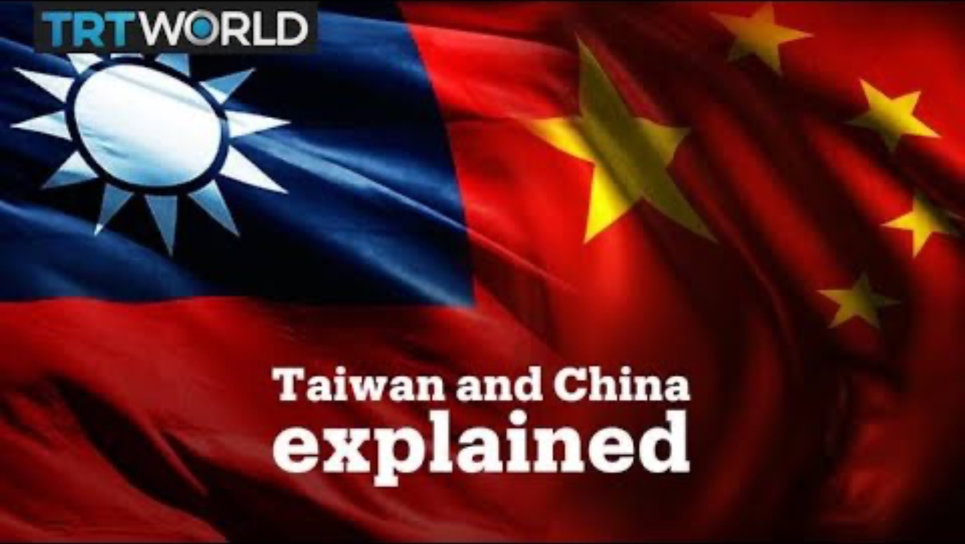
Taiwan and China Explained
Notes:
TRT World. (2019, January 11). Taiwan and China explained [Video]. YouTube. https://www.youtube.com/watch?v=a2a4yR4P_Vk

Slide 10
SIT
With a partner, discuss the things you found to be…
  Surprising
  Interesting
  Troubling
Notes:
K20 Center. (n.d.). S-I-T (Surprising, interesting, troubling). Strategies. https://learn.k20center.ou.edu/strategy/926

Slide 11

Six-Word Memoir
Summarize the relationship between China and Taiwan in one sentence that is exactly six words.
Notes:
K20 Center. (n.d.). Six-word memoirs. Strategies. https://learn.k20center.ou.edu/strategy/75

