Slide 2
Jazz in Oklahoma
The Contributions of Oklahoma’s Jazz Musicians

Slide 3

Fiction and Facts
Even though jazz is rooted in both the musical traditions of West Africa and Europe, it is considered an American art form.
Jazz music was originally developed by Black musicians across the American South.
Oklahoma City, Oklahoma, is considered the birthplace of jazz music.
Notes:
Source: https://learn.k20center.ou.edu/strategy/60u)

Slide 4
Essential Questions
How did Oklahoma jazz musicians contribute to the evolution of jazz music?
Why and how do we honor the contributions of people of the past?

Slide 5
Lesson Objectives
Describe the contributions of Oklahoma jazz musicians, including the Oklahoma City Blue Devils, Jimmy Rushing, and Charlie Christian.
Analyze how the contributions of Oklahoma’s jazz musicians are honored and remembered today.

Slide 6

Painting a Picture: Music Observations
An observation is anything you see or hear in the resources.
As you engage with articles, music recordings, and photographs, record your observations in the “observations” column of the chart.
Notes:
K20 Center. (n.d.) Painting a picture. Strategies. https://learn.k20center.ou.edu/strategy/1331

Slide 7
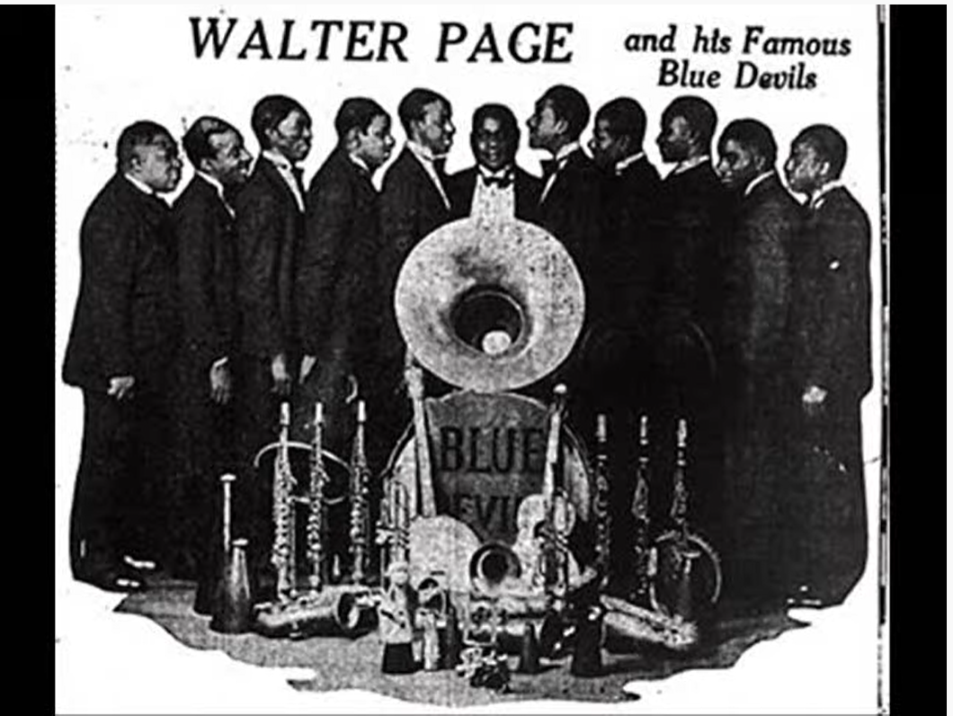
Blue Devil Blues
Notes:
Source: Page, Walter. (2012, Dec. 23). Walter Page’s Blue Devils: Blue Devil Blues. [Radio Show]. YouTube. https://www.youtube.com/watch?v=K51s5KBDZ9Y
Performance recorded in 1929.

Slide 8
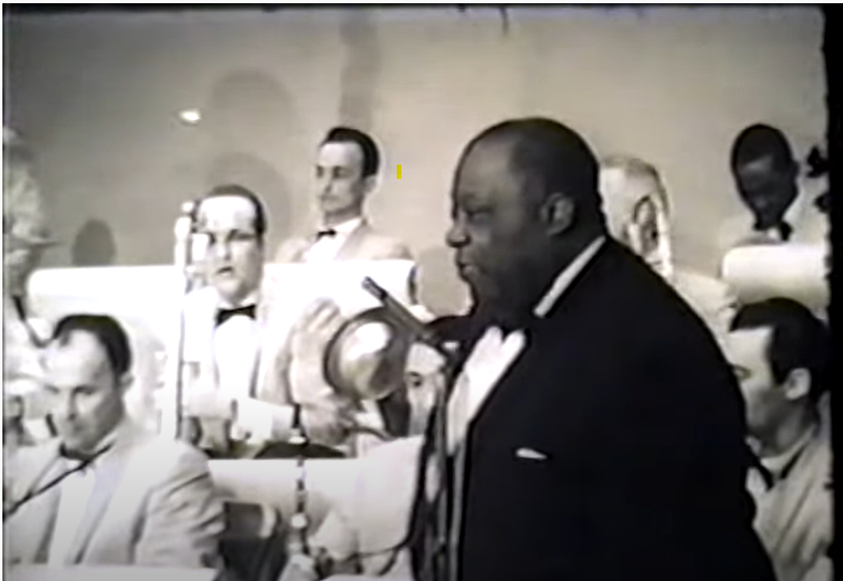
Goin’ to Chicago
Notes:
Rushing, Jimmy. (2012, Feb. 27). Going to Chicago. [Music Video]. YouTube. https://www.youtube.com/watch?v=xiETUJXRk7o&t=11s

Slide 9
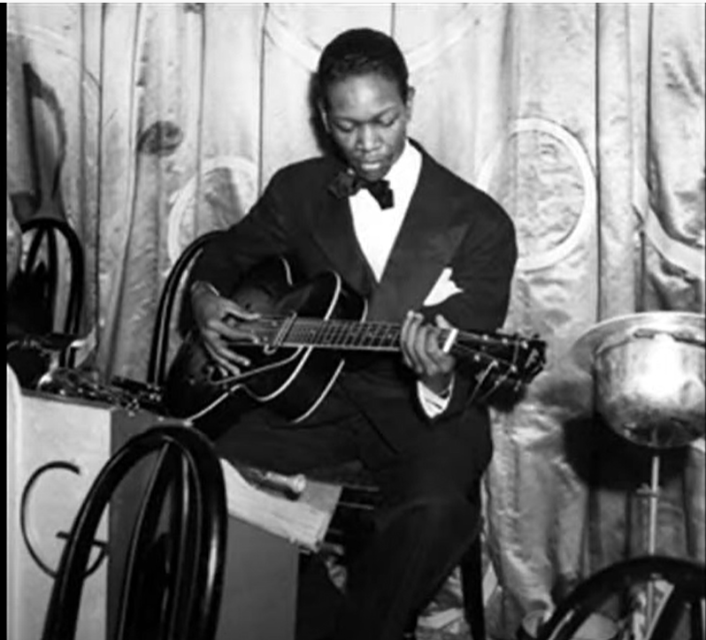
Flying Home
Notes:
Source: Goodman, B. and C. Christian. (2013, Jan. 1). Flying home. [Music Video]. YouTube.https://www.youtube.com/watch?v=gn0hDIkvl0Y&t=7s

Slide 10
Painting a Picture: Music Inferences
An inference is a conclusion you make based on your observations and prior knowledge.
Using your observations plus your prior knowledge, record your inferences in the “inferences” column of the chart.
Notes:
K20 Center. (n.d.) Painting a picture. Strategies. https://learn.k20center.ou.edu/strategy/1331

Slide 11
Painting a Picture: Photograph Observations
An observation is anything you see in the photographs and their captions.
As you examine the photographs in the next three slides, record your observations in the “observations” column of the chart.
Notes:
K20 Center. (n.d.) Painting a picture. Strategies. https://learn.k20center.ou.edu/strategy/1331

Slide 12
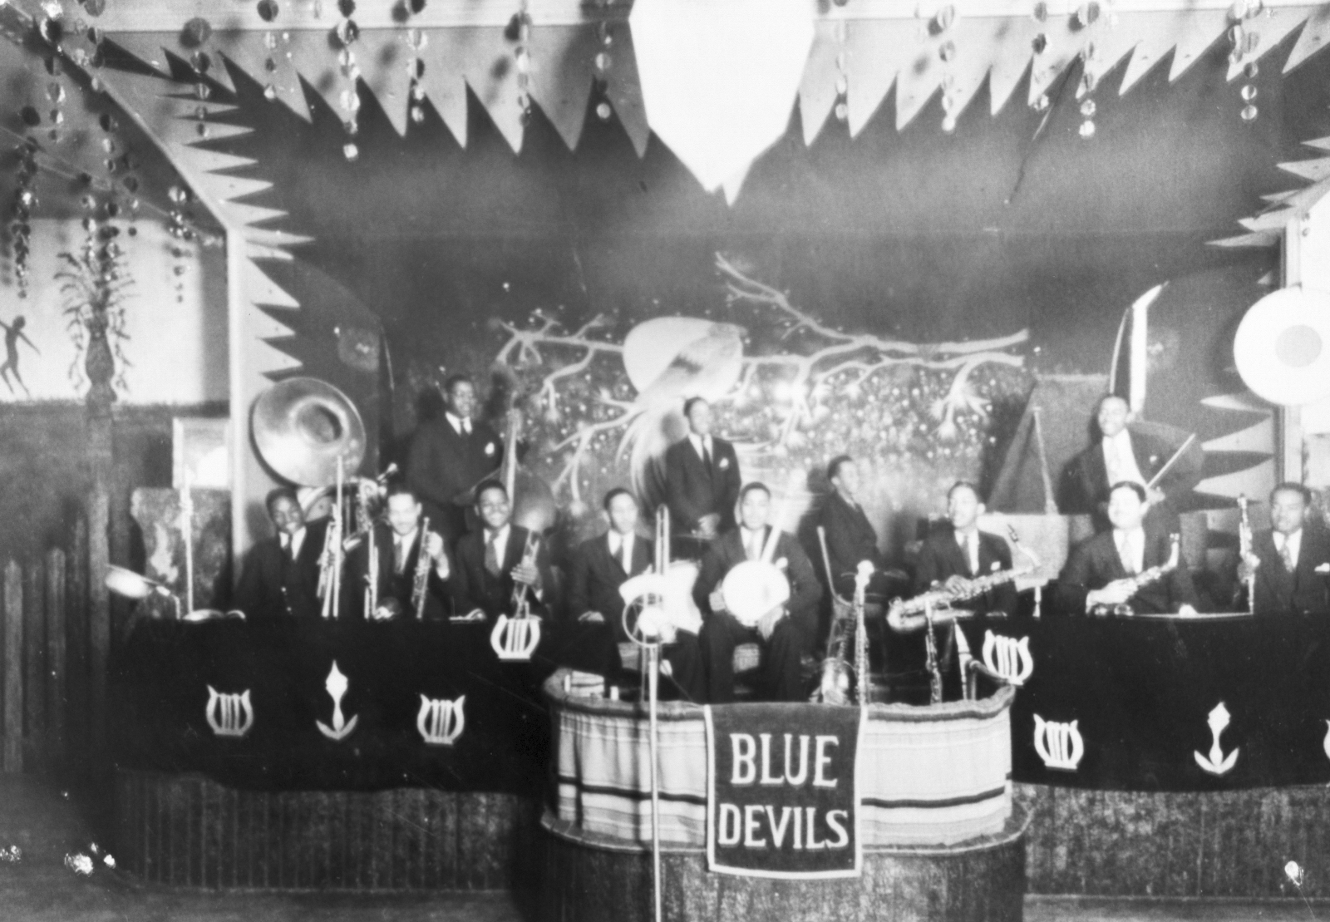
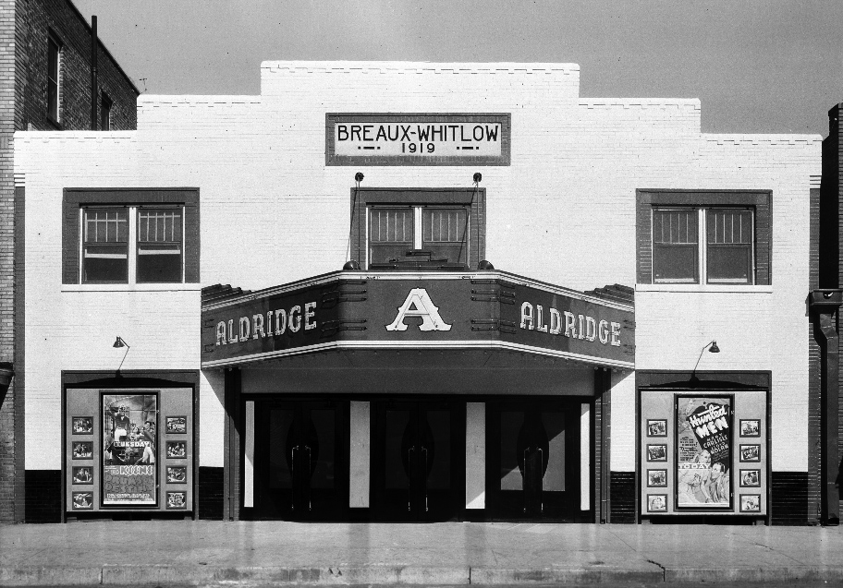
Document Set 1:
Photographs: Oklahoma City Blue Devils
Document Set 1: Photographs:
Oklahoma City Blue Devils
Notes:
Source (Left): The Blue Devils, (n.d.). Oklahoma Historical Society, OKPOP Collections. [Photograph]. https://www.travelok.com/music-trail/venues/deep-deuce
Source(Right): The Aldridge Theatre, (n.d.). Oklahoma Historical Society, OKPOP Collections. [Photograph]. https://www.travelok.com/music-trail/venues/deep-deuce

Slide 13
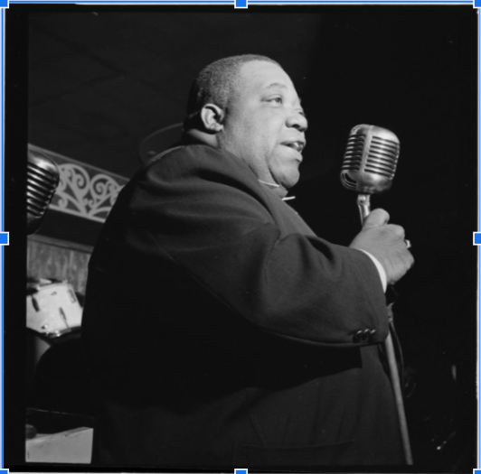
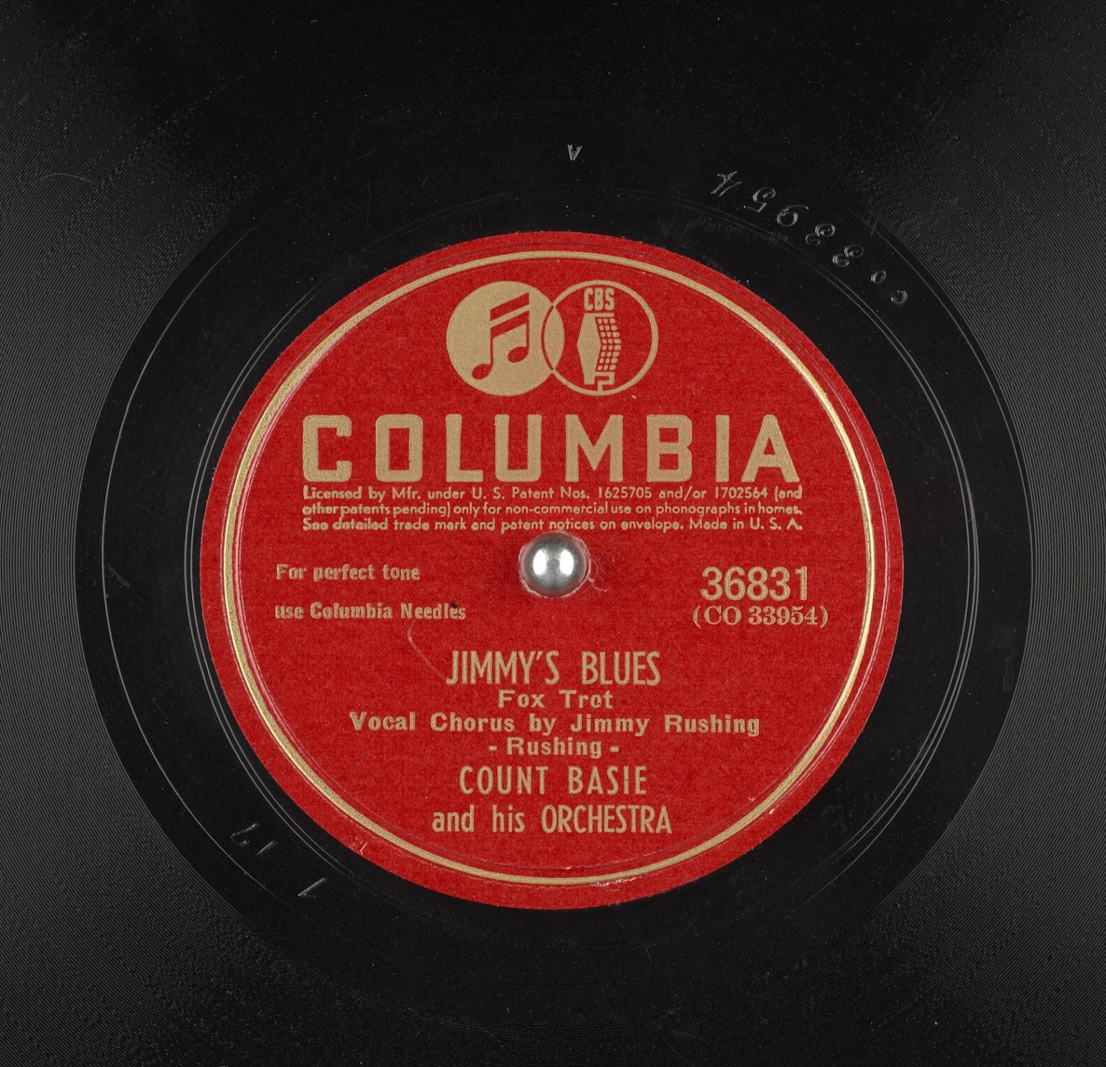
Document Set 2:
Document Set 2:
Photographs: Jimmy Rushing
Notes:
Source (Left): Gottlieb, W. P. (1946) Portrait of Jimmy Rushing, Aquarium, New York, N.Y., ca. Oct. United States, 1946. , Monographic. [Photograph]Library of Congress, https://www.loc.gov/item/gottlieb.07551/.
Source (Right): Count Basie and His Orchestra, Jimmy Rushing (1944). Jimmy’s Blues. Internet Archive. [Photograph]. https://archive.org/details/78_jimmys-blues_count-basie-and-his-orchestra-jimmy-rushing-rushing_gbia0009218b

Slide 14
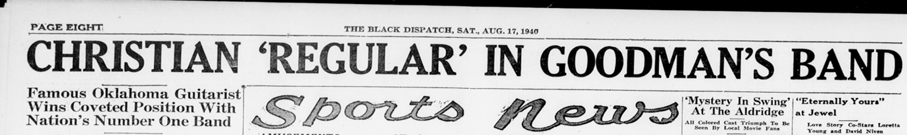
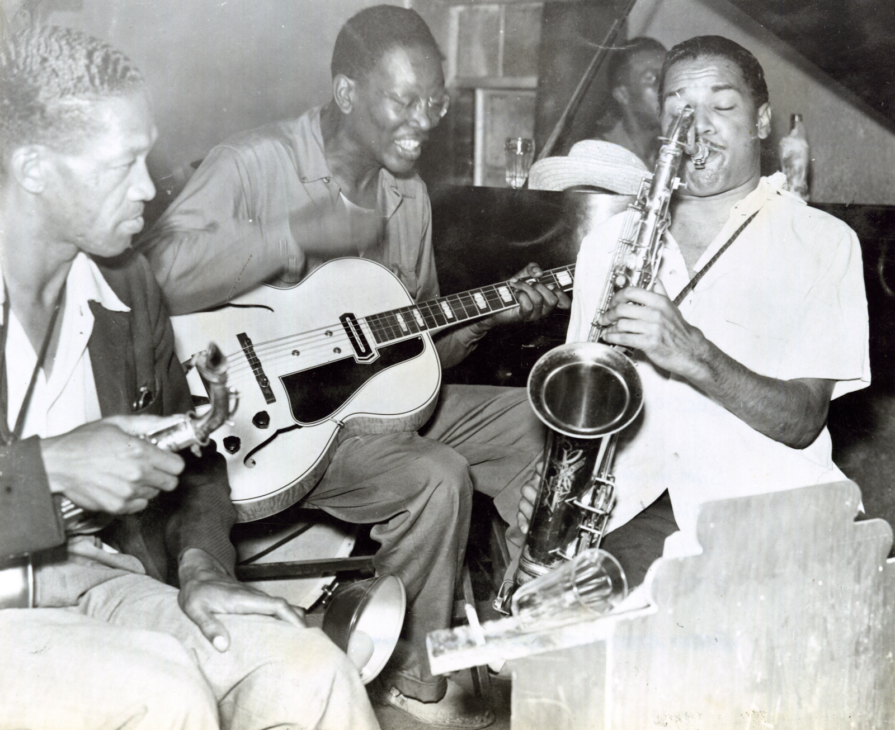
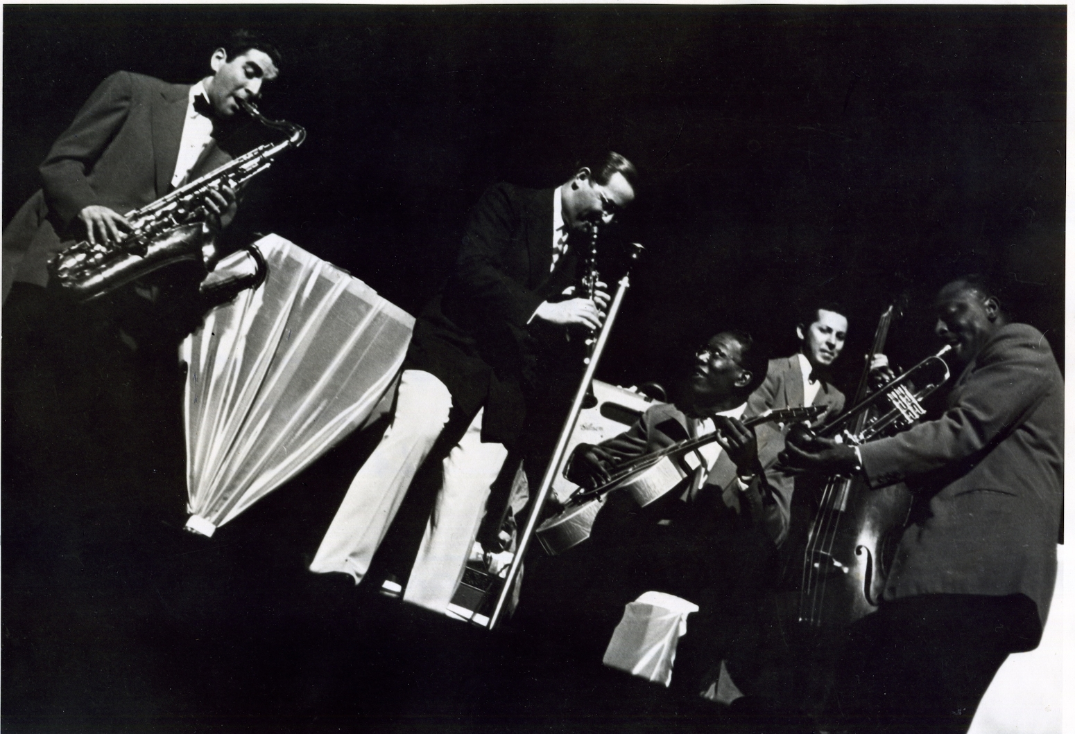
Document Set 3:
Photographs: Charlie Christian
Notes:
Source (Top): The Black Dispatch Headline, (1940). Oklahoma Historical Society, OKPOP Collection. https://www.travelok.com/music-trail/artists/charlie-christian
Source (Bottom Left): Sam Hughes, Charlie Christian, Leslie Sheffield, and Dick Wilson (n.d.). Oklahoma Historical Society, https://gateway.okhistory.org/ark:/67531/metadc1595579/
Source (Bottom Right): Benny Goodman Sextet (1941). Oklahoma Historical Society, https://gateway.okhistory.org
/ark:/67531/metadc1593803/m1/1/?q=charlie%3Cand%3E%20christian

Slide 15
Painting a Picture - Photograph Inferences
An inference is a conclusion you make based on your observations and prior knowledge.
Using your observations, plus your prior knowledge, record your inferences in the “inferences” column of the chart.
Notes:
K20 Center. (n.d.) Painting a picture. Strategies. https://learn.k20center.ou.edu/strategy/1331

Slide 16

Why-Lighting
As you read the article, Deep Deuce and the Cultivation of Jazz in Oklahoma, Why-Light any information that helps to answer this question:
  How did Oklahoma musicians contribute to the evolution of jazz music?
Justify your decision with notes in the margins that explain your reasoning.
Notes:
Source: K20 Center. (n.d.). Why-Lighting. Strategies. https://learn.k20center.ou.edu/strategy/128

Slide 17
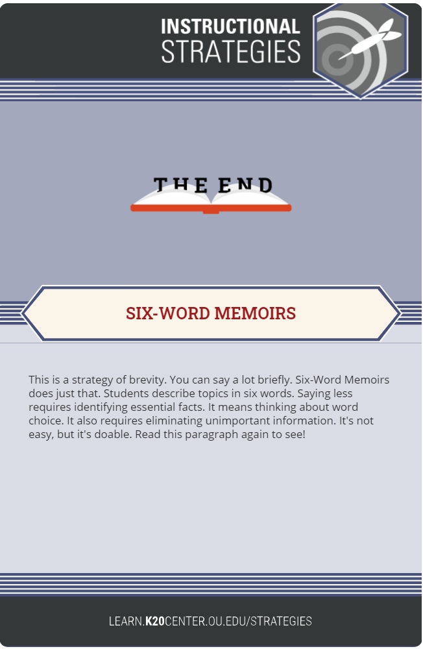
Six-Word Memoirs
Construct a “memoir” that is exactly six words and captures the significance of the following:
  The Blue Devils
  Jimmy Rushing
  Charlie Christian
Notes:
Source: K20 Center. (n.d.). Six Word Memoir. Strategies. https://learn.k20center.ou.edu/strategy/75

Slide 18
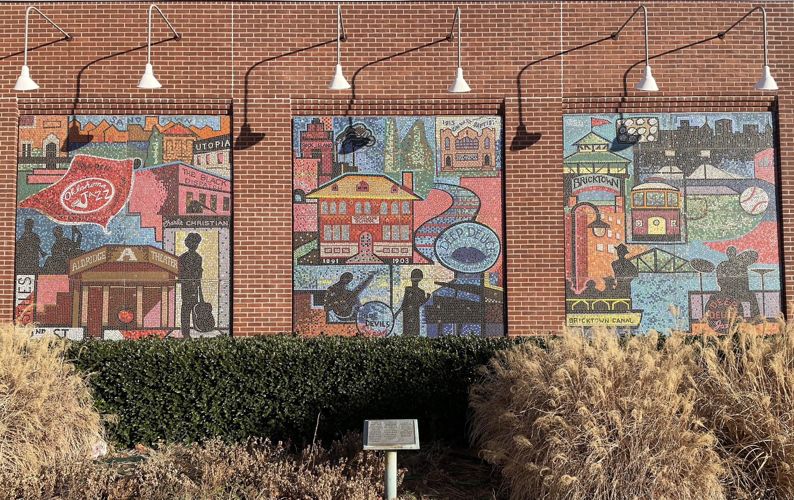
Bricktown Mural – 3 Panels
Notes:
Source: Brewer, S. (2021). The History of Bricktown Mural: 3 Panels. [Photograph].

Slide 19
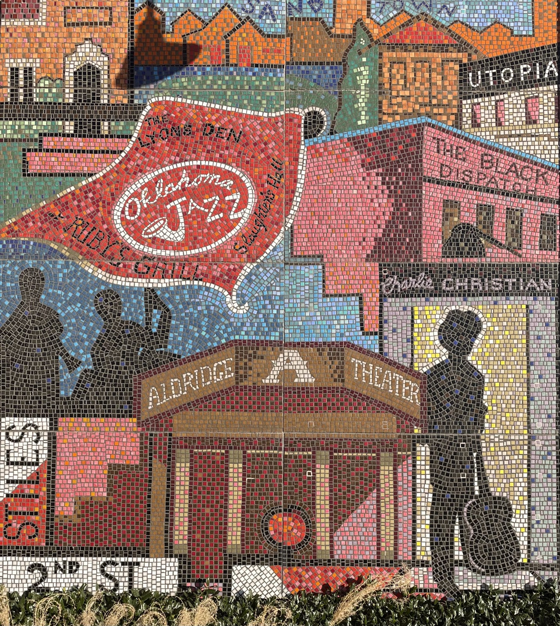
Bricktown Mural – Panel 1
Notes:
Source: Brewer, S. (2021). The History of Bricktown Mural. Panel 1 [Photograph].

Slide 20
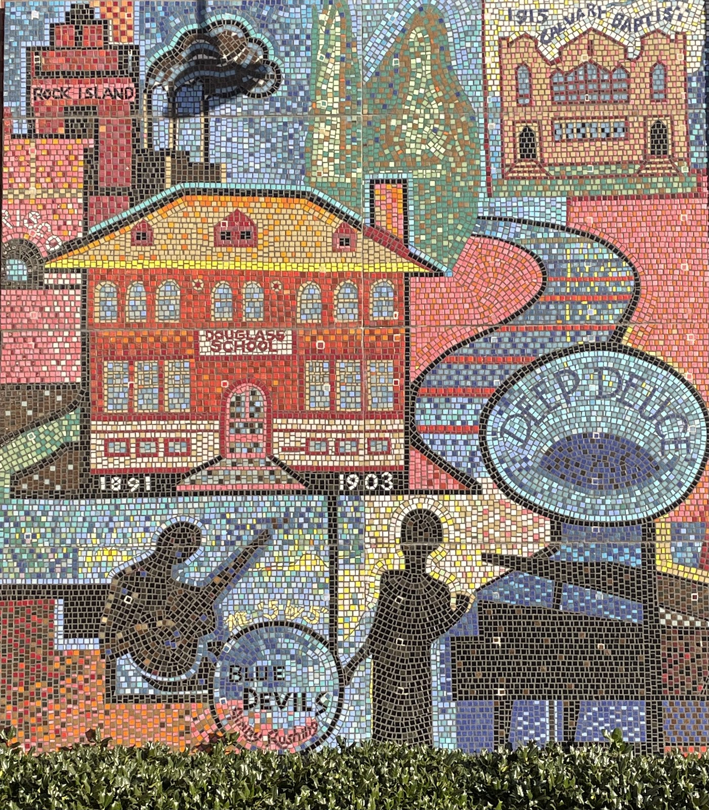
Bricktown Mural – Panel 2
Notes:
Source: Brewer, S. (2021). The History of Bricktown Mural. Panel 2 [Photograph].

Slide 21
Small Group Discussion
What story does the mural tell?
What purpose does the mural serve?

Slide 22
Small Group Discussion
How do these murals help us, as a collective society or community, remember our past and honor the legacy of those who have come before us?
Why is it important to do so?

