Slide 2
Ch-Ch-Ch-Ch-Changes
Biology

Slide 3
Essential Question
How does environmental change impact evolutionary shift(s) to an organism’s genetic makeup?

Slide 4
Lesson Objectives
Synthesize, communicate, and evaluate claims that changes in environmental conditions will affect survival strategies of populations.
Construct an evidence-based explanation for how an adaptation leads to differential survival and reproduction of organisms.
Analyze evidence to predict how changes in gene frequency within a population can alter its survival and reproduction.
Evaluate evidence to predict how changes in environmental conditions will affect the fitness of a species.
Synthesize, evaluate, and communicate how selection pressures and adaptations can affect biodiversity on earth.

Slide 5
Telephone
The instructor will pull a student aside to whisper a phrase.
That student will be asked to whisper that same phrase only one time to the next student.
Students will continue to pass the message along until it reaches the last student.
The last student will announce to the whole class what the original phrase was.

Slide 6
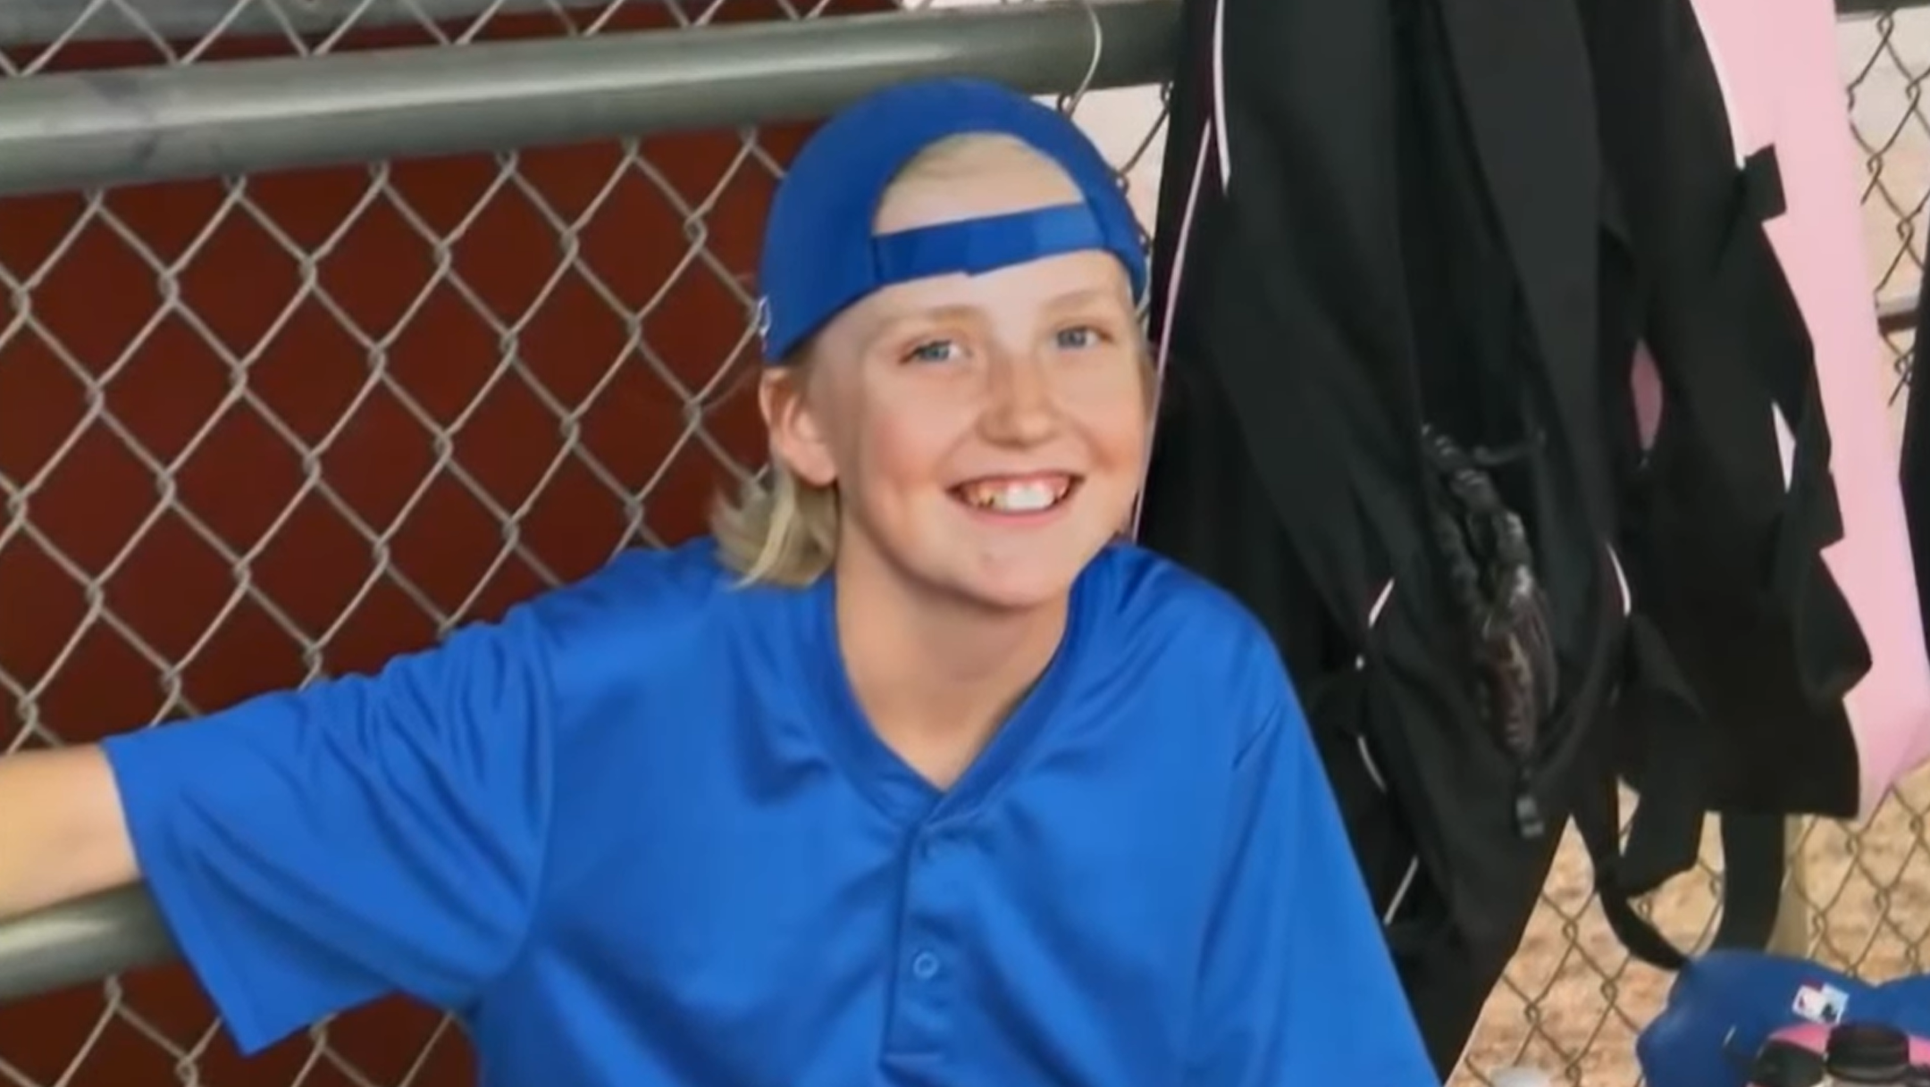
Hunting the Nightmare Bacteria
Answer the questions on the handout “Video Questions: Hunting the Nightmare Bacteria” while watching the video.
Notes:
Source: Young, R. (2013, October 23). Hunting the Nightmare Bacteria.|PBS. Retrieved December 03, 2020, from https://www.pbs.org/wgbh/frontline/film/hunting-the-nightmare-bacteria/
Make copies and pass out the video questions for learners to answer along with the video. Refer to Attachment: “Video Questions: Hunting the Nightmare Bacteria.”

Slide 7
S-I-T
On a sheet of paper, identify one surprising fact or idea, one interesting fact or idea, and one troubling fact or idea from the video. Next, swap your paper in your assigned group of 4 clockwise.
Choose one of the three points made by your peer and add an additional fact, idea, or correction through words or a drawing.
Continue to pass and add to each paper until the paper gets back to the original writer.
Take 5 minutes to review the comments you received on your paper.
Take another 5 minutes as a group to come up with a summary
of the main lesson you gathered from Addie’s video concerning
evolution.
Notes:
If students are working online, have them post their facts and ideas to the discussion board.
Give students 15 minutes to find picture and add hashtag in padlet.
Give students 15 minutes to respond to a classmate’s picture.

Slide 8
Photo Deconstruction
Take a close look at the fossil photo on the next slide.
On a sticky note, infer something about the organism based on the characteristics you notice:
What do you think this organism might have eaten? Why?
Where do you think it may have lived? Why?
What animal do you think it is related to? Why?
Place your sticky note on the board when you have completed the task.
Notes:
Allow students to have 40 minutes minutes to complete activity
For highlighting-This does not mean highlighting every line after the main idea. It means selectively picking out the key points that support the main ideas.
Summaries should take each idea and pull all the evidence together to explain the article in 3-5 sentences.

Slide 9
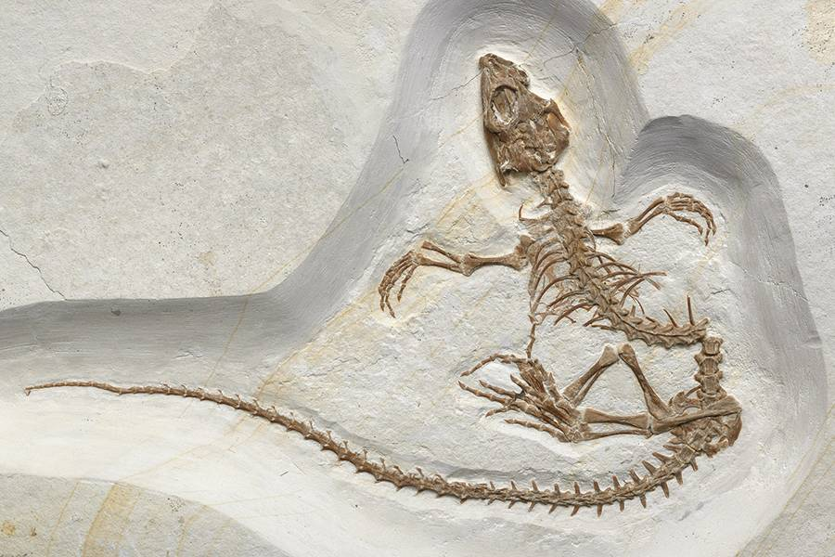
Photo Deconstruction
Notes:
Leave the slide open long enough for the students to draw their inferences.
https://www.zmescience.com/science/ancient-lizard-dino-evolve-ocean-0432/

Slide 10
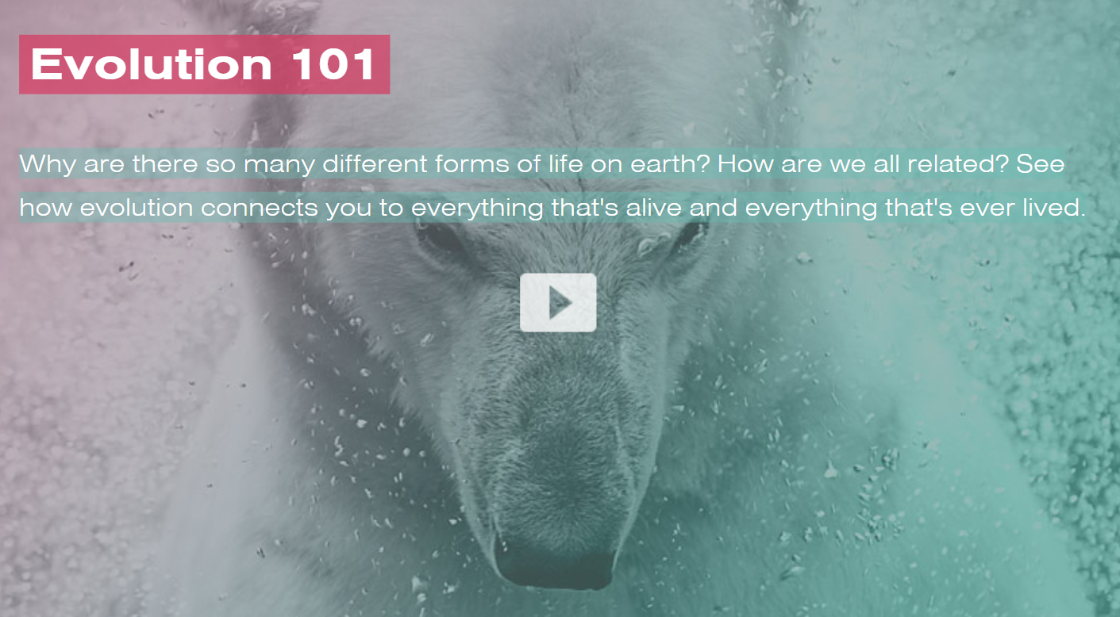
Evolution 101
Answer the questions given while watching the video.
Notes:
Make copies and pass out the video questions for learners to answer along with the video. Note that PBS Video must be opened in browser. Link cannot be posted in slide deck.
PBS Online: Nova Labs. (2020). Evolution 101.|WBGH Educational Foundation. Retrieved December 03, 2020, from https://www.pbs.org/wgbh/nova/labs//lab/evolution/research#/chooser

Slide 11
Word Cloud
Go to menti.com or use the QR code to the left.
Enter in the following code:
40 70 64 3
Add one or two words that give the overall concept/theme that you gathered about evolution from this video.
Notes:
The following egg drop video may help to provide learners with some inspiration.

Slide 12
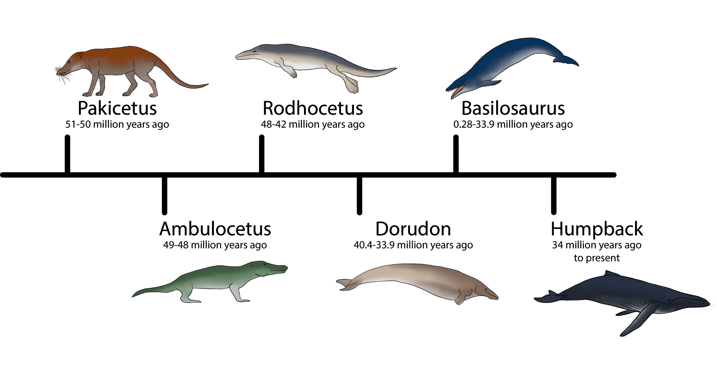
Evolutionary Timeline
Develop a timeline of an organism (plant, animal, fungi, bacteria, protist) of your choice using the link provided or any other program of your choosing.
You can use any program you like to create your timeline (ie. Prezi, PPT, Adobe Sparks, or Knight Lab).
In the timeline show:
How the organism has evolved over time in at least three different periods.
The environmental conditions and factors that may have caused an evolutionary shift during each time period.
Submit timeline in Canvas. Check the rubric before submitting.
Notes:
Remind students of submission and presentation dates

Slide 13
I Used to Think...But Now I Know
Go to the following Padlet link or use the QR code to the right:
[insert link here]
Give a one sentence response comparing what you used to know about evolution with what you now know.
Respond to at least two of your classmates.
[insert QR Code here]

