Slide 2
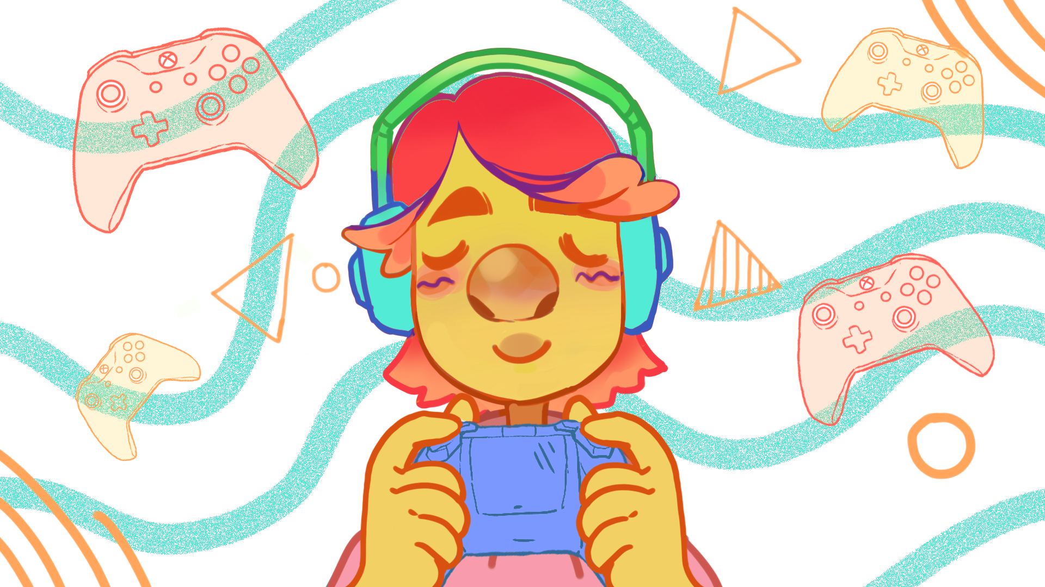
Beyond the Slinky
Information Transmission Through Waves

Slide 3
Essential Question
How does the use of more complex wave patterns impact the communication of audiovisual messages?

Slide 4
Lesson Objectives
Compare analog and digital electromagnetic (EM) waves
Construct an argument with evidence that supports a claim about whether digital or analog signals are more reliable to send information

Slide 5
The Evolution of Video Games
Fill out the I Notice/ I Wonder
I notice… | I wonder…
The Evolution of Super Mario Video
Notes:
YouTube. (n.d.). Evolution of Super Mario Game and Movie, LEGO (1985 ~ 2023). YouTube. https://www.youtube.com/watch?v=n9_nOA3Md_c

Slide 6
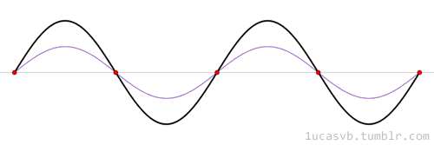
Sending Messages with Waves
Electromagnetic (EM) waves carry the information sent and received by our electronic devices.
Notes:
Public domain. https://commons.wikimedia.org/wiki/File:Standing_wave_2.gif

Slide 7
Sending Messages with Waves
Transmit
Group Roles
Anchor → holds down the spring
Transmitter → sends the signal
Receiver → reports the signal they detect
Image generator→ records the card color and the receiver’s report
Receive
Translate
Sending Information

Slide 8
Sending Messages with Waves: Activity 1
Transmit
Make waves of different sizes using the snaky spring without stopping in between.
With these waves, figure out how to get your secret signal from the Transmitter to the Receiver.
Receive
Translate

Slide 9
Sending Messages with Waves
What were some strengths of sending signals this way?
What were some weaknesses?
If you could wait between waves, how would that change the reliability of your signals?

Slide 10
Sending Messages with Waves: Activity 2
Transmit
This time when you make waves, stop between each of them.
With these waves, figure out how to get your secret signal from the Transmitter to the Receiver.
Receive
Translate
Notes:
Activity 2
For Activity 2, ask students to send their wave signals using discrete waves (i.e., pausing between waves). As in Activity 1, students should send different signals for blank boxes and filled boxes. After, ask them to compare the strengths and weakness of transmitting signals this way. Most groups will try to send blank boxes as silence/extended pauses between signals. They should consider whether they could tell whether “silence” was a blank box, a missed signal on the part of the Receiver, or a delay by the Transmitter. [Go to Explain 1]

Slide 11
Sending Messages with Waves
What were some strengths of sending signals this way?
What were some weaknesses?
How could you tell if “silence” was a blank box, a signal your receiver missed, or your transmitter taking too long to send a signal?

Slide 12
Sending Messages with Waves
Think about the signals from Activity 1 and Activity 2.
What were some strengths and weaknesses compared to each other?

Slide 13
Anatomy of a Wave
Activity 1:
Analog signals: sent using a different amplitude for each unique piece of information
Notes:
https://www.pngegg.com/en/png-yqsfr Listed as Non-commercial use, DMCA

Slide 14
Anatomy of a Wave
Activity 1:
Analog signals: sent using a different amplitude for each unique piece of information
Activity 2:
Digital signals: binary (0s and 1s), sent using a different frequency for each value
Notes:
https://www.pngegg.com/en/png-yqsfr Listed as Non-commercial use, DMCA

Slide 15
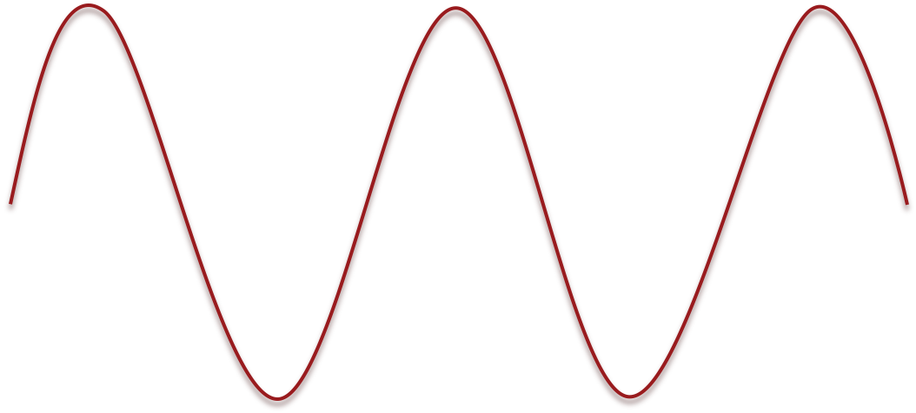
Anatomy of a Wave
Amplitude - the height of a wave from the middle (equilibrium point) to a peak
Wavelength - the distance between two consecutive peaks
Frequency - the number of complete waves passing a point each second
Notes:
Discuss the basic properties of waves. Ts should have prior knowledge (MS-PS4-1) (Image made by our GAs for BTS2)

Slide 16
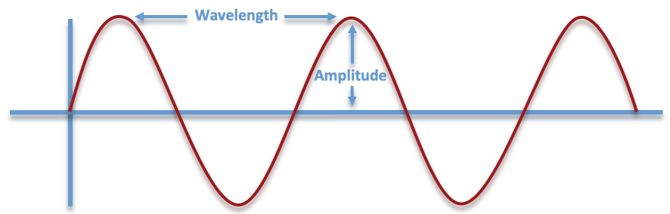
Anatomy of a Wave
What wave feature is the most relevant to sending analog signals?
What wave feature is the most relevant for sending digital signals?
Frequency 🕐
Notes:
Analog: amplitude
Digital: frequency
(Image made by our GAs for BTS2)

Slide 17
Sending Digital Signals
Analog signals are continuous and use a different amplitudes to send different pieces of information
Digital signals are discrete (pauses between waves) and the amplitude of digital waves does not matter
Simple digital signals can only send one of two values at a time
In real digital signals
single wave pulse = 1
two wave pulses = 0

Slide 18
Why are digital signals a more reliable way to send information than analog signals?
Use evidence from your investigation, class discussion, and notes to support your answer.

Slide 19
Sending a Low-resolution Image
1 | 0 | 1
0 | 1 | 0
1 | 0 | 1
Using your snaky spring digital model, send this signal:
1-0-1-0-1-0-1-0-1
Record the result in your 3x3 grid.

Slide 20
Sending a Low-resolution Image
Make new secret codes and try to transmit your digital images.

Slide 21
Sending a Low-resolution Image
What was it like sending low-resolution images? Did the order matter?
What do you wonder about how low-resolution images are sent in real devices?
How could we improve the resolution of the image?

Slide 22
Image Resolution
Resolution: how much detail an image has
Pixel: a “picture element,” each square in your 3x3 image represents a pixel
How does the number of pixels affect image resolution?

Slide 23
Sending High-resolution Images
Using your snaky spring digital model, send this signal:
1-0-0-0-1-0-1-0-1-0-0-0-1-0-0-0-1-0-1-0-1-0-0-0-1
Record the result in your 5x5 grid.
1 | 0 | 0 | 0 | 1
0 | 1 | 0 | 1 | 0
0 | 0 | 1 | 0 | 0
0 | 1 | 0 | 1 | 0
1 | 0 | 0 | 0 | 1

Slide 24
The Evolution of Video Games
How was sending the 5x5 image different from sending the 3x3 image?
Why would we want to send higher resolution images?

Slide 25
The Evolution of Video Games
What about our digital devices makes it possible to send high resolution images?
(Hint: What is it like to use an old computer compared to a newer one?)

Slide 26
The Evolution of Video Games
How do we get from this...
to these?
Notes:
Atre, S. (2019, January 31). Evolution of mario: A staple for Classic and modern graphics. Medium. https://medium.com/@soniaatre/evolution-of-mario-a-staple-for-classic-and-modern-graphics-7acec3a6b914

Slide 27
How Waves Affect Video Games
The Evolution of Super Mario Video
Notes:
Atre, S. (2019, January 31). Evolution of mario: A staple for Classic and modern graphics. Medium. https://medium.com/@soniaatre/evolution-of-mario-a-staple-for-classic-and-modern-graphics-7acec3a6b914
YouTube. (n.d.). Evolution of Super Mario Game and Movie, LEGO (1985 ~ 2023). YouTube. https://www.youtube.com/watch?v=n9_nOA3Md_c

Slide 28
How Waves Affect Video Games
Why do the video game graphics look better over time?
Use evidence and scientific information from your investigations and discussions to support your explanation.
How did your thinking change from the beginning of the lesson to now?
Notes:
K20 Center. (n.d.). Claim, evidence, reasoning (CER). Strategies. https://learn.k20center.ou.edu/strategy/d9908066f654727934df7bf4f506fc09

