Slide 2
Beyond the Slinky®, Part 3
Information Transmission Through Waves

Slide 3
Essential Question
How does the use of more complex wave patterns affect the communication of audiovisual messages?

Slide 4
Lesson Objectives
We will compare analog and digital electromagnetic (EM) waves.
We will construct an argument with evidence that supports a claim about whether digital or analog signals are a more reliable way to send information.

Slide 5
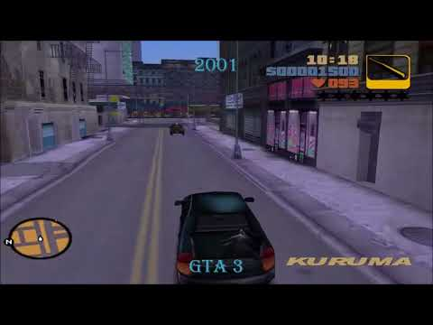
The Evolution of Video Games
Why do video game graphics improve over time?
Notes:
Play the video by clicking on the image or copying and pasting this link into your browser: https://www.youtube.com/watch?v=mXq0totmYCg
Video source:
Shaffery, H. (2017, December 11). Videogame quality phenomenon [Video]. YouTube. https://www.youtube.com/watch?v=mXq0totmYCg&feature=youtu.be

Slide 6
Sending Messages With Waves
Electromagnetic (EM) waves carry the information that is sent and received by our electronic devices.
Notes:
Image source:
Vieira, L. (2006, January 26). Standing Wave [GIF]. Wikimedia Commons. https://commons.wikimedia.org/wiki/File:Standing_wave_2.gif

Slide 7
Sending Messages With Waves
Transmit
Group Roles
Anchor → holds down the spring
Transmitter → sends the signal
Receiver → reports the signal they detect
Image generator → records the card color and the receiver’s report
Info
Receive
Info
Translate
Sending Information
Notes:
For groups of three, the receiver and image generator can be the same person.
Anchor
In model: Holds their end of the spring stationary on the floor.
In electronics: Necessary to make the model work and does not have a real-world equivalent.
Transmitter
In model: Holds the opposite end of the spring from the anchor and flicks their wrist to create horizontal waves along the floor.
In electronics: The component of a device that sends digital pulses.
Receiver
In model: Student is located next to the anchor with a blindfold or closed eyes. They attempt to feel the spring signal (one hand’s pinky on the floor, thumb raised, palm facing the spring.
In electronics: The component of a device that senses signal pulses.
Image generator
In model: Listens to Receiver announce the signal and visually records that signal on paper.
In electronics: The component of a device that translates the digital signal into a human-friendly output (audio or visual).

Slide 8
Sending Messages With Waves: Activity 1
Transmit
Use the snaky spring to make waves of different sizes without stopping in between.
With these waves, figure out how to get your secret signal from the Transmitter to the Receiver.
Info
Receive
Info
Translate
Notes:
Hand out the colored code cards to student groups.
Activity 1: Without pausing between waves (continuous), have students find a way to send their signals by generating waves with the snaky springs. Since they can't pause between waves, they will have to figure out a way to differentiate between waves representing blank boxes and waves representing filled boxes. Afterward, students should discuss the strengths and weakness of transmitting signals this way. Direct students to think about how reliable their signals might or might not be if they could wait between signals instead of sending a constant stream.

Slide 9
Questions: Activity 1
What were some strengths of sending signals this way?
What were some weaknesses?
If you could wait between waves, how would that change the reliability of your signals?

Slide 10
Sending Messages With Waves: Activity 2
Transmit
This time when you make waves, stop between each of them.
With these waves, figure out how to get your secret signal from the Transmitter to the Receiver.
Info
Receive
Info
Translate
Notes:
Activity 2: Ask students to send their wave signals using discrete waves (i.e., pausing between waves). As in Activity 1, students should send different signals for blank boxes and filled boxes. Afterward, ask them to compare the strengths and weakness of transmitting signals this way. Most groups will try to send blank boxes as silence/extended pauses between signals. They should consider whether they could tell whether “silence” was a blank box, a missed signal on the part of the Receiver, or a delay by the Transmitter. [Go to Explain 1]

Slide 11
Questions: Activity 2
What were some strengths of sending signals this way?
What were some weaknesses?
How could you tell whether “silence” meant there was a blank box, a signal the Receiver missed, or a delay from the Transmitter?

Slide 12
Comparing Signals
Think about the signals from Activity 1 and Activity 2.
What are some strengths and weaknesses you notice when you compare the two methods of sending signals?
Notes:
ANALOG & DIGITAL SIGNALS: To kick off the Explain discussion, have students compare the strengths and weaknesses of their signaling methods in Activity 1 vs. Activity 2. Next, define the types of signals they modeled: analog (Activity 1) and digital (Activity 2).
Review amplitude, wavelength, and frequency with students. Solicit their ideas before providing explicit answers/direct instruction. Ask them what part of the wave is relevant to analog signals (amplitude) and what is most relevant to digital signals (frequency).
After the class discussion, you should formalize or explain the following information:
Digital signals can communicate only in discrete pulses (as opposed to analog signals that are continuous and based on wave magnitude).
The amplitude of a digital wave does not matter.
Simple digital signals can send only one of two values at a time.
Real digital signals use a single pulse for 1, and two pulses to send 0.
Before continuing, ask students to answer the following prompt: "Why are digital signals a more reliable way to send information than analog signals? Use evidence from your investigation and class discussion to support your answer." Allow students to draw models and diagrams to support their answers.
[Go to Explore 2]

Slide 13
Types of Signals
Activity 1:
Analog signals are sent using a different amplitude for each unique piece of information.
Notes:
Image source:
PNG Egg. (n.d.). Digital signal processing, analog signal [Image]. PNGEgg. https://www.pngegg.com/en/png-yqsfr

Slide 14
Types of Signals
Activity 1:
Analog signals are sent using a different amplitude for each unique piece of information.
Activity 2:
Digital signals are binary (using 0s and 1s) and are sent using a different frequency for each value.
Notes:
Image source:
PNG Egg. (n.d.). Digital signal processing, analog signal [Image]. PNGEgg. https://www.pngegg.com/en/png-yqsfr

Slide 15
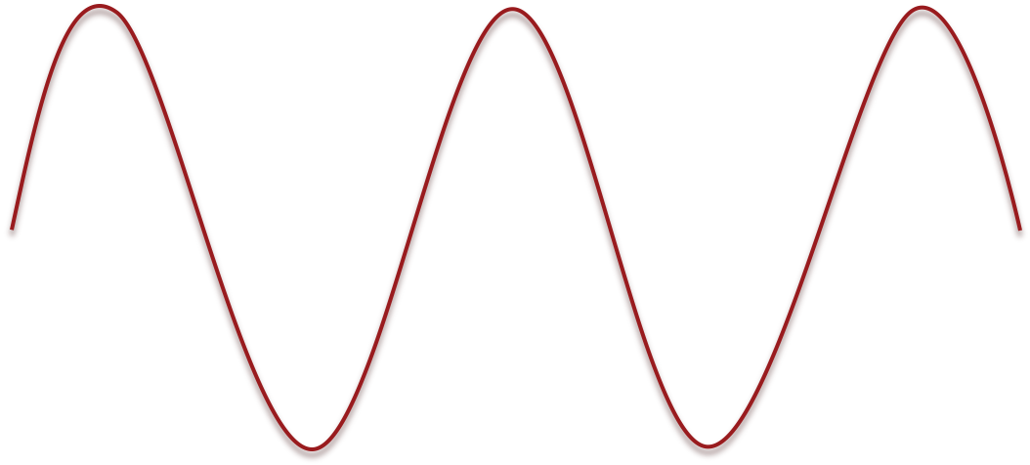
Anatomy of a Wave
Amplitude: the height of a wave from the middle (equilibrium point) to a peak.
Wavelength: the distance between two consecutive peaks.
Frequency: the number of complete waves passing a point each second.
Notes:
Discuss the basic properties of waves. Students should have prior knowledge (MS-PS4-1).

Slide 16
Anatomy of a Wave
What wave feature is most relevant for sending analog signals?
What wave feature is most relevant for sending digital signals?
Wavelength
Amplitude
Frequency 🕐
Notes:
Analog: amplitude. Digital: frequency.

Slide 17
Sending Digital Signals
Analog signals are continuous and use different amplitudes to send different pieces of information.
Digital signals are discrete (pause between waves), and the amplitude of a digital wave does not matter.
Simple digital signals can send only one of two values at a time. In real digital signals:
Single wave pulse = 1
Two wave pulses = 0

Slide 18
Why are digital signals a more reliable way to send information than analog signals?
Use evidence from your investigation, class discussion, and notes to support your answer.

Slide 19
Sending a Low-Resolution Image
Using your snaky spring digital model, send this signal: 1-0-1-0-1-0-1-0-1
Record the result in your 3x3 grid.
1 | 0 | 1
0 | 1 | 0
1 | 0 | 1
Notes:
Low-Resolution Images: Once students have established the concept that digital signals are sent as a single wave (1) or two waves (0), they will create "low-resolution" images using digital signals. Give them the 3x3 grids and have them figure out how to send the message (i.e., the order in which the boxes should be signaled). Technically, this should be left to right from top to bottom, but it's okay if students come up with other methods at this point. Don’t tell students how to send the signal right away. Show them the correct answer after they’ve shared what they came up with for images/process. (Click again on this slide to show the answer.) [Go to Explain 2]

Slide 20
Sending a Low-Resolution Image
Make new secret codes, then try again to transmit your digital images.
Notes:
Discussion questions:
What order does this code go in? (Whether right or wrong, have students create new codes to test it.)
Any ideas about the role of waves in the improvement of video game graphics?
Conclusions?

Slide 21
Low-Resolution Images
How would you describe your experience with sending low-resolution images?
What do you still wonder about how real devices send and receive low-resolution images?
Resolution means how much detail an image has.
Notes:
Low-Resolution Images: As a class, discuss students’ experiences and solicit their impressions and questions about sending low-resolution images. If students have the prior knowledge to do so, have them develop a working definition for resolution. If they do not, provide it to them by clicking again on this slide. Next, ask students how they think they could send a higher-resolution image. Students should conclude that sending an image with more boxes (e.g., a 5x5 grid) would create a higher-resolution image.
This is an ideal time to stop and provide some direct instruction. Ask students to share any prior knowledge they have about pixels. Reinforce any information they may have and/or explain the idea that each square/box in the grid represents a pixel. Help students make the explicit connection between resolution and pixels by asking a guiding question, such as, "How does the number of pixels affect image resolution?" (More pixels = higher resolution.)

Slide 22
Image Resolution
A pixel is a “picture element.” Each square in the grid represents a pixel.
How does the number of pixels affect image resolution?
Notes:
Answer: More pixels = higher resolution.

Slide 23
Sending a High-Resolution Image
Using your snaky spring digital model, send this signal:
1-0-0-0-1-0-1-0-1-0-0-0-1-0-0-0-1-0-1-0-1-0-0-0-1
Record the result in your 5x5 grid.
1 | 0 | 0 | 0 | 1
0 | 1 | 0 | 1 | 0
0 | 0 | 1 | 0 | 0
0 | 1 | 0 | 1 | 0
1 | 0 | 0 | 0 | 1
Notes:
Give students time to transmit a higher-resolution image using their spring model and a 5x5 grid. They may draw their own images or send a 5x5 version of the letters they sent previously. As before, click again on this slide to reveal the correctly filled 5x5 grid.

Slide 24
Comparison
How did sending the 5x5 image differ from sending the 3x3 image?
Why would we want to send higher-resolution images?
Notes:
Ask students to compare sending 3x3 images with sending 5x5 images. Through discussion, they should come to understand that sending more complex information/visuals requires more wave signals, and this process takes more time.

Slide 25
Real-Life Connection
What is it about our digital devices that makes it possible to send high-resolution images?
Hint: What is it like to use an old computer compared with a newer one?
Notes:
Discuss how computers and other electronic devices can send many digital signals rapidly, which allows them to produce more complex images and videos. A good guiding question might be to ask students how using old computers/devices differs from using newer ones. (They're much slower, among other things.)

Slide 26
The Evolution of Video Games
How do we get from this…
to these?
Notes:
Image source:
Atre, S. (2019, January 30). Evolution of Mario: a staple for classic and modern graphics [Image]. Medium. https://medium.com/@soniaatre/evolution-of-mario-a-staple-for-classic-and-modern-graphics-7acec3a6b914

Slide 27
How Waves Affect Video Games
Notes:
Rewatch the video game evolution video, then ask students to answer the prompts on the following slide.
Sources:
Atre, S. (2019, January 30). Evolution of Mario: a staple for classic and modern graphics [Image]. Medium. https://medium.com/@soniaatre/evolution-of-mario-a-staple-for-classic-and-modern-graphics-7acec3a6b914
Shaffery, H. (2017, December 11). Videogame quality phenomenon [Video]. YouTube. https://www.youtube.com/watch?v=mXq0totmYCg&feature=youtu.be
Vieira, L. (2006, January 26). Standing Wave [GIF]. Wikimedia Commons. https://commons.wikimedia.org/wiki/File:Standing_wave_2.gif

Slide 28
How Waves Affect Video Games
Why do video game graphics improve over time?
Use evidence and scientific reasoning from your investigations and discussions to support your answer.
Look at the explanation you wrote after the first time you watched the video. Compared with your final explanation, in what ways did your thinking change?
In other words, what is different about your two answers?
Notes:
As before, allow students to draw models and diagrams to support their answers.

