Slide 2
That Which We Call a Rose
Connotation and Denotation

Slide 3
Essential Question
How can language and word choice impact attitudes?

Slide 4
Learning Objectives
Analyze the connotation and denotation of words.
Determine the importance of understanding the connotation of words when reading and writing.

Slide 5
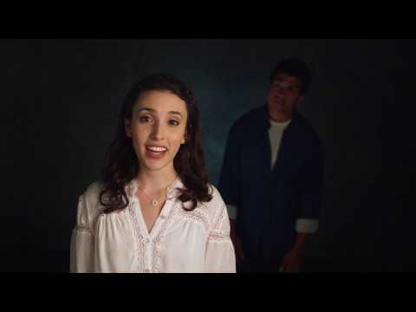
Act II, Scene II of Romeo and Juliet
Notes:
myShakespeare. (2017, April 25). Romeo and Juliet 2.2 Performance: Romeo and Juliet, Lines 33-78 [Video]. YouTube. https://www.youtube.com/watch?v=htXkvQoLZiU&feature=youtu.be

Slide 6
Quick Write
In Act II, Scene II of Shakespeare's play Romeo and Juliet, Juliet says this phrase in reference to family and the family name of Romeo: “What’s in a name? / That which we call a rose / By any other name would smell as sweet.”
Write for a few minutes to answer these questions:
  What does Juliet mean?
  How does the quote make you feel?
  What emotions does it evoke, or what emotions would it evoke if you were in Romeo's shoes?
When you are finished writing, share with an Elbow Partner.

Slide 7
Card Sort
On these cards are words you might find in Romeo and Juliet. Sort the words into three categories of your own choosing based on the emotion the word evokes (or the associations the word creates in your mind).
  Each word has two synonyms or near-synonyms. Each synonym should be in different categories. If you are unsure of the definition of a word, you may use a dictionary.
First, sort the words individually. Then discuss with your group. Try to reach a consensus about how the words are best sorted.
When you reach a consensus, choose a spokesperson to share with the class.

Slide 8
Paired Texts H-Chart
While you watch the next two videos, focus on the similarities and differences in denotation and connotation. Think about how people have different reactions to, and different feelings about, certain words.
  On the left side of the H-Chart, take notes about the first video.
  On the right side of the H-Chart, take notes about the second video.
  In the middle of the H-Chart, write in your own words what you have learned about denotation and connotation from both videos. Be thorough with your details.
You will be using this information during the next activity.

Slide 9
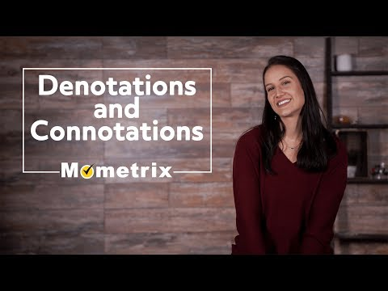
Denote or Connote?
Notes:
Mometrix Academy. (2018, October 23). Denote or Connote? [Video]. YouTube. https://youtu.be/2efQrHdqbgQ

Slide 10
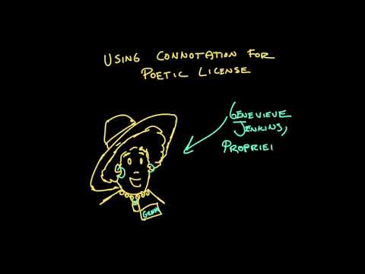
Connotation
Notes:
Khan Academy. (2020, May 20). Connotation [Video]. YouTube. https://www.youtube.com/watch?v=XRt1N0sJJQo

Slide 11
Anchor Chart
In your group, create an Anchor Chart showing what you have learned about connotation and denotation. Include these items on your chart:
  A definition of denotation and connotation in your own words.
  Examples of denotation and connotation (you could use words from the Card Sort).
  An illustration to accompany your example.
  Why it is important to know the connotation of words.

Slide 12
Gallery Walk
As you walk around the room looking at your classmates’ Anchor Charts, think about what you have learned from the chart. Use sticky notes to leave one or two comments on each chart.
When everybody has had a chance to visit each chart, return to your original chart and review the feedback given by your classmates.

Slide 13
Flipgrid Reflection
Using what you’ve learned about denotation and connotation, write your thoughts on each. Be sure to address the below questions in your response:
  Why is it important to understand the connotation as well as the denotation of a word before you use it?
  How does the connotation of some words affect attitudes and relationships?
  How does understanding the connotation of words help you be a better reader and writer?
Post your response in a video on Flipgrid. Respond to one or two of your classmates’ reflections.

