Slide 2
Learning About the Past
Comparing Primary and Secondary Sources

Slide 3
Essential Question
How can I learn about the past from primary and secondary sources?

Slide 4
Lesson Objectives
Students will compare different accounts of the same historical event using primary and secondary sources.
Students will understand the difference between primary and secondary sources and how these sources help us know about the past

Slide 5
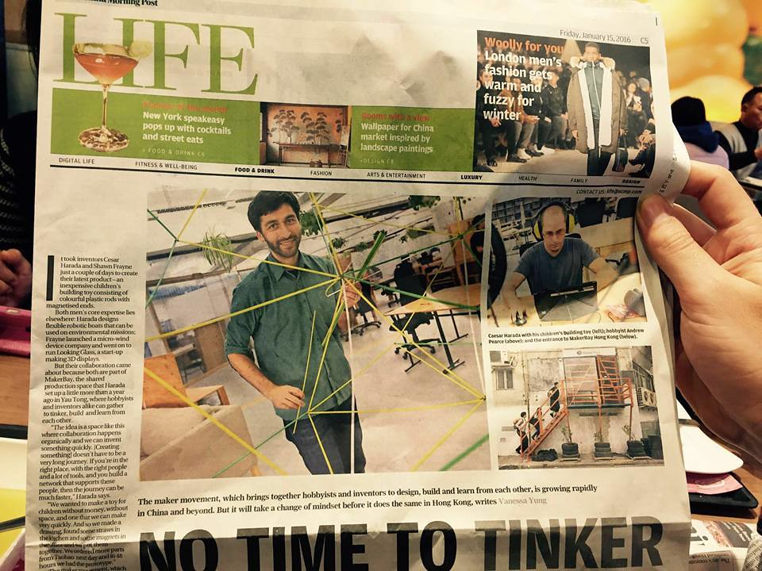
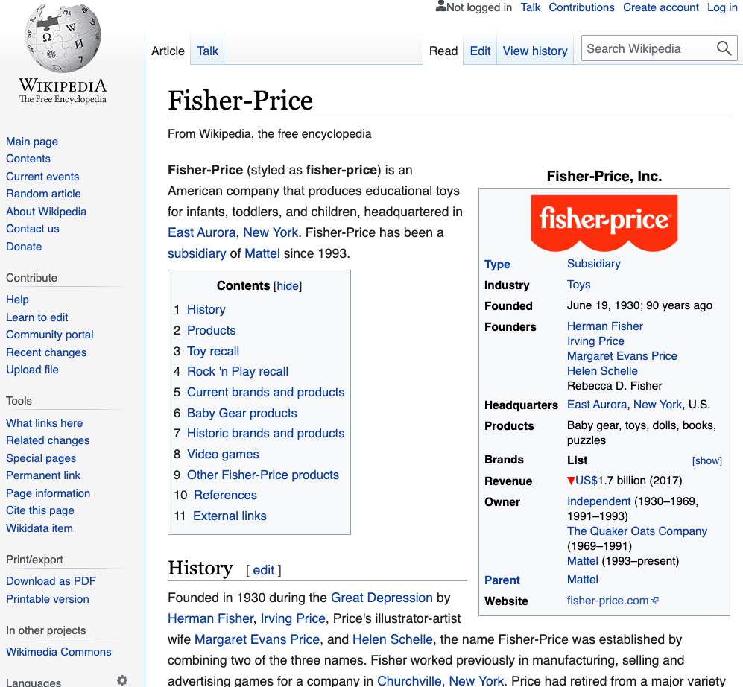
What do these sources tell us about?
Newspaper
Photo
Diary
Articles and websites
Biography
Notes:
Claire CJS, (2017, June 3). yardsale haul – Avengers and Spider-Man stuff. [Photo] Flickr. https://www.flickr.com/photos/clintjcl/37553222925
Harada, C. (2016, January 19). MakerBay in South China Morning Post cover. [Photo] Flickr. https://www.flickr.com/photos/27703797@N06/24474266895
Madhav, V. (2013, August 8). Leon the Lion. Diaries of Robin’s Toys. [Book Cover] Sweet Cherry Publishing. https://sweetcherrypublishing.com/the-diaries-of-robins-toys/
Polinsky, P. V. (2017, September 1). American Girl Entrepreneur: Pleasant Rowland. Abdo Publishing. https://abdobooks.com/shop/show/10354
Wikipedia. (n.d.) Fisher Price. [Screenshot]. https://en.wikipedia.org/wiki/Fisher-Price

Slide 6
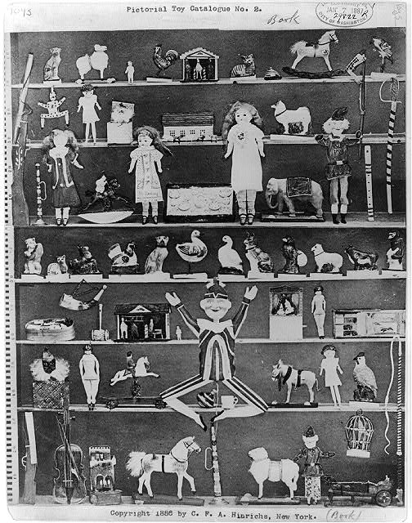
What does this source tell us?
What do you notice about the 1887 toy catalog page ?
What toys could children buy in the past?
This is a
Primary source
Notes:
The items on this slide come in one at a time. This gives time for discussion.
Library of Congress. Advertisement for Pictorial Toy Catalogue No. 2 showing composite of many toys on shelves. 1887. [Photograph]. https://www.loc.gov/item/2004672357/.
There is a copy of this in the attachments that you can print out and give to your students.

Slide 7
What does this source tell you?
The earliest written mention of a toy comes from Greece in 500 B.C.E. and referred to a yo-yo [source: Encyclopaedia Brittanica]. Before the 18th century, toys as such, barely existed. Children made their own playthings from whittled-down sticks or played with cooking utensils while imitating their mothers at work. In any case, children didn't have a lot of time for play as they were expected to work in the house or on the farm. Commercially made toys began to appear in the 1700s and took the form of dolls, dollhouses and rocking horses, among other items. These exquisite expensive items were often for wealthy adults as much as their children – a "toy" didn't necessarily mean an object for a child, but rather an item of amusement. [source: Chudacoff]. In the 1700s and 1800s, most toys such as kites, hoops or dolls were likely to have been made at home. Written by Beth Brindle
What do you notice about this article written about toys of the past?
Where did Beth Brindle find the information to use to write the article?
This is a Secondary Source
Notes:
The items on this slide come in one at time to allow time for discussion
https://www.howstuffworks.com/
modified by Pat Turner

Slide 8
Card Sort Thinking
What do you observe in the pictures? What are the images, who are the people, what are the objects?
Are there any words or numbers on the images?
What do you think is the importance of these images, words, numbers, and symbols?
What do you think is happening?
Why would someone take this picture?

Slide 9
Working on the Anchor Chart
Primary Sources
Secondary Sources
Notes:
How do Primary and Secondary Sources differ?
What makes a primary source?
How is that different than a secondary source?

Slide 10
Muddiest Point
What do you think was the muddiest or most confusing point about primary and secondary sources?

Slide 11
Focus Vocabulary Words
source
primary source
secondary source
past
present
future
historical event
Notes:
These words are the focus vocabulary and should be introduced and worked with through-out the lesson. They should not be introduced at the beginning as a separate assignment.

Slide 12
Make Your Own Primary Source Document
What am I making?
Are you writing a letter about something that happened to you?
Are you writing a diary entry for a day or specific time?
Are you making a map of something from what you see?
Include only things you have seen, heard or experienced yourself.
Include date, place, time–as much specific information as possible

Slide 13
Make Your Own Secondary Source Document:
Who am I going to ask my question to?
Do you have your notecard ready to record what you heard from the person talking?
Here is a question to ask: What is the most significant historical event that you remember?

Slide 14
Sharing our Primary and Secondary sources.

Slide 15
Essential Question
How can I learn about the past from primary and secondary sources?

Slide 16
Explaining my Reasoning

