Slide 2
Survival: Traits and Advantages
Animal Adaptations

Slide 3
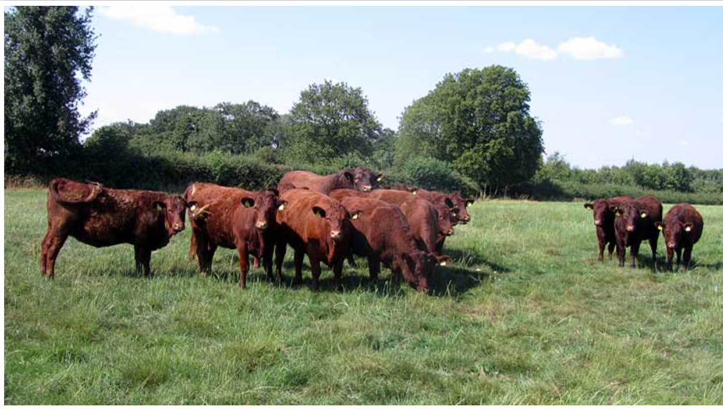
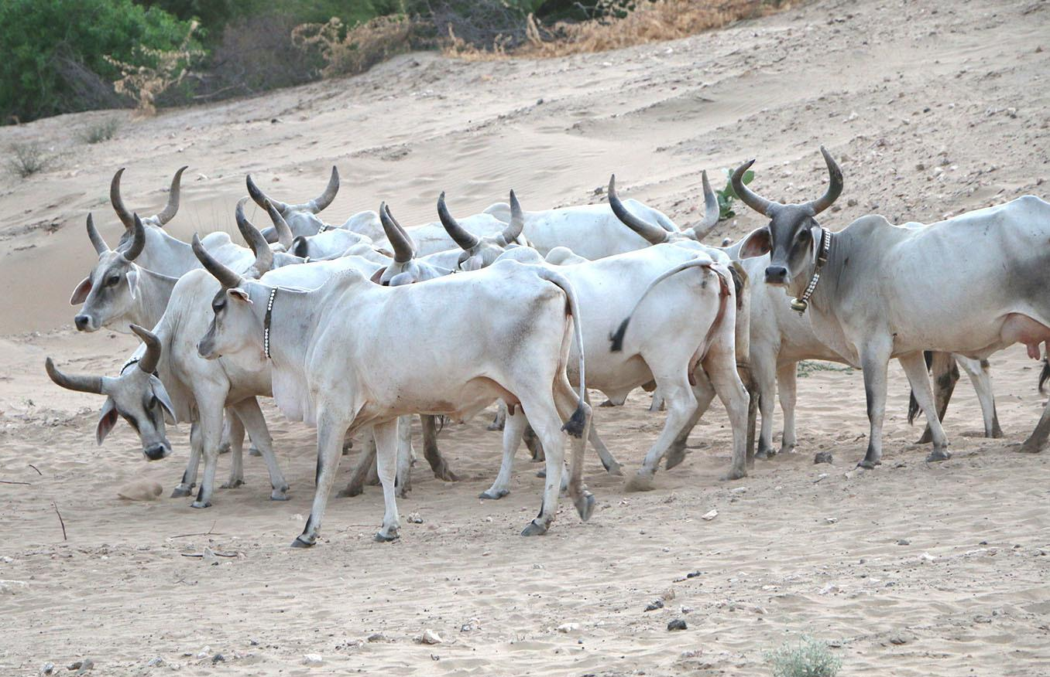
I Notice, I Wonder

Slide 4
Essential Question
How do variations in characteristics among individuals of the same species provide advantages?

Slide 5
Lesson Objectives
Demonstrate an understanding of the value of adaptation in various species.

Slide 6
Survival Characteristics
Look at the four animals in the slide .
Think about which animal is most likely to survive in their environment.
Move to the corner of the room that aligns to the animal you chose.

Slide 7
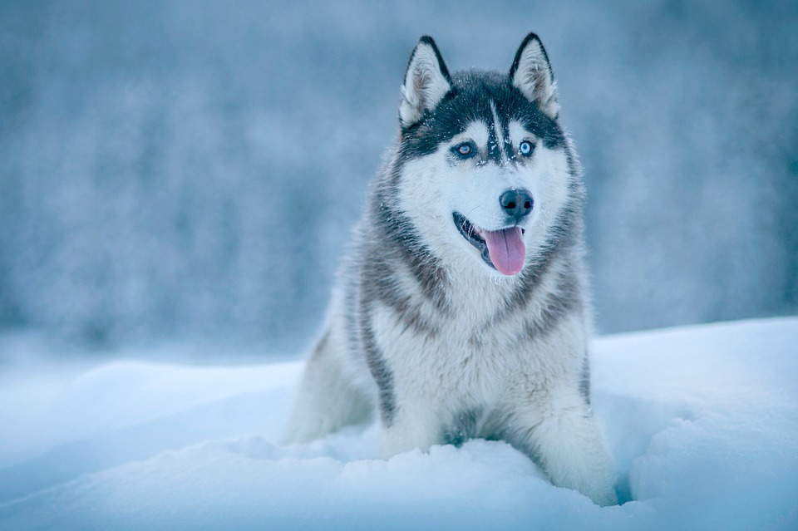
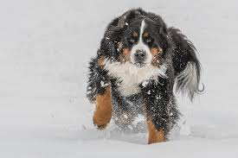
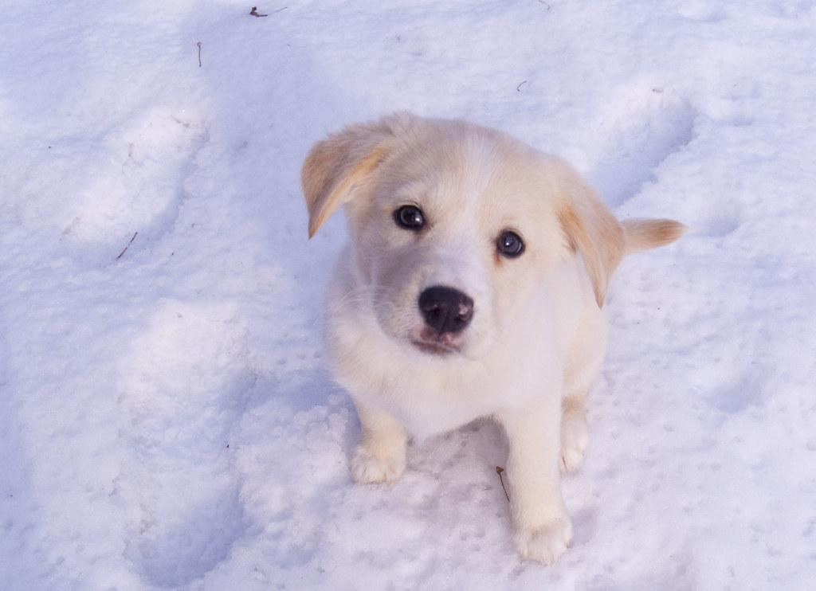
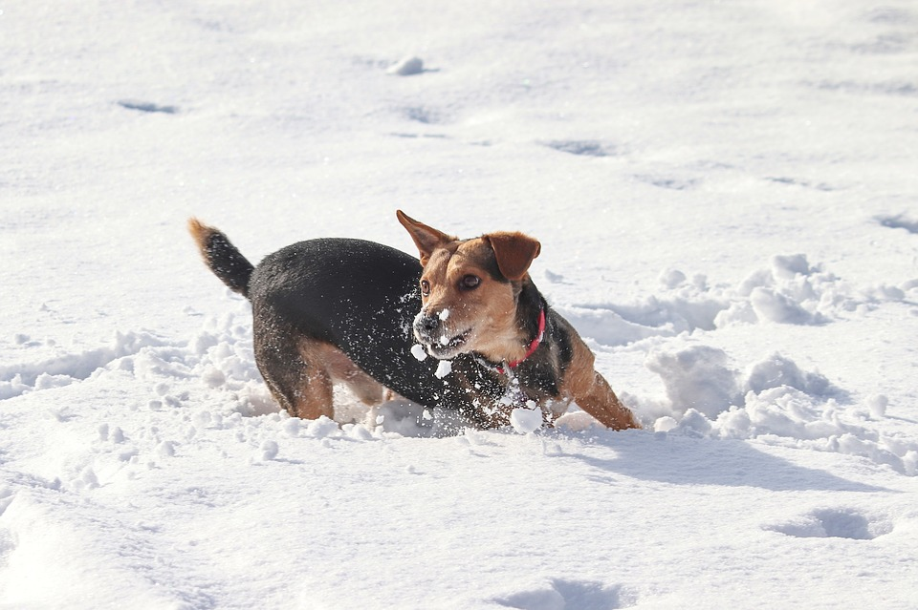
Pick an animal and discuss what characteristics help that animal survive in cold weather.
1.
2.
What characteristics are needed to survive in a cold area?
Why?
3.
4.

Slide 8
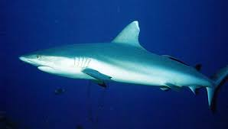
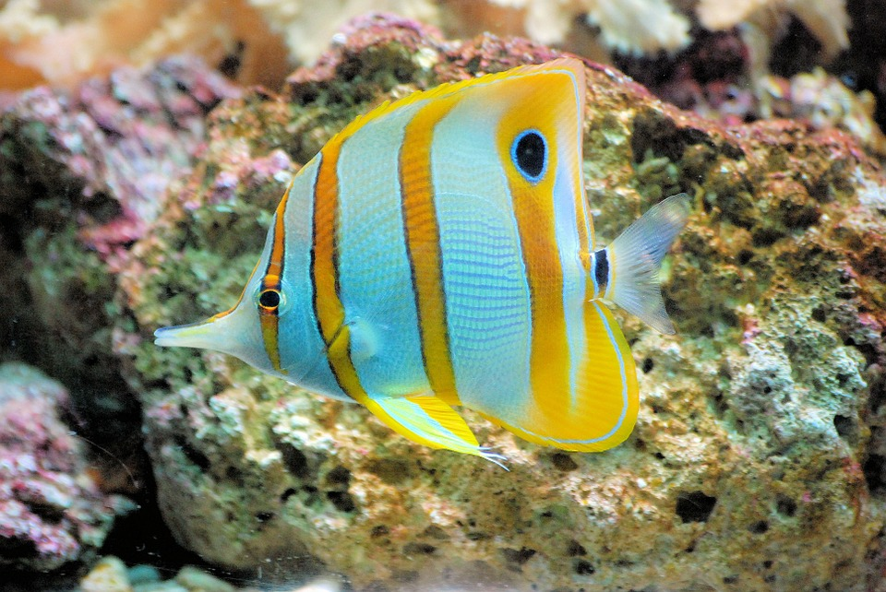
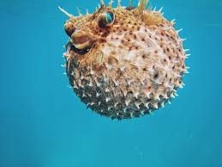
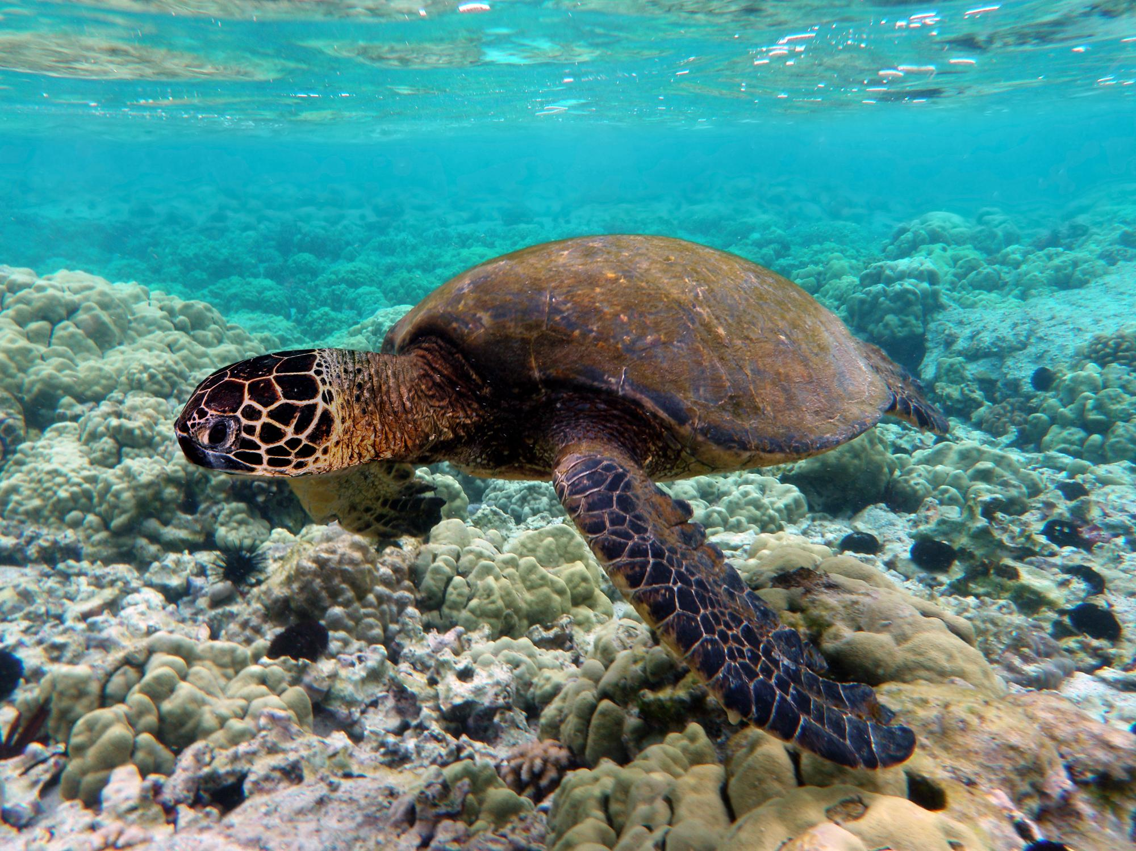
Pick an animal and discuss what characteristics help that animal survive in the ocean.
1.
2.
What characteristics are needed to survive in the ocean?
Why?
3.
4.

Slide 9
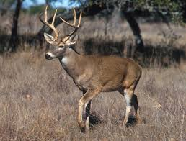
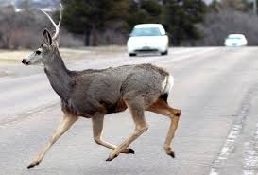
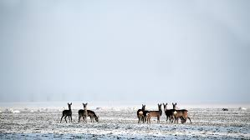
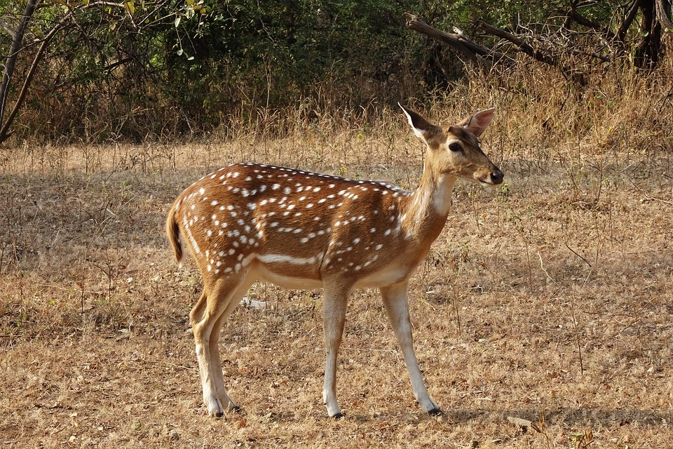
Pick an animal and discuss what characteristics help that animal survive on the prairie.
1.
2.
What characteristics are needed to survive on a prairie?
Why?
3.
4.

Slide 10
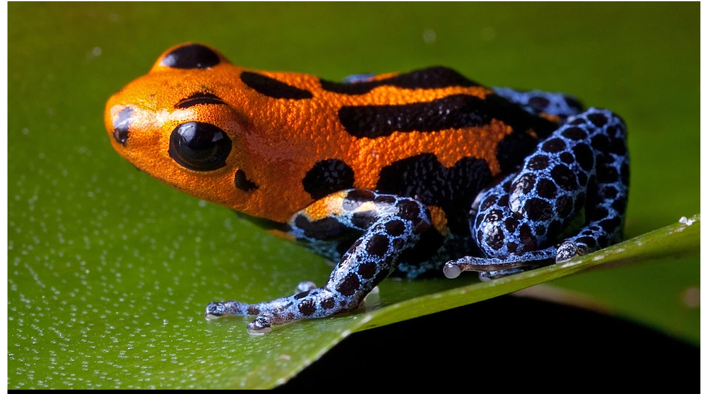
Let’s Learn About Animals

Slide 11
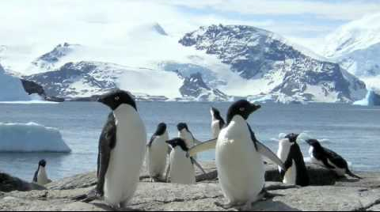
Animal Adaptations: How An Animal’s Body Helps Them Survive in Their Habitat

Slide 12
Comparing T-Charts
Work with another student to compare your T-Charts.
Choose one fact that surprised you.
Be ready to share with the class.

Slide 13
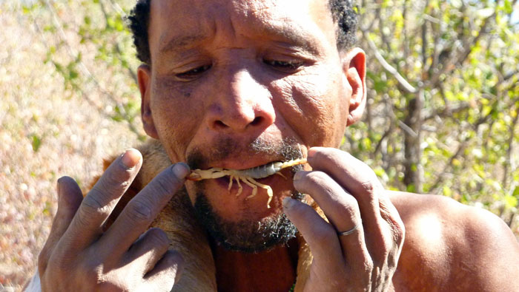
Traits of Humans
What characteristics/traits do humans have that help them survive in their environment?

Slide 14
Imaginary Human Traits
Think about which animal trait you would like to have to help you better survive in your environment.
Review your T-Chart for inspiration.
On your Imaginary Human Traits handout, create and illustration that shows what trait you would like to have.

Slide 15
What? So What? What Now?
What have you learned?
Why does it matter to you?
How does this new knowledge change your thoughts about traits for survival?

