Slide 2
Get Your Kicks on Route 66
Oklahoma History: Culture, Migration, and Tourism

Slide 3
Nat King Cole Sings “Get Your Kicks on Route 66”
Notes:
Video Source: [141fumi]. (2012, June 27). Route 66 : Nat King Cole : with lyrics [Video]. YouTube. https://youtu.be/MF_uuHvOz8w

Slide 4
Essential Question
What does Route 66 teach us about the impact that transportation, tourism, and migration have had on Oklahoma’s culture and history?

Slide 5
Lesson Objective
By the end of this lesson, you will be able to describe the changing perceptions, in Oklahoma and elsewhere, of Oklahoma and its citizens as reflected in Route 66.

Slide 6
Jigsaw
Take 10-15 minutes to read; be sure to take notes.
Discuss what you’ve learned with your groupmates and summarize your article.
When your group is called on, be prepared to share your article with the whole class.

Slide 7
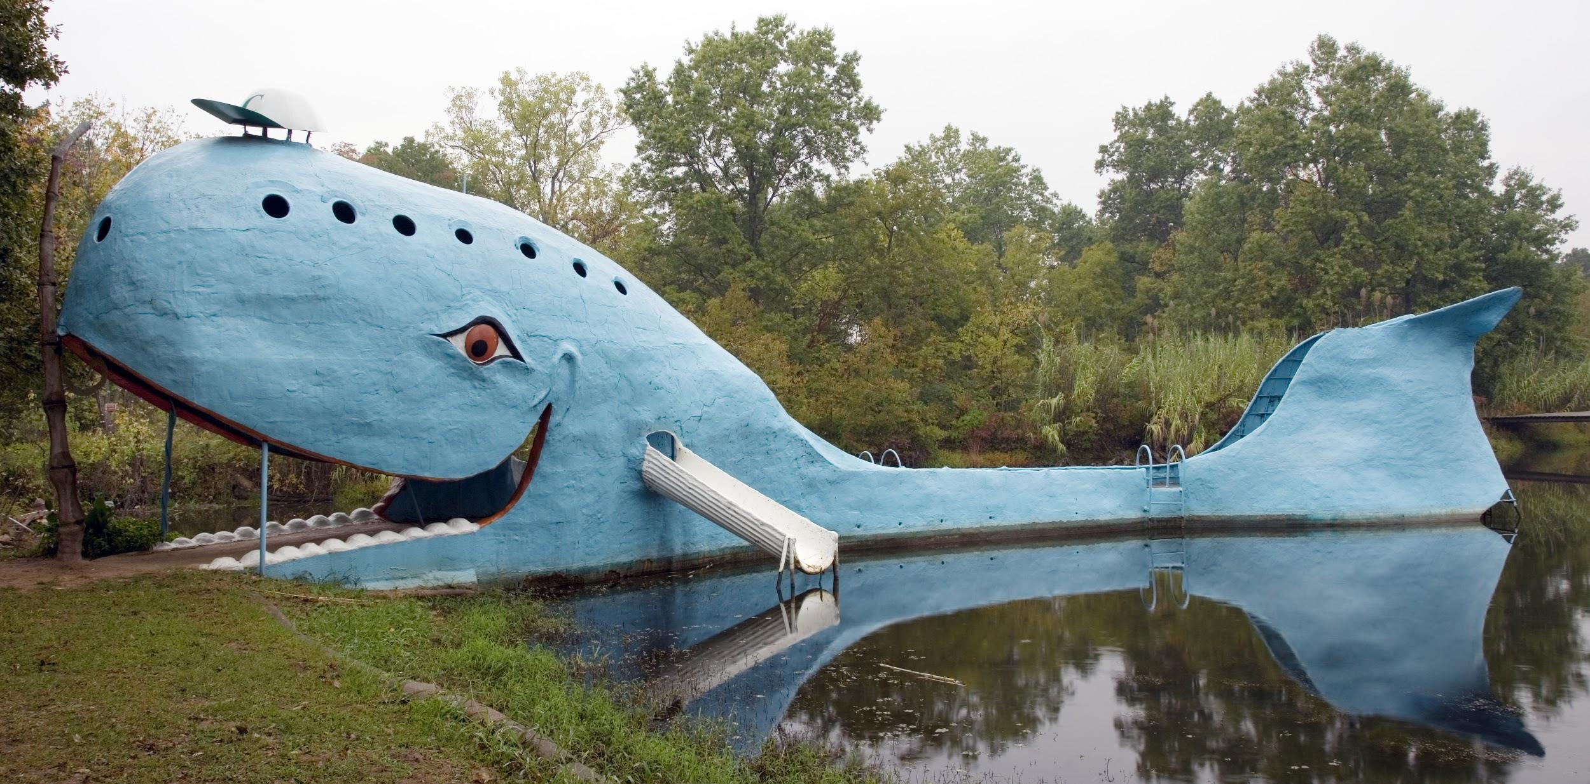
A Journey Down Route 66
Let’s use Google Earth to take a virtual road trip along Route 66. You’ll have the option of creating your own virtual road trip on Google Earth soon.
Route 66 Road Trip
Notes:
Image Source: Highsmith, C. M. (2006, October 10). The blue whale of Catoosa [Image]. ​Wikimedia Commons. https://commons.wikimedia.org/wiki/File:Rt_66_Blue_Whale_Highsmith.jpg​

Slide 8
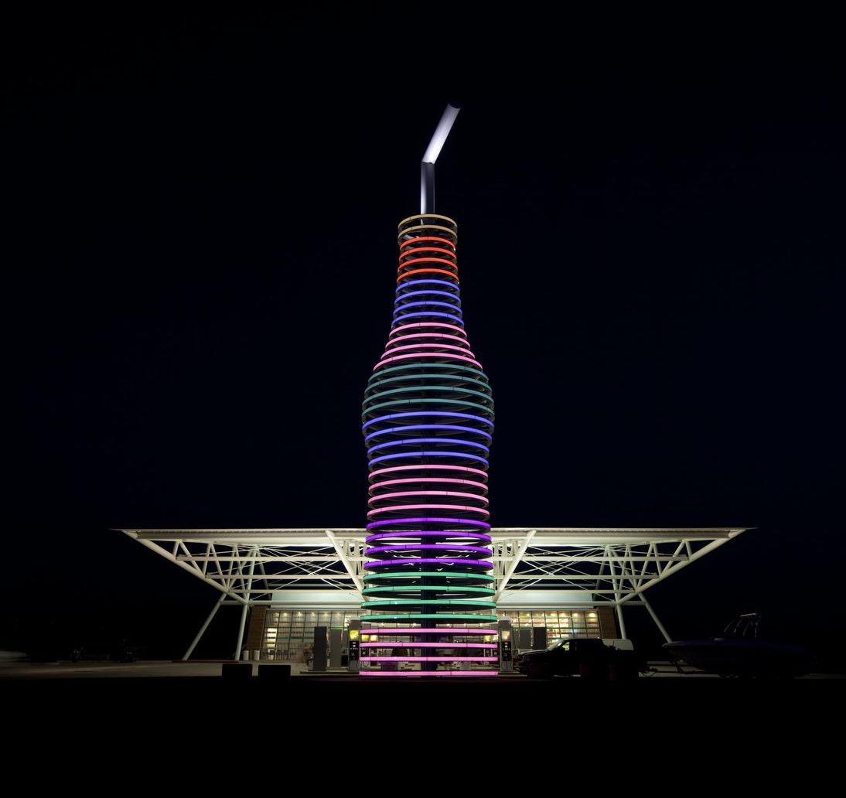
It’s Your Turn To Travel Route 66!
Pick three stops and plot the site locations on a map.
You can draw your map by hand or create a project on Google Earth.
Notes:
Image Source: Highsmith, C. M. (2009). Pops Restaurant and Gift Shop, Route 66, Arcadia, Oklahoma [Image]. Wikimedia Commons. https://commons.wikimedia.org/wiki/File:Pops_Restaurant_and_Gift_shop,_Route_66,_Arcadia,_Oklahoma_LCCN2010630481.tif

Slide 9
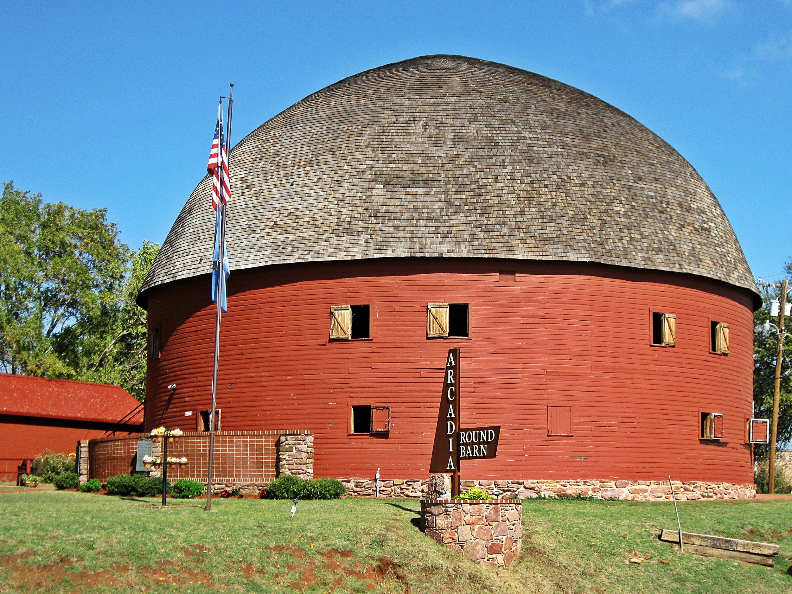
It’s Your Turn To Travel Route 66!
Use the Route 66 Trip Planner handout to answer questions about each of the three types of sites.
On your map, add images and a caption for each site. The caption should summarize the answers to your questions on the handout in paragraph form.
Notes:
Image Source: Robinette, R. (2011, October 23). Arcadia round barn [Image]. Wikimedia Commons. https://commons.wikimedia.org/wiki/File:Arcadia_Round_Barn_in_Fall.JPG

