Slide 2
Woman Crush Wednesday: Marjory Stoneman Douglas
Grades 9-10 Science

Slide 3
Bell Ringer
Answer the following questions to the best of your knowledge before we begin today’s lesson:
What is an ecosystem?
Can you name any endangered species and how they became endangered?
How do you think a species being endangered affects the other species in the ecosystem?

Slide 4
Essential Questions
How have female scientists shaped science today?
What threatens ecosystems?

Slide 5
Lesson Objectives
Illustrate the contributions of a particular scientist, Marjory Stoneman Douglas, as a way to humanize the field of science.
Summarize how changes in one part of an ecosystem affect other parts of the ecosystem.
Explain how species are adapted to their ecosystem.

Slide 6
Who Was Marjory Stoneman Douglas?
Familiarize yourself with Marjory Stoneman Douglas and her contributions to science using one of the following options:
Read the excerpt from Women in Science.
Watch the video The Everglades River of Grass (0:00-3:48).
Notes:
Book: Ignotofsky, R. (2016). Women in science: 50 fearless pioneers who changed the world. Berkeley, CA: Ten Speed Press.
Image source: McKissick, K. (2016, April 28). Women in science: The next science art book you need. Scientific American. https://blogs.scientificamerican.com/symbiartic/women-in-science-the-next-science-art-book-you-need/
Video source: https://www.youtube.com/watch?v=stU7K1zU0r4

Slide 7
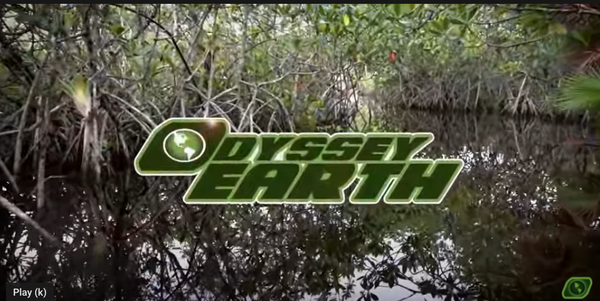
Who Was Marjory Stoneman Douglas?
Notes:
Video source: https://www.youtube.com/watch?v=stU7K1zU0r4

Slide 8
TIP Chart
On your handout, place your everglade species (5 animals and 5 plants) in the Terms column.
In the Information column, describe each organism and its adaptations to thrive in the Everglades
In the Picture Column, paste or draw a picture of the species.

Slide 9
TIP Chart Debrief
Add 1 plant and 1 animal to the class master TIP Chart.
Discuss what adaptations are common in the Everglades.
Finish The Everglades River of Grass (3:48-End)
Notes:
Video source: https://www.youtube.com/watch?v=stU7K1zU0r4

Slide 10
Bison are Back
Read your assigned portion of the “Bison are Back” article.
In groups share your notes on the portion of text you were assigned.
Each group will share out their understanding of the article.
Notes:
Article source: https://theconversation.com/bison-are-back-and-that-benefits-many-other-species-on-the-great-plains-107588

Slide 11
Takeaways- Marjory Stoneman Douglas and the Everglades
With a partner, discuss the following topics
How did Marjory Stoneman Douglas fight for the Everglades?
Are their similar issues happening in our state?
How can you champion a local ecosystem?

Slide 12
Public Service Announcement (PSA)
Create a PSA to summarize threats to a local ecosystem and how individuals can help protect that ecosystem.
These will be displayed around the room. Take time to make them presentable in your chosen format and set them up around the room.

Slide 13
Gallery Walk
Walk around to each of the PSA’s and as you read through them, use your sticky notes to provide feedback.
After you see all of the PSA’s, write down the most significant thing you can do to protect an ecosystem.

