Slide 1
The Tulsa Race Massacre
Oklahoma History

Slide 2
Objective
Essential Question
By the end of this lesson, you will understand the events immediately preceding, during, and immediately following the Tulsa Race Massacre.
How do we know what happened during the Tulsa Race Massacre?

Slide 3
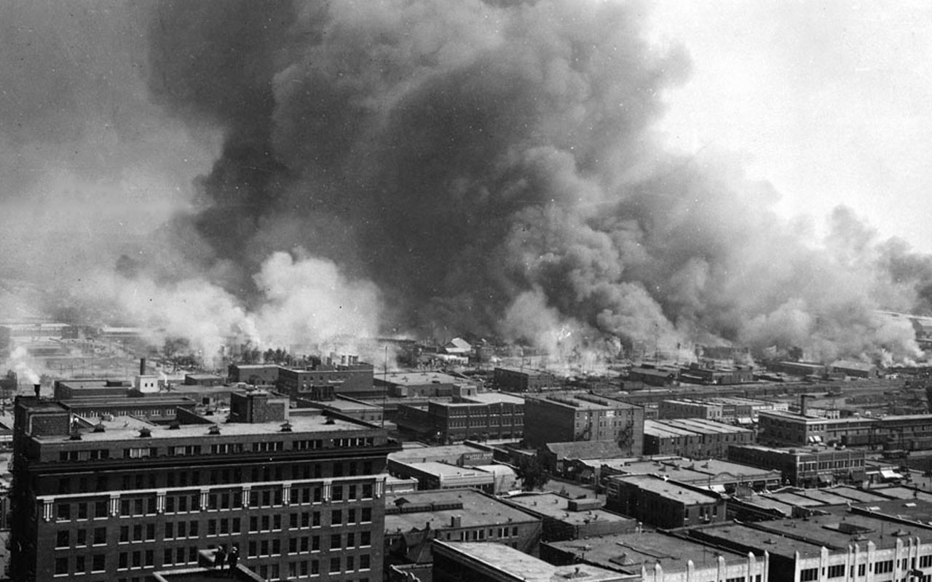
Notes:
Ask students to think about what they are seeing in the photo, and give them about 30 seconds to do so.
Image Source: Unknown author. (2013, November 12). The “Little Africa” section of Tulsa, OK in flames during the 1921 race riot. [Photo Image]. Wikimedia Commons. https://commons.wikimedia.org/wiki/File:Tulsa_race_riot_inflames-1921.jpg

Slide 4
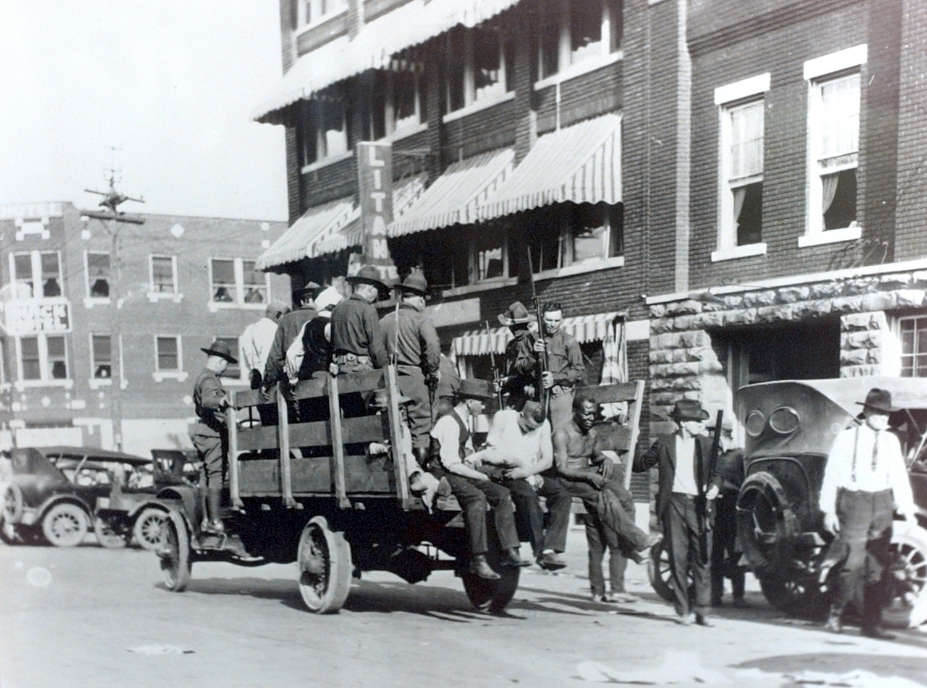
Notes:
Ask students to think about what they are seeing in the photo and give them about 30 seconds to do so.
Image Source: Tulsa World. (2013, November 12). National Guard and wounded during 1921 Tulsa race riots. This caption claims that the wounded are being taken to the Brady theater. [Photo Image]. Wikipedia. https://en.m.wikipedia.org/wiki/File:Tulsaraceriot1921-wounded-pickedup-fullpicture.jpg

Slide 5
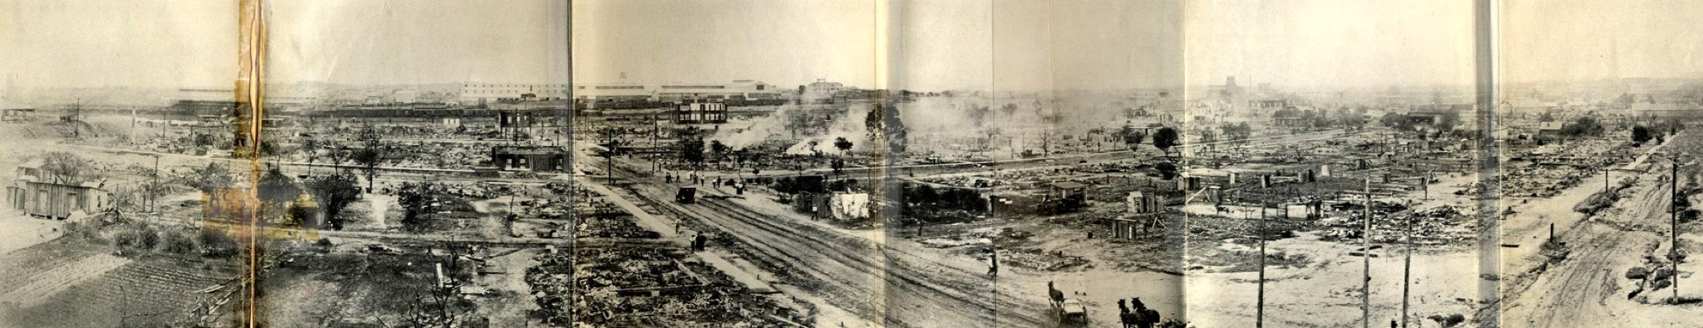
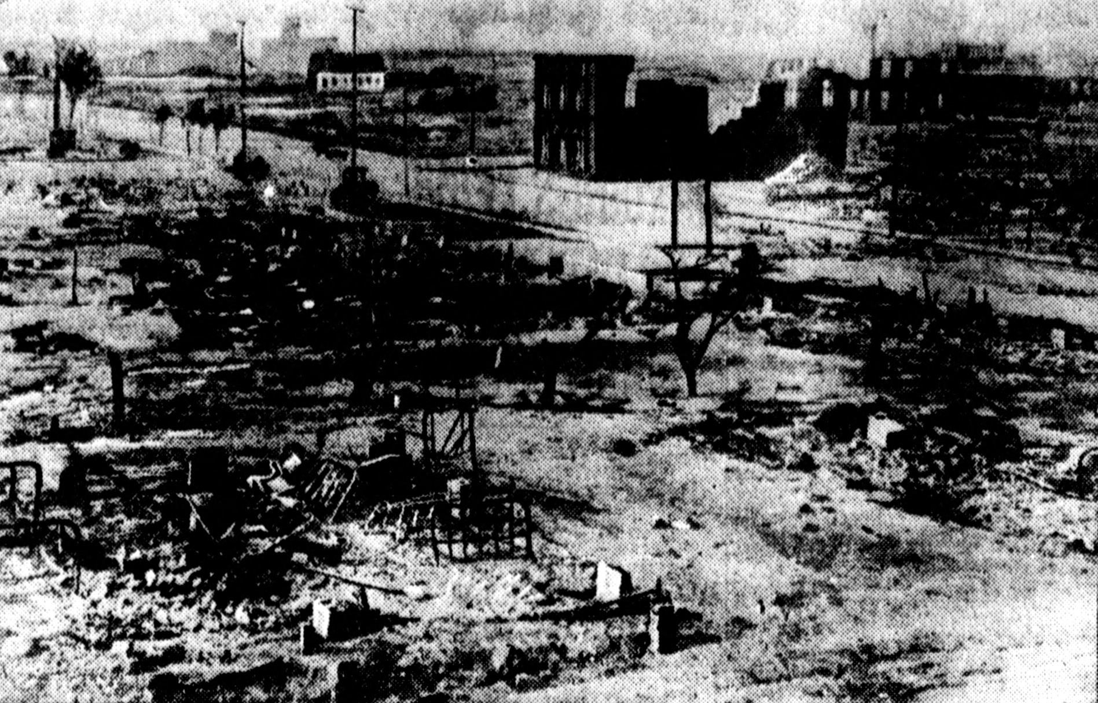
Notes:
Ask students to think about what they are seeing in the photo and give them about 30 seconds to do so.
Image Sources:
Top: Parrish, M. E. J. (2013, November 12). Taken from the southeast corner of the roof of Booker T. Washington High School, this panorama shows much of the damage within a day or so of the riot and the burning. The road running laterally through the center of the image is Greenwood Avenue, the road slanting from the center to the left is Easton, and the road slanting off to the right is Frankfort. [Photo Image]. Wikimedia Commons. https://commons.wikimedia.org/wiki/File:Panorama_of_the_ruined_area_tulsa_race_riots.jpg
Bottom: Evening Public Ledger. (2013, November 12). Tulsa race riot. [Photo Image]. Wikimedia Commons. https://commons.wikimedia.org/wiki/File:Tulsaraceriot1921-residentialblocksburneddown.jpg

Slide 6
What do all of these pictures together tell us about a time in our history?
Notes:
Ask students to write a one-sentence caption, answering the question, “Based on your inferences about these pictures, what conclusions can you make about what the photos as a group say about a time in our history?” Ask a few partners to share out their answers and have a brief discussion about the pictures and things they noticed, also answering any questions they might have.

Slide 7
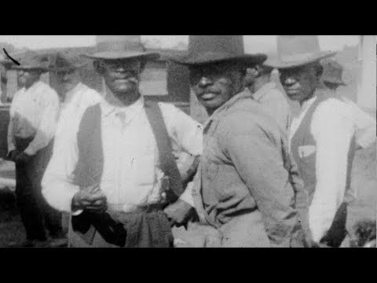
What information does the video provide that helps you understand the photos?
Notes:
Tell students they are going to watch a video that will help them with their understanding of what was happening in the photos from the previous activity. As they watch, tell them to jot down any notes from the video that add information and understanding.
After the video is over, ask students to share the new information they wrote down with their partner. If their partner caught something that they missed that also adds to their understanding, ask them to add it to their notes. Ask the students to quickly discuss how this video helped them understand what happened.
Ask for a few students to share out what they picked up from the video and answer any questions they might have.
THIRTEEN. (2019, April 18). Greenwood and the Tulsa race riots | BOSS: The black experience in business | PBS. [Video]. YouTube. https://youtu.be/-yceK9LHFSA

Slide 8

Why-Lighting
As you read, highlight anything in the text that you feel is critical to your understanding of what happened during
the Tulsa Race Massacre.
For anything that you highlight, write in the margin why you highlighted that passage, or why it's a critical piece of information to help your understanding.
Notes:
Instruct students to use the Why-Lighting strategy while they read. As they read, they will highlight any part of the reading that they think is critical to their understanding of what happened immediately before, during, and immediately after the Tulsa Race Massacre. Tell students that for any passage they highlight, they should note in the margin why they highlighted that piece of information or why it is a critical piece of information to help their understanding.

Slide 9
Partner Share
With your partner, share what you highlighted and why, specifically pointing out how the information helped with your understanding of the Tulsa Race Massacre.
With your partner, answer the question: How do the excerpt, video, and photos from the previous activity help you understand what happened?
Notes:
Tell students to share what they highlighted and why with their partner. Have them fully explain how the passages they highlighted helped them build understanding about what happened. Ask students to also discuss how the information from the text might help them answer the essential question, How do we know what happened during the Tulsa Race Massacre? Ask for some students to share out what they highlighted and why.

Slide 10
Virtual Tour
John Hope Franklin Reconciliation Park
Why does our country choose to memorialize events?
Notes:
Please make sure to look at all the notes in the LEARN narrative for this activity.

Slide 11
What do all of these pictures together tell us about a time in our history?
Notes:
Ask students to return to their Caption This graphic organizers and write a new caption in light of what they have learned.

