Slide 2
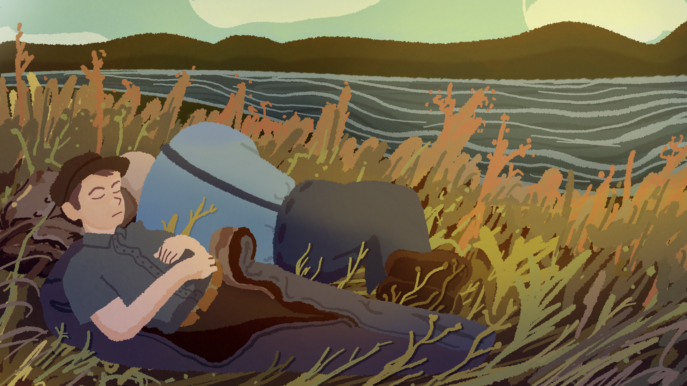
Of Mice and Men in the Great Depression
Background and Setting

Slide 3
Essential Questions
What was society like during the 1930s?
How does understanding the 1930s prepare us for reading Of Mice and Men?

Slide 4
Learning Objectives
Identify and summarize societal issues of the Great Depression.
Connect Great Depression issues to the novel’s background and setting.

Slide 5
I Think – What Do You Observe? | We Think
1. 2. 3. 4.

Slide 6
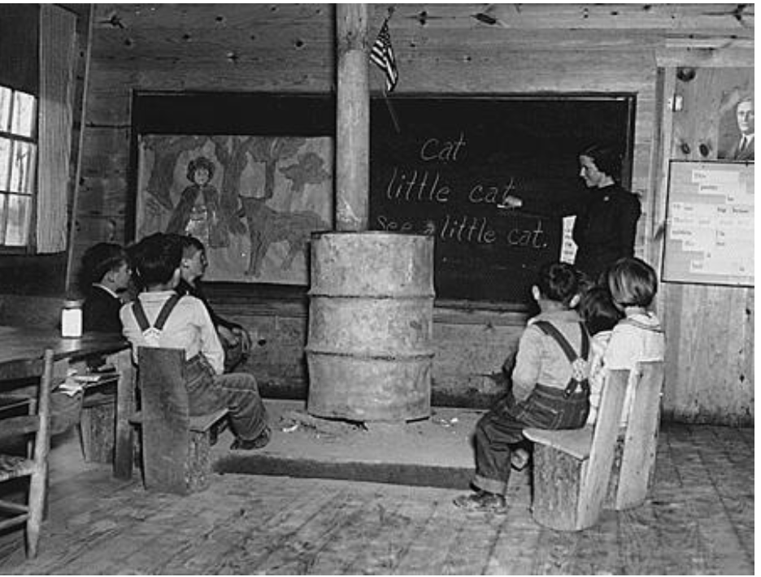
Elementary School in Alabama (1935)
Notes:
Source: Franklin D. Roosevelt Presidential Library & Museum. (1935). School--Alabama [Image]. http://www.fdrlibrary.marist.edu/archives/collections/franklin/index.php?p=digitallibrary/digitalcontent&id=3325

Slide 7
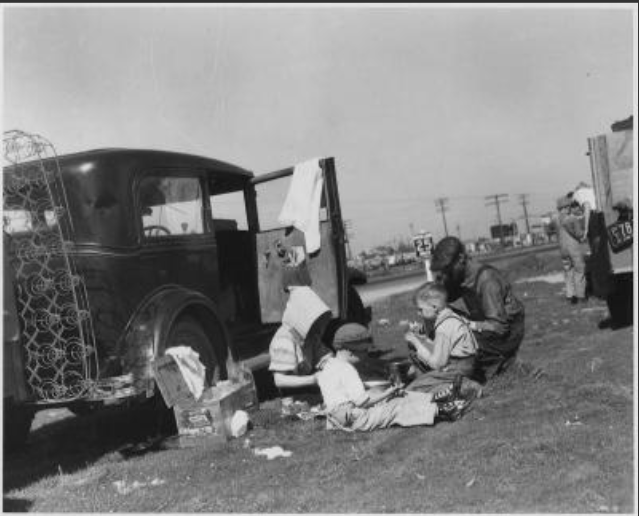
Migrants Eating Lunch (1935)
Notes:
Source: Franklin D. Roosevelt Presidential Library and Museum. (1935). Migrants [Image]. http://www.fdrlibrary.marist.edu/archives/collections/franklin/index.php?p=digitallibrary/digitalcontent&id=3508

Slide 8
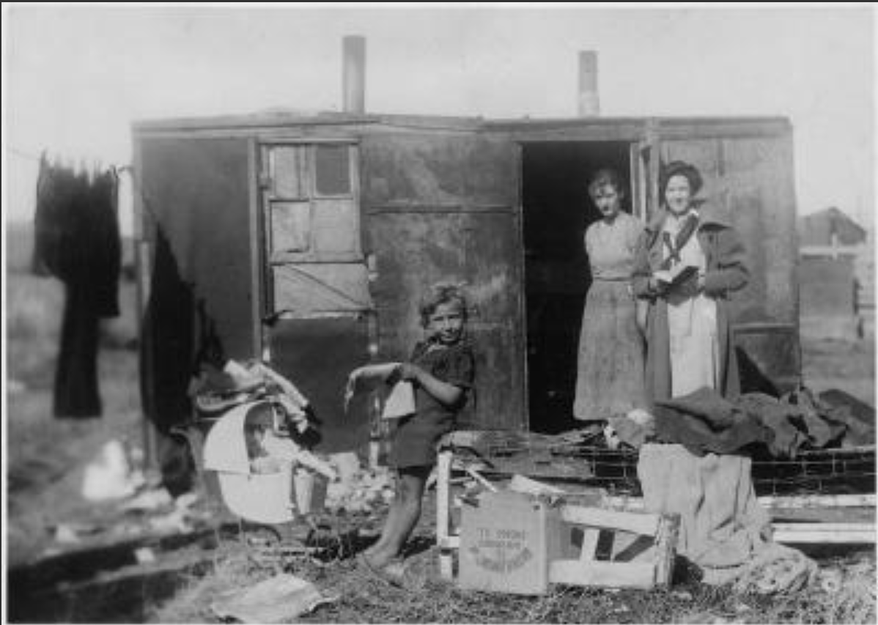
A Visit from the Public Health Nurse (no date), presumed early 1930s
Notes:
Source: National Archives. (n.d.). Social Security: Public Health nursing made available through child welfare services [Image]. Franklin D. Roosevelt Library Public Domain Photographs, 1882-1962. https://catalog.archives.gov/id/195887

Slide 9
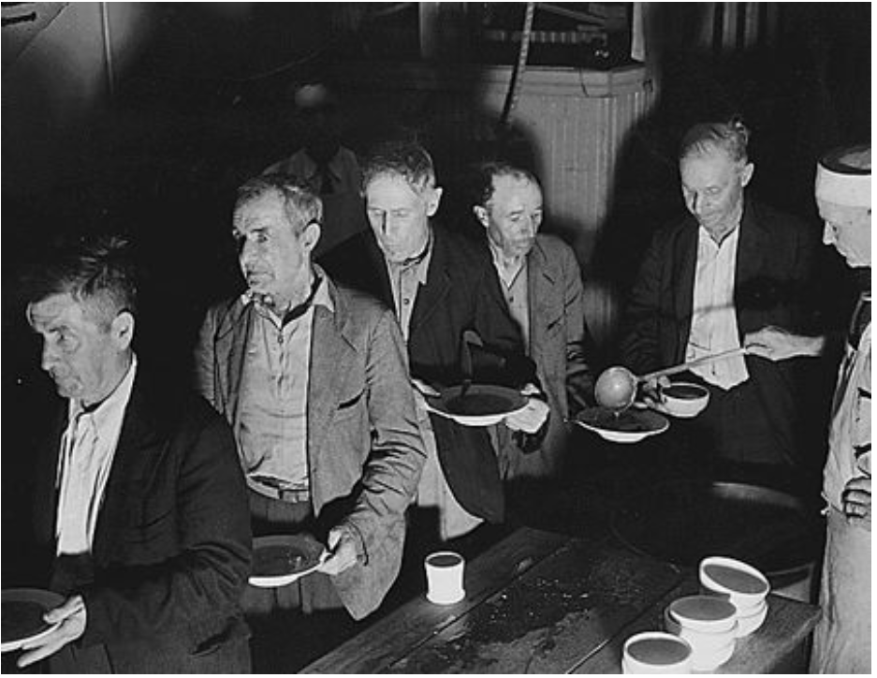
Soup Kitchen in Washington, DC (1936)
Notes:
Source: Franklin D. Roosevelt Presidential Library and Museum. (1936, June). Works Progress Administration. Washington, DC. Unemployed shown at Volunteers of America soup kitchen [Image]. http://www.fdrlibrary.marist.edu/archives/collections/franklin/index.php?p=digitallibrary/digitalcontent&id=3296

Slide 10
I Think | We Think
What do you observe? 1. 2. 3. 4. | What do these pictures tell you about the Great Depression? With your group, write statements about what life may have been like during the era of the Great Depression.

Slide 11

CUS and Discuss
As you read:
Circle important ideas.
Underline supporting details.
Summarize what you read in two or three sentences.
Be prepared to discuss what you read.

Slide 12
Inverted Pyramid Discussion
Find a partner who read the same text. Discuss your main ideas and summary of the reading.
Partners

Slide 13
Inverted Pyramid Discussion
Combine with another pair who read the same text.
Share your main ideas and summary of the reading.
Pairs Share
Partners

Slide 14
Inverted Pyramid Discussion
Form a group of three.
Each group should have a person who read a different text.
Summarize and share what you read with each other.
One to Five Groups
Pairs Share
Partners

Slide 15
Concept Map
Art
Family
Life
One to Five Groups
The Great Depression
Pairs Share
Finding Work

Slide 16
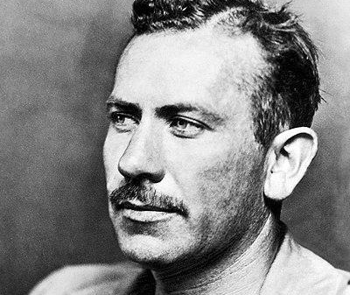
Of Mice and Men: Background & Setting
Background:
Novel published in 1937.
Steinbeck wrote about the Depression as a young man.
Steinbeck lived in California.
Setting:
Lenny and George (main characters) are migrant ranch workers in California.
Lenny is intellectually disabled.
John Steinbeck in 1939
Notes:
Image source: McFadden Publications, Inc. (1939, November). Photograph of John Steinbeck. Wikimedia Commons. https://commons.wikimedia.org/wiki/File:John-Steinbeck-1939.jpg

Slide 17
Of Mice and Men: Predictions
Steinbeck wrote about what he knew—the Great Depression, migrant workers, and life in California.
What predictions can you make about what might happen in this story?
John Steinbeck in 1939
Notes:
Image source: McFadden Publications, Inc. (1939, November). Photograph of John Steinbeck. Wikimedia Commons. https://commons.wikimedia.org/wiki/File:John-Steinbeck-1939.jpg

