Slide 1
Brother Can You Loan Me a Dime?
Personal Financial Literacy

Slide 2
Essential Question
What types of financial institutions lend money?

Slide 3
Objective
By the end of this lesson, you will be able to explain the difference between financial institutions and describe the conditions under which they lend money.

Slide 4
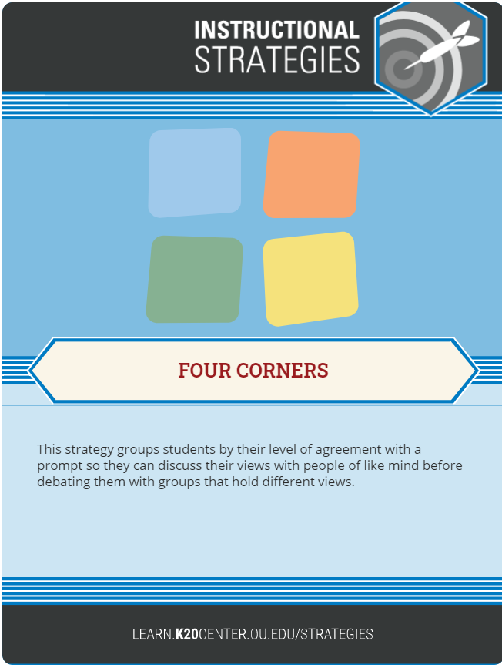
Four Corners
“It’s okay to go into debt for what you need in life.”
Stand in front of the sign that represents your level of agreement with the following statement:
  AGREE
  STRONGLY AGREE
  DISAGREE
  STRONGLY DISAGREE
Be prepared to share your reasoning with your group.
Notes:
Source: K20 https://learn.k20center.ou.edu/strategy/138

Slide 5
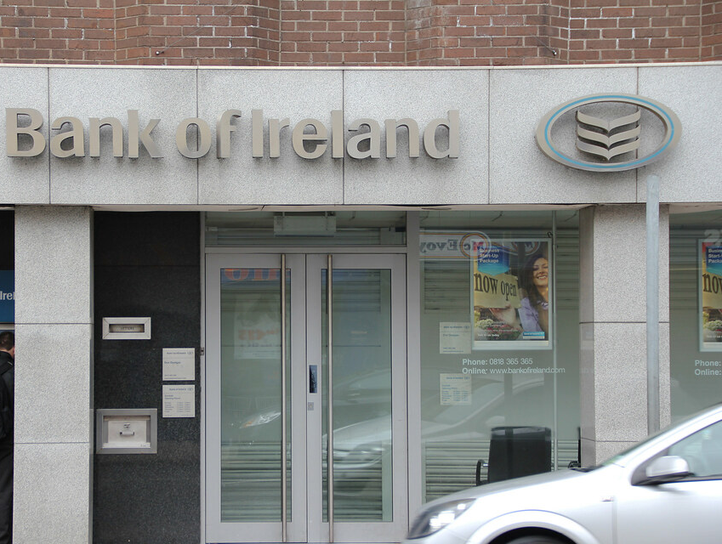
A.
Notes:
"Bank of Ireland Dundalk Branch" by Can Pac Swire is licensed with CC BY-NC 2.0. https://creativecommons.org/licenses/by-nc/2.0/

Slide 6

B.
Notes:
Source: America's Credit Union" by I-5 Design & Manufacture is licensed with CC BY-NC-ND 2.0. https://creativecommons.org/licenses/by-nc-nd/2.0/

Slide 7
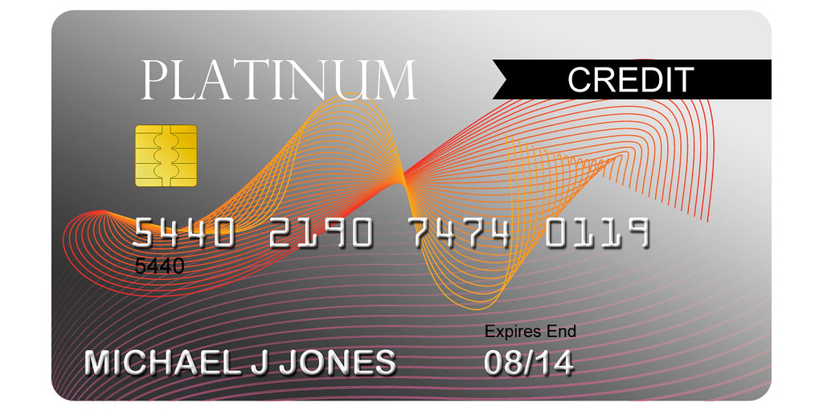
C.
Notes:
Source: "Platinum Credit Card" by Rareclass is licensed under CC BY-ND 2.0
https://creativecommons.org/licenses/by-nd/2.0/
https://search.creativecommons.org/search?license=&license_type=&categories=&extension=&aspect_ratio=&size=&source=&q=Platinum%20Credit%20Card%20&searchBy=&mature=

Slide 8
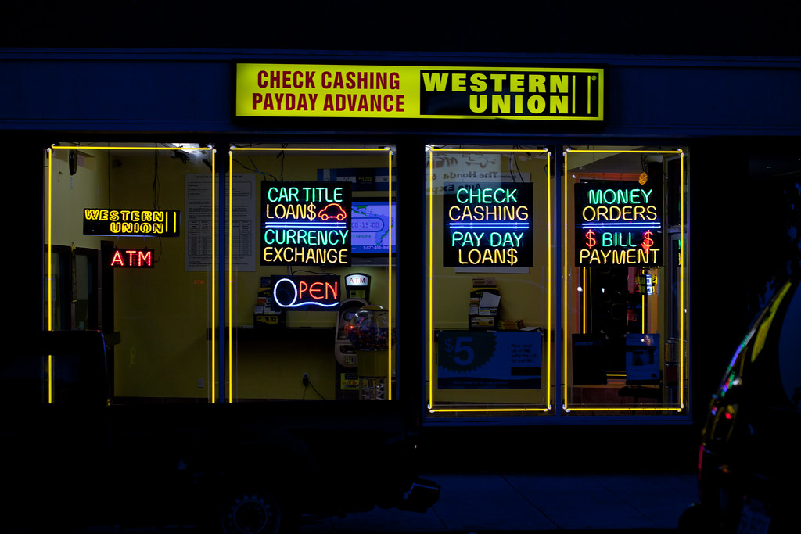
D.
Notes:
Source: "Pay Day Loan$" by Jeremy Brooks is licensed under CC BY-NC 2.0
https://search.creativecommons.org/photos/c4c14622-1050-4a80-8189-ee79dd8a1059

Slide 9

E.
Notes:
Source:
"Citywide Mug" by Editor B is licensed with CC BY 2.0. To view a copy of this license, visit https://creativecommons.org/licenses/by/2.0/

Slide 10
Lending or Loan Sources – Answer Key
Bank
Credit Union
Credit Card
Pay Day Loan Store
Mortgage Company

Slide 11
Group Share
For each financial service, jot down what you know about it in the second column.
Bank
Credit Union
Credit Card
Pay Day Loan Store
Mortgage Company

Slide 12

Reading: Categorical Highlighting
As you read the handout about financial services:
Highlight important ideas about your assigned topic.
Notes:
Source: https://learn.k20center.ou.edu/strategy/192)

Slide 13

Reading Group Summary
Create a three-sentence summary about your topic.
Be prepared to share with the class.
Notes:
Source: Levent-Levi, T. WebRTConmobile. WebRTC on mobile. https://creativecommons.org/licenses/by/2.0/

Slide 14
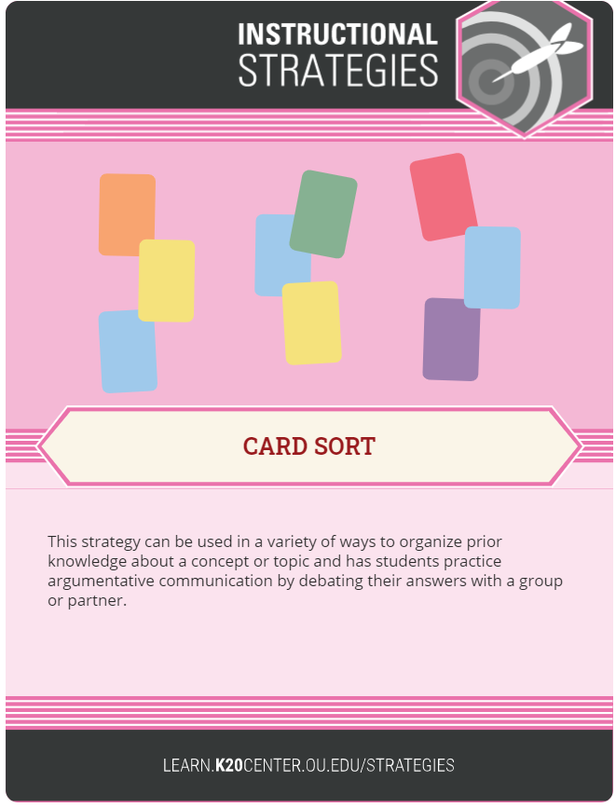
Card Sort (Optional Activity)
Write each of the 22 words from the Cars Sort handout on an index card.
Create a definition for each word using context clues.
Mix up the cards.
Turn them face down.
Take turns with your partner matching the terms with their definitions.
Once you and your partner have mastered your cards, challenge other pairs in the class to a contest.
Notes:
Source: https://learn.k20center.ou.edu/strategy/147)

Slide 15
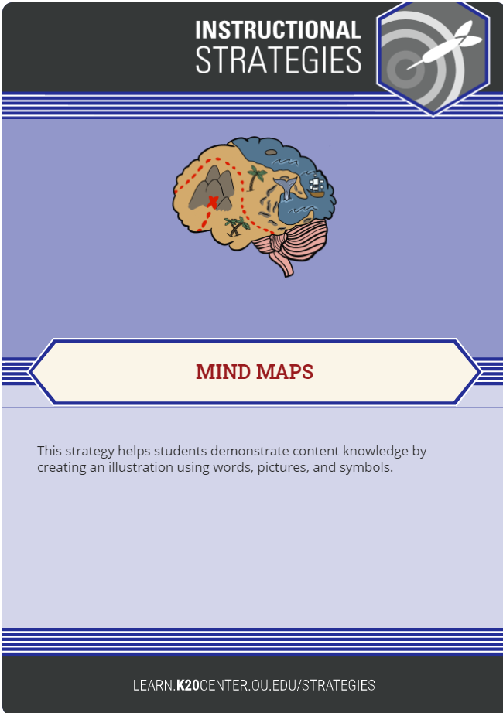
Mapping Your Mind
Your mind map will be a diagram used to organize information visually.
You and a partner will create a map around a single concept related to financial literacy.
Draw an image in the center of a blank page and add relate images, words, and parts of words.
Notes:
Source: https://learn.k20center.ou.edu/strategy/1277

Slide 16
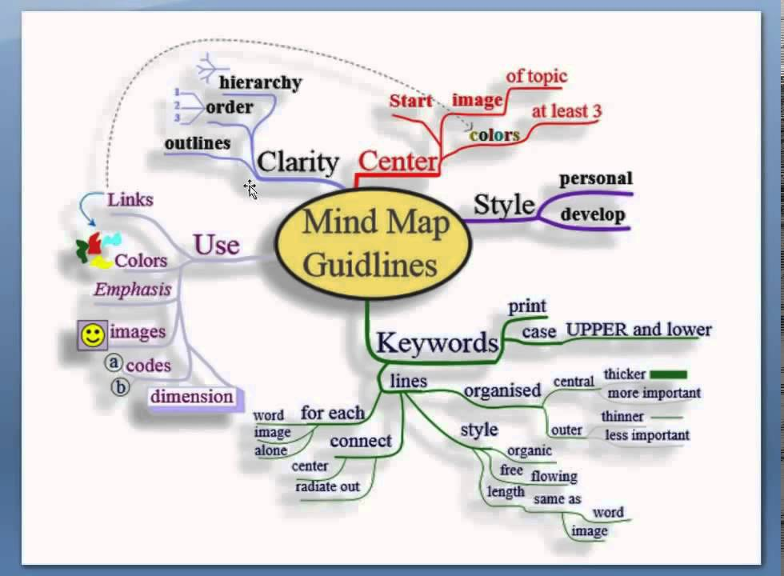
Creating Your Financial Literacy Mind Map
Show the connections between the different financial services.
Write your main idea in a circle in the middle of your page.
Draw branches from the center with related details that elaborate the main idea.
Connect related ideas with arrows and lines.
Add a variety of colors, words, pictures, and symbols.
Be as creative as you like to make your mind map a work of art.
Notes:
Source: Nicoguaro. (2011, June 7). Mind map guidelines. https://en.wikipedia.org/wiki/File:MindMapGuidlines.svgedia

Slide 17
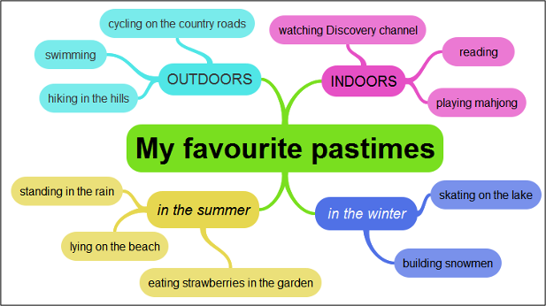
Sample Mind Map
Notes:
Explain how the mind map is divided into categories that make connections with one another– outdoors, indoors, in the summer, in the winter.
Source: Svenca, B. (2013, Jan. 5). Using mind maps with students. B’s life with English. Blogspot.com. [Image]. http://baibasvenca.blogspot.com/2013/01/using-mind-maps-with-students.html

Slide 18
Sample Mind Map
Pay Day Loans
High interest rates
Credit Cards
Easy to use
QUICK CASH
FINANCIAL
LENDING
SOURCES
Notes:
This is a beginning mind map for the student topics.

Slide 19
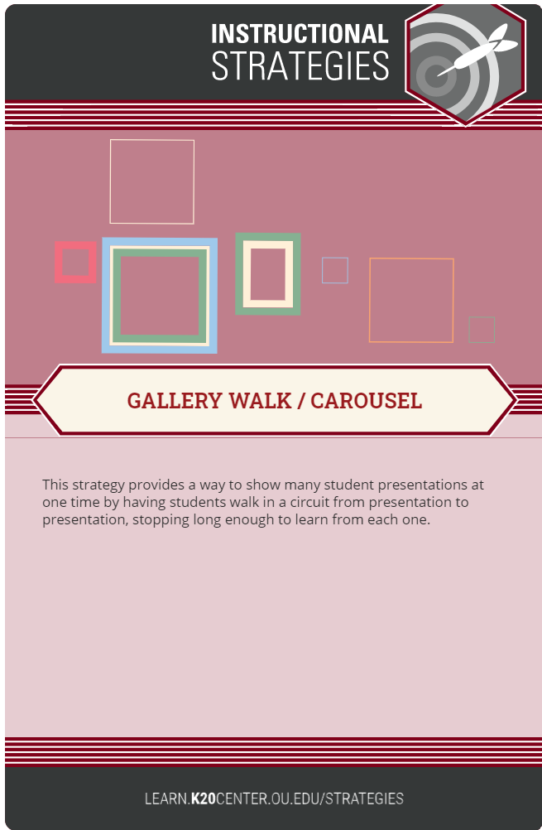
Gallery Walk
Select one group member to stand by your mind map to explain connections and answer questions.
Consider the following as you walk through the gallery:
  What connections or similarities do you see?
  What are the differences among the lending sources?
Notes:
Source: https://learn.k20center.ou.edu/strategy/118

Slide 20

Two-Minute Paper
After you have looked at all the Mind Maps, write a brief paper that addresses these questions:
What connections do you see among the financial services?
What differences do you see?
In your opinion, which service seems the best source from which to borrow money? Why?
Notes:
Source: https://learn.k20center.ou.edu/strategy/152

