Slide 2

Looking Between the Lines
Parallel lines, Transversal lines, and Angles

Slide 3
Essential Question
How do the angles formed by two parallel lines and a transversal relate to each other?

Slide 4
Lesson Objective
Students will identify special angles pairs formed by parallel lines and transversal and solve real world scenarios using those properties.

Slide 5

Collective Brain Dump
Where do we see parallel lines in real life?
Notes:
K20 Center. (n.d.). Collective brain dump. Strategies. https://learn.k20center.ou.edu/strategy/111

Slide 6
Lines and a Protractor
Draw a line through the “Trial #1” parallel lines that are NOT perpendicular.
Use a colored pencil to shade in the acute angles.
Use a different colored pencil to shade in the obtuse angles.

Slide 7
Lines and a Protractor
Use a protractor to investigate the angles.
Talk to your group about what you noticed after measuring your angles.
Repeat the process for the parallel lines under “Trial #2.”
Try to make your line different from the first one (for example: direction of line or steepness).

Slide 8

Think - Pair - Share
With your partner, write a statement on the bottom of your worksheet about how the angles were created when a transversal crosses parallel lines relate to each other. Be specific.
Share your findings with another group.
Notes:
K20 Center. (n.d.). Think-pair-share. Strategies. https://learn.k20center.ou.edu/strategy/139

Slide 9
Think - Pair - Share
Did your findings differ or were they similar to others?
What do we now know about parallel lines when a transversal cuts through them?
Notes:
K20 Center. (n.d.). Think-pair-share. Strategies. https://learn.k20center.ou.edu/strategy/139

Slide 10
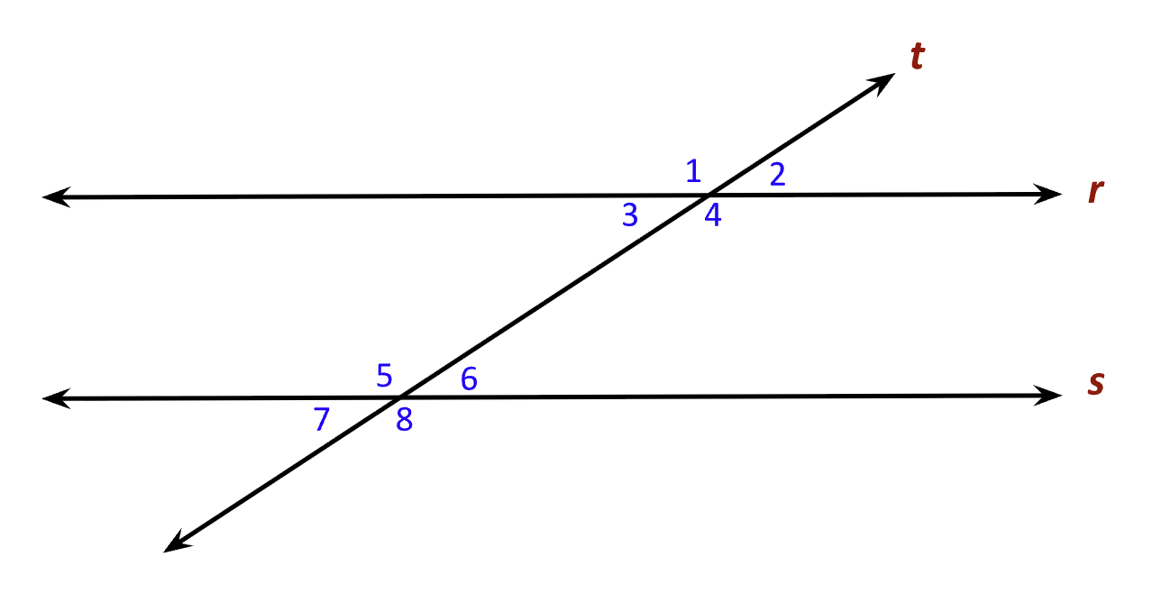
Diving Into the Vocab
Parallel Lines
Transversal Lines
Corresponding Angles
Consecutive Interior Angles
Alternate Interior Angles
Alternate Exterior Angles

Slide 11
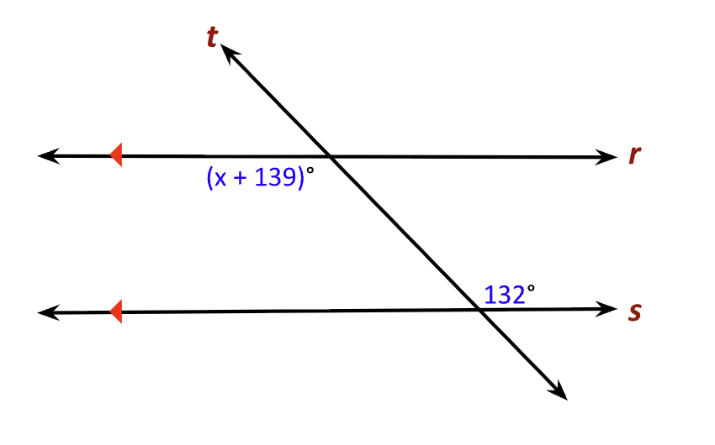
Solve for x

Slide 12
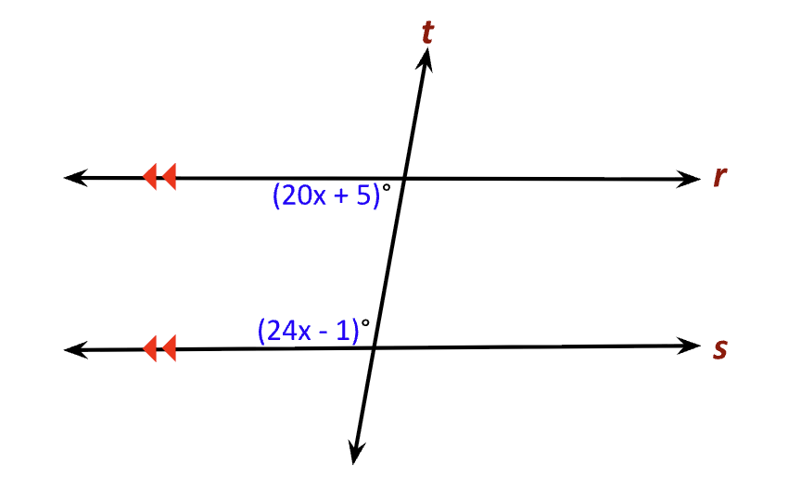
Solve for x

Slide 13
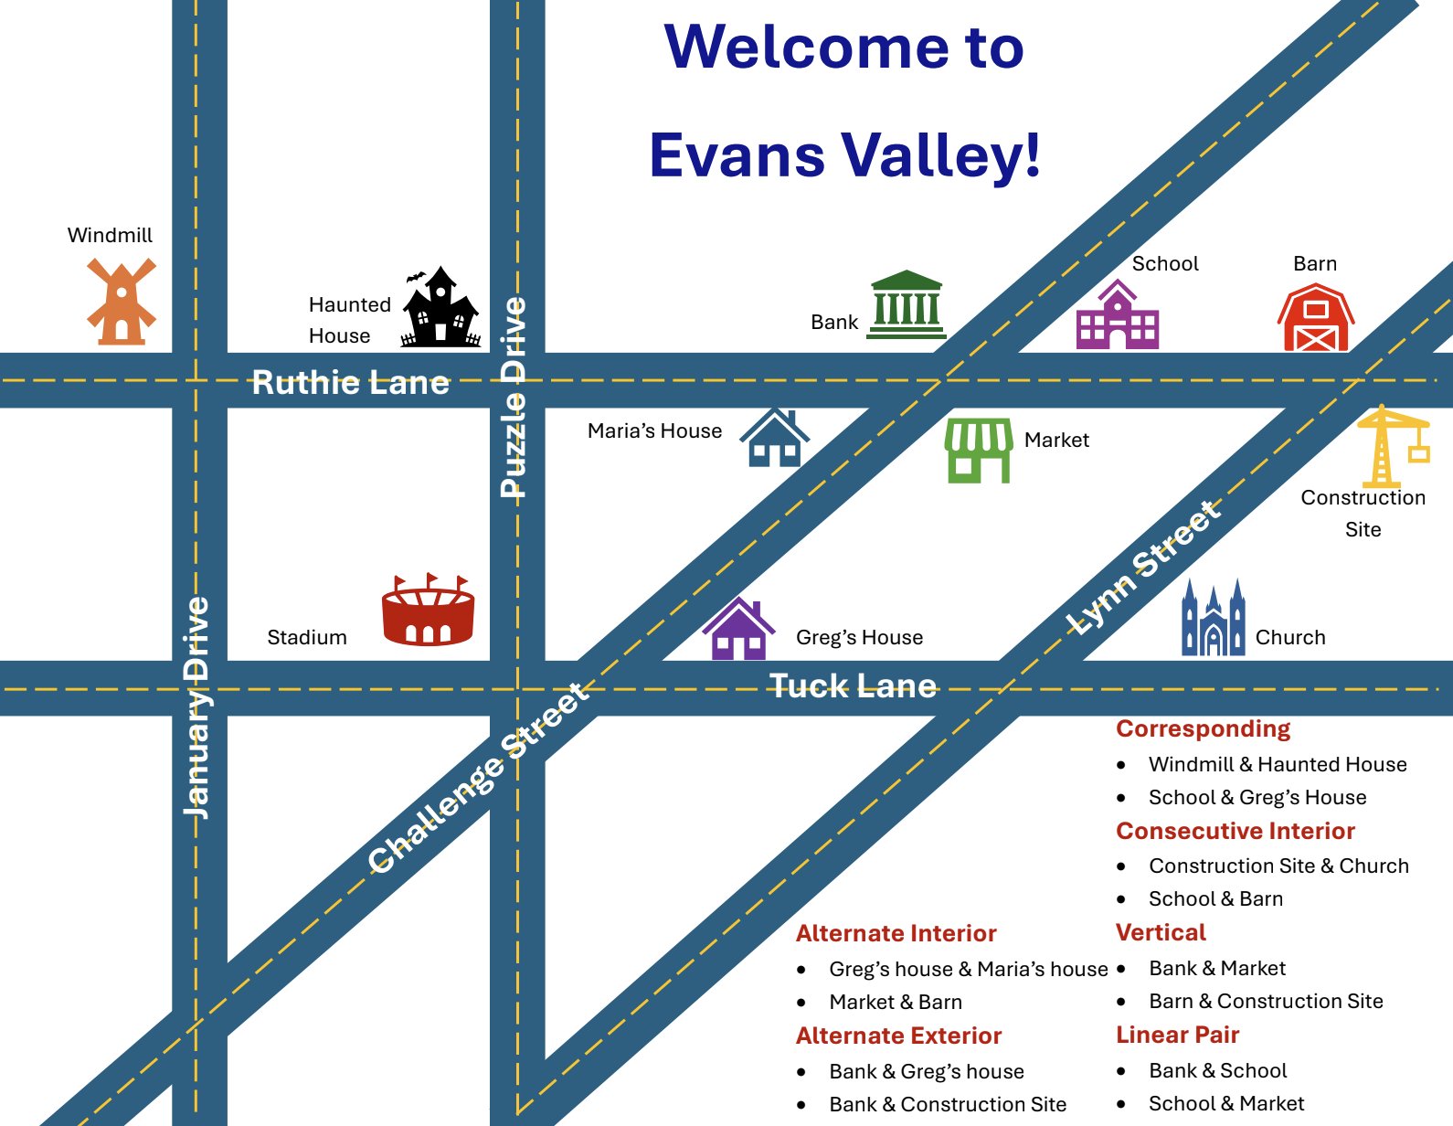
Create Your Own Town!
You are the mayor of a new town that is about to be built!
What needs to be in a town for people to survive and thrive?

Slide 14
Create Your Own Town!
Create a blueprint that you will present to the council of your new town. It must include the following:
Name of the Town
Streets that are parallel with at least one transversal
Buildings or landmarks that are corresponding angles
Buildings or landmarks that are consecutive interior angles
Buildings or landmarks that are alternate interior angles
Buildings or landmarks that are alternate exterior angles
Two solving for x problems - show your work!!!

Slide 15

I Notice, I Wonder
Hang up your city design in the classroom.
Visit three different city designs.
As you look at their design, write down the following on your I Notice, I Wonder handout:
  The name of the city
  Things you Notice (observations)
  Things you Wonder (questions)

Slide 16
Exit Ticket
Using your knowledge of the transversal lines and the angle relationships, solve the problems on the Exit Ticket handout.

