Slide 2

Looking Between the Lines
Parallel lines, Transversal lines, and Angles

Slide 3
Essential Question
How do the angles formed by two parallel lines and a transversal relate to each other?

Slide 4
Learning Objective
Identify special angles pairs formed by parallel lines and transversal and solve real world scenarios using those properties.

Slide 5

Collective Brain Dump
Where do we see parallel lines in real life?
Notes:
K20 Center. (n.d.). Collective brain dump. Strategies. https://learn.k20center.ou.edu/strategy/111

Slide 6
Lines and a Protractor
Draw a line through the “Trial #1” parallel lines that are NOT perpendicular.
Use a colored pencil to shade in the acute angles.
Use a different colored pencil to shade in the obtuse angles.

Slide 7
Lines and a Protractor
Use a protractor to investigate the angles.
Talk to your group about what you noticed after measuring your angles.
Repeat the process for the parallel lines under
“Trial #2.”
Try to make your line different from the first one
(for example: direction of line or steepness).

Slide 8

Think - Pair - Share
With your partner, write a statement on the bottom of your worksheet about how the angles were created when a transversal crosses parallel lines relate to each other. Be specific.
Share your findings with another group.
Notes:
K20 Center. (n.d.). Think-pair-share. Strategies. https://learn.k20center.ou.edu/strategy/139

Slide 9
Think - Pair - Share
Did your findings differ or were they
similar to others?
What do we now know about parallel lines when a transversal cuts through them?
Notes:
K20 Center. (n.d.). Think-pair-share. Strategies. https://learn.k20center.ou.edu/strategy/139

Slide 10
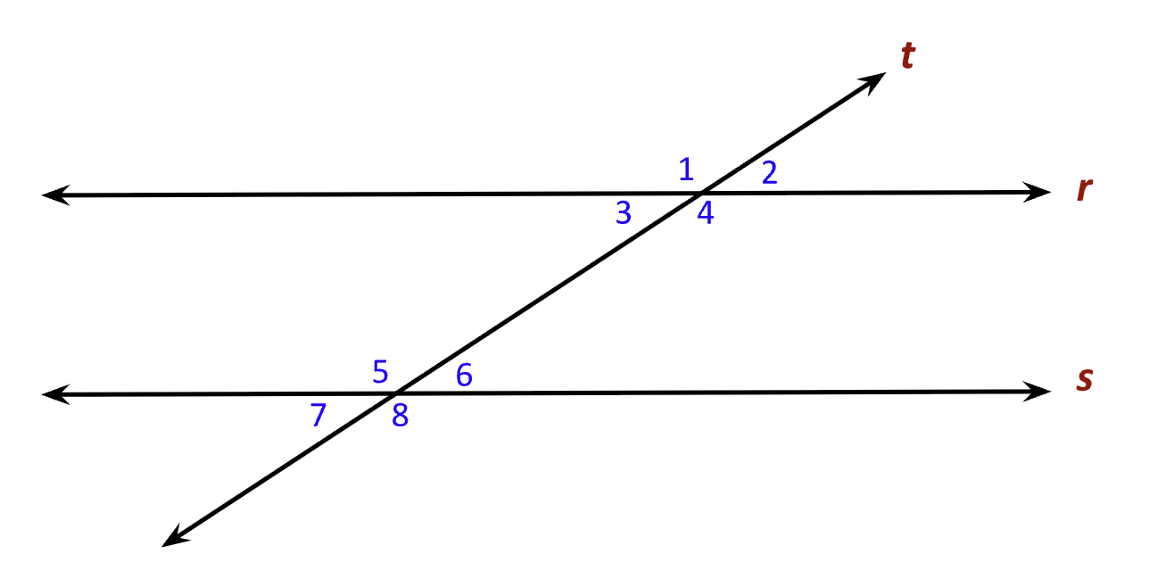
Diving Into the Vocab
Parallel Lines
Transversal Lines
Corresponding Angles
Consecutive Interior
Angles
Alternate Interior Angles
Alternate Exterior Angles

Slide 11
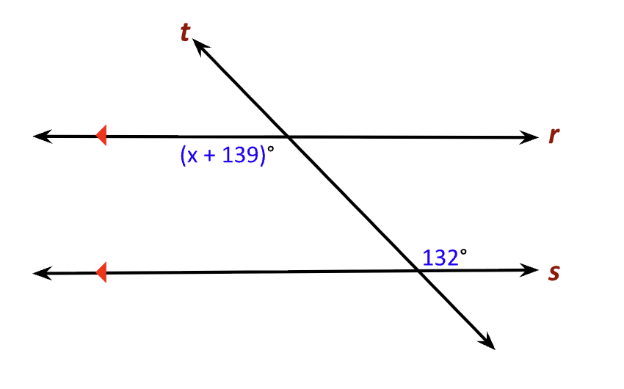
Solve for x

Slide 12
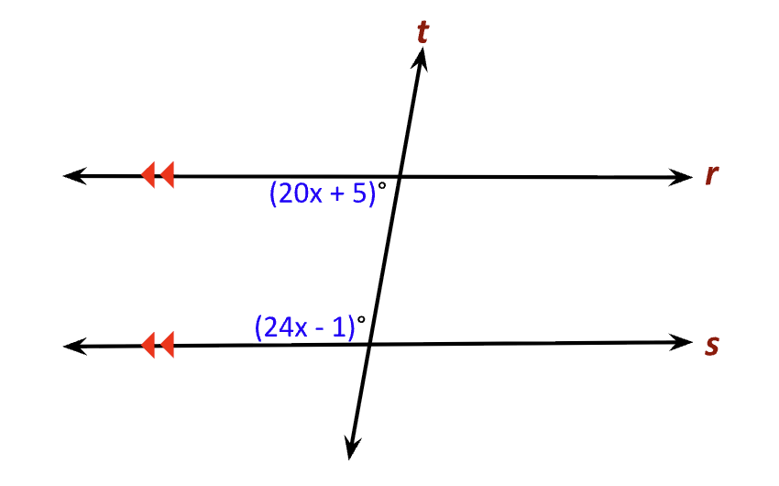
Solve for x

Slide 13
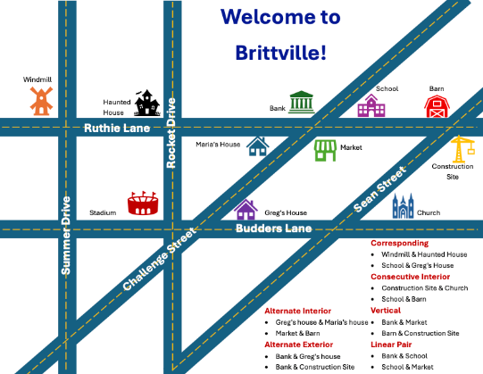
Create Your
Own Town!
Welcome to
Brittville!
You are the mayor of a new town that is about to be built!
What needs to be in a town for people to survive and thrive?

Slide 14
Create Your
Own Town!
Name of the town, streets, & landmarks
At least 3 pairs of parallel lines
At least 2 transversals
(not perpendicular)
2 sets of corresponding angles
2 sets of consecutive interior angles
2 sets of alternate exterior angles
2 sets of alternate interior angles
1 pair of vertical angles
1 linear pair
Create a blueprint that you will present to the council of your new town.
It must include:

Slide 15

I Notice, I Wonder
Hang up your city design in the classroom.
Visit three different city designs.
As you look at their design, write down the following on your I Notice, I Wonder handout:
  The name of the city
  Things you Notice (observations)
  Things you Wonder (questions)
Notes:
K20 Center. (n.d.). I notice, I wonder. Strategies. https://learn.k20center.ou.edu/strategy/180

Slide 16

Exit Ticket
Using your knowledge of the
transversal lines and the angle relationships,
solve the problems on the Exit Ticket handout.
Notes:
K20 Center. (n.d.). Bell ringers and exit tickets. Strategies. https://learn.k20center.ou.edu/strategy/125

