Slide 2
Looking Between the Lines
Parallel Lines, Transversal Lines, and Angles

Slide 3
Essential Question
How do the angles formed by two parallel lines and a transversal relate to each other?

Slide 4
Lesson Objective
We will identify special angle pairs formed by parallel lines and a transversal, and then use those properties to solve problems in real-world scenarios.

Slide 5
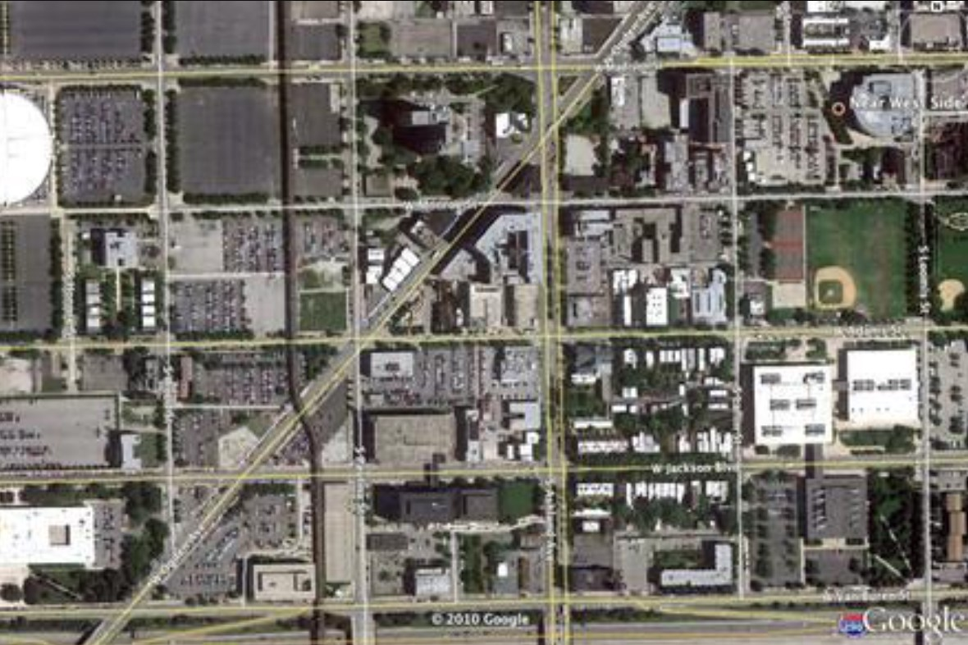
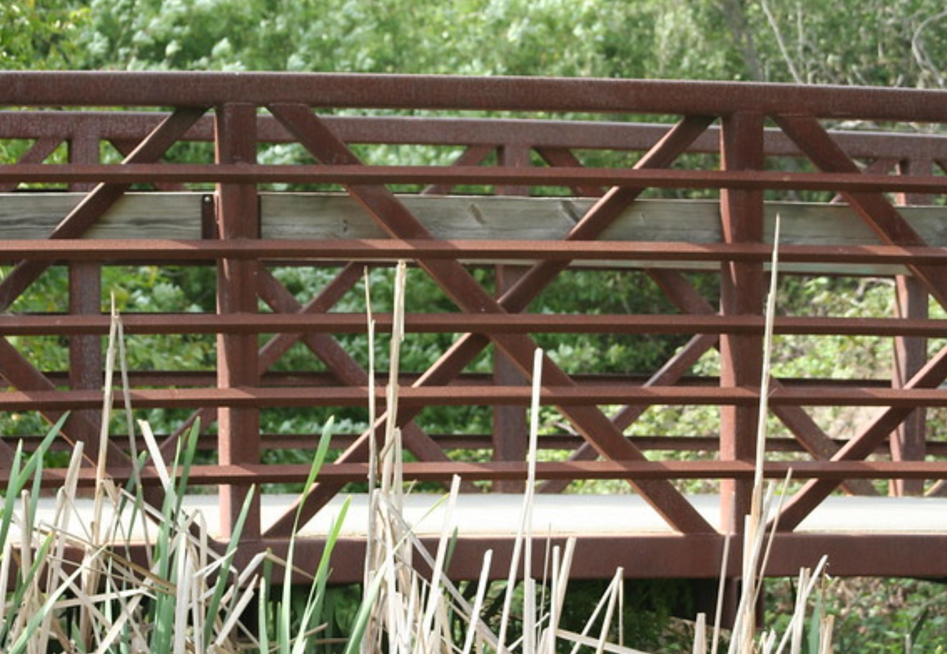
Caption This
Create a caption for each picture based on what you see!
Picture 1
Picture 2
Notes:
Picture 1 source: Schoolfy [@schoolfy]. (2014, May 5). #Geometry idea: With Google Maps, students identify parallel streets & transversals in their neighborhoods. #mathchat [Image attached to tweet]. Twitter. https://twitter.com/schoolfy/status/463495401530593280
Picture 2 source: Cvangundy4. (n.d.). Parallel Lines Cut by a Transversal [Image]. Blendspace. https://www.blendspace.com/lessons/hdWIpdNn0jkjHw/parallel-lines-cut-by-a-transversal

Slide 6
Caption This
What do these pictures have in common, and how do they relate to mathematics?

Slide 7
Lines and a Protractor
Draw two parallel lines and a transversal that is not perpendicular to the lines.
Shade or mark the acute angles with one color.
Shade or mark the obtuse angles with another color.
Using a protractor, measure all of the angles.
After completing the steps above, create two parallel lines with a different transversal. Compare the results.

Slide 8
Discussion: Think-Pair-Share
With your partner, write a statement based on your findings. Be specific about the data.
Share your findings with another pair of students.
As a class, we’ll discuss the following questions:
Did your findings differ, or were they similar to others?
What do we now know about parallel lines when a transversal cuts through them?

Slide 9
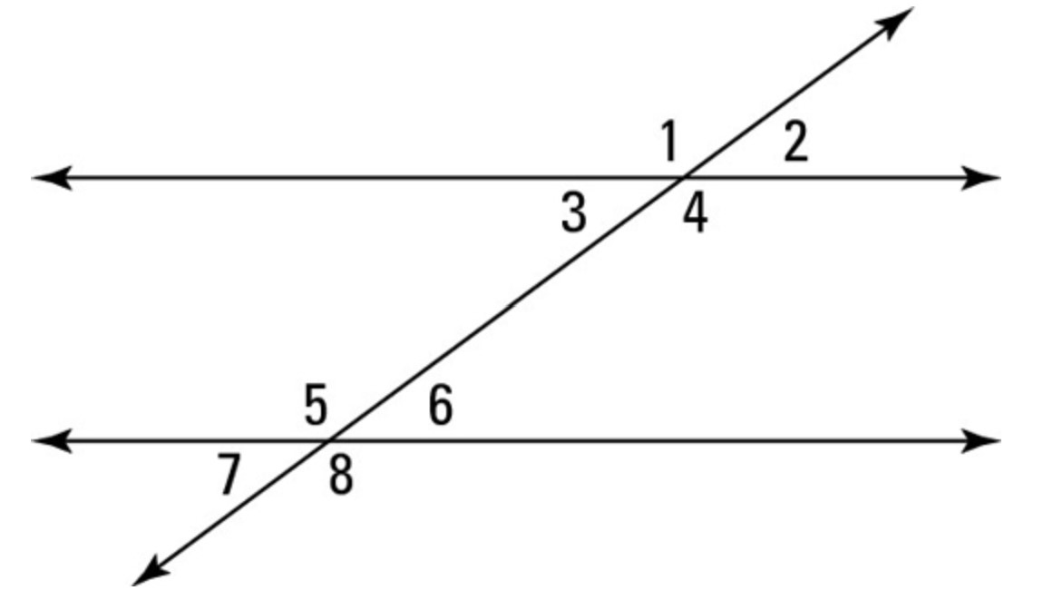
Diving into the Vocab
Parallel lines
Transversal lines
Corresponding angles
Consecutive interior angles
Alternate interior angles
Alternate exterior angles
Notes:
Source: Ryan, M. (n.d.). Definitions and Theorems of Parallel Lines [Image]. For Dummies. https://www.dummies.com/education/math/geometry/definitions-and-theorems-of-parallel-lines/

Slide 10
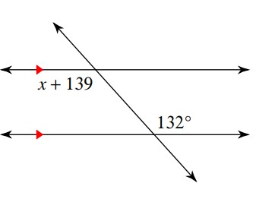
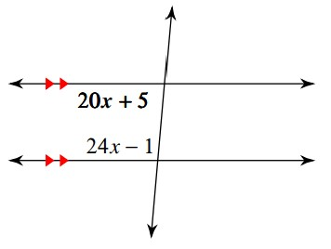
Solve for X.
Notes:
Source: Kuta Software - Infinite Geometry. (n.d.). Parallel Lines and Transversals Worksheet [Images]. Kuta Software. https://cdn.kutasoftware.com/Worksheets/Geo/3-Parallel%20Lines%20and%20Transversals.pdf

Slide 11
Create Your Own Town!
You are the mayor of a new town that is about to be built.
What needs to be in a town for people to survive and thrive?

Slide 12
Create Your Own Town!
Create a blueprint that you will present to the council of your new town. It must include the following:
Name of the town
Streets that are parallel with at least one transversal
Buildings or landmarks that are corresponding angles
Buildings or landmarks that are consecutive interior angles
Buildings or landmarks that are alternate interior angles
Buildings or landmarks that are alternate exterior angles
Two “solve for X” problems

Slide 13
Where Are You Moving?
You and your family want to move to a new town, but you want to do some research before you make a final decision.
Pick a blueprint of your choice.
Solve the two algebraic equations related to the angles on your chosen blueprint.
Would you move to this town? Why or why not?

