Slide 2
Understanding Patriots & Loyalists
US History
8th Grade

Slide 3
By the end of this lesson, students will be able to:
Distinguish between the viewpoints of a patriot, a loyalist or a neutral colonist prior to the American Revolution.
Discuss and write about these different viewpoints and the motivations for their stance.

Slide 4
Essential Question
How do the various viewpoints of colonists contribute to our understanding of the American Revolution?

Slide 5
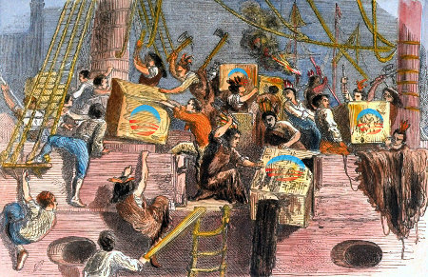
What do you know about the Boston Tea Party?
Notes:
Photo by Unknown Author as licensed under Creative Commons.

Slide 6
Think- Pair -Share
Were all colonists pleased about the events of the Boston Tea Party? What do you think?

Slide 7
Pair Share Match How did colonists respond to the ideas of rebellion and revolution?
Loyalists
Neutralists
Patriots
Someone who had no opinion about the government and its policies.
Someone who protested and rebelled against the British government.
Someone who obeyed the law of the British government.

Slide 8
Match Answers How did colonists respond to the ideas of rebellion and revolution?
Loyalists (3)
Neutralists (1)
Patriots (2)
Someone who had no opinion about the government and its policies.
Someone who protested and rebelled against the British government.
Someone who obeyed the law of the British government.

Slide 9
Group Directions
Each group member is to read ONE of the documents:
A, B, or C.
As you read your document, fill out the SOAPS handout.
S: Who is the speaker of the writing or who do you believe wrote it?
O: What is the occasion or time and place?
A: Who is the audience the document is written for?
P: What is the purpose of the writing?
S: Summarize what the reading is about.
This Photo by Unknown Author is licensed under CC BY-NC

Slide 10
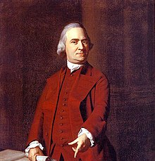
Who does your document represent?
A Loyalist
A Neutralist (fence-sitter)
A Patriot
This Photo by Unknown Author is licensed under CC BY-SA
Samuel Adams, leader of the Sons of Liberty
Notes:
Photo by unknown author and licensed under Creative Commons

Slide 11
Poster
What?
What was their stance?
Why?
What were their reasons for their choice?
Who?
What type of people?
LOYALIST
PATRIOT OR
NEUTRALIST

Slide 12
Partner Scenario
With your understanding of the different viewpoints of colonists, choose whether your document was written by a:
Loyalist
Patriot
Neutralist
Be prepared to explain your reasoning.

Slide 13
Partner Scenario Colonist A
He is a poor farmer in the Hudson valley. Colonist A has paid not attention to the trouble brewing. His problems have become worse because his landowner, a Loyalist, has raised his rent three times. He is worried he will be evicted from his farm. He, his wife, and six children will have nowhere to go.

Slide 14
Partner Scenario Colonist B
This colonist is a wealthy woman from New York City. She claims to be related to members of the House of Lords in the British Parliament. She worries about the amount of violence by the mobs called Sons of Liberty. She and her husband fear that their wealth and connections to Britain may make them targets of the mob.

Slide 15
Partner Scenario Colonist C
This colonist is a wealthy tea merchant in Boston. His goal is to make money and he doesn’t care if he violates the law. Since the tax on tea, he has been importing tea from the Dutch. His ships hide from the British. He’s been caught smuggling tea, but he was able to buy off the official. His friends say there is an arrest warrant out for him and he should go into hiding.

Slide 16
Partner Scenario Colonist D
Colonist D is a wealthy tobacco merchant from Virginia. He sells tobacco to the British and has a rich lifestyle. He was educated in Britain and hopes to send his son to Britain for a decent education. He is also heavily in debt and worries that the British banks may foreclose on his property.

Slide 17
Partner Scenario Colonist E
Colonist E, originally from Germany, now lives on the frontier. He has decided to move his family to the fertile Ohio Valley. The farmland is near a British fort for protection from Indians. British soldiers have stopped him and told him that the Proclamation of 1763 prohibits him from moving into the Ohio Valley.

Slide 18
Partner Scenario Colonist F
This colonist is a New York City merchant who buys many products from Britain. He fears that if the colonies break free from Britain, a new America could not protect his ships with goods at sea. He knows that the Sons of Liberty are bullying shop owners to get rid of British goods. A friend was attacked for selling British goods. Since his friend’s attack, Colonist F has participated with the boycotts.

Slide 19
Partner Scenario Colonist G
Colonist G is a poor dock worker on Boston’s waterfront. He loads and unloads ships. While playing cards and drinking at the local tavern, the Sons of Liberty try to recruit him to their cause. Because of the Intolerable Acts, the Boston Harbor is closed to trade. Colonist G is out of a job.

Slide 20
Partner Scenario Colonist H
Colonist H is a lawyer and a tobacco plantation owner in Virginia. Many colonist are paid in tobacco rather than in money. The British government raises the price of tobacco. Some colonists wish to be paid with this higher tobacco price against the wishes of the Virginia colony. The colonist makes a speech in the House of Burgess against the unfairness of this higher price for tobacco imposed by the king.

Slide 21
RAFT Writing
Role: Choose one of the colonists’ viewpoints.
Audience: Write for the audience of that colonist.
Format: Write using the assigned format.
Topic: Write your reasoning for this colonist’s viewpoint.

