Slide 2
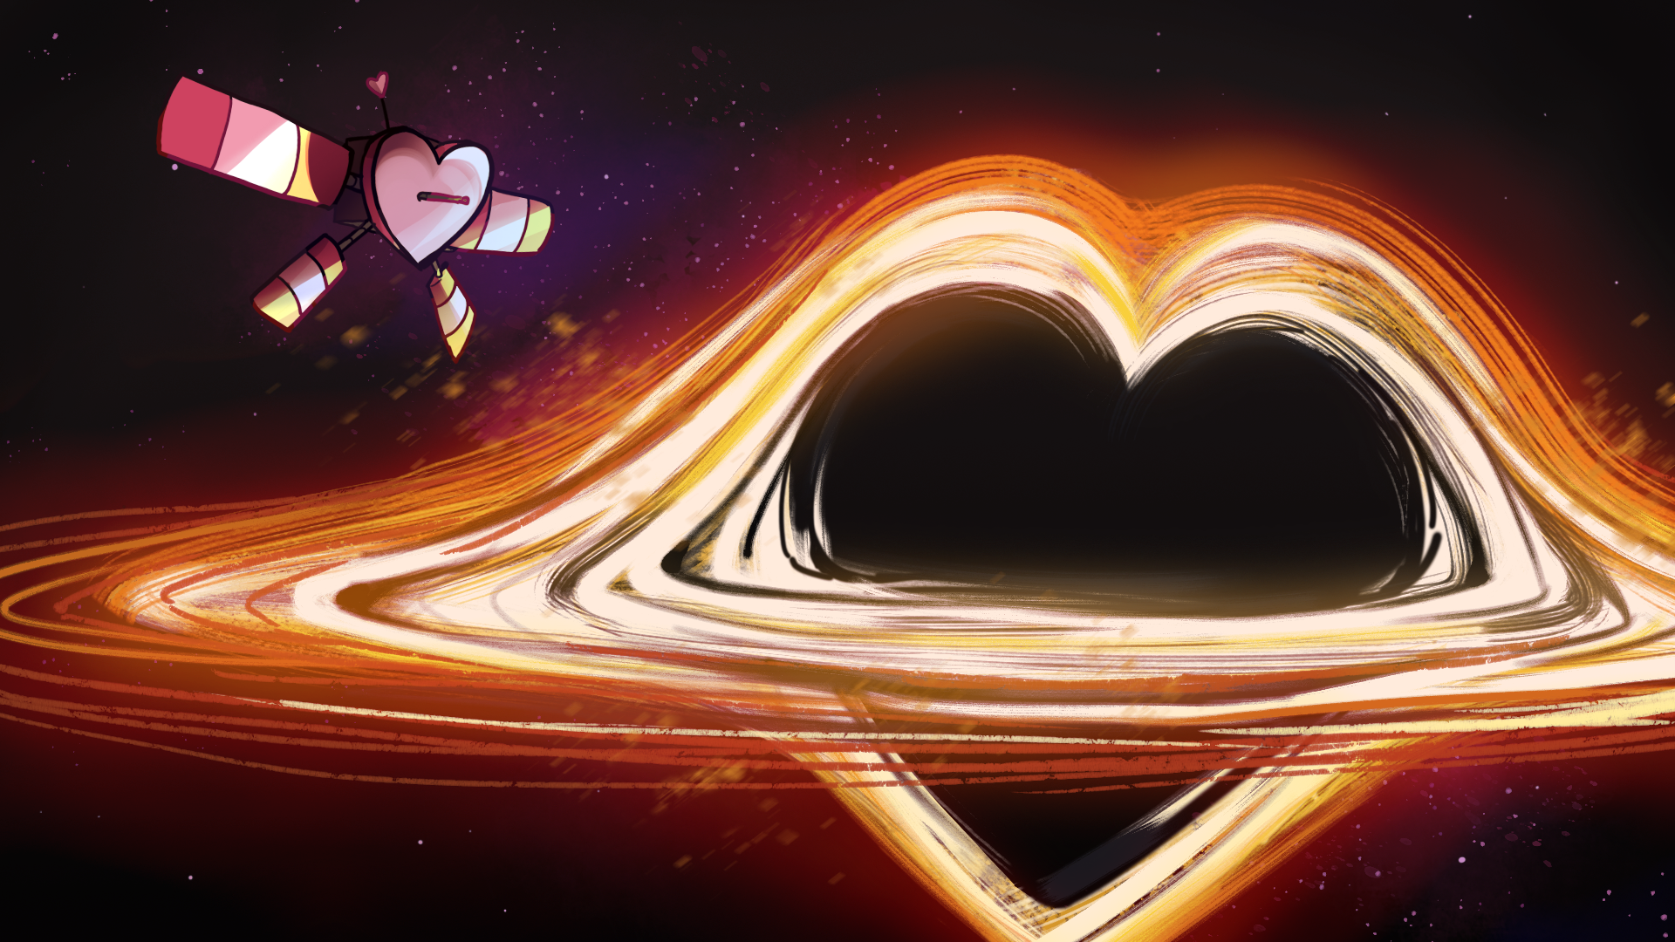
The Bigger the Heart,
the Bigger the Attraction
Relative Gravity and Gravitational Force

Slide 3
Essential Question
How do physical properties influence gravitational interactions?

Slide 4
Learning Objectives
Construct and present arguments using evidence to support the claim that gravitational interactions depend on the masses of interacting objects.

Slide 5
Love Letters to Earth
“Even if Earth didn’t have gravity,
I’d still fall for you.”
On your paper, explain why this line is funny. You may also write if you think your crush would like it or not.

Slide 6
Black Hole vs. Sun
Respond to the following question in the left column of your handout:
How does the sun compare to a black hole? Explain your thinking.
Notes:
K20 Center. (n.d.). Claim, evidence, reasoning (CER). Strategies. https://learn.k20center.ou.edu/strategy/156
Puiu, T. (2017, March 16). The mass of a supermassive black hole relative to the Sun explained in one crazy GIF [GIF]. ZME Science. https://www.zmescience.com/space/supermassive-black-hole-vs-sun/

Slide 7
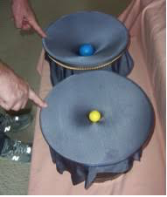
Gravity Bucket Lab
Conduct the lab using the procedures outlined in your handout.
Document as many observations as possible.
Notes:
NASA. (2008, October 20). BHBuckets2 [Photograph]. NASA. https://nightsky.jpl.nasa.gov/news/398/

Slide 8
Talk & Think it Out
How was gravity represented in this lab?
What factors influence the amount of gravity?
How do your responses to Question 2 in Stage 2 influence the amount of gravity?
Why did we use the gravity bucket model of the solar system instead of observing the solar system?
How did this lab change the way you think about the solar system?

Slide 9
Always, Sometimes, or Never True
Read the statements and determine the level of truth for each. Categorize each statement as one of the following:
Always true
Sometimes true
Never true
Some statements may be difficult to evaluate. Attempt to answer each one. It is okay if your response is incorrect.
Notes:
K20 Center. (n.d.). Always, sometimes, or never true. Strategies. https://learn.k20center.ou.edu/strategy/145

Slide 10
How Do the Planets Measure Up?
Compare the data of the planets in the solar system and respond to the questions on your handout.
Re-read the statements on your Always, Sometimes, or Never True handout. Did you change your answer to any of the statements? Are some statements easier to evaluate now?

Slide 11
Always, Sometimes, or Never True
As the ball dipped farther into the bucket, its gravitational pull lowered.
Always Sometimes Never
Notes:
K20 Center. (n.d.). Always, sometimes, or never true. Strategies. https://learn.k20center.ou.edu/strategy/145

Slide 12
Always, Sometimes, or Never True
As the ball dipped farther into the bucket, its gravitational pull lowered.
Always Sometimes Never
Reasoning: The steel ball, which was the heaviest, dipped lower into the bucket.
Notes:
K20 Center. (n.d.). Always, sometimes, or never true. Strategies. https://learn.k20center.ou.edu/strategy/145

Slide 13
Always, Sometimes, or Never True
When a heavy ball and a light ball were in the gravity bucket, the light ball rolled toward the heavy ball.
Always Sometimes Never
Notes:
K20 Center. (n.d.). Always, sometimes, or never true. Strategies. https://learn.k20center.ou.edu/strategy/145

Slide 14
Always, Sometimes, or Never True
When a heavy ball and a light ball were in the gravity bucket, the light ball rolled toward the heavy ball.
Always Sometimes Never
Reasoning: Although the light ball typically rolled toward the heavy ball, and the heavy ball never rolled toward the light ball, sometimes the two balls were too far apart to roll together and would sit still in the bucket.
Notes:
K20 Center. (n.d.). Always, sometimes, or never true. Strategies. https://learn.k20center.ou.edu/strategy/145

Slide 15
Always, Sometimes, or Never True
Black holes have a higher gravitational pull than the sun.
Always Sometimes Never
Notes:
K20 Center. (n.d.). Always, sometimes, or never true. Strategies. https://learn.k20center.ou.edu/strategy/145

Slide 16
Always, Sometimes, or Never True
Black holes have a higher gravitational pull than the sun.
Always Sometimes Never
Reasoning: It was easier to make objects orbit the baseball rather than the steel ball.
Notes:
K20 Center. (n.d.). Always, sometimes, or never true. Strategies. https://learn.k20center.ou.edu/strategy/145

Slide 17
Always, Sometimes, or Never True
Gravity is greater when objects are closer in distance to each other.
Always Sometimes Never
Notes:
K20 Center. (n.d.). Always, sometimes, or never true. Strategies. https://learn.k20center.ou.edu/strategy/145

Slide 18
Always, Sometimes, or Never True
Gravity is greater when objects are closer in distance to each other.
Always Sometimes Never
Reasoning: Things close together always rolled together.
Notes:
K20 Center. (n.d.). Always, sometimes, or never true. Strategies. https://learn.k20center.ou.edu/strategy/145

Slide 19
Always, Sometimes, or Never True
Objects with greater volume have greater gravitational pull.
Always Sometimes Never
Notes:
K20 Center. (n.d.). Always, sometimes, or never true. Strategies. https://learn.k20center.ou.edu/strategy/145

Slide 20
Always, Sometimes, or Never True
Objects with greater volume have greater gravitational pull.
Always Sometimes Never
Reasoning: Gravity is related to mass, but heavy things could be big. The baseball had more mass than the steel ball, as well as more volume.
Notes:
K20 Center. (n.d.). Always, sometimes, or never true. Strategies. https://learn.k20center.ou.edu/strategy/145

Slide 21
Always, Sometimes, or Never True
Objects with greater mass have a greater gravitational pull.
Always Sometimes Never
Notes:
K20 Center. (n.d.). Always, sometimes, or never true. Strategies. https://learn.k20center.ou.edu/strategy/145

Slide 22
Always, Sometimes, or Never True
Objects with greater mass have a greater gravitational pull.
Always Sometimes Never
Reasoning: Everything rolled quickly toward the steel ball, but if the distance had been greater, this might not have been the case.
Notes:
K20 Center. (n.d.). Always, sometimes, or never true. Strategies. https://learn.k20center.ou.edu/strategy/145

Slide 23
Always, Sometimes, or Never True
Distance influences the gravitational pull between two objects.
Always Sometimes Never
Notes:
K20 Center. (n.d.). Always, sometimes, or never true. Strategies. https://learn.k20center.ou.edu/strategy/145

Slide 24
Always, Sometimes, or Never True
Distance influences the gravitational pull between two objects.
Always Sometimes Never
Reasoning: In the table, the closer the planet, the faster it orbited around the Sun.
Notes:
K20 Center. (n.d.). Always, sometimes, or never true. Strategies. https://learn.k20center.ou.edu/strategy/145

Slide 25
Always, Sometimes, or Never True
Mass influences the gravitational pull between two objects.
Always Sometimes Never
Notes:
K20 Center. (n.d.). Always, sometimes, or never true. Strategies. https://learn.k20center.ou.edu/strategy/145

Slide 26
Always, Sometimes, or Never True
Mass influences the gravitational pull between two objects.
Always Sometimes Never
Reasoning: In the table, Jupiter had a lot of mass and a lot of gravity.
Notes:
K20 Center. (n.d.). Always, sometimes, or never true. Strategies. https://learn.k20center.ou.edu/strategy/145

Slide 27
Build Your CER
Claim: Write a statement about the difference between the gravitational pull of the sun compared to that of a black hole.
Evidence: Provide 2–3 examples of observations from the lab or class activities that support your claim.
Reasoning: Use scientific terminology and explanations to explain how your evidence supports your claim.
Notes:
K20 Center. (n.d.). Claim, evidence, reasoning (CER). Strategies. https://learn.k20center.ou.edu/strategy/156
Puiu, T. (2017, March 16). The mass of a supermassive black hole relative to the Sun explained in one crazy GIF [GIF]. ZME Science. https://www.zmescience.com/space/supermassive-black-hole-vs-sun/

