Slide 2
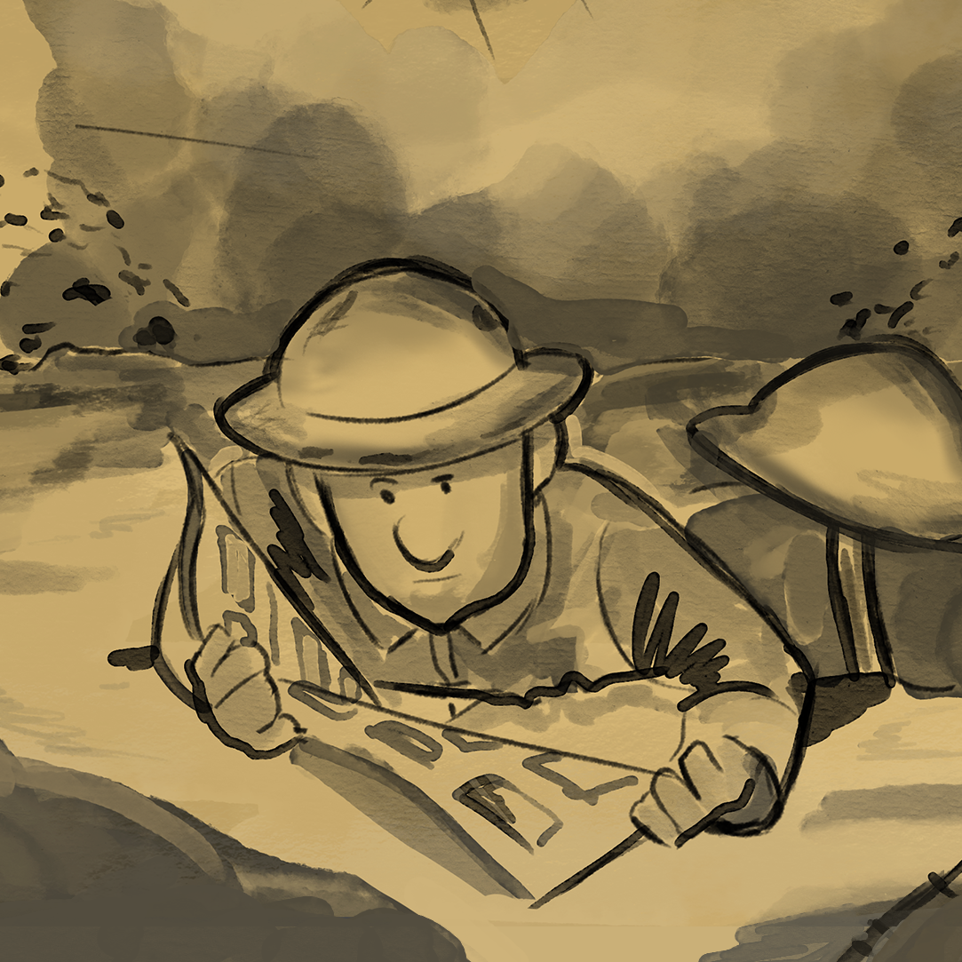
The M.A.I.N. Cartoons of
World War I
Understanding the Causes
of World War I

Slide 3
Essential Questions
What were the causes of World War I?
Why were so many nations involved in World War I?

Slide 4
Learning Objective
Analyze the factors that led to the First World War.

Slide 5
Think and Respond
What causes a nation to go to or participate in a war?
  Write a response on the sticky note and place it on the board.

Slide 6

Causes of World War I Card Sort
Sort each card into one of the four categories:
  Militarism
  Alliances
  Imperialism
  Nationalism
Notes:
K20 Center. (n.d.). Card sort. Strategies. https://learn.k20center.ou.edu/strategy/147

Slide 7

T.A.C.O.S. Cartoon Analysis
Time period: Identify the time period and region the cartoon takes place in.
Action: Describe what is happening in the cartoon.
Caption: If there is a caption, write it down.
Objects: List the different objects in the cartoon, including any symbols shown or colors used.
Summary: Write one sentence that summarizes the meaning of the cartoon.
Notes:
K20 Center. (n.d.). T.A.C.O.S. Strategies. https://learn.k20center.ou.edu/strategy/1196

Slide 8

Anchor Chart Creation
Design an anchor chart that includes the following:
  The political cartoon your group analyzed
  The country, or countries, represented in your cartoon
  The overall meaning of the political cartoon
  The M.A.I.N. category the cartoon fits into
  How this cartoon explains a cause of World War I
Anchor charts should use a variety of colors and include images.
Notes:
K20 Center. (n.d.). Anchor chart. Strategies. https://learn.k20center.ou.edu/strategy/58

Slide 9
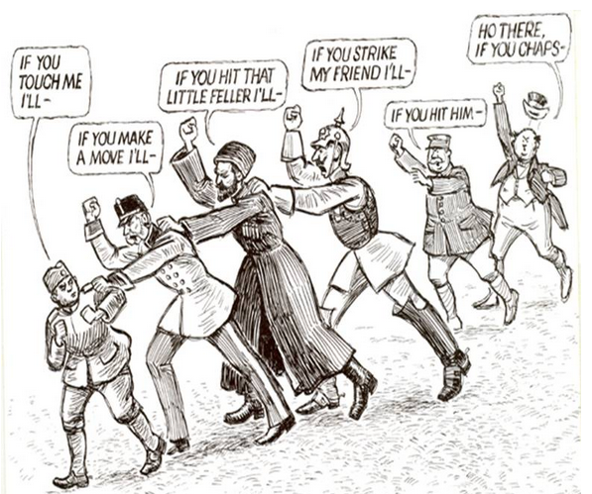
Notes:
Harding, N. (1912). A threatening situation [Cartoon]. Wikimedia Commons. https://commons.wikimedia.org/wiki/File:Chain_of_Friendship_cartoon.jpg

Slide 10
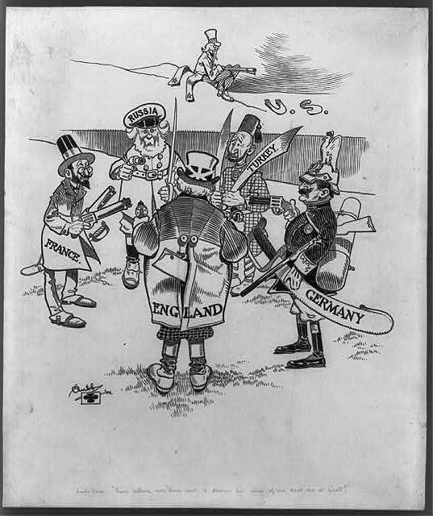
Notes:
Clubb, J. S. (1906). Uncle Sam: “Them fellers over there want to disarm but none of ‘em dast do it first!” [Cartoon]. Library of Congress. https://www.loc.gov/resource/cph.3b30703/?st=list

Slide 11
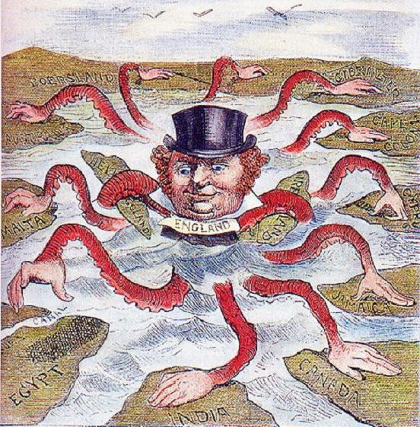
Notes:
Bull, J. (1882). The devilfish in Egyptian waters [Cartoon]. Wikimedia Commons. https://commons.wikimedia.org/wiki/File:English_imperialism_octopus.jpg

Slide 12
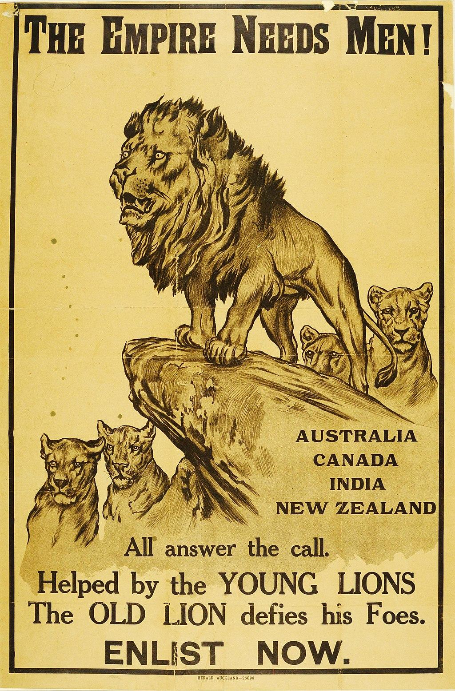
Notes:
Wardle, A. (1915). The Empire needs men! [Poster]. National Army Museum. https://collection.nam.ac.uk/detail.php?acc=2005-11-219-1

Slide 13
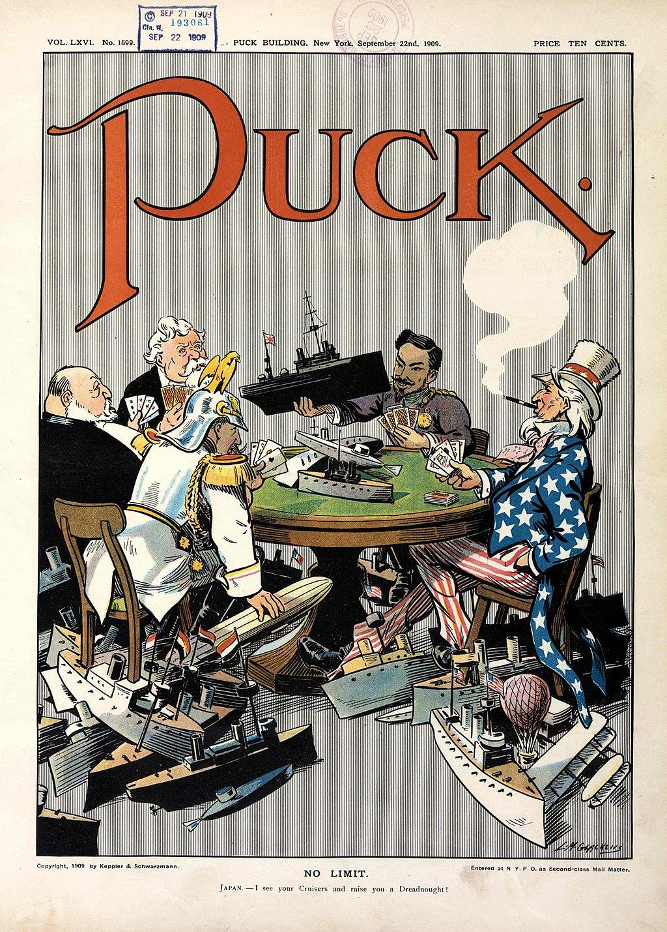
Notes:
Glackens, L. M. (1909). No limit [Cartoon]. Library of Congress. https://www.loc.gov/pictures/item/2011647506/

Slide 14
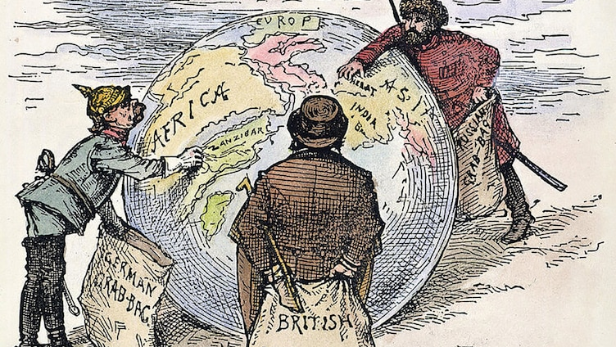
Notes:
Nast, T. (1885). The world’s plunderers [Cartoon]. Wikimedia Commons. https://commons.wikimedia.org/wiki/File:Imperialism_1885.jpg

Slide 15
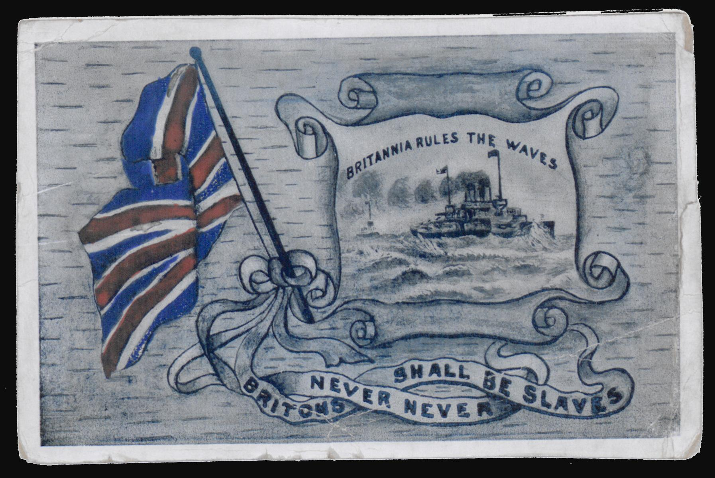
Notes:
Ingram, W. J. (1914). Britannia rules the waves [Cartoon]. British Library. https://searcharchives.bl.uk/catalog/040-002350814

Slide 16
Discuss
Which of the M.A.I.N. categories may have been the most important factor in leading to war?
If one of the M.A.I.N. categories wasn’t a factor, would the war still have occurred?
Which categories of M.A.I.N. can be seen in our world today? Do they create a cause for concern?

