Slide 2
She Sells Seashells by the Seashore
Biology

Slide 3
Essential Question
What principles help provide evidence of evolution among organisms?

Slide 4
Lesson Objectives
After this lesson, we will be able to:
Evaluate claims that changes in the environment can affect survival strategies of populations.
Use evidence to show how adaptation leads to differentiation in organisms’ reproduction and survival.
Analyze evidence to predict how changes in a population’s genes can alter its reproduction and survival.
Evaluate evidence to predict how changes to the environment can affect the fitness of a species.
Explain how selection pressures and adaptations can affect the earth’s biodiversity.

Slide 5
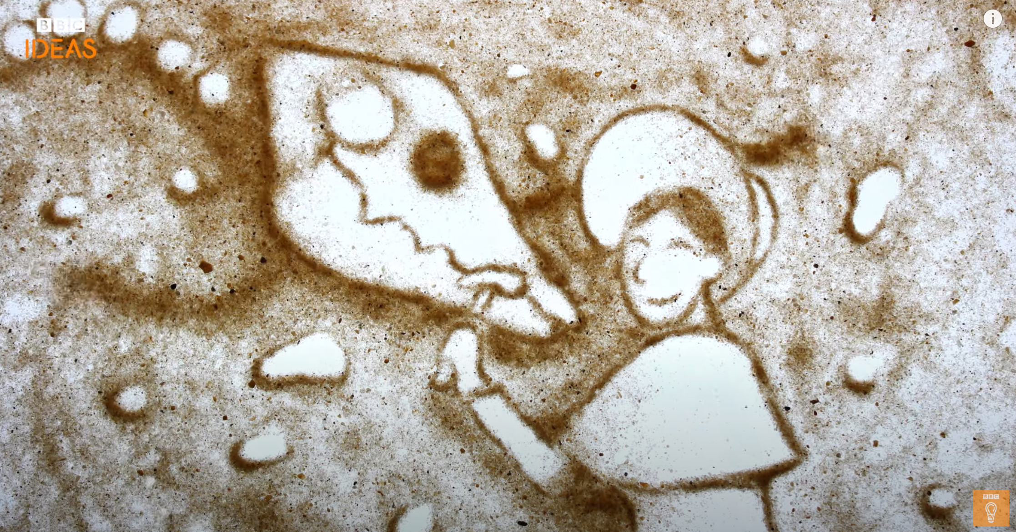
The True Story of Mary Anning
Notes:
Video Source: BBC Ideas. (2019, March 27). The true story of Mary Anning: The girl who helped discover dinosaurs | BBC Ideas [Video]. YouTube. https://www.youtube.com/watch?v=BEbgTpdwRgI

Slide 6
Six-Word Memoir
Imagine that you work at a museum and want to let people know about your new Mary Anning exhibit.
Write a Six-Word Memoir to attract others to this exhibit, paying special attention to Anning’s contribution to evolution.
After all memoirs have been submitted, vote by liking the memoir you think is the most intriguing to attract you to the exhibit.
Notes:
You could have them vote in a group of four, then the winners from that vote be voted by the class. You could also have students post their 6 word memoir in an online discussion doc/forum and have them vote.
Consider placing an image of Mary Anning in the class or outside the classroom door with the winner’s memoir in bold above it.

Slide 7
Ancient Whale Bones
Notes:
Video Source: National Geographic. (2020). Ancient whale bones | National Geographic [Video]. YouTube. https://www.youtube.com/watch?v=WK8i8_qsWjo
Make copies and pass out the video questions for learners to answer along with the video.

Slide 8
Card Sort
Match each definition with the image or graph you believe it is best associated with.
We will review the answers later in the lesson.
Notes:
Print and cut out card sort, place them into bags, place students into groups of 4, and inform learners to not open bag until instructions are given.

Slide 9
Evolution Presentations
Seven principles of evolution
Fossils
Homologous Structures
Analogous Structure
Vestigial Structures
Embryology
Biochemistry
DNA Technology
Three types of selection
Stabilizing Selection (Genetic Equilibrium)
Directional Selection
Disruptive Selection

Slide 10
Evolution Presentations
With your group, research the principle of evolutionary reconstruction or type of evolutionary selection that you are assigned.
Fill out the Evolution Research Notes handout with the details of your research and turn it in to your teacher for approval.
Once approved, create a slide to summarize your research. Make sure to include both images and text on your slide.
Notes:
You will need to compile the slides in the order you want them to present each term. Review presentation etiquette before presentation. You may even consider adding a slide on making sure learners know the terms: evolution, species, biodiversity and adaptation.

Slide 11
Get Ready To Race!
Go to blooket.com/play or use the QR code to the right.
Enter the Game ID.
Try to get as many questions correct as quickly as you can to outscore your classmates and win the race.
[Replace this QR code with your own.]

Slide 12
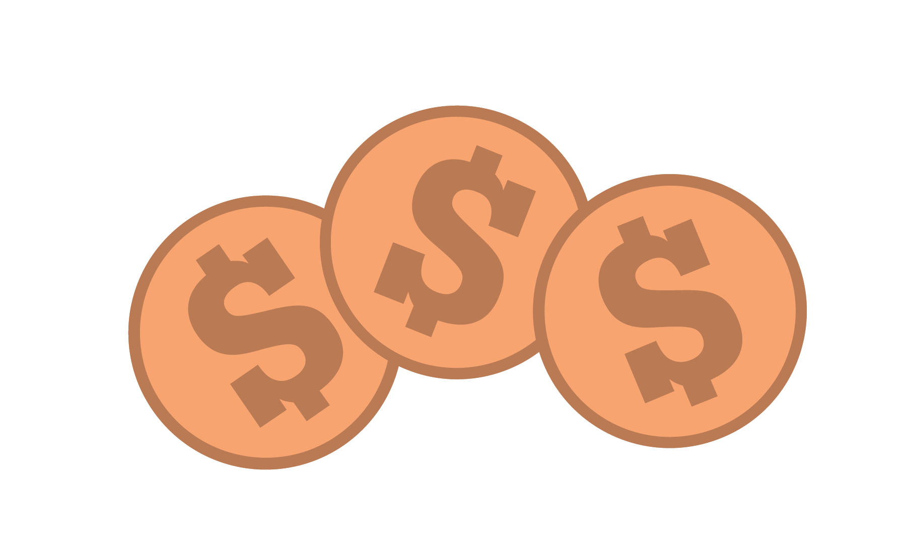
Spend A Buck
Go to menti.com or use the QR code to the right.
Enter the class code.
The seven principles of evolution and three types of selection are listed. Distribute your 100 points across all 10 based on where you believe the evolution of the whale from the Ancient Whale video falls.
Notes:
Instructions for how to set up a mentimenter can be found here on the K20 website.

Slide 13
Discussion Board
Review the questions that you and your classmates asked about the Ancient Whale video.
On a piece of paper, indicate which one of the questions you will answer
Write a three- or five-sentence answer based on:
your top 2 choices you had in the spend-a buck; and
how it overall relates to environmental pressures effects on biodiversity on Earth.
Notes:
Display the list of questions that you compiled from the end of the ancient whale video to the students. After giving some wait time for students to record their thought, have them share out their responses and add to others.

