Slide 2
Journey of the Isolated Variable, Part 4
Absolute Value Equations

Slide 3
Essential Question
How do you solve one-variable absolute value equations?

Slide 4
Lesson Objective
Solve absolute value equations with one variable.

Slide 5

Collective Brain Dump
On the Engage handout, list everything you
know about the terms “equations” and “absolute value.”
  You may use words, drawings, examples, etc.
In a small group, compare your lists.
  Add new information to your list as each group member shares.
Notes:
K20 Center. (n.d.). Collective brain dump. Strategies. https://learn.k20center.ou.edu/strategy/111

Slide 6
Class List
Equations | Absolute Value

Slide 7
Desmos
Navigate to student.desmos.com.
Enter the code: INSERT DESMOS CODE
Read each screen and answer the questions.
On your Explore Activity handouts, explain your thought process and why you moved the sliders on screens 12–16.
Notes:
Teacher’s Note: Prior to the lesson, visit the activity linked in the Explore phase and obtain an invitation code. Paste the code in place of the highlighted text above.

Slide 8
Class Discussion
What key details helped you determine where the sliders should be moved?
Why do you think those details are important?
How might one solve the problems in a different way?

Slide 9
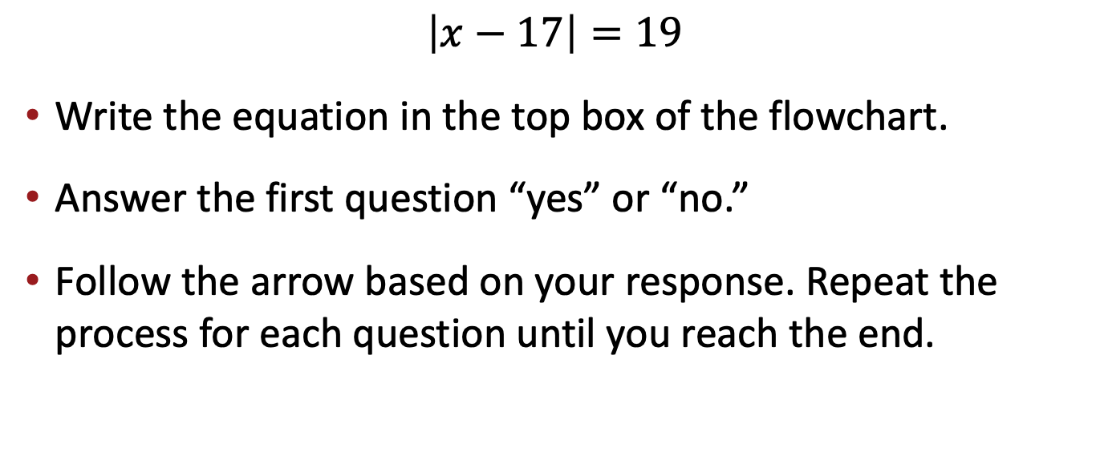
Absolute Value Equations: Flowchart
$$\left|x−17\right|=19$$
Write the equation in the top box of the flowchart.
Answer the first question “yes” or “no.”
Follow the arrow based on your response. Repeat the process for each question until you reach the end.

Slide 10

Absolute Value Equations: Example 2
$$\left|x+2\right|=5$$

Slide 11

Absolute Value Equations: Example 3
$$\left|−3x+1\right|+12=8$$

Slide 12

Absolute Value Equations: Example 4
$$2\left|3x−4\right|−8=6$$

Slide 13

Absolute Value Equations: Example 5
$$−3\left|2x+1\right|−3=−9$$

Slide 14
Find the Error
Complete the following tasks for each problem:
Identify the error in solving the absolute value equation.
Correct the error by demonstrating the correct steps.
Explain how and why one might have made that error.
Justify the correct answer and steps.

Slide 15
Group Verification
Find two other pairs of students and form a group of 6.
Sort your papers into three stacks: Problem 1, Problem 2, and Problem 3.
Have two people in your group check the four steps on Problem 1, have two different people check the four steps on Problem 2, and have another pair check the four steps on Problem 3.
Compare and discuss how each pair in your group corrected the same mistake.

Slide 16

Exit Ticket
Read the four types of equations. For each equation:
Solve the example.
Justify how you solved it.
Explain what is unique about that type of equation.
Notes:
K20 Center. (n.d.). Bell ringers and exit tickets. Strategies. https://learn.k20center.ou.edu/strategy/125

