Slide 2
Journey of the Isolated Variable, Part 2
Solving Multi-Step Equations

Slide 3
Essential Question
How do I isolate a variable in a multi-step equation?

Slide 4
Lesson Objective
We will be able to solve multi-step equations by applying algebraic properties and properties of rational numbers.

Slide 5
Picture Notes
Independently, generate your own definitions of each term by creating a sketch, a statement, or an example.
Do the best you can. If you do not know the meaning of a term, do not look at your neighbor’s work.
We will come back to this activity later.
Notes:
K20 Center. (n.d.). Picture Notes. Strategies. https://learn.k20center.ou.edu/strategy/104

Slide 6
Desmos: Smallest Solution
Navigate to student.desmos.com.
Enter code.
Complete each screen and practice solving equations with variables on both sides.
Your mission is to create an equation that has the smallest possible solution for x.
Write your equations on the Note Catcher handout.

Slide 7
Think-Pair-Share Discussion
Individually, start to think about why you believe your equation has the smallest solution.
Find a partner. Share your equations, and then discuss which equation you want to present to the whole class.
Share your chosen equation with the class. We will vote for the best equation!
Notes:
K20 Center. (n.d.). Think-Pair-Share. Strategies. https://learn.k20center.ou.edu/strategy/139

Slide 8
Just Give Me a Reason
Work together to solve each equation.
Write the first step for solving the problem in the Process column and explain what you did in the Reason column.
One person starts Problem 1 while the other starts Problem 2.
Once you complete the first step, trade papers, and complete the second step.
Continue until the problem is solved.
Notes:
K20 Center. (n.d.). Pass the Problem. Strategies. https://learn.k20center.ou.edu/strategy/151

Slide 9
Just Give Me a Reason: Step 1
Show all of your work for each solving step. Then write your reasoning.
Step 1) Draw the number of x’s you have on each side.
 | Process | Reason
Step 1 |  | modeling the equation
Notes:
K20 Center. (n.d.). Pass the Problem. Strategies. https://learn.k20center.ou.edu/strategy/151

Slide 10
Just Give Me a Reason
Trade problems.
Check your partner’s work and reasoning.
Complete the next step and write your reasoning.
Show your work.
Repeat until the problem is solved.
Notes:
K20 Center. (n.d.). Pass the Problem. Strategies. https://learn.k20center.ou.edu/strategy/151

Slide 11
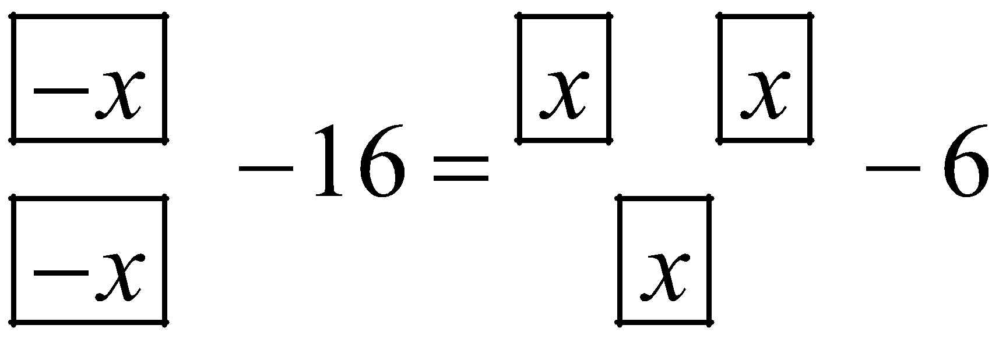
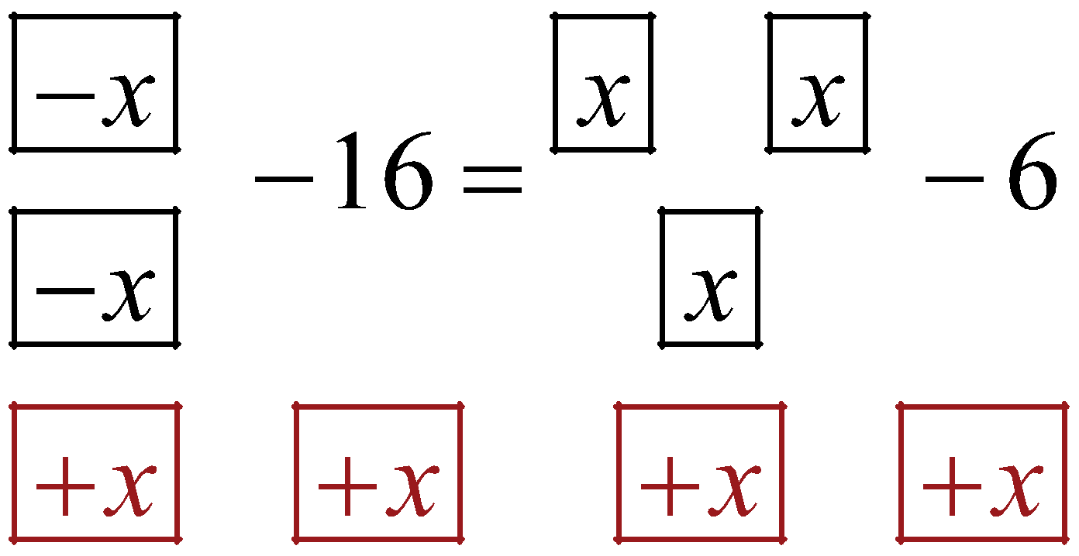
Sample Response: Steps 1–2
 | Process | Reason
Step 1 |  | modeling the equation
Step 2 |  | addition property of equality
Notes:
K20 Center. (n.d.). Pass the Problem. Strategies. https://learn.k20center.ou.edu/strategy/151

Slide 12
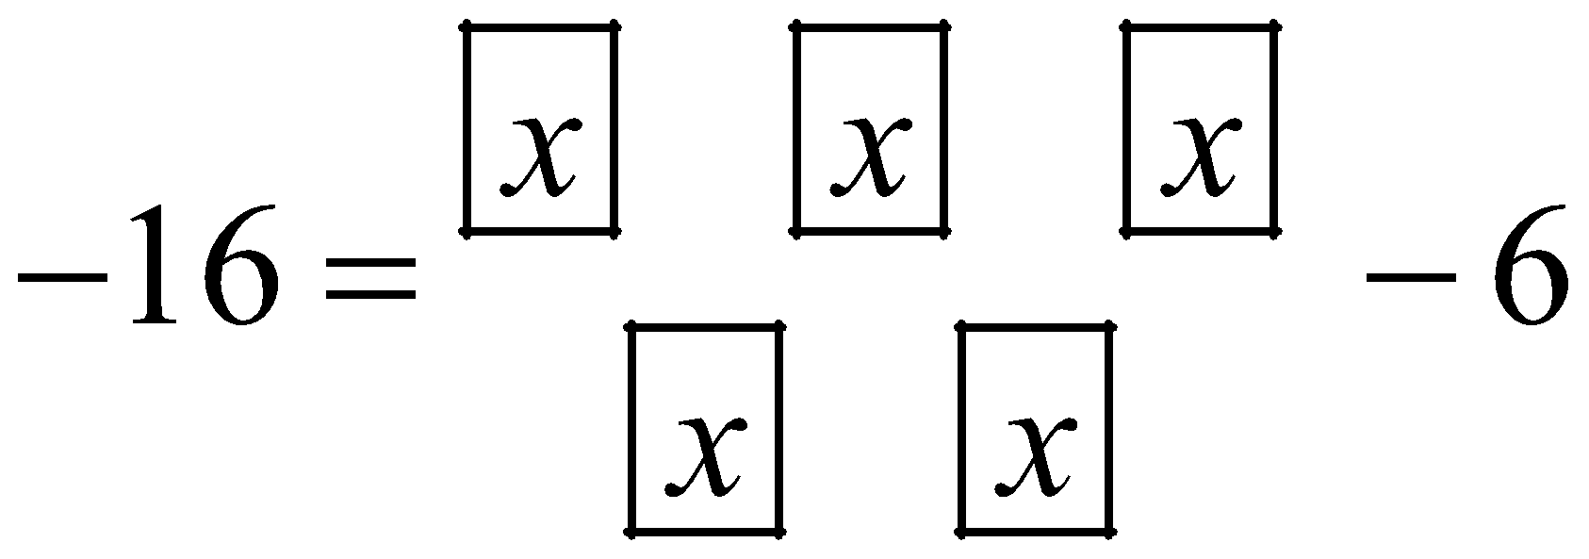
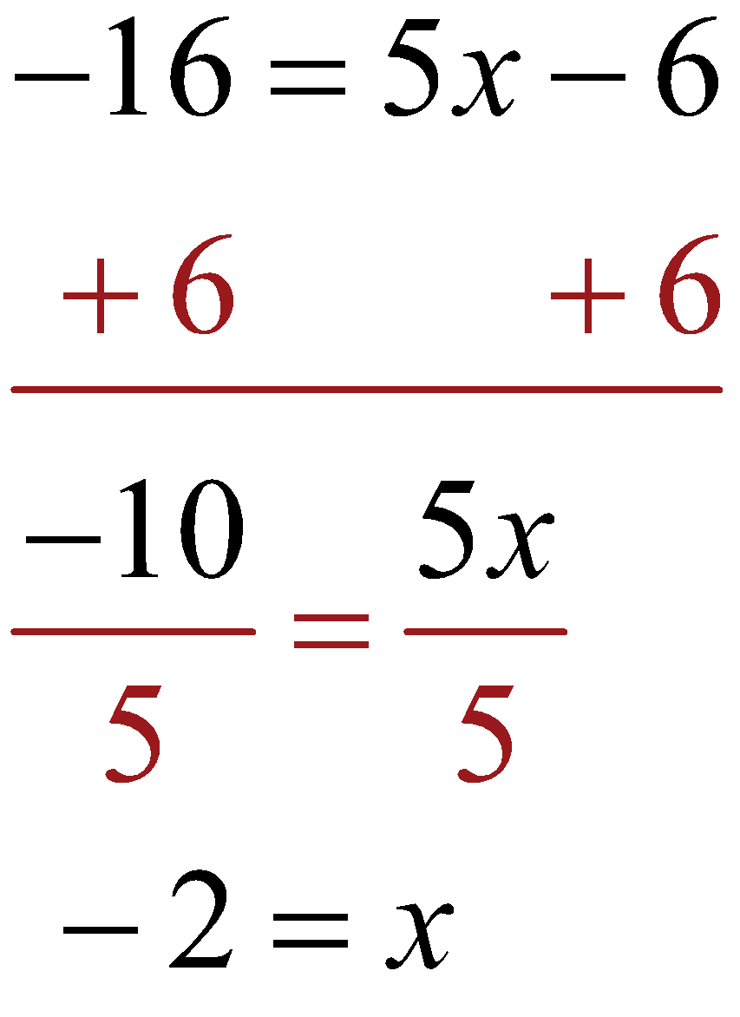
Sample Response: Steps 3, 4, …
 | Process | Reason
Step 3 |  | simplify
Step 4 And Finish |  | addition property of equality division property of equality
Notes:
K20 Center. (n.d.). Pass the Problem. Strategies. https://learn.k20center.ou.edu/strategy/151

Slide 13
Just Give Me a Reason: Problem 3
Work with your partner to solve Problem 3.
Show your work for each step and write your reasoning.
What is different about Problem 3?
Notes:
K20 Center. (n.d.). Pass the Problem. Strategies. https://learn.k20center.ou.edu/strategy/151

Slide 14
Solving Multi-Step Equations: Flowchart

Slide 15
Solving Multi-Step Equations: Example 2
GUS Method
G—Guessed U—Unsure S—Sure
Notes:
K20 Center. (n.d.). GUS Method. Strategies. https://learn.k20center.ou.edu/strategy/76

Slide 16
Solving Multi-Step Equations: Example 3
GUS Method
G—Guessed U—Unsure S—Sure
Notes:
K20 Center. (n.d.). GUS Method. Strategies. https://learn.k20center.ou.edu/strategy/76

Slide 17
Solving Multi-Step Equations: Example 4
GUS Method
G—Guessed U—Unsure S—Sure
Notes:
K20 Center. (n.d.). GUS Method. Strategies. https://learn.k20center.ou.edu/strategy/76

Slide 18
Picture Notes: Revisit
Is there anything you need to add to your Picture Notes or change based on what you have learned so far?
Consult with your classmates regarding any boxes where you are missing a definition.
Are there any words that you are still not sure about?
Notes:
K20 Center. (n.d.). Picture Notes. Strategies. https://learn.k20center.ou.edu/strategy/104

Slide 19
Drive-in Movie Theater
If you were the owner, what would you spend money on?
What if you were a customer?
Notes:
Spielventure. (2020). Winchester drive-in theatre [Oklahoma City]. [Video]. YouTube. https://youtu.be/S5FP28yDChI?si=k5zajTEF9VSKE8zT

Slide 20
Word Problem Example
The state fair offers a discount for group admission. A group of 25 kids purchased 25 passes and 25 concert tickets. Each concert ticket costs $15. The total cost of the group’s admission is $512.50. Find the cost of each pass.

Slide 21
Create Your Own Problem
After each round, you move stations, your paper does not.
Round 1: Write 1 story problem with the template.
Round 2: Write 1 story problem on your own.
Round 3: Write the algebraic equation for each of the 2 story problems.
Round 4: Check then solve the equations.
Round 5: Check the solution using substitution.
Round 6: Review the work of your peers.

Slide 22
Exit Ticket
Use what you have learned in this lesson to answer the So Many Snacks question on your handout.
How many Gatorades did they sell?
Notes:
K20 Center (n.d.). Bell Ringers and Exit Ticket. Strategies. https://learn.k20center.ou.edu/strategy/125

