Slide 2
Hexomino Hullabaloo
Area, Perimeter, Spatial Reasoning, and Patterns

Slide 3
Essential Question
What relationships exist between the areas and perimeters of all possible formations of hexominoes?

Slide 4
Lesson Objectives
Use spatial reasoning skills to find all possible hexomino formations and categorize them.
Calculate the perimeter and area of each hexomino to recognize and analyze the patterns that emerge.

Slide 5
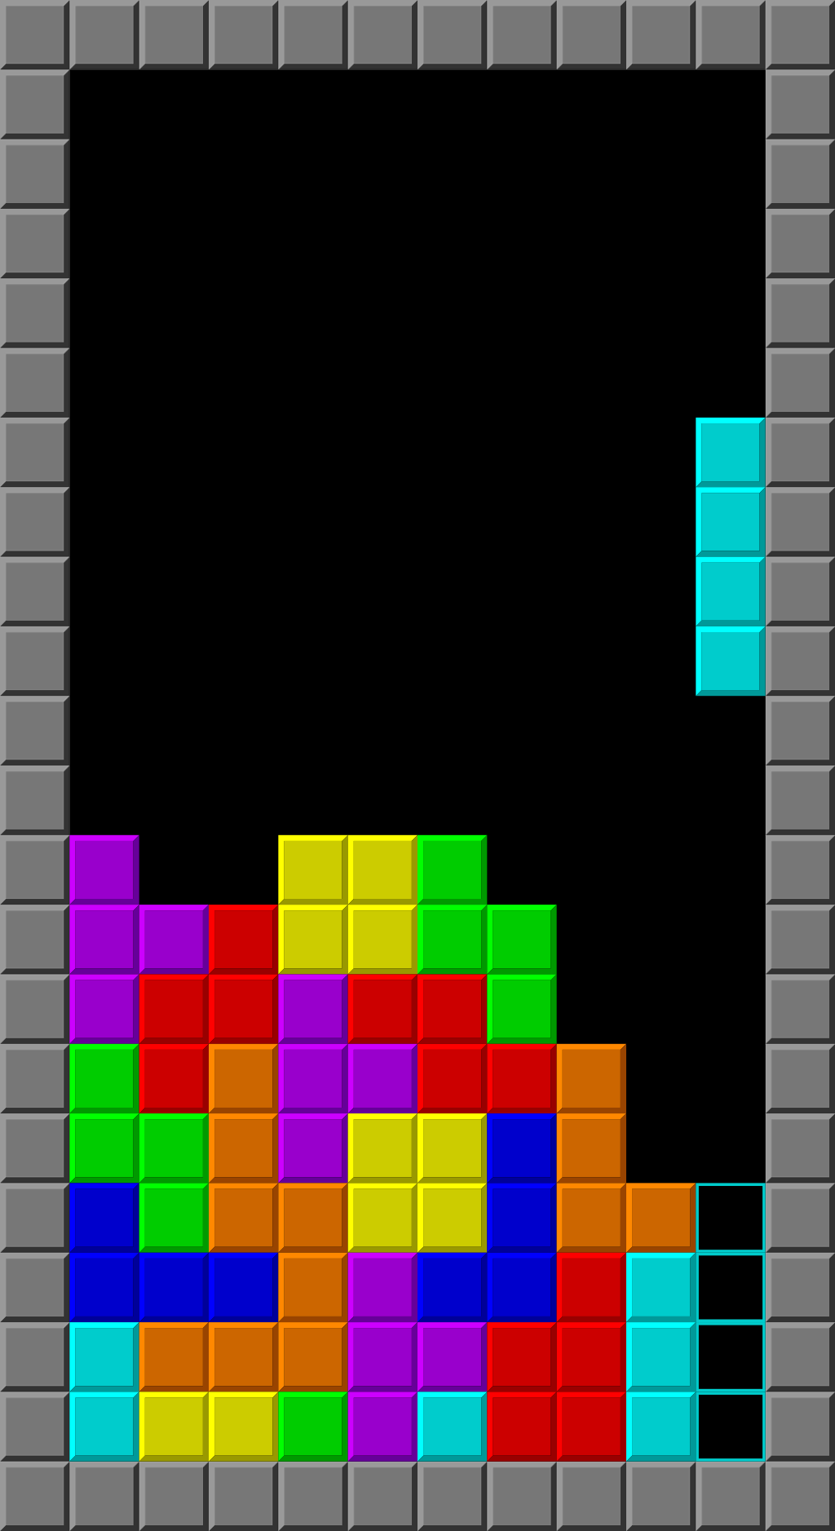
Tetris
Tetris was invented in 1984 by a Russian game designer.
The game’s name is derived from the Greek prefix “tetra,” which means “four.”
Notes:
Image source:
Brandenads. (2020, May 28). Typical Tetris Game [Image]. Wikimedia Commons. https://commons.wikimedia.org/wiki/File:Typical_Tetris_Game.svg

Slide 6
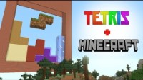
Notes:
Play the video on the slide or go to the following link to play the video: https://www.youtube.com/watch?v=vzw0wnPiukQ
Video source:
Pacckker. (2019, August 9). Tetris in Minecraft (Stop Motion) [Video]. YouTube. https://www.youtube.com/watch?v=vzw0wnPiukQ

Slide 7
The Name of the Game
Why do you think the inventor of Tetris used the prefix “tetra” to name the game?

Slide 8

How many types of Tetris pieces are there?
Think to yourself for a minute.
Pair up with an elbow partner to discuss your thoughts.
Share with the whole class what you discussed with your partner.
Notes:
K20 Center. (n.d.). Think-Pair-Share. Strategies. https://learn.k20center.ou.edu/strategy/139

Slide 9
Hexomino Exploration
With a partner, work to discover all possible formations of hexominoes.
  You can draw them, use manipulatives to create them, or find another creative way to display them.
Notes:
Pass out the Hexomino Exploration handout.

Slide 10
3-2-1
In groups of four, discuss:
  Three things you found interesting about this investigation.
  Two observations about how your peers sorted their hexominoes.
  One question you still have.
How do you know that you have found all possible formations of hexominoes?
Notes:
K20 Center. (n.d.). 3-2-1. Strategies. https://learn.k20center.ou.edu/strategy/117

Slide 11
Perimeter, Area, and Patterns
Calculate the perimeter of each hexomino.
  Organize the hexominoes into categories based on perimeter.
Calculate the area of each hexomino.
  Organize the hexominoes into categories based on area.
When folded, which hexominoes form cubes?
Notes:
Pass out the Hexomino Extension handout.

Slide 12
Exit Ticket
Reflect on the activity and answer the following questions on a sticky note:
How am I feeling?
What am I thinking?
Notes:
K20 Center. (n.d.). Bell ringers and exit tickets. Strategies. https://learn.k20center.ou.edu/strategy/125
K20 Center. (n.d.). How am I feeling? What am I thinking? Strategies. https://learn.k20center.ou.edu/strategy/187

