Slide 2
People Here, People There, People, People Everywhere
Population Density of Japan

Slide 3
Essential Questions
Can too many people live in one area?
How does city planning help accommodate large numbers of people living in one area?

Slide 4
Lesson Objectives
Recognize and describe the relationship between population density and the geography of an area.
Identify examples of how city planning can accommodate the needs of people within densely populated areas.

Slide 5
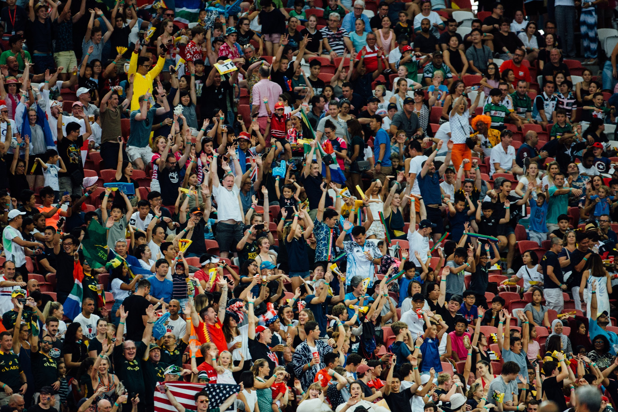
Notes:
Lu, Hanson. (2019, May 17). People lot photo [Photograph]. Unsplash. https://unsplash.com/photos/people-lot-WrNbw7UeNq

Slide 6
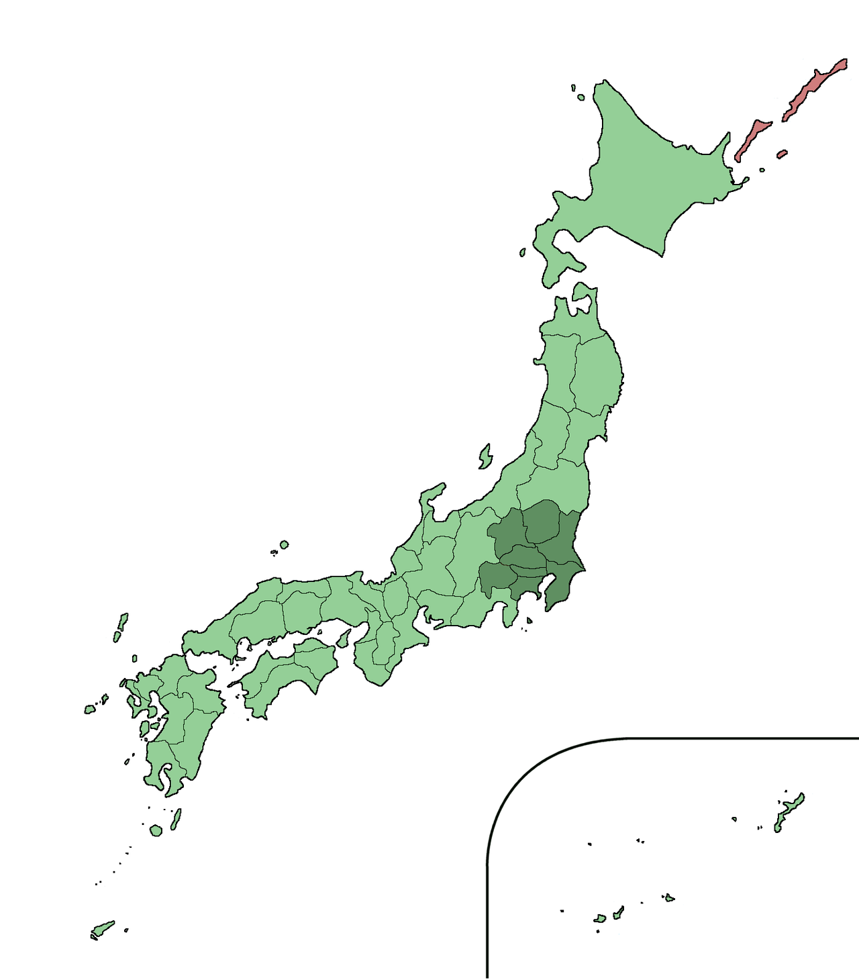
Population Facts
Total population of Japan: 126.8 million
Tokyo Metropolis: 13 million
Greater Tokyo Area: 38 million within 5,200 square miles
Population density: 7,307 per sq. mile
Notes:
Qrsk075. (2011, June 18). Location of greater Tokyo area [Image]. Wikimedia Commons. https://commons.wikimedia.org/wiki/File:Greater_Tokyo_Area.png

Slide 7
Pictures of Tokyo
Picture 1
Picture 2
Picture 3
Notes:
Teacher’s Note: Picture 2 links out to a complete article. Scroll down to item number 8 in the article to show students the picture of the 9h Capsule Hotel beds.
Chris 73. (2007). Rush hour at Ueno Station in Tokyo, 2007 [Photograph]. Wikimedia Commons. https://en.wikipedia.org/wiki/Passenger_pusher#/media/File:Rush_hour_at_Ueno_02.JPG
Crowe, R. (2018). 10 unique capsule hotels in Tokyo that are worth staying at. The Travel. https://www.thetravel.com/10-unique-capsule-hotels-in-tokyo-that-are-worth-staying-at/1/
Carlson, L.V. (2006, July 2). Shibuya Station crossing [Photograph]. Wikimedia Commons. https://upload.wikimedia.org/wikipedia/commons/0/09/Shibuya_Station_Crossing.JPG

Slide 8
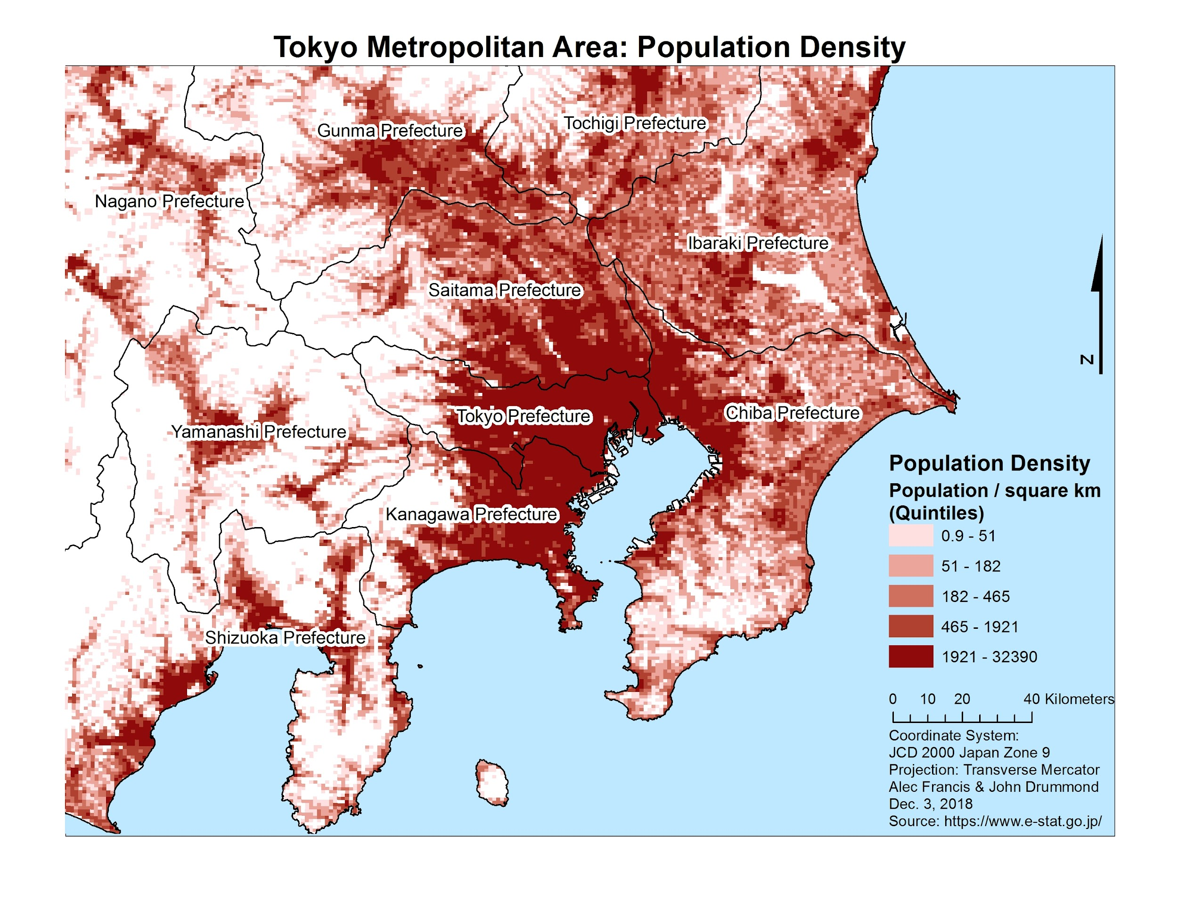
Notes:
Francis, A. & Drummond, J. (2018, December 3). Tokyo metropolitan area: Population density [Image]. The University of British Columbia. https://blogs.ubc.ca/socialvulnerabilitytokyo/analysis/

Slide 9
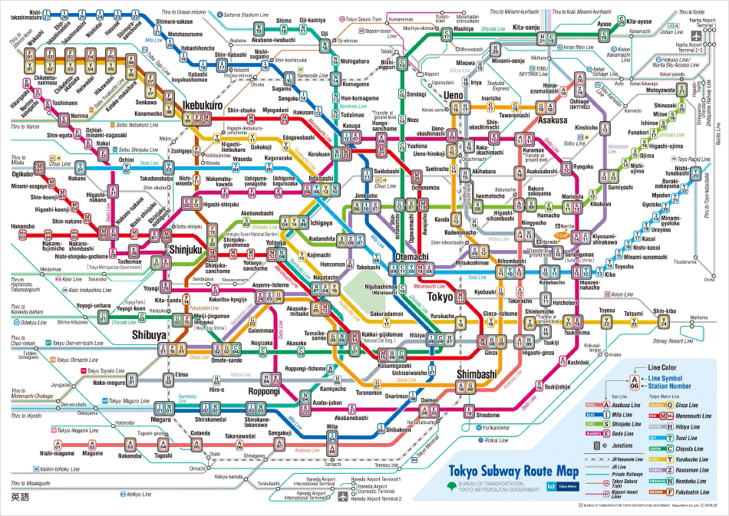
Notes:
Tokyo Metro. (n.d.). Tokyo subway route map [Image]. https://www.tokyometro.jp/en/subwaymap/

Slide 10
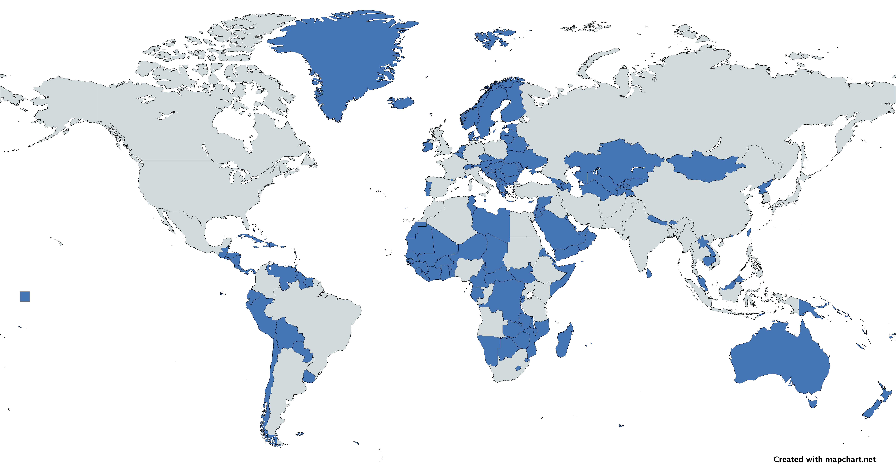
Countries with Smaller Populations than Tokyo Prefecture
Notes:
Teacher’s Note: The data used to create the map was obtained from the Central Intelligence Agency’s World Factbook in 2024. Mention to students that the data presented by the map may change depending on the year.
Central Intelligence Agency. (n.d.). The world factbook. https://www.cia.gov/the-world-factbook/

Slide 11
Window Notes Conclusions
Work with a partner to write down conclusions and statements about the Tokyo Prefecture in the lower left-hand box of your handout. Ensure that your responses answer the following questions:
What do you now know about Tokyo’s dense population?
How do Tokyo officials deal with population issues?
Notes:
K20 Center. (n.d.). Window notes. Strategies. https://learn.k20center.ou.edu/strategy/189

Slide 12
More Information on Tokyo
Read the article. As you read, consider the question, “How does Tokyo plan or prepare for dense population-related issues?”
After you finish reading, jot down your response to the question in the lower right-hand box.
Notes:
K20 Center. (n.d.). Window notes. Strategies. https://learn.k20center.ou.edu/strategy/189

Slide 13
City Planning
Watch the interview with a city planner. As you watch, take notes in the left-hand box of your handout. Use the following questions to guide your notes:
What does a city planner do? What does their daily work look like?
How does city planning help manage large populations?
What other factors contribute to city planning?
Prepare to share your responses.
Notes:
K20 Center. (n.d.). Window notes. Strategies. https://learn.k20center.ou.edu/strategy/189

Slide 14
Interview with Jane Hudson: City Planner
Notes:
K20 Center. (2020, May 26). ICAP – People here, people there, people everywhere [Video]. YouTube. https://www.youtube.com/watch?v=neRA3yz7bwQ

Slide 15
Summarize Your Thoughts
With your partner, answer the following questions in the right-hand box of your handout.
Can too many people live in one area?
If so, how can people in an area work and live together comfortably?

