Slide 2
Transcending Boundaries:
The Kiowa Six
The Legacy and Contributions of Six Kiowa Artists

Slide 3
Lesson Objectives
Examine the art of the Kiowa Six and determine its significance.
Evaluate whether assimilation helped or hindered the work of the six Kiowa artists.
Articulate the six Kiowa artists’ contributions to Oklahoma and to the art world.

Slide 4
Essential Questions
How does art reflect culture?
Did acculturation and assimilation help or hinder the work of the Kiowa Six?
What is the legacy of the Kiowa Six?

Slide 5
It’s OPTIC-al
With your group, consider the following for each painting:
What do you Observe?
Which Parts stand out?
What do the Title, author, and date suggest?
What is the Interrelationship, or what does the entire painting convey?
What Conclusions can you make about the painting, message, and artist?
Notes:
K20 Center. (n.d.). It’s OPTIC-al. Strategies. https://learn.k20center.ou.edu/strategy/99

Slide 6
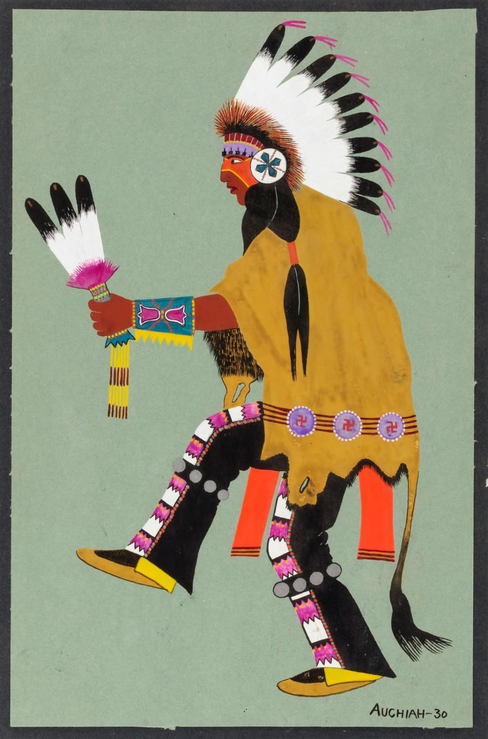
Painting 1
Kiowa Buffalo Dancer
James Auchiah, 1930
Notes:
Source: Auchiah, J. (1930). Kiowa buffalo dancer [Painting]. Smithsonian American Art Museum. Washington, D.C. https://americanart.si.edu/artwork/kiowa-buffalo-dancer-664

Slide 7
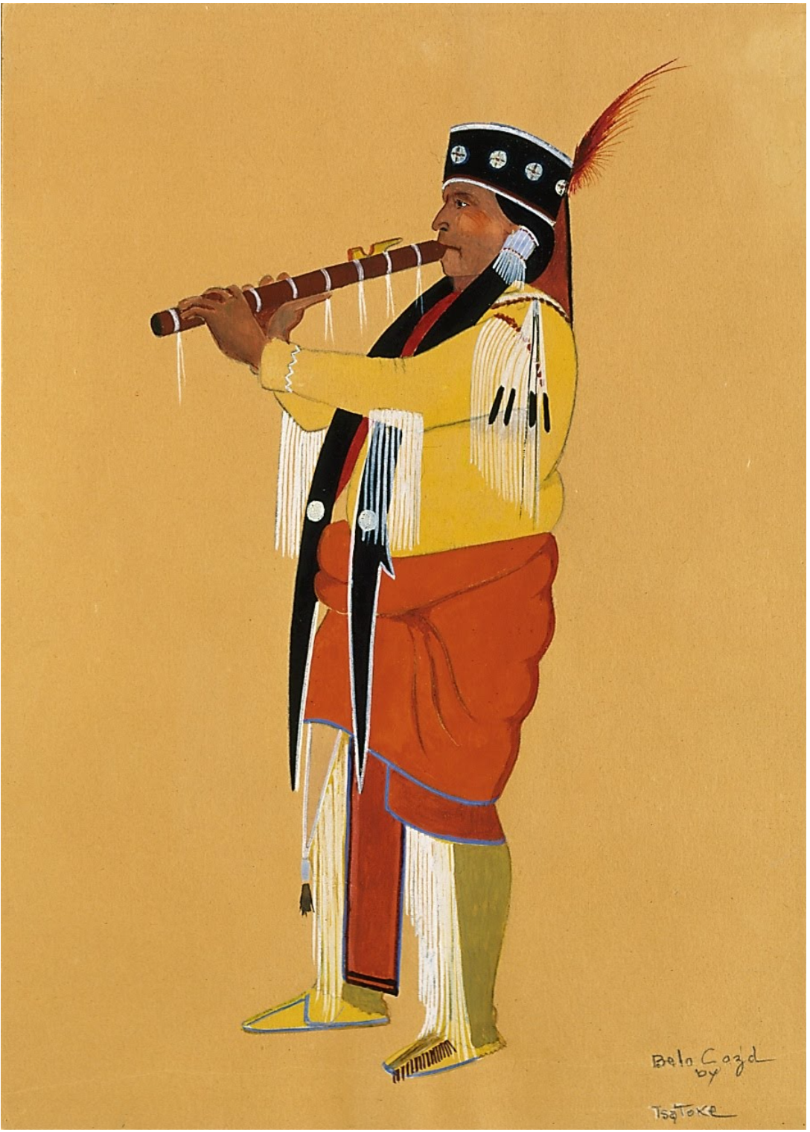
Painting 2
Belo Cozad
Monroe Tsatoke, (date unknown)
Notes:
Source: Tsatoke, M. (n.d.) Belo Cozad [Painting]. Google arts and culture. Located at: National cowboy & western heritage museum. Oklahoma City, Oklahoma. https://artsandculture.google.com/asset/belo-cozad-monroe-tsatoke-1904-1937/DwEbOCgxCdxfxQ?hl=en

Slide 8
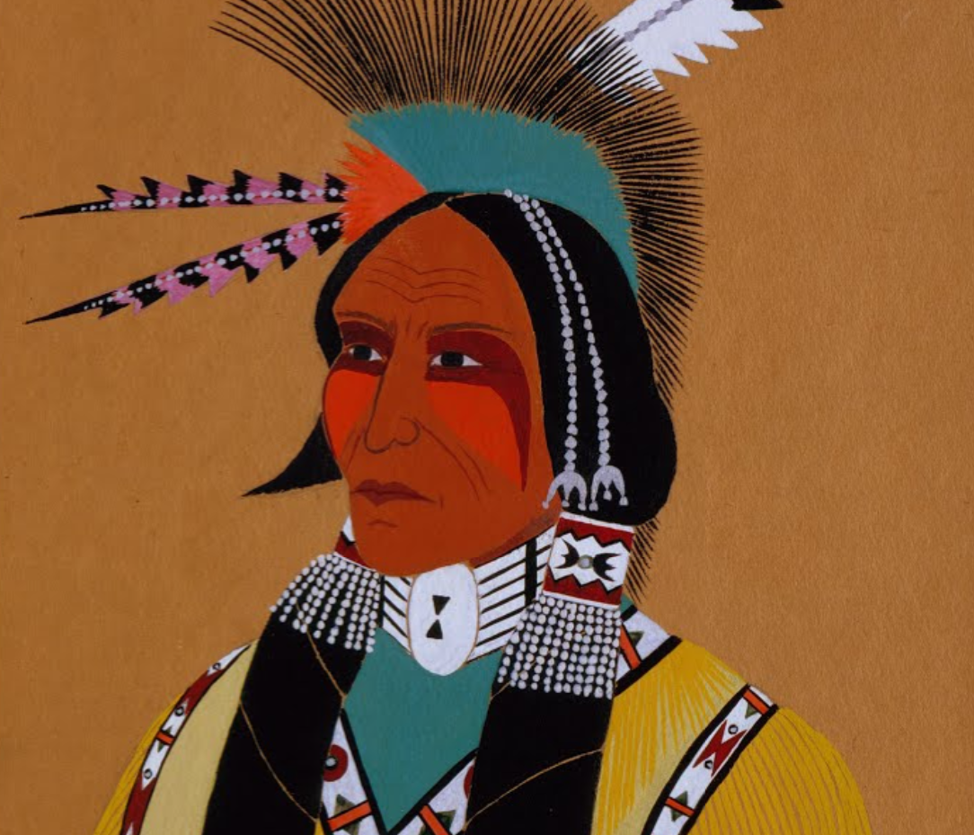
Painting 3
Apache Ben
Stephen Mopope, 1928
Notes:
Source: Mopope, S. (1928). Apache Ben [Painting]. Google arts and culture. Located at: National cowboy and western heritage museum. Oklahoma City, Oklahoma. https://artsandculture.google.com/asset/apache-ben-stephen-mopope-1898-1974/rAFm8MuHScByhg?ms=%7B%22x%22%3A0.5%2C%22y%22%3A0.5%2C%22z%22%3A8.652150766633639%2C%22size%22%3A%7B%22width%22%3A2.849269657793004%2C%22height%22%3A1.237499999999999%7D%7D

Slide 9
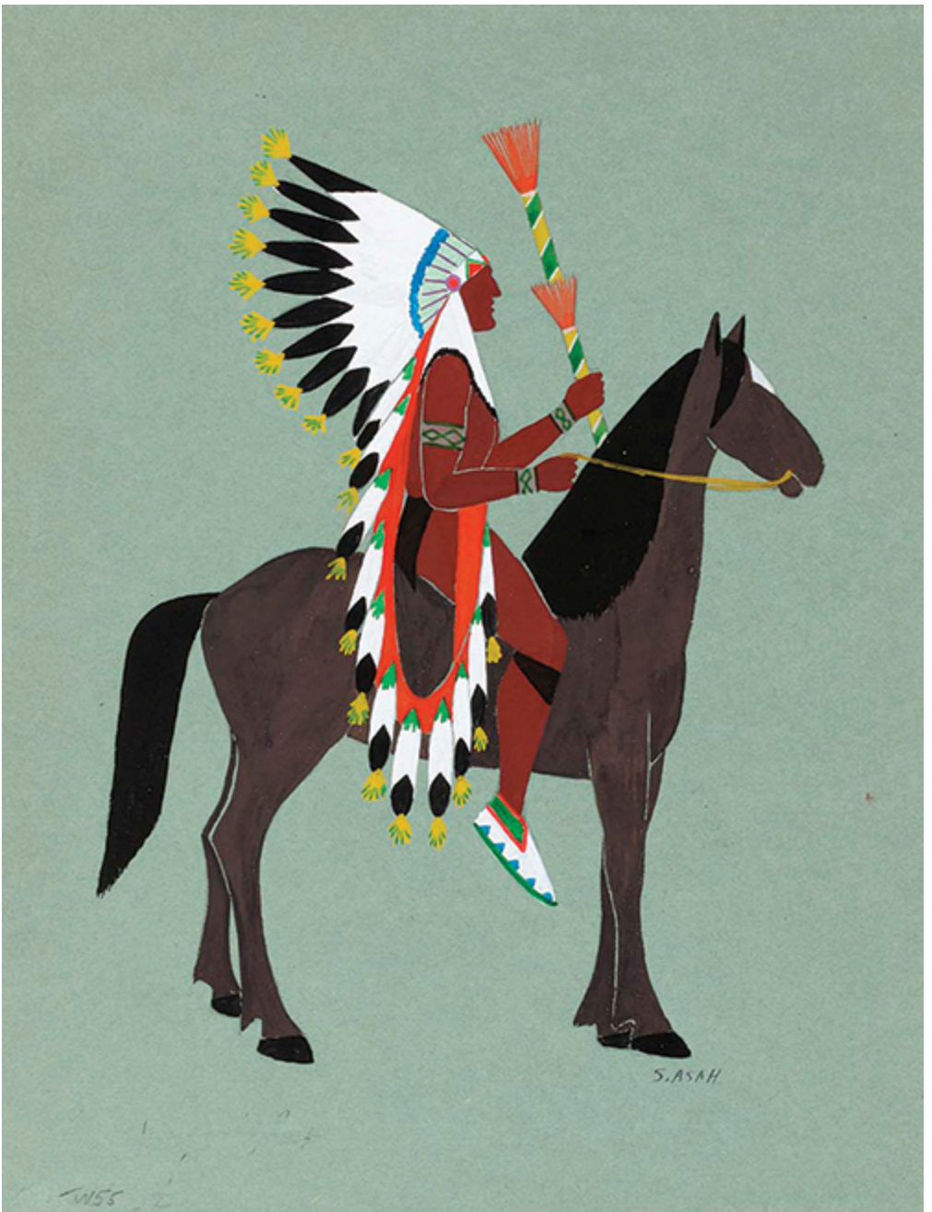
Painting 4
Feathered Man on Brown Horse
Spencer Asah, (date unknown)
Notes:
Source: Asah, S. (n.d.) Feathered man on brown horse [Painting]. Smithsonian American Art Museum. Washington, D.C. https://americanart.si.edu/artwork/costumed-horseman-feathered-man-brown-horse-635

Slide 10
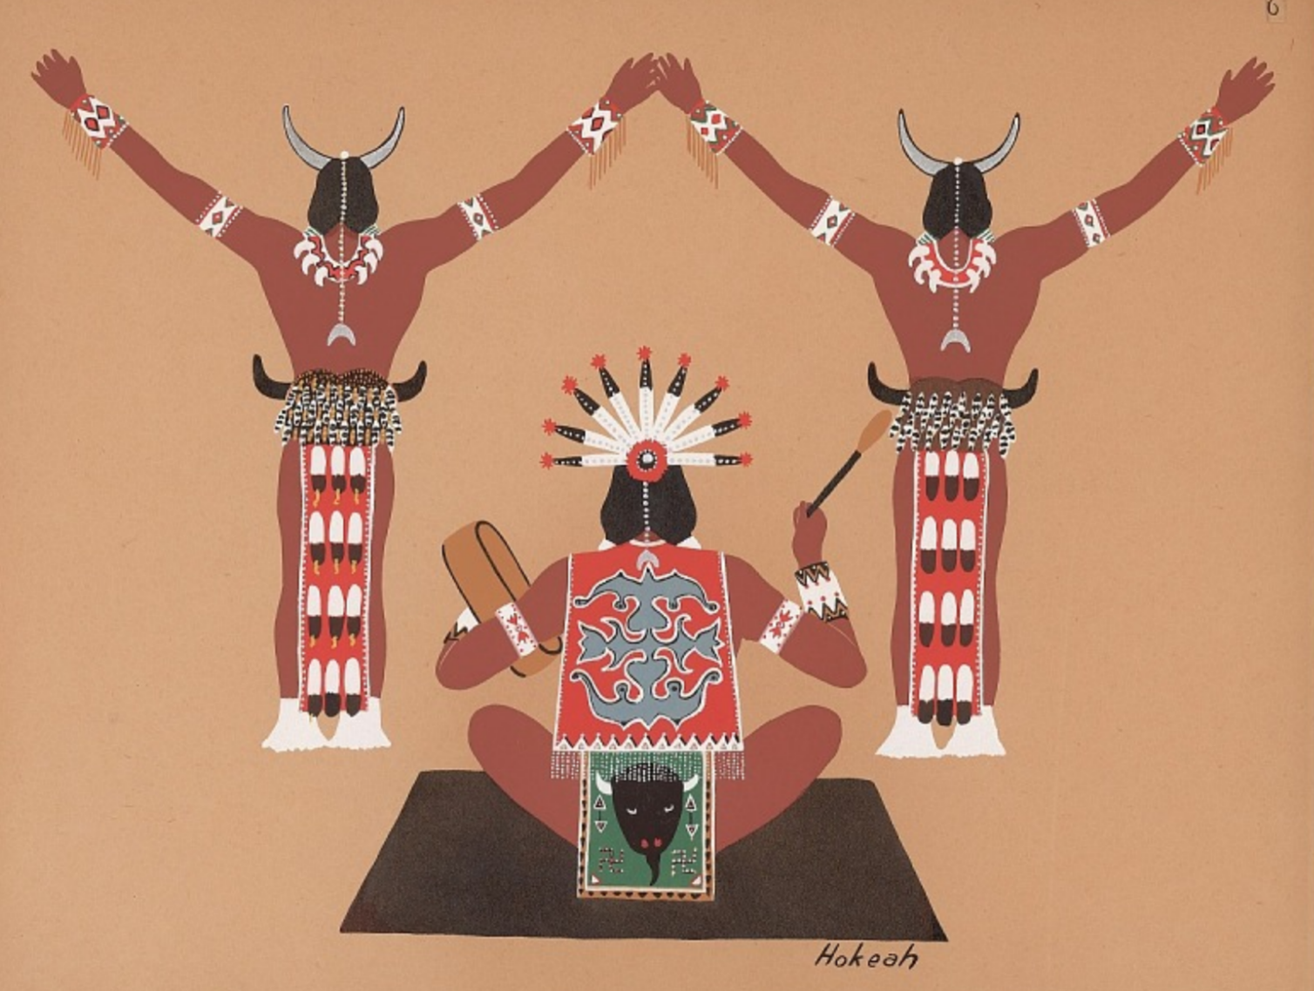
Painting 5
Greeting of the Moon God
Jack Hokeah, 1929
Notes:
Source: Hokeah, J. (1929). Greeting of the moon god [Painting]. Smithsonian American art museum. Washington, D.C. https://collections.si.edu/search/detail/ead_component:sova-naa-ms7536-ref4?q=Jack+Hokeah&record=20&hlterm=Jack%2BHokeah&inline=true

Slide 11
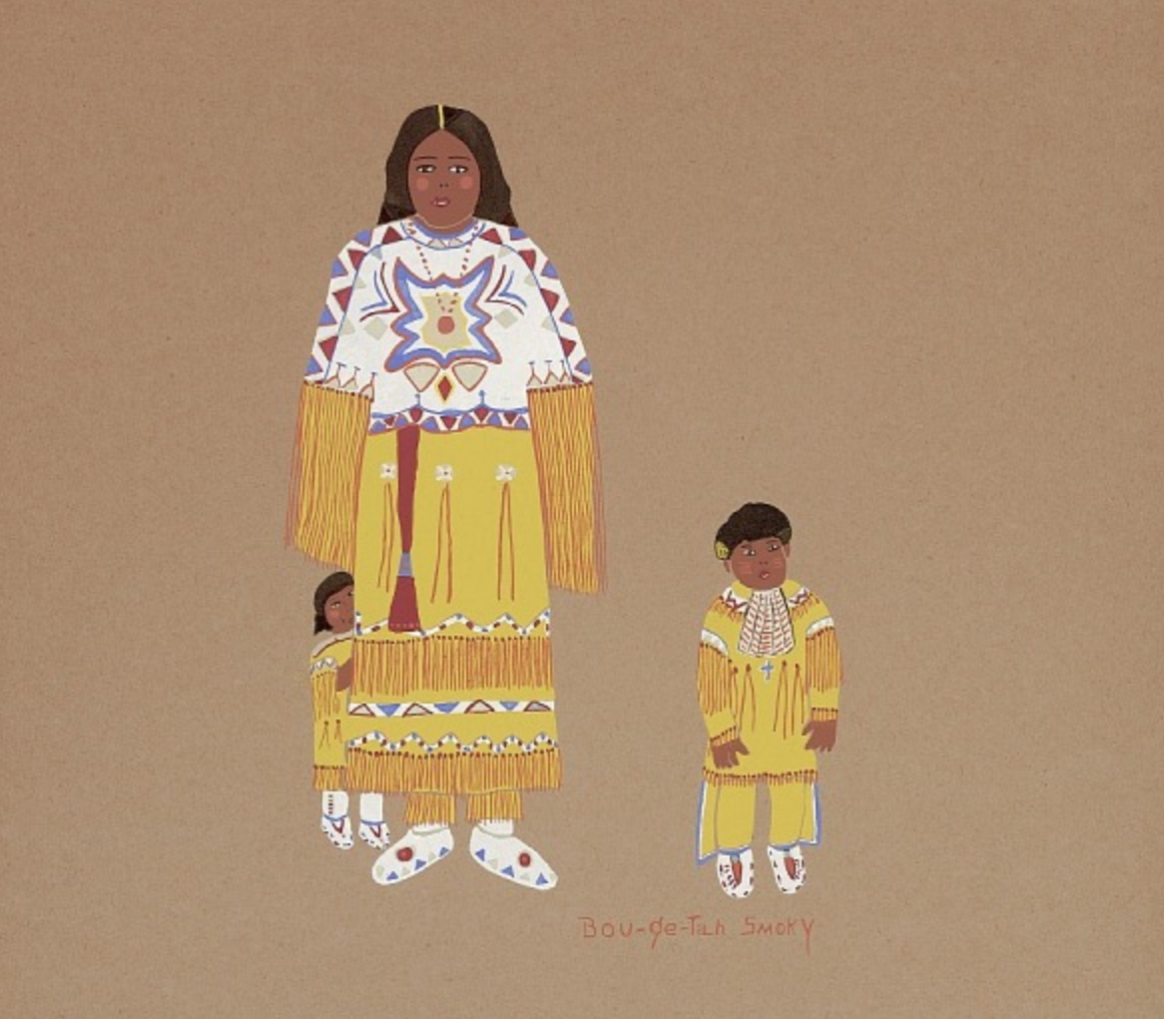
Painting 6
Kiowa Family
Lois Smoky, 1929
Notes:
Source: Smoky, L. (1929). Kiowa family [Pochoir print]. Smithsonian American art museum. Washington, D.C. https://collections.si.edu/search/detail/ead_component:sova-naa-ms7536-ref6

Slide 12
Art Analysis and Gallery Walk
Examine each of the paintings.
List several words or phrases to describe what they all have in common regarding:
  Color
  Style or design
  Theme or subject matter
Notes:
K20 Center. (n.d.). Gallery Walk / Carousel. Strategies. https://learn.k20center.ou.edu/strategy/118
K20 Center. (n.d.). List-group-label. Strategies. https://learn.k20center.ou.edu/strategy/55

Slide 13
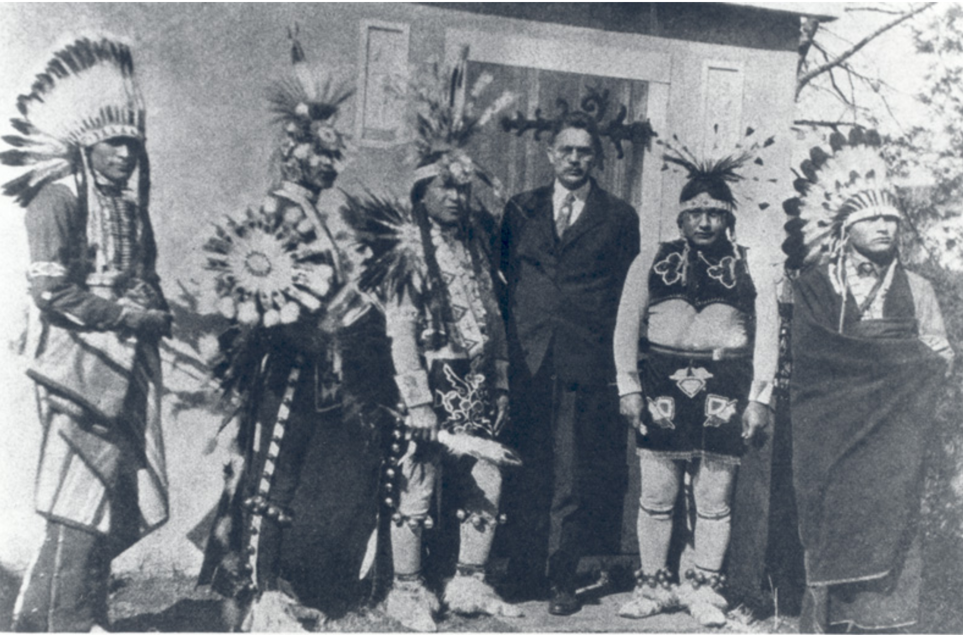
The Artists Known as the Kiowa Six
Kiowa artists
Known for their unique style
Painted Kiowa traditions
Received national and international acclaim
OU Professor Oscar Jacobson with five of the six Kiowa artists in 1933.
Notes:
Image Source: Oscar B. Jacobson Collection. (1933). Tsatoke, Hokeah, Mopope, Jacobson, Asah, Auchiah [Photograph]. Oklahoma Historical Society. https://www.okhistory.org/publications/enc/entry.php?entry=MO017

Slide 14
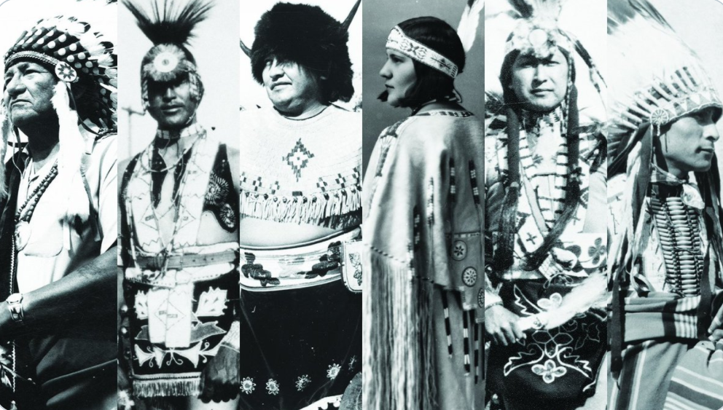
The Importance of the Kiowa Six
As you watch the video, jot down notes about the significance or importance of the Kiowa Six.
Left to right: James Auchiah, Jack Hokeah, Spencer Asah,
Lois Smoky, Stephen Mopope, and Monroe Tsatoke
Notes:
Video Link: https://www.youtube.com/watch?v=QQuEKWjiuTw
Video Source: National Cowboy and Western Heritage Museum. (2016). Explore the West - Kiowa Six [Video]. YouTube. https://nationalcowboymuseum.org/explore/the-kiowa-six/
Image Source: Fred Jones Jr. Museum of Art. (2020). Kiowa Six [Image Collage]. Twitter. https://twitter.com/fjjma/status/1328787227950915590

Slide 15
How does art reflect culture?
How did the work of these six Kiowa artists reflect their Kiowa culture?

Slide 16
Definitions
Acculturation | Assimilation
A process in which a person adapts or adjusts to a new cultural environment and its customs and practices. | A process in which a minority group begins to resemble a society’s majority group by assuming that group’s beliefs, values, and lifestyle.
Notes:
The definitions provided here are a summary of Encyclopedia Britannica, Dictionary.com, and Wikipedia definitions.

Slide 17

Why-Lighting
As you read the article:
Highlight one sentence that stands out to you in each section.
Note in the margin why it’s important to know.
Notes:
K20 Center. (n.d.). Why-Lighting. Strategies. https://learn.k20center.ou.edu/strategy/128

Slide 18
Did acculturation and assimilation help or hinder the work of the Kiowa Six?

Slide 19
What do you think?
Choose one of these claims:
The Kiowa Six benefited from the process of assimilation to become world-famous artists.
The Kiowa Six preserved their traditions and heritage in their artwork despite the system of assimilation.
Notes:
K20 Center. (n.d.). Claim, evidence, reasoning. Strategies. https://learn.k20center.ou.edu/strategy/156

Slide 20
What is the legacy of the Kiowa Six?

Slide 21
Letter to the Governor
Write an email or letter to the governor summarizing the importance and contributions of the Kiowa Six.
Suggest one way for the state of Oklahoma to honor these artists and recognize their legacy.
Notes:
Students can use the reading, their Art Analysis paragraphs, and their Claim, Evidence, Reasoning (CER) handouts as resources to complete their writing.

