Slide 2
The Interlopers: Are You Ready to Rumble?
Conflict, Motivation, and Setting

Slide 3
Essential Question
How do motivation and setting influence conflict for characters?

Slide 4
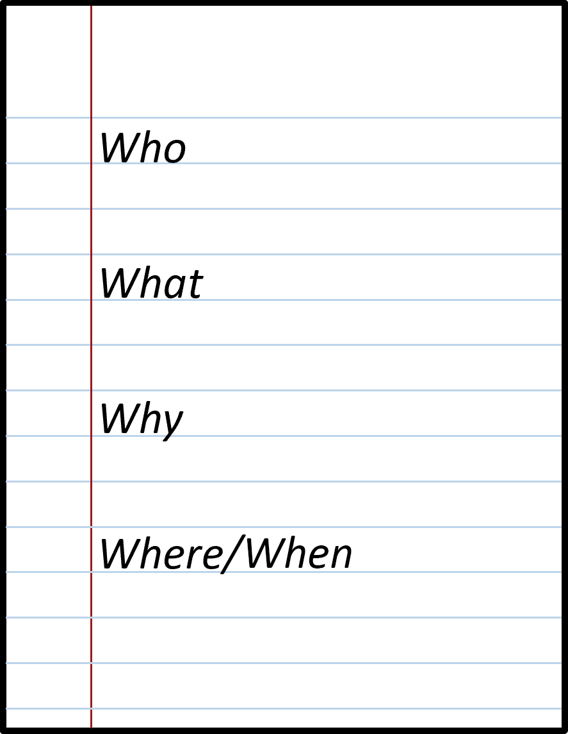
Notes
On a piece of notebook paper, write the following words in a column:
  Who, What, Why, & Where/When
As you watch the following video, pay attention to the lyrics, and jot down the answers to these question starters.

Slide 5

“Your Obedient Servant”
The clip you are about to watch is
from the musical Hamilton, which
follows the life and career of
Alexander Hamilton around the
time of the American Revolution.
This song takes place after Aaron Burr, the U.S. vice president of the time, finds out that Hamilton is supporting his political rival.
Notes:
Leslie Odom Jr.. (2017, April 20). Your obedient servant [Thumbnail]. YouTube. https://www.youtube.com/watch?v=E94po1TSQuA

Slide 6

Your Obedient Servant

Slide 7

Roundabout Conversations
Split into 2 equal groups.
Both groups need to form a circle.
  One group is the inner circle, and
  one group is the outer circle.
When the music begins, you will walk in a circle.
  The inner circle walks clockwise, and the outer circle walks counterclockwise.
When the music stops, you will turn and face your new discussion partner.
Notes:
K20 Center. (n.d.). Roundabout conversations. Strategies. https://learn.k20center.ou.edu/strategy/196

Slide 8

Roundabout Conversations
There will be 5 rounds, where
the music will stop, and you will
be given questions to discuss
with a new partner.
Use your notes to discuss the given questions.
You will be given 2 minutes for each discussion.
Notes:
K20 Center. (n.d.). Roundabout conversations. Strategies. https://learn.k20center.ou.edu/strategy/196

Slide 9

Round 1: Who?
Who were the individuals in conflict with one another?
What do we know about them?
How do you know?
90-Second Timer
Notes:
K20 Center. (2021, September 21). K20 Center 90 second timer [Video]. YouTube. https://www.youtube.com/watch?v=AMW_5yR32mM

Slide 10
Round 2: What?
What was the conflict?
What were the causes?
How does each side view it?
How do you know?
90-Second Timer
Notes:
K20 Center. (2021, September 21). K20 Center 90 second timer [Video]. YouTube. https://www.youtube.com/watch?v=AMW_5yR32mM

Slide 11
Round 3: Why?
Why was this conflict an issue?
What do you think this conflict will lead to?
How do you know?
90-Second Timer
Notes:
K20 Center. (2021, September 21). K20 Center 90 second timer [Video]. YouTube. https://www.youtube.com/watch?v=AMW_5yR32mM

Slide 12
Round 4: Where and When?
Where and when did the conflict(s) take place?
How does the time and place influence the conflict?
How do you know?
90-Second Timer
Notes:
K20 Center. (2021, September 21). K20 Center 90 second timer [Video]. YouTube. https://www.youtube.com/watch?v=AMW_5yR32mM

Slide 13
Roundabout Conversations: Reflection
Who?
What?
Why?
Where and When?
Notes:
K20 Center. (n.d.). Roundabout conversations. Strategies. https://learn.k20center.ou.edu/strategy/196

Slide 14
Lesson Objectives
Analyze a short story for character motivation and the effects of the setting on the conflict.
Construct a writing piece to describe a historical feud, its outcome, and provide an alternative resolution.

Slide 15

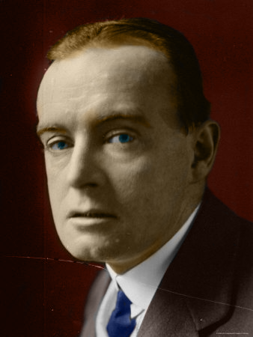
The Interlopers by Saki
Saki (author)
Hector Hugh Monro, British author, used the pen name Saki
1870–1916
A master of dark wit and deep insight into human nature
The Interlopers
A story of an ongoing feud over property and the
rights to use the resources of the forest
Notes:
Saki. (2014, October 4). The Interlopers [Video]. YouTube. https://www.youtube.com/watch?v=O_k-Ss0bBPs
Nicholas95. (2012, May 20). Héctor Hugh Munro [Photograph]. Wikimedia Commons. https://commons.wikimedia.org/wiki/File:H%C3%A9ctor_Hugh_Munro.png

Slide 16

Categorical Highlighting
Read the story again and highlight key information:
pink—conflict
  person vs. nature, person, society, or self
blue—character motivation
  Why are the characters doing what they are doing?
yellow—description of the setting
  What details help you visualize the where and when of the story?
Notes:
K20 Center. (n.d.) Categorical highlighting. Strategies. https://learn.k20center.ou.edu/strategy/192

Slide 17
Categorical Highlighting
“In a forest of mixed growth somewhere on the eastern spurs of the Carpathians, …”
I highlighted this because it specifically describes where the action of the story takes place.
Notes:
K20 Center. (n.d.) Categorical highlighting. Strategies. https://learn.k20center.ou.edu/strategy/192

Slide 18
Categorical Highlighting
“In a forest of mixed growth somewhere on the eastern spurs of the Carpathians, …”
Where the action takes place
Notes:
K20 Center. (n.d.) Categorical highlighting. Strategies. https://learn.k20center.ou.edu/strategy/192

Slide 19
Types of Conflict
Conflict Type | Examples From the Story
Person vs. Person
Person vs. Nature
Person vs. Self
Person vs. Society

Slide 20

Interloper Defined: Think
Think about what interloper
must mean, based on your reading.
Write your own definition for interloper.
Identify examples of interlopers in the story.
Record your thoughts for the “Definition” and “Table” portions of your handout.
Notes:
K20 Center. (n.d.). Think-pair-share. Strategies. https://learn.k20center.ou.edu/strategy/139

Slide 21
Interloper Defined: Pair-Share
Find a partner.
Discuss what you wrote on your handout.
  How did you define interloper?
  What examples did you find? How do you know?
Be ready to share.
Notes:
K20 Center. (n.d.). Think-pair-share. Strategies. https://learn.k20center.ou.edu/strategy/139

Slide 22
Interloper Defined: Point of View
Assume the viewpoint of one of the main characters:
Partner A: Ulrich von Gradwitz
Partner B: Georg Znaeym

Slide 23
Interloper Defined: Point of View
Independently answer the following questions based on your character.
What was the conflict?
What was their motivation?
What is the setting?
What effect does the setting have on your character?

Slide 24
Interloper Defined: Point of View
Now discuss your answers with your partner.
[My character] saw the conflict as ___.
[My character]’s motivation was ___.
Be sure to share your textual evidence for each.
I think this because paragraph ___ states ___.

Slide 25
Interloper Defined: Reflection
With your partner, write a reflection statement to summarize your observations about the effect of the setting on each of the main characters:
Ulrich von Gradwitz
Georg Znaeym

Slide 26
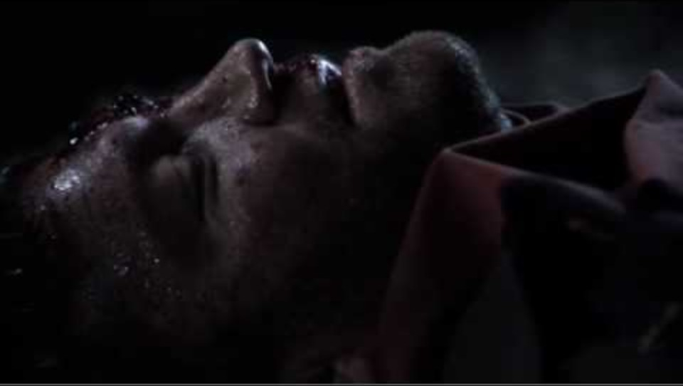
The Interlopers: A Short Film by Ben Hurst

Slide 27

V is for Vendetta; F is for Feud
Research a real-life vendetta or feud.
Be prepared to:
  Describe each side’s claim to being right.
  Describe the reasoning behind each side’s claim.
  Describe how the feud ended in real life.
  Propose an alternative solution to the feud that you think would have led to a better outcome.
Notes:
OpenClipart-Vectors. (2013, October 19). Vendetta [Image]. Pixabay. https://pixabay.com/vectors/vendetta-mask-guy-fawkes-face-man-157703/

Slide 28

Choice Board
Choose a presentation option from the Choice Board.
Your presentation should include the following information about your famous feud:
  A description of the feud
  Why each side felt the way they did
  An explanation of how the feud resolved, if it was resolved
  Your proposal for an alternative resolution
Notes:
K20 Center. (n.d.). Choice boards. Strategies. https://learn.k20center.ou.edu/strategy/73

Slide 29
Choice Board
Write a Song or Rap | Write a Poem | Write a Short Story
Create a Piece of Art | Create a Musical Mashup | Create a Conflict Cartoon
Write a Skit | Write an Incident Report | Write a News Article
Notes:
K20 Center. (n.d.). Choice boards. Strategies. https://learn.k20center.ou.edu/strategy/73

Slide 30
V is for Vendetta.
F is for Feud.
Student Presentations
Notes:
OpenClipart-Vectors. (2013, October 19). Vendetta [Image]. Pixabay. https://pixabay.com/vectors/vendetta-mask-guy-fawkes-face-man-157703/

Slide 31

Exit Ticket
What do you think it takes to resolve a conflict?
Notes:
K20 Center. (n.d.). Bell ringers and exit tickets. Strategies. https://learn.k20center.ou.edu/strategy/125

