Slide 2
The Interlopers: Are You Ready to Rumble?
Conflict, Motivation, and Setting

Slide 3
Essential Question
How do motivation and setting influence conflict for fictional/non-fictional characters?

Slide 4
Objectives
Analyze a short story for character motivation and the effects of the setting on the conflict.
Construct a writing piece chosen from a variety of genres to describe an argument connecting evidence to a claim and a conclusion.

Slide 5
Notes
Take out a sheet of notebook paper.
Write the following words across the top of the page:
Who?
What?
Why?
Where?
As you listen to the music video, jot down the answers to these question starters.

Slide 6
“The Room Where It Happens”
Notes:
Source: Schultz, T. (2020, Mar. 15). The room where it happened. “Hamilton.” [Music video]. https://www.youtube.com/watch?v=tKrrsblW4IQ
Original lyrics: Miranda, L-M. (2015). The room where it happens. Musixmatch. [Song lyrics]. https://www.bing.com/search?q=the%20room%20where%20it%20happens%20lyrics%20pdf&qs=n&form=QBRE&msbsrank=1_1__0&sp=-1&pq=the%20room%20where%20it%20happens%20lyrics%20pdf&sc=1-36&sk=&cvid=DD66A671179940E8BD38DFFA8FC8DF74

Slide 7
Roundabout Conversations
Split into two equal groups, an inner circle and an outer circle.
Each group will walk in a circle as the music video plays.
Each time the music stops, turn toward your new partner.
Share your responses with your partner to the questions on the following screens.
Use the song lyrics and notes you took as you watched the video.
Notes:
Source: K20 Center. (n.d.). Roundabout Conversations. Strategies. https://learn.k20center.ou.edu/strategy/196

Slide 8
Roundabout Conversations
As the song plays:
The outer circle walks clockwise;
The inner circle walks counter clockwise.
When the music stops, face your new partner.
Discuss the five questions listed on the following slides one at a time.
Notes:
Note: students should be evenly divided between inner and outer circles.

Slide 9
Question for Thought #1
Who were the individuals in conflict with one another?
How do you know?
What is your evidence?

Slide 10
Question for Thought #2
What was the conflict?
How do you know?
What is your evidence?

Slide 11
Question for Thought #3
Why was this conflict an issue?
How do you know?
What is your evidence?

Slide 12
Question for Thought #4
Where did the problem(s) take place?
How do you know?
What is your evidence?

Slide 13
Question for Thought #5
How does the setting impact the conflict?
How do you know?
What is your evidence?

Slide 14
Roundabout Conversations Reflection
Who
What
Why
Where
How

Slide 15
Objectives
Analyze a short story for character motivation and the effects of the setting on the conflict.
Construct a writing piece chosen from a variety of genres to describe an argument connecting evidence to a claim and a conclusion.

Slide 16
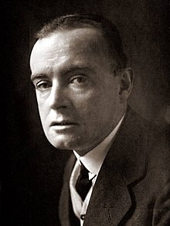
“The Interlopers” by Saki
Saki (author)
Hector Hugh Monro, British author, used the pen name Saki
1870-1916
A master of dark wit and deep insight into human nature
Story of an ongoing feud over property and the rights to use the resources of the forest.
Notes:
Link to video: https://youtu.be/O_k-Ss0bBPs
Source: Billy Wells Horror. (2018, Oct. 19). Classic short stories audio—The Interlopers by Saki. [Photograph]. https://billywellshorror.com/classic-short-stories-audio-the-interlopers-by-saki-h-h-munro/
Source: Billy Wells Horror. (2018, Oct. 19). Classic short stories audio—The Interlopers by Saki. [Audio Recording]. https://billywellshorror.com/classic-short-stories-audio-the-interlopers-by-saki-h-h-munro/

Slide 17
Categorical Highlighting
Read the story again with a partner, and highlight key information.
Pink—Theme
Blue—Character Motivation
Green—Description of the Setting
Yellow—Unknown Vocabulary
Notes:
Source: K20 Center. (n.d.). Categorial highlighting. Strategies. https://learn.k20center.ou.edu/strategy/192

Slide 18
Categorical Highlighting Example
“In a forest of mixed growth somewhere on the eastern spurs of the Karpathians,...”
I highlighted this because it specifically describes where the action of the story takes place.

Slide 19
Categorical Highlighting Example
“In a forest of mixed growth somewhere on the eastern spurs of the Karpathians,...”
Where the action takes place.

Slide 20
Types of Conflict
Conflict Type | Examples from the Story
Man vs. Man
Man vs. Nature
Man vs. Self
Man vs. Society

Slide 21
Think-Pair-Share
Use the Interlopers Defined handout.
Think about the questions and write your answers.
Pair up with a partner and discuss your ideas.
Make changes, if needed.
Share with the class.
Notes:
Source: K20Center. (n.d.). Think-Pair-Share. Strategies. https://learn.k20center.ou.edu/strategy/139

Slide 22
Think-Pair-Share
Who is the interloper?
How do you know?

Slide 23
Think-Pair-Share
Assume the view point of one of the main characters:
Partner A: Ulrich von Gradwitz
Partner B: Georg Znaeym
Answer the following questions based on your character:
What is the conflict?
What is the motivation?
What is the setting?
What effect does the setting have on your character?

Slide 24
Think-Pair-Share
Write a reflection statement with your partner to summarize your observations about the effect of the setting on each of the main characters, Ulrich von Gradwitz and Georg Znaeym.

Slide 25
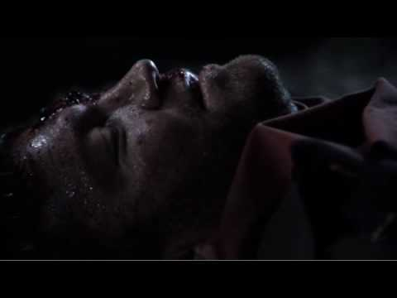
The Interlopers by Ben Hurst
Notes:
Source: Hurst, B. (2010, May 4). The Interlopers: A short film. [Video]. https://www.youtube.com/watch?v=Upw0e5j2uJg

Slide 26
V is for Vendetta; F is for Feud
Research a real-life vendetta or feud.
Be prepared to:
Describe the argument.
Connect evidence to the claim of each side.
Provide a resolution to the problem.
Notes:
Pixabay. [n.d.]. Guy Fawkes mask. [Image]. https://pixabay.com/vectors/vendetta-mask-guy-fawkes-face-man-157703/
Moore, A., Lloyd, D. & Weare, T. (2008). V for Vendetta. Vertigo.

Slide 27
Choice Board
Choose one activity from the Choice Board.
Your Choice Board writing piece should include the following information about your famous feud:
A description.
Evidence to support the claims of each side.
An explanation of how the feud was resolved, IF it was resolved.
Notes:
Source: K20 Center. (n.d.) Choice Boards. Strategies. https://learn.k20center.ou.edu/strategy/73

Slide 28
Choice Board
Write a song or rap. | Write a feud poem. | Write a short story.
Create an original piece of art depicting the feud. Include a short explanation. | Create a musical mashup depicting the emotions of the opposing forces. Include a short explanation for each song chosen. | Create a conflict cartoon with the types of conflicts and captions.
Write a skit depicting the feud. | Write and incident report that includes the 5Ws. | Write a news article with the facts of the feud. This can be factual, editorial, or an opinion piece.

Slide 29
V is Vendetta.
F is for Feud.
Student presentations

Slide 30
Exit Ticket
What do you think it takes to resolve a conflict?
Notes:
Source: K20 Center. (n.d.). Bell ringers and exit tickets. Strategies. https://learn.k20center.ou.edu/strategy/125

