Slide 2
Expanding Binomials, Expanding Your Mind
Connecting Pascal’s Triangle To Binomial Expansion

Slide 3
Essential Question
What patterns emerge in Pascal’s triangle, and how can they connect to binomial expression expansions?

Slide 4
Lesson Objective
Students will explore patterns found in Pascal’s triangle as a relation to expanding binomial expressions.

Slide 5
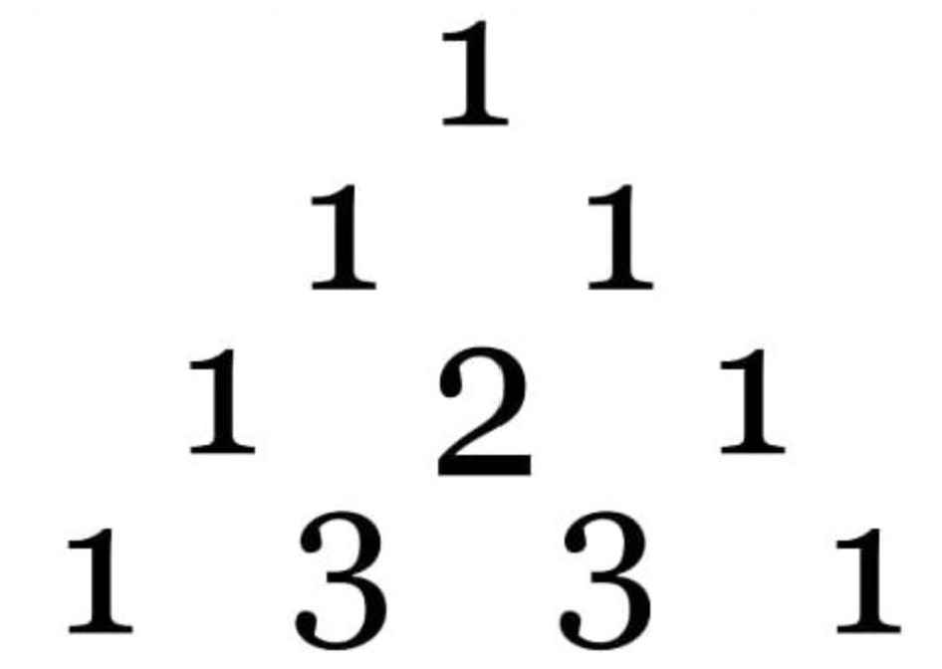
What’s the Pattern?
With a partner, determine the patterns needed to fill in the missing numbers for the remaining triangle.

Slide 6
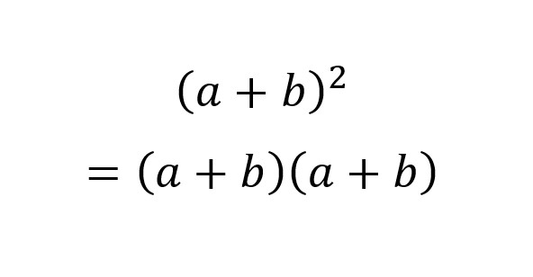
Make the Connection
Complete Part 1 and Part 2 of the Binomial Expansion Exploration Handout
Take your time solving the binomials and try to make connections along the way.
Helpful Reminder:
*USE THE FOIL METHOD TO SOLVE*

Slide 7
Discussion
What connections did you make between expanding binomials and Pascal’s Triangle?
Find a partner from a different group and discuss your findings from Part 1 and Part 2 of the Binomial Expansion Exploration Handout.
Compare and Contrast your results and then go back to your original group to talk about the new knowledge you potentially gained.

Slide 8
Dive A Little Deeper
Now understanding the process of binomial expansion as it relates to Pascal’s Triangle, let's dive into more complex problems.
Complete Part 4 of the handout
Use the Window Notes handout to help you analyze the process

Slide 9
Questions and Reflections
Based on the Window Notes, what questions are still lingering in your mind?
Once all confusion is eliminated, you will answer the following questions:
What did you do today?
So what? Why does this matter?
Now what? What will you take with you? How do you think this connects to other areas of mathematics?

