Slide 2


Glaciers:
Here Today, Gone Tomorrow?
Glacial Theory and Earth’s Systems

Slide 3
Essential Question:
What is happening to modern-day glaciers?

Slide 4
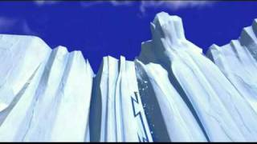
Field Trip Time
Destination: Ice Age
18,000 years ago
Scrat Ice Age 1
Notes:
Ichbinverrukt46. (2008, December 12). Scrat Ice Age 1 [Video]. YouTube. https://www.youtube.com/watch?v=vCTNioSW730
Stop the video at 2:06, as the end of the video (where two glaciers start sliding into each other) is not relevant to the glacial movement described in this lesson.

Slide 5

Tip of the Iceberg
Write what you already know about glaciers above the waterline.
Write anything you want to know about glaciers along the waterline.
Save the space below the waterline for later in the lesson.
Notes:
K20 Center. (n.d.). Tip of the iceberg. Strategies. https://learn.k20center.ou.edu/strategy/67

Slide 6
Lesson Objectives
Model how glaciers move.
Describe the role glaciers played in the formation of the Earth’s surface.
Predict what’s happening to glaciers and how they will determine the Earth’s surface in the future.

Slide 7
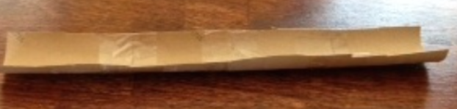
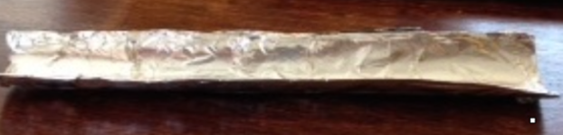
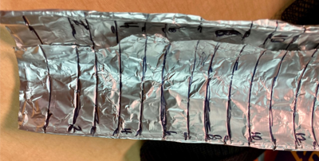
Building the Channel
Cut the paper towel tube in half, lengthwise, so that you have two open channels.
Cover the channels with aluminum foil.
Using a marker, mark the sides of each channel in 1 cm increments from top to bottom.

Slide 8
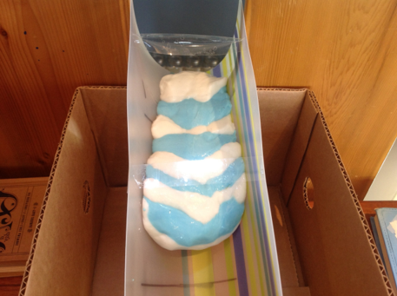
Building the Glacier
Make the Gak!
  Follow the directions on the Gak Recipe handout.
  You should have 2 different colors of Gak.

Slide 9
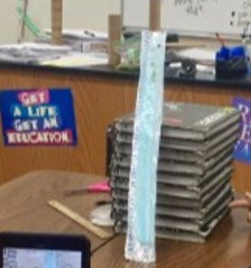
Building the Simulation
Grab some books and prop up the channel.
Get some Gak of each color and add 10–15 small rocks to it.
Layer the two Gaks like a stack of coins, alternating colors.

Slide 10
Go With the Flow
First, draw your simulated glacier setup.
Next, collect data by following the instructions on your handout.
  Start timing when you place the Gak layers at the top.
  In the table, record the time (in seconds) each time your “glacier” moves 1 cm farther.

Slide 11
Speedy Glaciers
How far (cm) did your glacier move by the end of class? How long did it take the glacier to move that distance?
Speed = distance
time
Who had the fastest glacier?

Slide 12
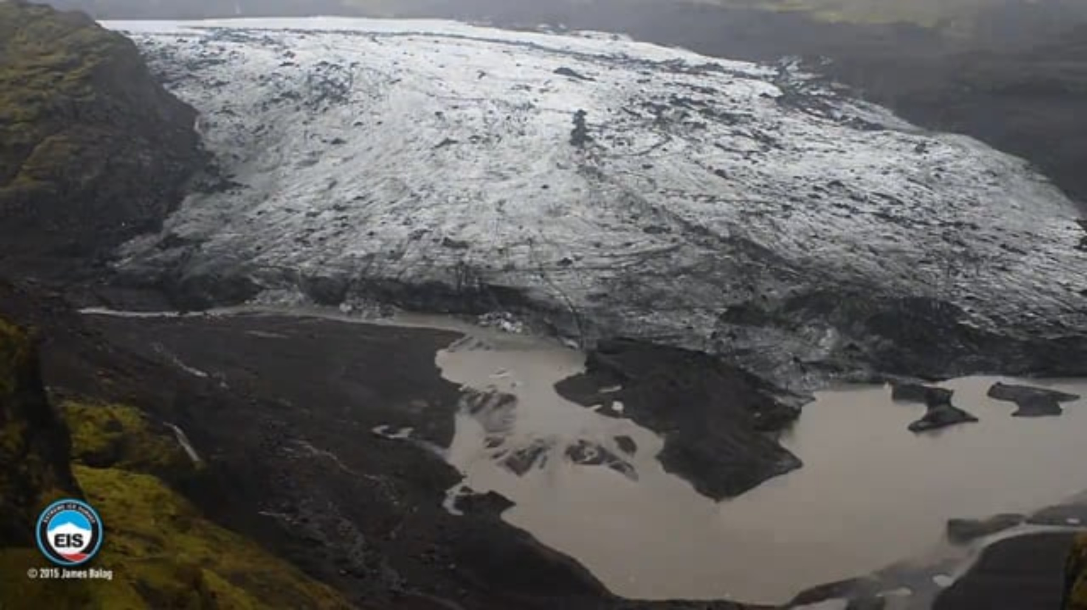
The Real Deal
Why did you have to take so many time readings while your glacier moved?
Sólheimajökulll Glacier (Iceland) Time-lapse
Notes:
Extreme Ice Survey. (2009, August 10). IL-05 Sólheimajökulll Glacier (Iceland) Time-lapse [Video]. Vimeo. https://vimeo.com/6039933

Slide 13

T-Chart
What are the similarities and differences you noticed between your simulated glacier and a real glacier? List them on your handout.
Discuss as a class.

Slide 14
T-Chart
What are the benefits of using simulations and models in science?
What are the drawbacks?

Slide 15
Let’s Dig Deeper, Part 1
When a glacier moves, along with the rocks it carries, what does it do to the valley underneath?
What happens over a long period of time if the glacier continues to scratch the ground?
What shape is the valley that forms when a glacier moves through?

Slide 16
Let’s Dig Deeper, Part 2
What causes glaciers to move and keep moving?
In your glacier simulation, what do the different colors of Gak represent?
Did you have any rocks deposited along the way as your glacier moved?

Slide 17
Diluvial Theory Glacial Theory
This is the first idea of how Earth's surface was shaped.
It suggested that the land was shaped by a worldwide flood.
It is also referred to as
“flood geology.”
This theory is not supported by geological evidence. It has been replaced by glacial theory.
This theory has been accepted since the late 1800’s.
Louis Agassiz, a Swiss geologist, tracked actual glaciers’ movements.
This theory claims that the land was shaped by ice sheets that covered Earth’s surface.
As the ice sheets moved, they carved out the land and deposited rocks, etc.

Slide 18
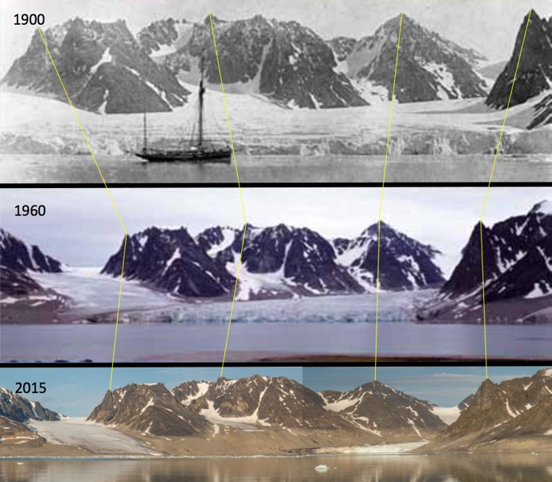
How do we continue to learn about glaciers?
Scientists who study glaciers are called glaciologists. They study glaciers using the following resources:
Still photos
Videos
Satellite images
Notes:
Image source:
Weith, A. (2016, December 6). Glacier decrease on Svalbard in the years 1900-1960-2015 [Photographs]. Wikimedia Commons. https://commons.wikimedia.org/wiki/File:Glacier_decrease_on_Svalbard_in_the_years_1900-1960-2015.jpg

Slide 19
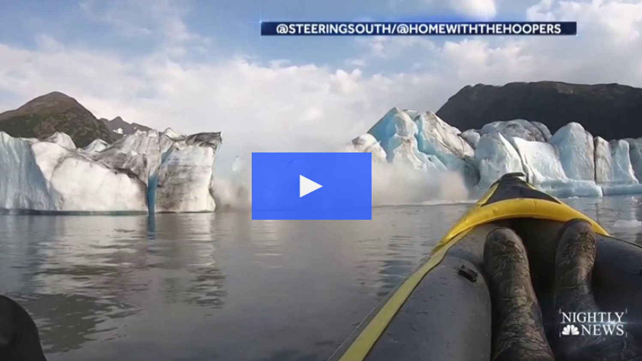
Alaska Glacier Collapses Near Kayakers
Notes:
NBC Nightly News. (2019, August 17). Dramatic video shows Alaska glacier collapse near kayakers [Video]. NBC. https://www.nbcnews.com/nightly-news/video/dramatic-video-shows-alaska-glacier-collapse-near-kayakers-66385477968

Slide 20
About & Obit
You are glaciologists.
As a team, develop an “About” presentation to help your classmates learn more about a U.S. glacier.
Individually, you will write an obituary, an “Obit,” for the glacier.

Slide 21
About & Obit Requirements
All information must be in your own words. Include the following:
In your group “About” presentation:
Glacier’s name, location, and status
1 image
1 interesting/unusual fact
In your individually written obituary “Obit:”
Glacier’s name and picture
Date of birth, date of death, and cause of death
Narrative that includes at least 1 important life event
Use a real organization or create a charity for a “fake” GoFundMe, which friends and family of the glacier can donate to in lieu of flowers

Slide 22

Spend a Buck
On your envelope, write the name of your organization listed in your Obituary.
You will collect “donations” in this envelope in memory of your glacier.
Notes:
K20 Center. (n.d.). Spend a Buck. Strategies. https://learn.k20center.ou.edu/strategy/154

Slide 23
About & Obit Presentations
Obit Presentation
Individually, share your obituaries for your glacier.
Remember to highlight your organization to donate to.
About Presentation
Each member should have a part.
Share your findings.

Slide 24
Spend a Buck
Donate to any glacier’s obituary, except yours!
Each strip on your bill represents $10.
You may choose to donate to only one, or you may split between several obituaries.
Notes:
K20 Center. (n.d.). Spend a buck. Strategies. https://learn.k20center.ou.edu/strategy/154

Slide 25
Tip of the Iceberg
Below the waterline, write what you have learned about glaciers during the lesson.
Are you able to answer the question(s) you wrote along the waterline after your experiment and research?
Notes:
K20 Center. (n.d.). Tip of the iceberg. Strategies. https://learn.k20center.ou.edu/strategy/67

