Slide 2
Glaciers: Here Today,
Gone Tomorrow?
Glacial Theory and Earth’s Systems

Slide 3
Essential Question
What is happening to modern-day glaciers?

Slide 4
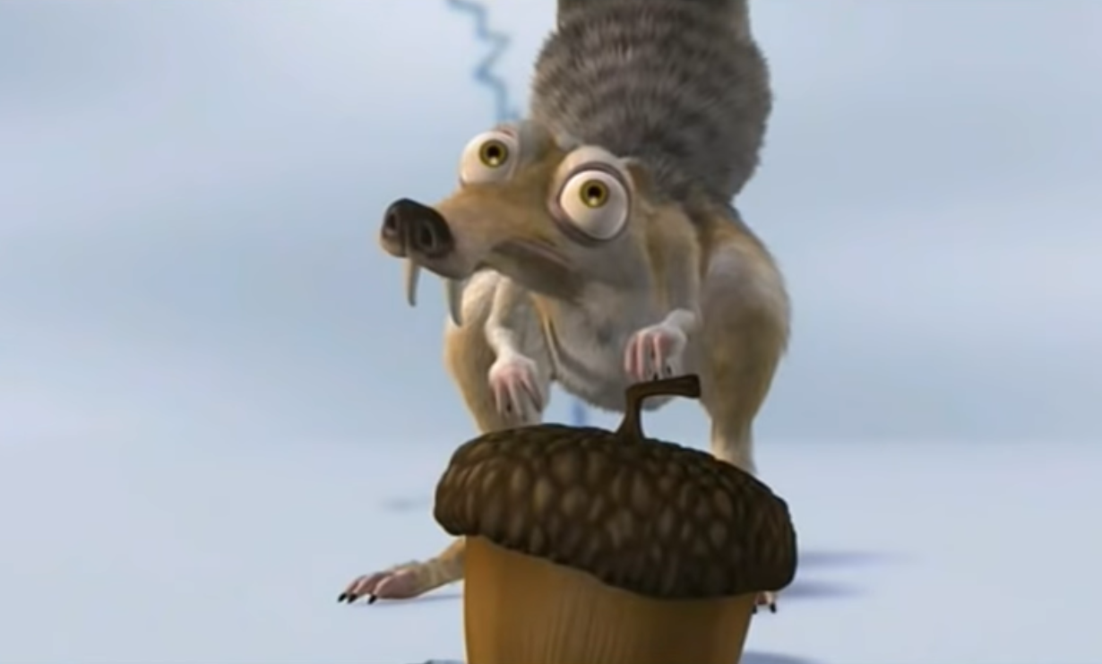
Field Trip Time
Destination: Ice Age
18,000 years ago
Notes:
Play the video by clicking on the image or pasting this link into your browser: https://www.youtube.com/watch?v=vCTNioSW730
Stop the video at 2:06, as the end of the video (where two glaciers start sliding into each other) is not relevant to the glacial movement described in this lesson.
Video source:
Ichbinverrukt46. (2008, December 12). Scrat Ice Age 1 [Video]. YouTube. https://www.youtube.com/watch?v=vCTNioSW730

Slide 5

Tip of the Iceberg
Write what you already know about glaciers above the waterline.
Write anything you want to know about glaciers along the waterline.
Save the space below the waterline for later in the lesson.
Notes:
K20 Center. (n.d.). Tip of the Iceberg. Strategies. https://learn.k20center.ou.edu/strategy/67

Slide 6
Lesson Objectives
Model how glaciers move.
Describe the role glaciers played in the formation of the Earth’s surface.
Predict what’s happening to glaciers and how they
will determine the Earth’s surface in the future.

Slide 7
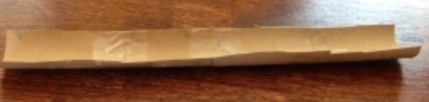
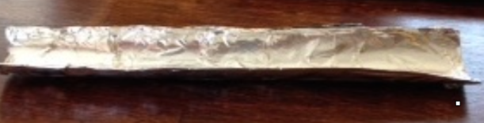
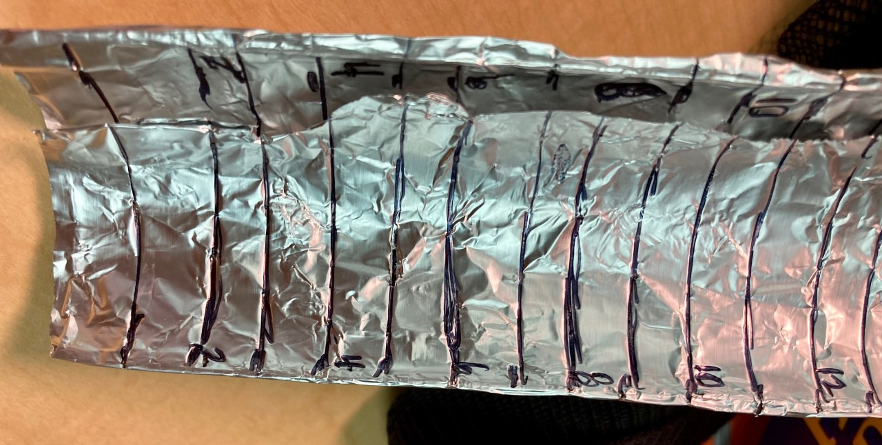
Build a Glacier, Part 1
Cut the paper towel tube in half, lengthwise, so you have two open channels.
Cover the channels with aluminum foil.
Mark the sides of each chute in 1 cm increments from top to bottom.
Notes:
As students complete the third step, be sure they mark each cm on the side of the foil-covered chute so they can read measurements even after they put the Gak in.

Slide 8
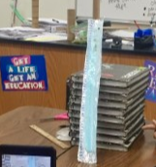
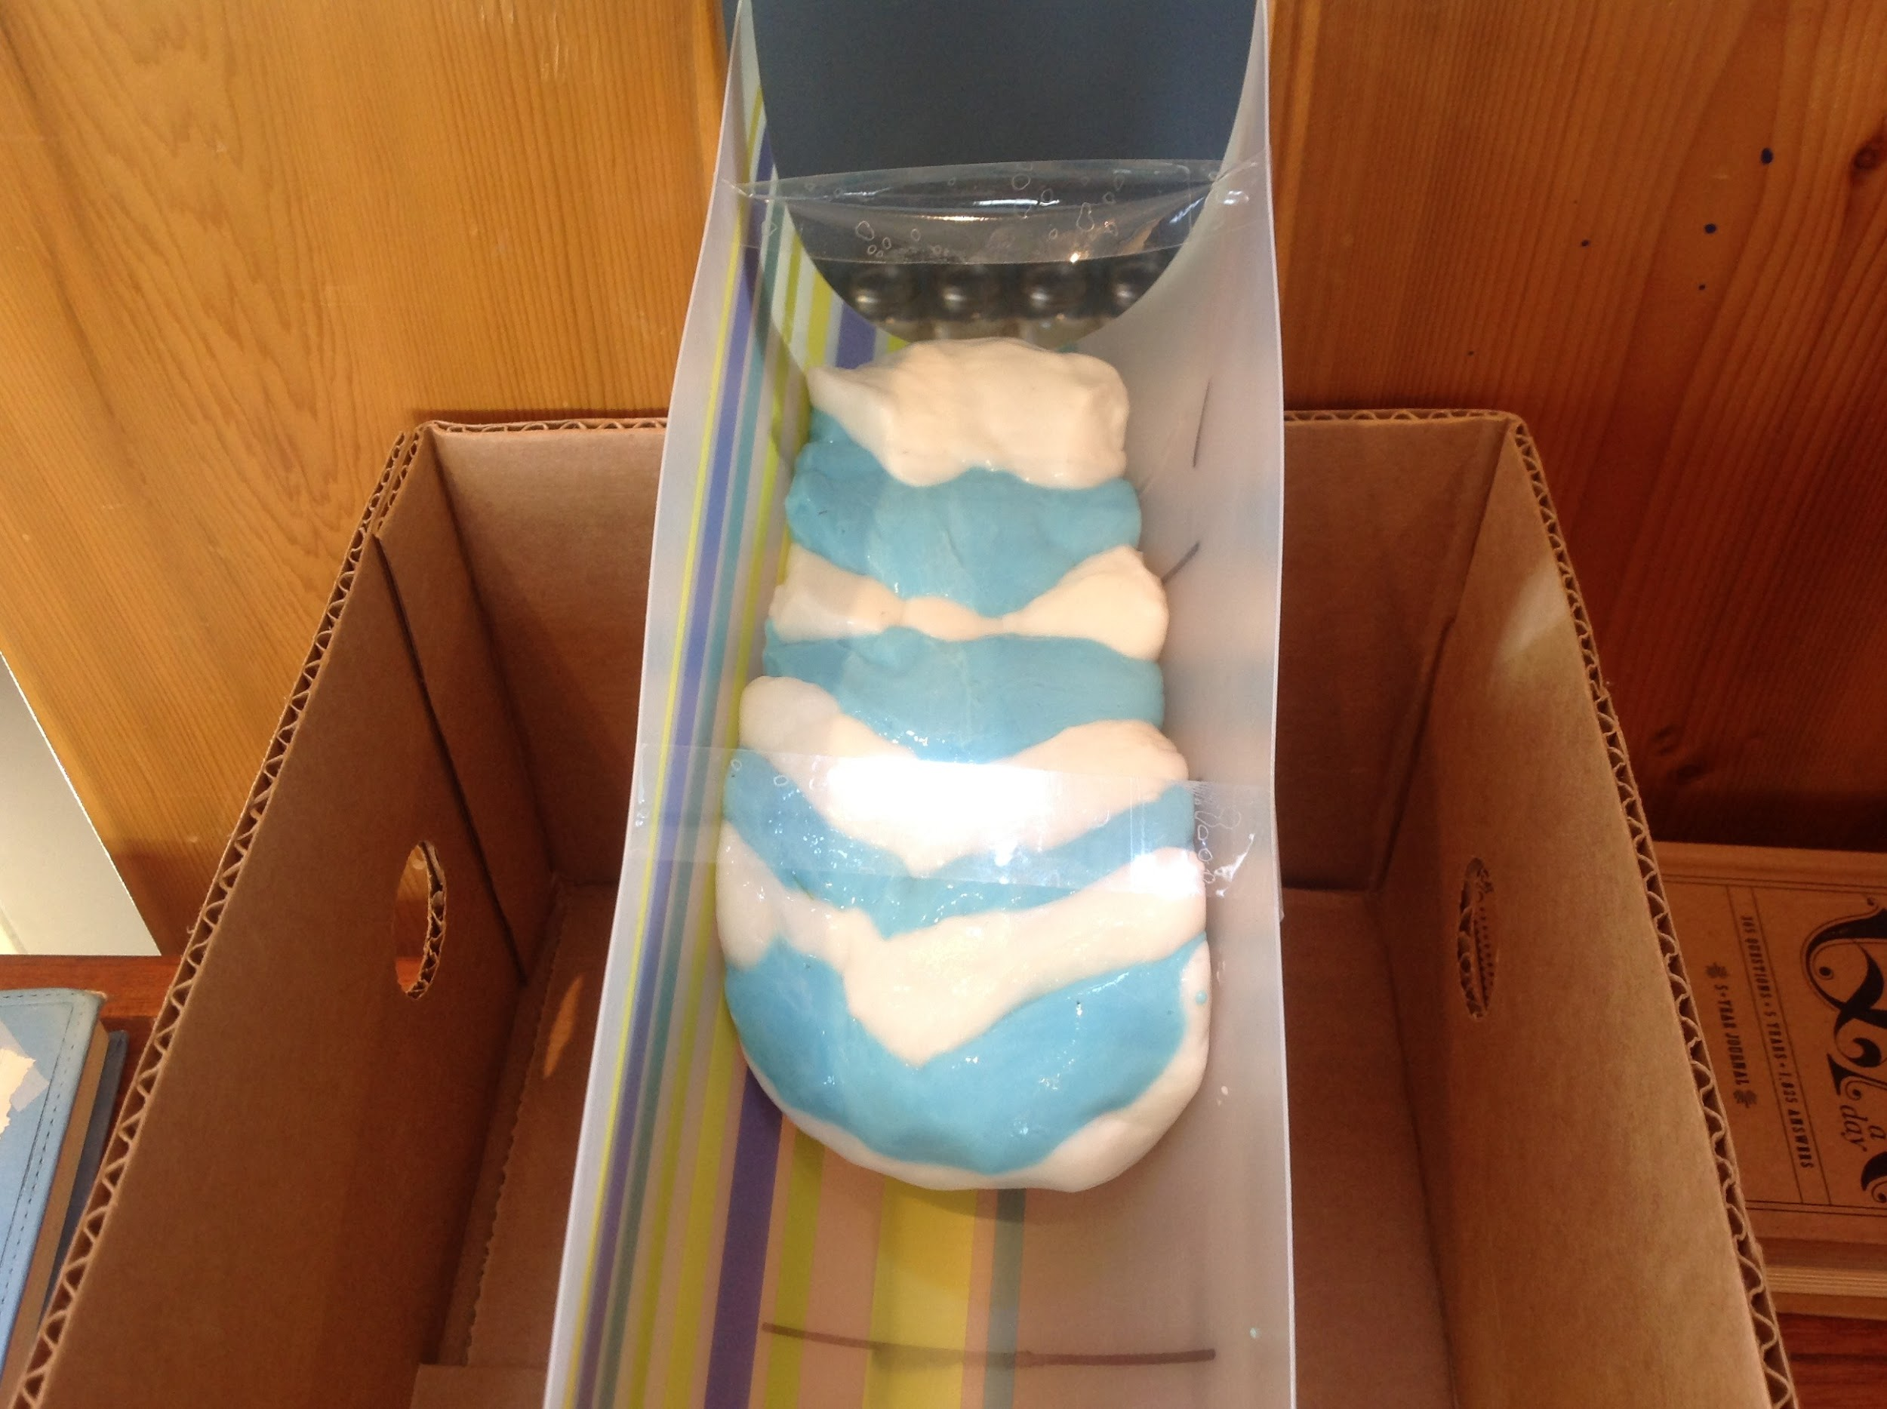
Build a Glacier, Part 2
Grab some books and prop up the channel.
Get some Gak of each color and add 10–15 small rocks to it.
Layer the two Gaks like a stack of coins, alternating colors.

Slide 9
Go With the Flow
First, draw your simulated glacier setup.
Follow the instructions on your handout to collect data.
  Start timing when you place the Gak layers at the top.
  In the table, record the time (in seconds) each time your “glacier” moves 1 cm farther.

Slide 10
Speedy Glaciers
How far (cm) did your glacier move by the end of class? How long did it take the glacier to move that distance?
Speed = distance
time
Who had the fastest glacier?

Slide 11
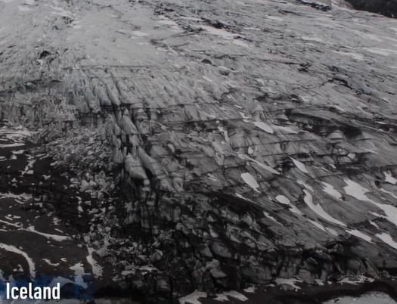
The Real Deal
Why did you have to take so many time readings while your glacier moved?
Notes:
Video link: https://vimeo.com/6039933
Video source:
Extreme Ice Survey. (2009, August 10). IL-05 Sólheimajökulll Glacier (Iceland) Time-lapse [Video]. Vimeo. https://vimeo.com/6039933

Slide 12

T-chart
What are the similarities and differences you noticed between your simulated glacier and a real glacier? List them on your handout.
What are the benefits of using simulations and models in science? What are the drawbacks?
Notes:
If students don’t make a connection right away, replay the video and ask them to note the date stamps (April 2007 to June 2016) of the time-lapse photography. You may also prompt them to look at debris.
K20 Center. (n.d.). T-chart. Strategies. https://learn.k20center.ou.edu/strategy/86

Slide 13
Let’s Dig Deeper, Part 1
When a glacier moves, along with the rocks it carries, what does it do to the valley underneath?
What happens over a long period of time if the glacier continues to scratch the ground?
What shape is the valley that forms when a glacier moves through?

Slide 14
Let’s Dig Deeper, Part 2
What causes glaciers to move and keep moving?
In your glacier simulation, what did the different colors of Gak represent?
Did you have any rocks deposited along the way as your glacier moved?

Slide 15
Diluvial Theory
Glacial Theory
First idea of how Earth's surface was shaped
Suggested land was shaped by a worldwide flood
Also referred to as
“flood geology”
Not supported by geological evidence and has been replaced by glacial theory
Accepted since late 1800s
Louis Agassiz, a Swiss geologist, tracked actual glaciers’ movements
Land was shaped by ice sheets that covered Earth’s surface
As ice sheets moved, they carved out the land,
deposited rocks, etc.

Slide 16
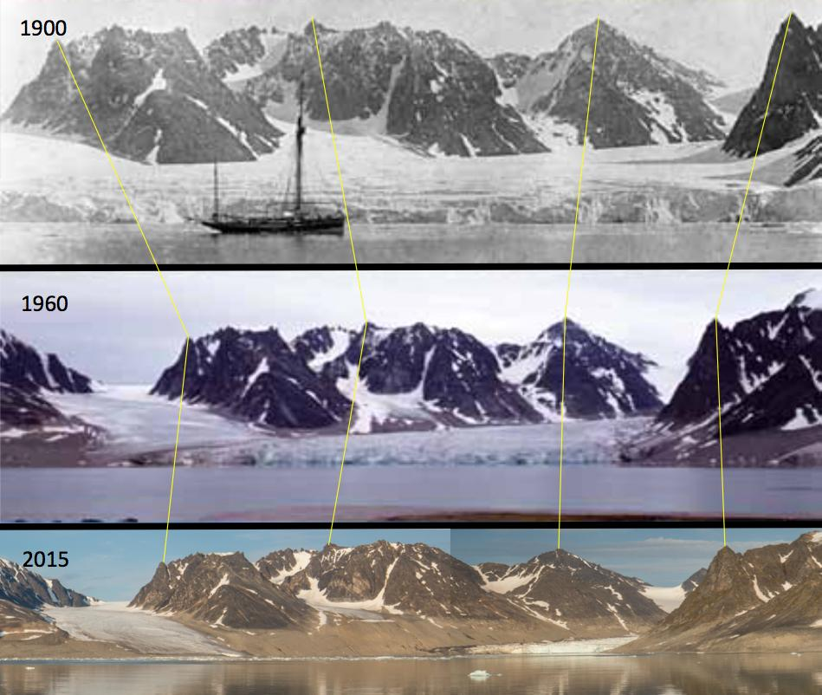
Here Today, Gone Tomorrow?
How do we continue to learn about glaciers?
Scientists called glaciologists study them using:
still photos,
videos, and
satellite images.
Notes:
Image source:
Weith, A. (2016, December 6). Glacier decrease on Svalbard in the years 1900-1960-2015 [Photographs]. Wikimedia Commons. https://commons.wikimedia.org/wiki/File:Glacier_decrease_on_Svalbard_in_the_years_1900-1960-2015.jpg

Slide 17
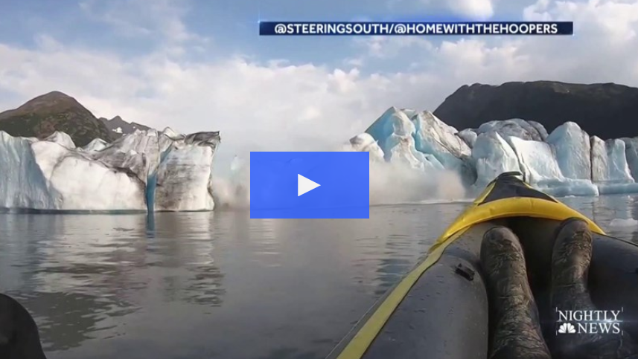
Notes:
Video link: https://www.nbcnews.com/nightly-news/video/dramatic-video-shows-alaska-glacier-collapse-near-kayakers-66385477968
Video source:
NBC Nightly News. (2019, August 17). Dramatic video shows Alaska glacier collapse near kayakers [Video]. NBC. https://www.nbcnews.com/nightly-news/video/dramatic-video-shows-alaska-glacier-collapse-near-kayakers-66385477968

Slide 18
Kahoot!
Notes:
Click on the iceberg to play, or paste this link into your browser: https://play.kahoot.it/v2/?quizId=4911091f-48ba-46aa-a0c5-3979f0294068

Slide 19

About & Obit
All information must be in
your own words. Include:
In your “About” presentation:
Glacier’s name, location, and status
1 image
1 interesting or unusual fact
In your written obituary:
Glacier’s name and picture
Date of birth, date of death, and cause of death
Narrative that includes at least 1 important life event
Real organization or charity for a “fake” GoFundMe, which friends
and family of the glacier can
donate to in lieu of flowers
Imagine you are glaciologists.
As a team, develop a presentation to help your classmates learn more about a U.S. glacier.
Individually, you will write an obituary for the glacier.
We will share our presentations next time.
Notes:
Click again to show students the requirements for the “About” group presentation, then click once more to reveal the “Obit” individual writing project guidelines.
Image source:
Raimondi1337. (2014, May 6). Tombstone [Illustration]. Openclipart. https://openclipart.org/detail/193304/tombstone

Slide 20
About & Obit Requirements
All information must be in your own words. Include:
In your “About” group presentation:
Glacier’s name, location, and status
1 image and 1 interesting/unusual fact
In your individually written obituary:
Glacier’s name and picture
Date of birth, date of death, and cause of death
Narrative that includes at least 1 important life event
Real organization or charity for a “fake” GoFundMe, which friends
and family of the glacier can donate to in lieu of flowers
Notes:
This slide is hidden, but you may choose to show it to students if they need to see the project requirements in a larger font size. To make the slide visible to students before you present, right-click on the slide preview (on the left side of your screen) and deselect “Hide Slide” near the bottom.

Slide 21

About & Obit Presentations
Groups: Each member should have
a part in the presentation.
Individuals: Share your obituary.
Each of you will receive a fake $100 bill to “donate”
to any organization but your own.
  You may “spend” all $100 on the same organization or divide
  your fake money among several organizations.
  Each strip on your bill represents $10.
Notes:
K20 Center. (n.d.). Spend a Buck. Strategies. https://learn.k20center.ou.edu/strategy/154

Slide 22
Tip of the Iceberg
Below the waterline, write what you have learned about glaciers during the lesson.
Are you able to answer the question(s) you wrote along the waterline now?
Notes:
K20 Center. (n.d.). Tip of the Iceberg. Strategies. https://learn.k20center.ou.edu/strategy/67

