Slide 2
Radiation and the Inverse Square Law
Electromagnetic Radiation, Astronomy, and the Inverse Square Law

Slide 3
Essential Questions
How does the intensity of radiation change as the distance from the radiating object changes?
What effect does this relationship have on the suitability of a planet for colonization?

Slide 4
Lesson Objectives
Establish the relationship between radiation intensity and the distance of a radiating source using a simple flashlight model.
Apply the inverse square relationship to consider effects of a planet’s distance from the Sun on its ability to be colonized.
Adapt the inverse square law to charge-charge and gravity attraction forces.

Slide 5
Where Could Humans Colonize in Our Solar System?
On a sticky note, answer this question: What planet or moon in the Solar System (excluding Earth) would be the best place to build a human colony?
Form groups of increasing size and compare answers. Explain why your chosen location would be a good place. Then post your answer in a common space.
Notes:
K20 Center. Affinity Process. Strategies. https://learn.k20center.ou.edu/strategy/87

Slide 6
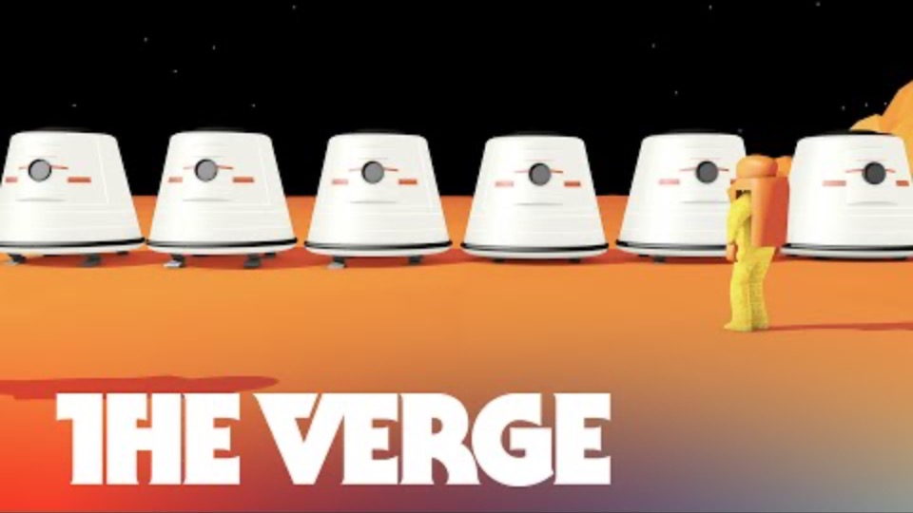
What are Reasons to Target Mars and Challenges of Colonizing It?
Take notes in a T-Chart:
Reasons Challenges
Notes:
The Verge. (2014, October 16). Can we colonize Mars? - THE BIG FUTURE Ep. 2 [Video]. YouTube. https://www.youtube.com/watch?v=9yI3U_yCfj8
K20 Center. (n.d.). T-Chart. Strategies. https://learn.k20center.ou.edu/strategy/86

Slide 7

Radiation Hitting Mars and Earth
One challenge is collecting solar energy for warmth and to grow food. List strategies the video raises for collecting beneficial solar radiation.
Hazardous radiation is a challenge. What types of electromagnetic radiation from the Sun are hazardous?

Slide 8
Using a Flashlight to Model the Sun
Mars is further from the Sun than the Earth is. Does that make the intensity of solar radiation relatively higher on Mars or on Earth? Explain.
In general, does the amount of radiation increase, decrease, or stay the same as the distance from a light source is increased? Do you think there an equation for this relationship?
Sun
Distance to Mars
M
Distance to Earth
E

Slide 9
Data to Measure and Calculate
Column 1 Light distance from surface (cm) | Column 2 Light circle radius (cm) | Column 3 Light circle radius (m) = Column 2 / 100 | Column 4 Light circle AREA =π (radius)(radius) = π r² = π (Column 3)² | Column 5 Light Circle BRIGHTNESS = 1/AREA = 1/Column 4
10
20
30
40
Measure these data first
Then calculate these columns

Slide 10
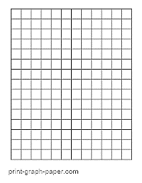
Explore Objectives
Form groups of 2–4 and gather materials.
Measure Column 2 data.
Calculate Column 3–5 data.
Check calculations with the teacher.
Make two graphs:
  Graph A: Radius vs. Distance
  Graph B: Brightness vs. Distance

Slide 11
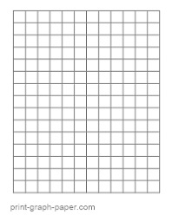
Inverse and Direct Relationships
Graph C (and Graph B?)
Graph D (and Graph A?)
Inverse Relationship: y ~ 1/x
Direct Relationship: y ~ x

Slide 12
Inverse or Direct? (Explain #1–6)
How do these light circle properties relate to the distance of a flashlight from the surface?
  Radius (Column 2; Graph A) DIRECT? INVERSE?
  Area (Column 4) DIRECT? INVERSE?
  Brightness (Column 5; Graph B) DIRECT? INVERSE?

Slide 13

Brightness, Geometry, and “Inverse Square Law” (Explain #7–9)
$Brightness= \frac{1}{{Distance}^{2}}$ OR $y= \frac{1}{x^{2}}$
3d
d
r
similar right triangle
3r
Distance 1d 2d 3d
Radius (similar triangles) 1r 2r 3r
Area (Area ~ r²) 1r²=r² (2r)² = 4r² (3r)² = 9r²
Brightness ~1/AREA = 1r² 1/4r²~1/4d² 1/9r²~1/9d²

Slide 14
Radiation in the Solar System (Extend #1–6)
Comparing Venus (V), Earth (E), and Mars (M)
E
M
V
Surface Temperature °C 471 16 -28
Incoming radiation Highest Medium Lowest
Radiation at surface Lower <<< Higher

Slide 15
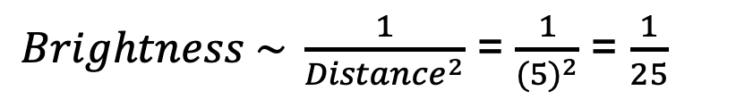
Jupiter vs. Earth (Extend #7)
J
1d
5d
E
r
5r
$Brightness \sim \frac{1}{{Distance}^{2}}$ = $\frac{1}{{(5)}^{2}}$ = $\frac{1}{25}$

Slide 16
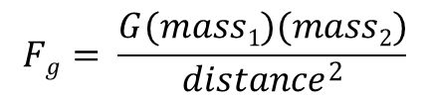
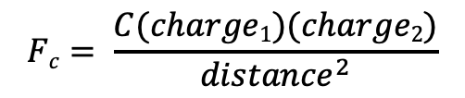
Other Inverse Square Law Examples (Extend #8–10)
Coulomb’s Law (charges) Newton’s Law (gravity)
Which circle allows the strongest charge attraction?
$$Fc= \frac{C(charge1)(charge2)}{{distance}^{2}}$$
$$Fg= \frac{G(mass1)(mass2)}{{distance}^{2}}$$
WHICH ATOM?
A
B

Slide 17
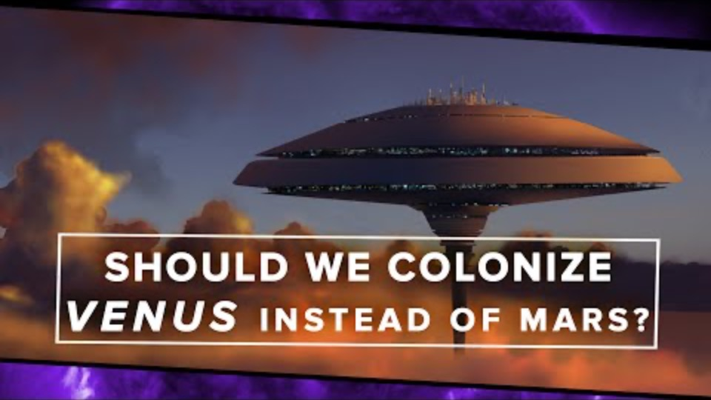
Is Venus a Better Target for Colonization?
Take notes in a T-Chart:
Reasons Challenges
Notes:
PBS Space Time. (2015, March 4). Should we colonize Venus instead of Mars? [Video]. YouTube. https://www.youtube.com/watch?v=gJ5KV3rzuag

Slide 18
Tell the POTUS Where We Should Colonize
Write a letter to the US President recommending a colony location.
  Recommend Mars, Venus, or a third location in the solar system.
  Use evidence to support your recommendation, such as T-chart notes you made while watching the Mars and Venus videos.
  If necessary, watch the Mars video again.
  If time allows, complete and use additional research.
  The letter should be at least one page long.

