Slide 2
Light Absorption and the Solar Spectrum
Light Absorption and Stars

Slide 3
Essential Question
What is light absorption and how does this phenomenon help scientists identify stars that harbor planets that could support life?

Slide 4
Lesson Objectives
Students will:
Explore the phenomena of light absorption by viewing the spectrum of the sun reflected off of different colors of paper.
Analyze data to identify elements that absorb light in the Sun and learn about the importance of this absorption.
Compare light spectra from two stars to learn more about how spectra are used to categorize stars.

Slide 5
Light Absorption in Daily Life
What clothing colors stay cooler on bright, sunny days? What role does light absorption and reflection play in this phenomenon?
Reflection
Emission
Absorption
Clothing

Slide 6
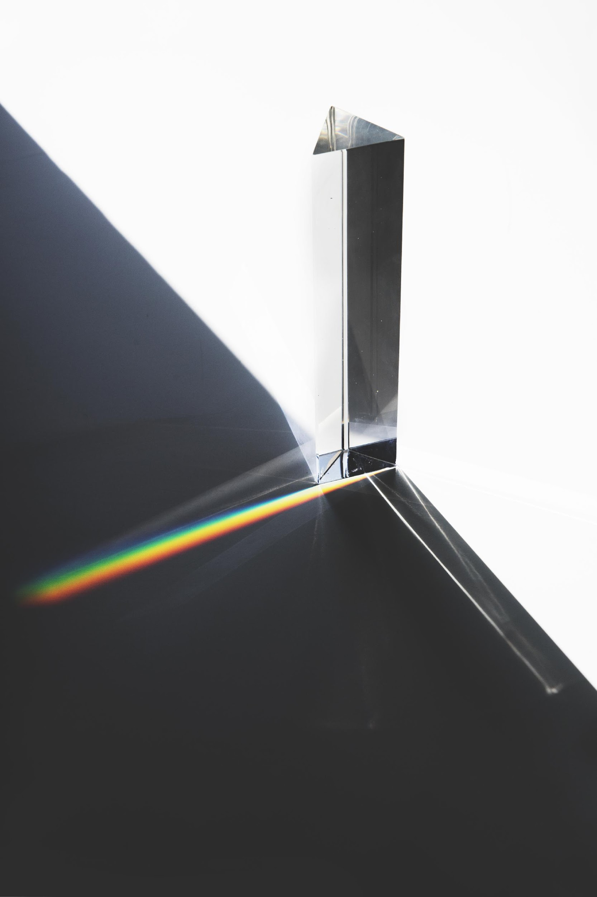
Details of Light Made by Stars
Draw or describe an example of a light spectrum. How do spectrometers help scientists observe them?
What star properties make it more likely they harbor an orbiting planet that sustains life? What can star spectra tell us about these properties?
https://www.freepik.com/photos/background

Slide 7

Why Is It Unsafe to Look Directly at the Sun?
Staring at the Sun can cause blindness. How exactly does sunlight cause blindness?
Absorption leads to:
solar keratitis
solar retinopathy
https://www.freepik.com/vectors/green

Slide 8
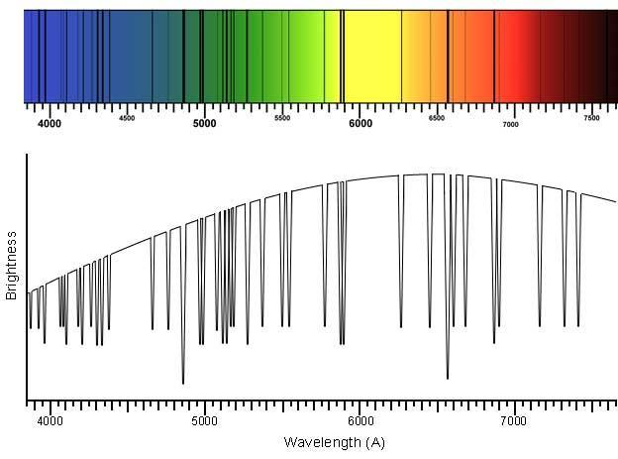
Emission and Absorption in the Sun’s Spectrum
Absorption
by Elements at Surface
Emission in the Center
https://ia.terc.edu/spectral_solar_spectrum.html

Slide 9
What Elements Absorb Light in the Sun?
How well do lines match? | Elements from database
ALL element lines are in the solar spectrum
SOME element lines are in the solar spectrum
NO element lines are in the solar spectrum

Slide 10
Color Materials Absorb and Reflect Different Colors of Light
Object color is reflected light
Complementary color is absorbed --> generates heat
What colors are absorbed by white? Black?
Reflection
Emission
Absorption
https://www.freepik.com/vectors/green

Slide 11
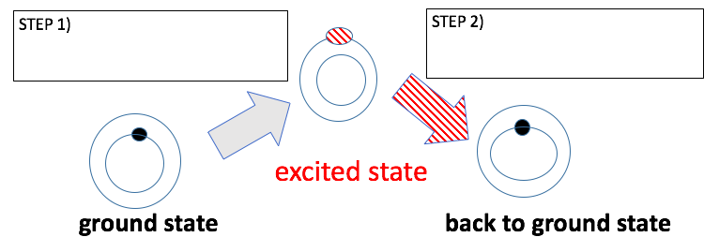
How Do Atoms Absorb Light?
Rings = Energy Levels; Dots = Electrons
Step 1 = Light Absorbed
Step 2 = Energy Released = Heat or Emitted Light
Overall energy is conserved

Slide 12
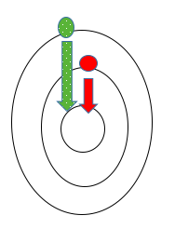

Why are Different Colors Absorbed?
Electrons in a Bohr Model
Different color = Different energy
High energy 🡪 Low energy

Slide 13
Are These Elements in the Sun if…
Hydrogen’s absorption lines match the Sun’s absorption lines?
Neon’s absorption lines do NOT match a solar absorption line?
Absorption
Hydrogen
Neon ???

Slide 14
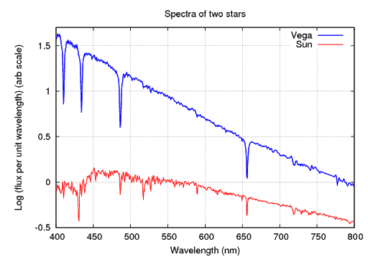
How Much Do Star Spectra Vary? Why?
Vega vs. the Sun
  Same color?
  Same elements?
VEGA
SUN
http://spiff.rit.edu/classes/phys301/lectures/spec_lines/spec_lines.html

Slide 15
Gallery Walk to discuss Extend Questions
You will pick or be assigned one of the questions in the Extend section to present to others.
Form groups with other students that picked the same question.
Discuss your answers and produce a poster to share with other students.
Tour the room to look at the other posters.

Slide 16
Two-minute Paper
Reflect on the following prompt:
  What is light absorption and how does this phenomenon help scientists learn about stars?
When advised to start, please write a two-minute report on the prompt.
Turn in your report.

Slide 17

Muddiest Point
At this point in the discussion, what is the most confusing idea you want to discuss to understand it better?
Write down your muddiest point and your name on a card.
Turn in the card, knowing your name will not be used if we discuss your confusion.

