Slide 2
Department of the Exterior Angles
Polygons and the Exterior Angle Sum Theorem

Slide 3
Essential Question
How do we solve problems using exterior angles?

Slide 4
Lesson Objectives
Identify the relationship between interior and exterior angles in the context of finding unknown values.
Analyze data to draw conclusions about the relationships between exterior angles of a polygon.
Evaluate all components of yearlong learning to decide what information applies to solving a specific problem.

Slide 5
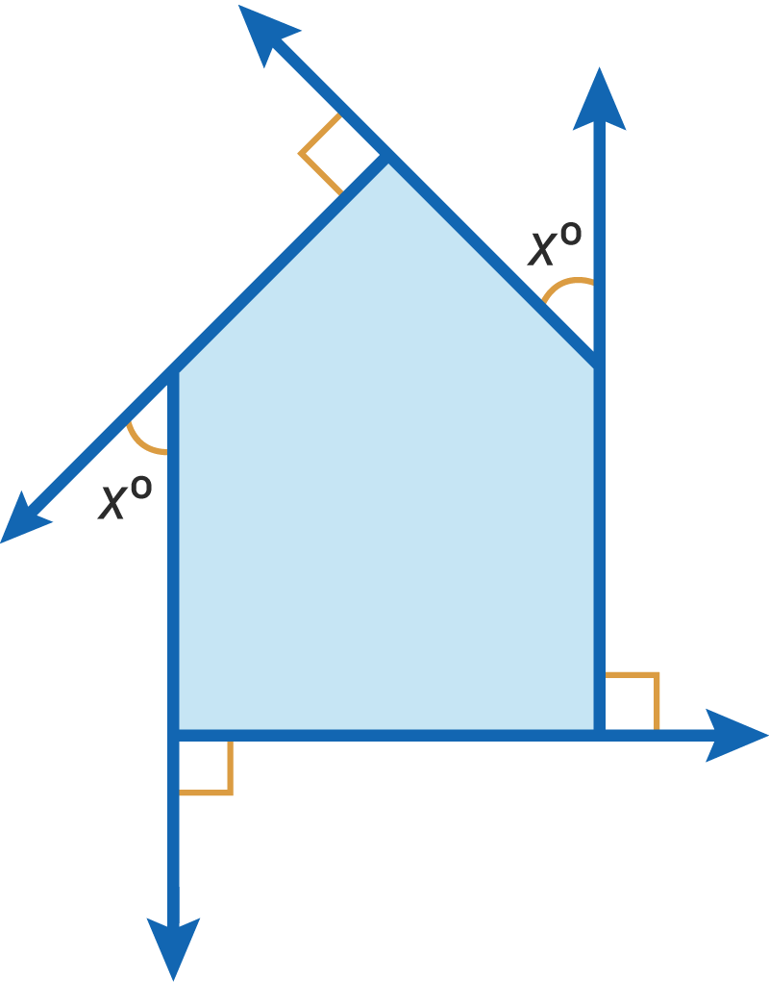
Polygon: Pass It On
In your group, take turns identifying and writing or labeling what you know about the given polygon.
Be sure to write your reasoning.
Pass the paper to the person on your right.
Repeat.
Notes:
Strategy: K20 Center. (n.d.). Chain Notes. Strategies. https://learn.k20center.ou.edu/strategy/52

Slide 6
Playing With Polygons
Before using scissors, carefully read all directions on your handout. Then, follow the steps.
When you put together the vertices of all the exterior angles, what shape do they form?
Make a prediction.
How could this change if the number of sides changes?

Slide 7
Playing With Polygons: Your Turn
Follow the steps from the handout to create your own polygon.
 | Step 1: Draw a polygon with dashed lines. |  | Step 3: Draw semi-circles that include the interior and exterior angles. Make each semi-circle a different color.
 | Step 2: Take a ruler and draw dashed lines to extend the legs of the polygon. Repeat around the polygon clockwise or counterclockwise. |  | Step 4: Number each exterior angle.
Step 5: Cut out the exterior angles.
Step 6: Put their vertices together to form a new shape.

Slide 8
Gallery Walk
Individually, go to four different stations.
Use your Polygon Patterns handout to collect data about different polygons and their exterior angles.
Don’t forget to write the name of each polygon type at the top of each table.
Talk with your group about your observations.
Notes:
Strategy: K20 Center. (n.d.). Gallery Walk. Strategies. https://learn.k20center.ou.edu/strategy/118

Slide 9
Why 360°?
Notes:
To play the video, click the image on the slide or copy and paste the following link into your web browser: https://www.youtube.com/watch?v=VYbiE9sDXXk
Video source:
VanHattum, S. (2019, April 14). Exterior angles, by magic pi - math animations. YouTube. https://www.youtube.com/watch?v=VYbiE9sDXXk

Slide 10
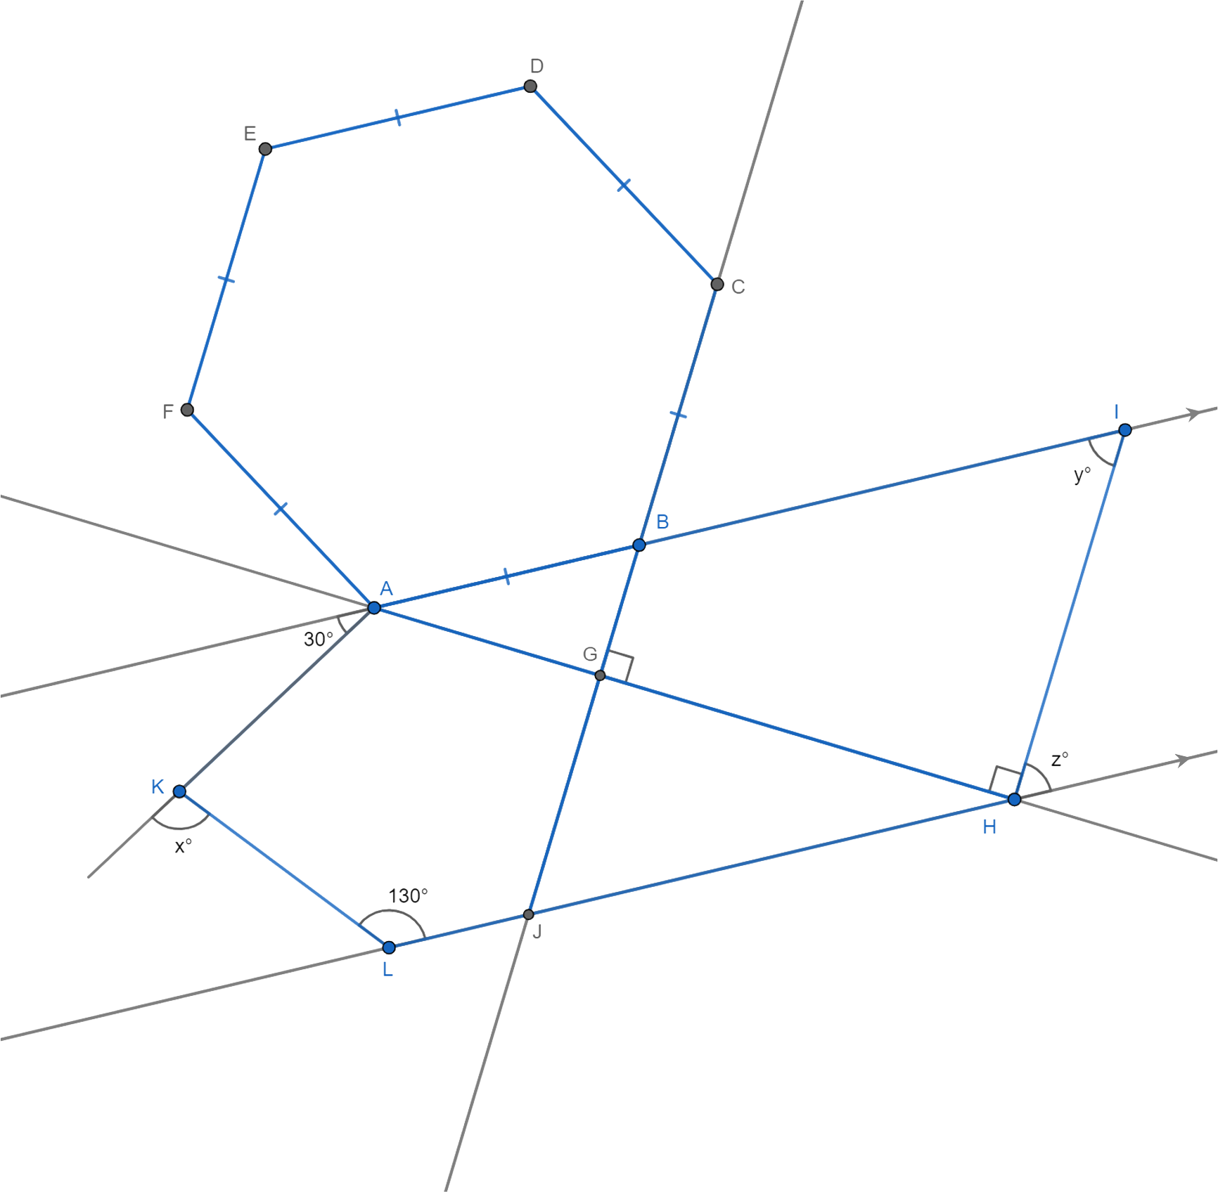
Polygon Puzzle

Slide 11
Polygon Perspectives
Talk to a new partner about the strategies each of you used to solve the Polygon Puzzle.
What was similar and what was different between your approaches?
Record your thoughts on the handout.
Notes:
Strategy: K20 Center. (n.d.). Bell ringers and exit tickets. Strategies. https://learn.k20center.ou.edu/strategy/125

