Slide 2
Department of the Exterior Angles
Polygons and the Exterior Angle Sum Theorem

Slide 3
Essential Question
How do we solve problems using exterior angles?

Slide 4
Lesson Objectives
Identify the relationship between interior and exterior angles in the context of finding unknown values.
Analyze data to draw conclusions about the relationships between exterior angles of a polygon.
Evaluate all components of yearlong learning to decide what information applies to solving a specific problem.

Slide 5
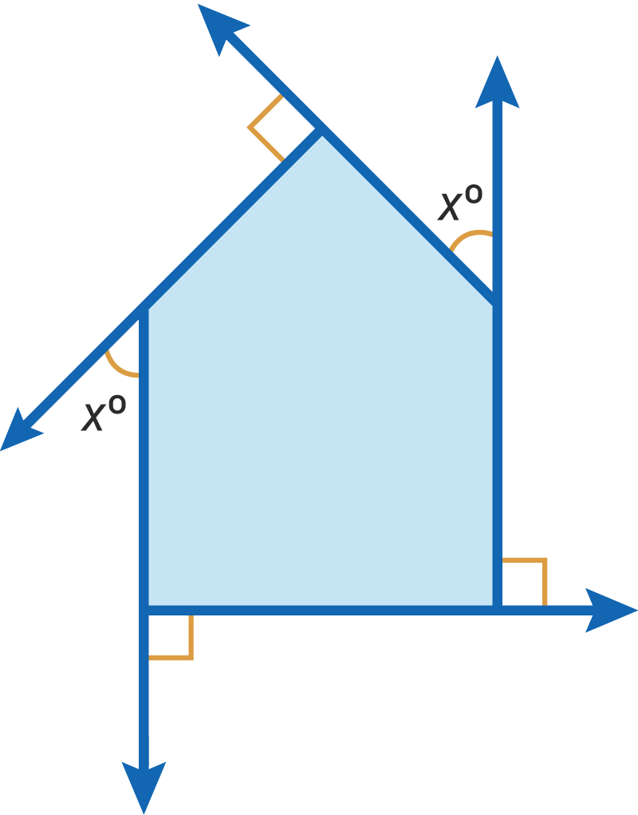
Polygon: Pass It On
In your group, take turns identifying and writing or labeling what you know about the given polygon.
  Be sure to write your reasoning.
  Pass the paper to the person on your right.
  Repeat.
Notes:
Strategy: K20 Center. (n.d.). Chain Notes. Strategies. https://learn.k20center.ou.edu/strategy/52

Slide 6
GeoGebra Activity
Carefully read and follow all the directions on the Polygon Patterns handout.
Move the points 3–4 times for each polygon before answering the questions in each table.
  Talk with your group about your observations.
Notes:
Link to the GeoGebra activity: https://www.geogebra.org/m/we6ww7cz
Source:
Brzezinski, T., and Eike, M. Department of the Exterior Angles. GeoGebra. https://www.geogebra.org/m/we6ww7cz

Slide 7
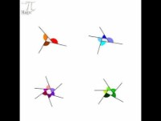
Why 360°?
Notes:
To play the video, click the image on the slide or copy and paste the following link into your web browser: https://www.youtube.com/watch?v=VYbiE9sDXXk
Video source:
VanHattum, S. (2019, April 14). Exterior angles, by magic pi - math animations. YouTube. https://www.youtube.com/watch?v=VYbiE9sDXXk

Slide 8
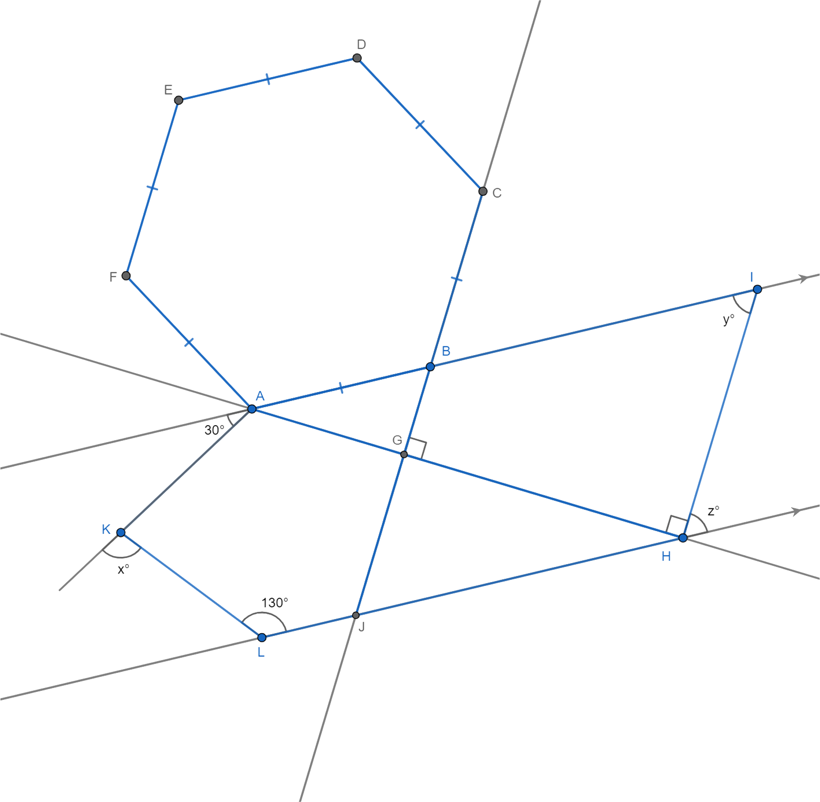
Polygon Puzzle

Slide 9

Polygon Perspectives
Talk to a new partner about the strategies each of you used to solve the Polygon Puzzle.
What was similar and what was different between your approaches?
  Record your thoughts on the handout.
Notes:
Strategy: K20 Center. (n.d.). Bell ringers and exit tickets. Strategies. https://learn.k20center.ou.edu/strategy/125

