Slide 2
A Write at the Museum
Ekphrastic Poetry

Slide 3
Lesson Objectives
Students will be able to:
Use specific language to achieve the aim of ekphrasis;
Create a multimodal artifact in response to visual art.

Slide 4
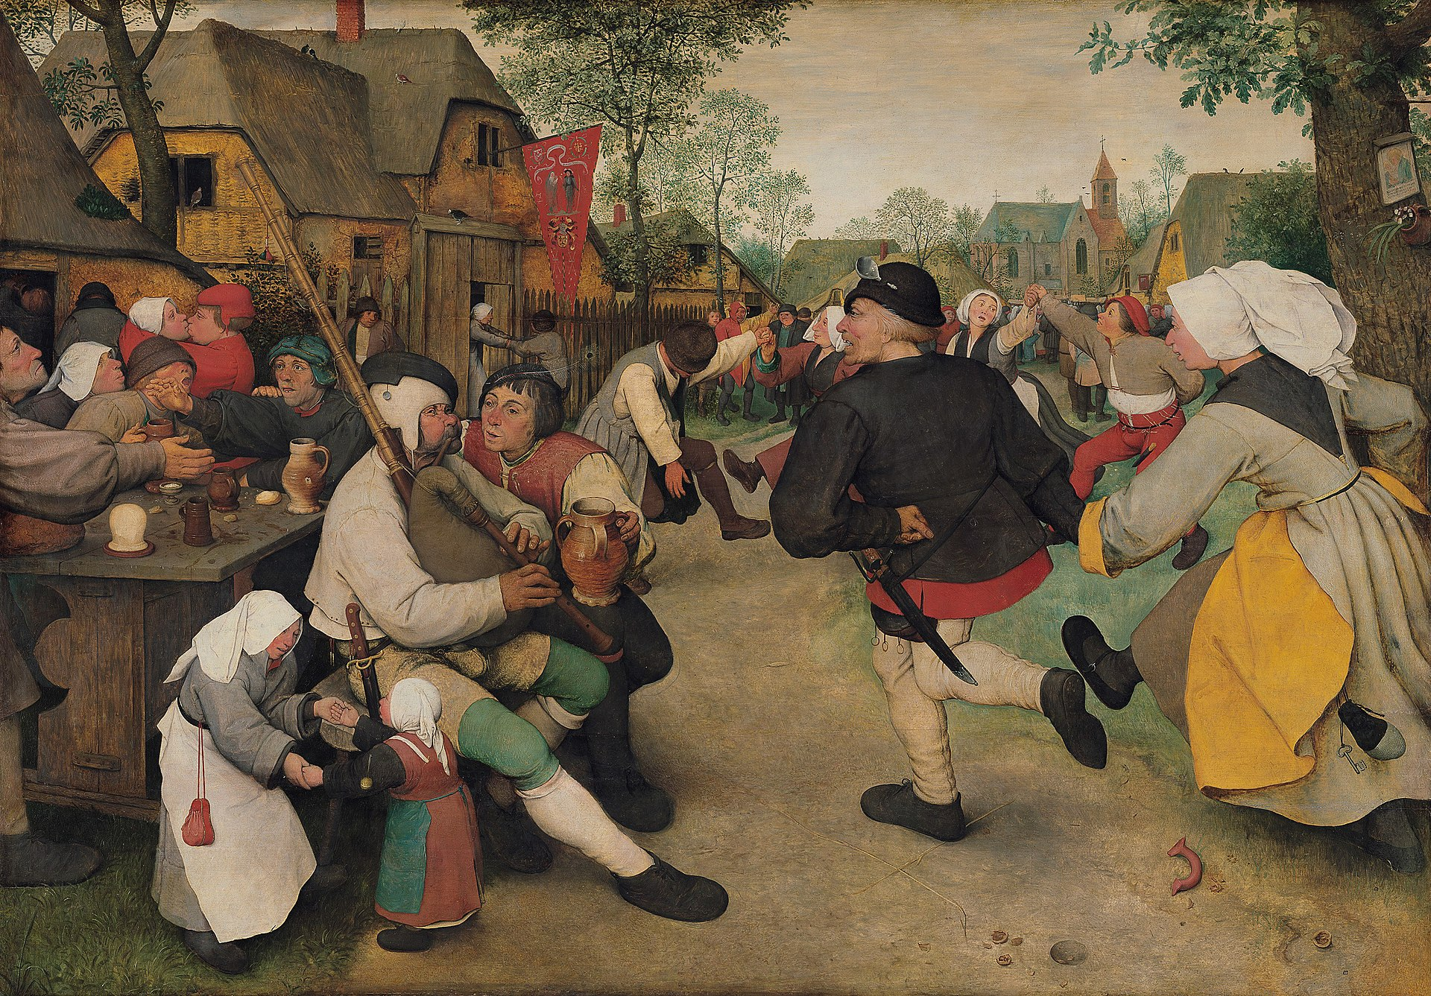
Notes:
Bruegel, Pieter. The Peasant Dance. 1567, Kunsthistorisches Museum, Vienna.

Slide 5
The Peasant Dance
Write a three-line poem describing “The Peasant Dance”:
In________________
The______________
Around____________

Slide 6
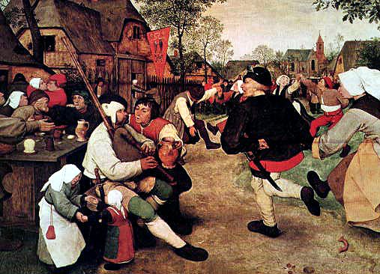
The Dance
by William Carlos Williams
In Breughel’s great picture, The Kermess,
the dancers go round, they go round and
round, the squeal and the blare and the
tweedle of bagpipes, a bugle and fiddles
tipping their bellies, (round as the thick-
sided glasses whose wash they impound)
their hips and their bellies off balance
to turn them. Kicking and rolling about
the Fair Grounds, swinging their butts, those shanks must be sound to bear up under such rollicking measures, prance as they dance
in Breughel’s great picture, The Kermess
Notes:
William Carlos Williams. 1962. The Dance. Poetry.com. https://www.poetry.com/poem/39703/the-dance

Slide 7
“The Dance” by William Carlos Williams
What similarities did you notice between this poem and yours?
What was it like to write about what was happening in the painting?

Slide 8
Ekphrasis
The word ekphrasis, which comes from Greek, is a vivid, often dramatic, verbal description of, or commentary on, a visual work of art.
Notes:
Ekphrasis | Definition of Ekphrasis by Merriam-Webster (merriam-webster.com)

Slide 9
Breugel Virtual Gallery
https://my.3dvirtualexperience.nl/bruegel_begegnen_only_in_vienna/index.html#dh=0&lang=en

Slide 10
The Met Virtual Gallery
https://www.metmuseum.org/art/online-features/metkids/
Click “Hop in the Time Machine”
Use the filters to specify the art you would like to see (then push the red button lower right)

Slide 11
The Met Virtual Gallery - Art Critic
What immediately grabs my attention? Why?
What am I drawn to because I like the way it looks?
  What positive feelings arise?
What am I drawn to because I don’t like the way it looks?
  What negative feelings arise?

Slide 12
The Met Virtual Gallery - Art Critic
Who made this?
What stands out in this piece?
Who/what is the subject matter?
What is happening in this piece?
What do you think the artist had in mind when creating this piece?
How do you feel when you look at this piece?
What does this piece remind you of?
What sensory details can you observe in this piece?
What sensory details can you infer from this piece?

Slide 13
Essential Question
How can poetry engage with visual art?

Slide 14
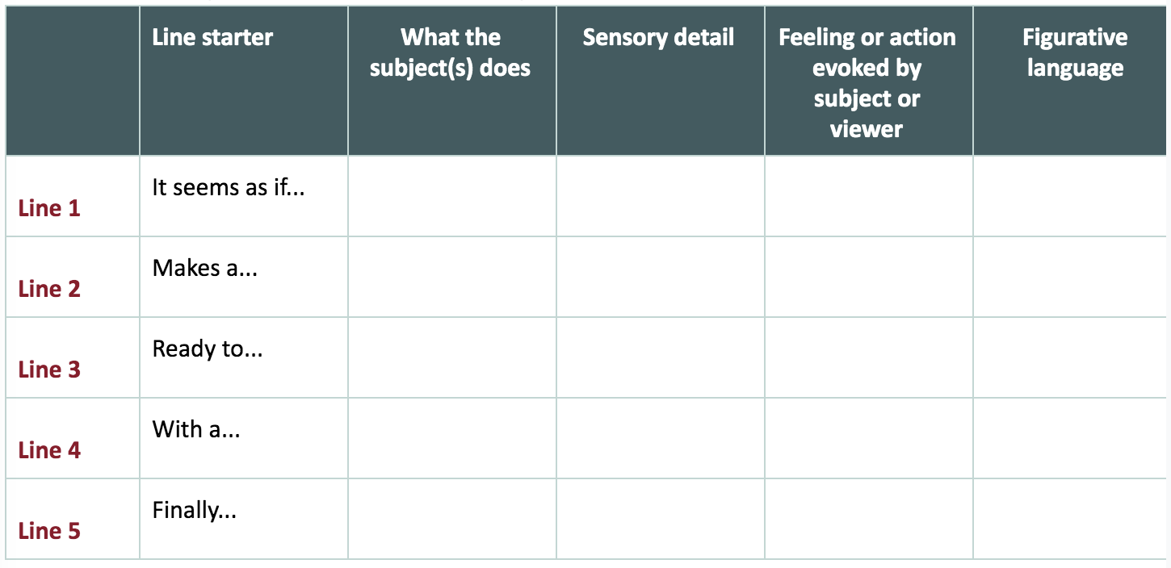

Slide 15
Ekphrasis Reflection
What is the tone of your poem? (earnest, romantic, sarcastic, humorous, etc.)
  Explain by citing specific parts of your poem.
What inspired the tone of your poem?
  Explain by citing specific parts of your poem and describing specific elements of the art.
How does the tone of your poem compare with how the piece of art appears?
  Does it complement or contrast with the art? Explain.

