Slide 2
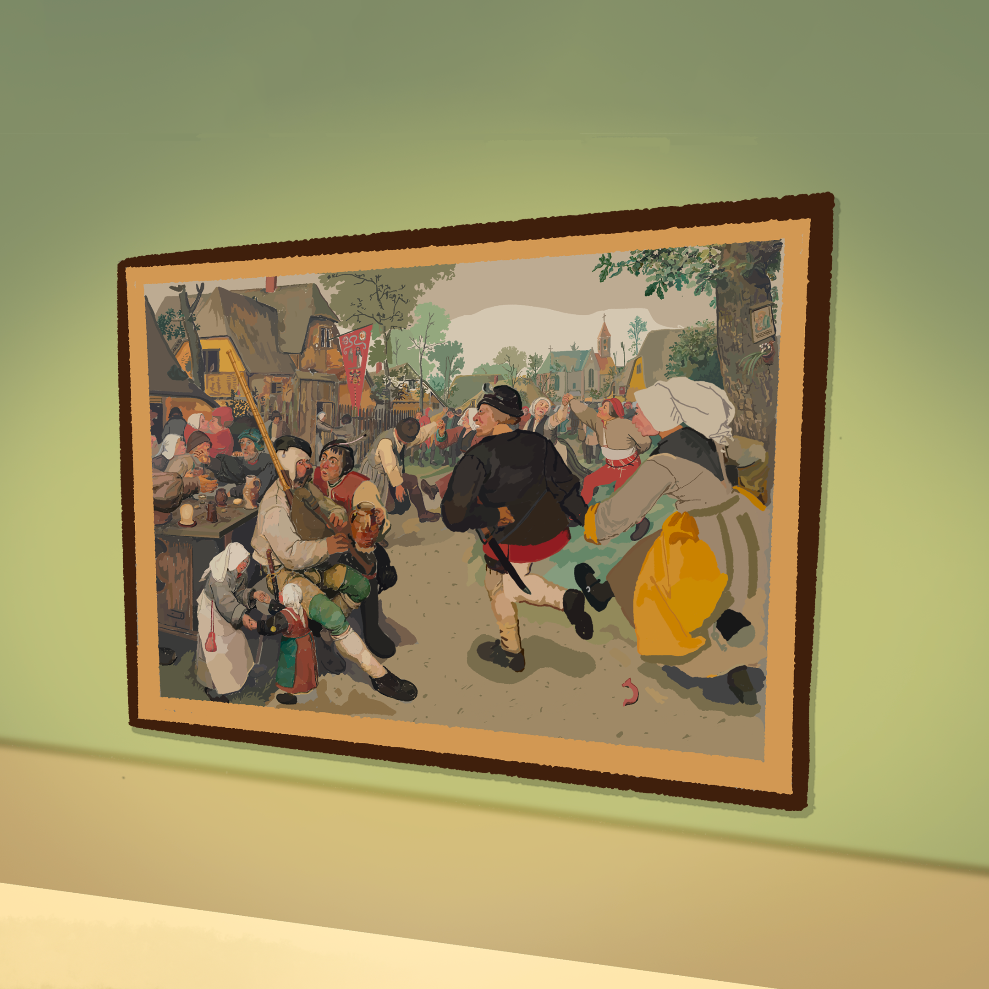
A Write at the Museum
Ekphrastic Poetry

Slide 3
Lesson Objectives
Analyze visual artwork to interpret its meaning using personal insight and observation.
Compose an original ekphrastic poem that communicates an interpretation of a selected work of art.

Slide 4
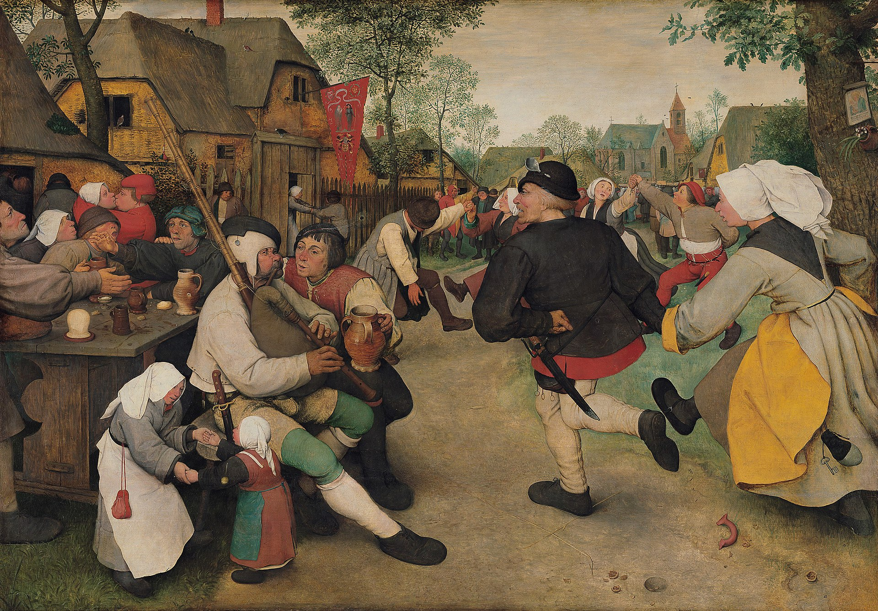
Bruegel, Pieter. (1567). The Peasant Dance [Painting]. Kunsthistorisches Museum, Vienna.
Notes:
Bruegel, Pieter. (1567). The Peasant Dance [Painting]. Kunsthistorisches Museum, Vienna.

Slide 5
The Peasant Dance
Write a three-line poem describing “The Peasant Dance.”
  In _______________
  The _______________
  Around _______________

Slide 6
“The Dance” by William Carlos Williams
What similarities did you notice between this poem and yours?
What was it like to write about what was happening in the painting?

Slide 7
Ekphrasis
The word ekphrasis, which comes from Greek, is a vivid, often dramatic, verbal description of or commentary on a visual work of art.

Slide 8
Breugel Virtual Gallery
Go to k20.ou.edu/6o.
Explore the virtual museum.

Slide 9
The Met Virtual Gallery
Go to k20.ou.edu/be.
Use the filters to specify the art you would like to see.
Push the red button in the lower right corner to create a virtual gallery.

Slide 10
The Met Virtual Gallery - Art Critic
What immediately grabs my attention? Why?
What am I drawn to because I like the way it looks?
  What positive feelings arise?
What am I drawn to because I don’t like the way it looks?
  What negative feelings arise?

Slide 11
The Met Virtual Gallery - Art Critic
Who made this?
What stands out in this piece?
Who/what is the subject matter?
What is happening in this piece?
What do you think the artist had in mind when creating this piece?

Slide 12
The Met Virtual Gallery - Art Critic
How do you feel when you look at this piece?
What does this piece remind you of?
What sensory details can you observe in this piece
What sensory details can you infer from this piece?

Slide 13
Essential Question
How can poetry engage with visual art?

Slide 14
 | Line Starter | What the Subject Does | Sensory Detail | Feeling or Action Evoked by Subject or Viewer | Figurative Language
Line 1 | It seems as if…
Line 2 | Makes a….
Line 3 | Ready to…
Line 4 | With a…
Line 5 | Finally…

Slide 15
Ekphrasis Reflection
Write a response that includes answers to the following questions. Your response should be at least one paragraph long.
What is the tone of your poem? (Earnest, romantic, sarcastic, humorous, etc.)
What inspired the tone of your poem?
How does the tone of your poem compare with how the piece of art appears?

