Slide 2
It’s Never Too Late To Apologize
Grade 9 English Language Arts

Slide 3
Essential Question
How do characters’ states of mind affect their development and the development of the theme in a text?

Slide 4
Lesson Objective
Analyze how a character’s emotional development affects the development of the theme in the text.

Slide 5
“This is Just to Say”
What is the speaker apologizing for?
What is his tone?
Does he mean it?
Notes:
Link to Poem: Williams, W. C. (1934). This is just to say. The Academy of American Poets. https://poets.org/poem/just-say
Image Source: aalmeidah (2017, Jan. 19). Plum. Pixabay. https://pixabay.com/illustrations/plum-fruit-fruits-orchard-nature-1992429/

Slide 6
SOAPSTone
Speaker: Identify the speaker
Occasion: Identify the time and place
Audience: Identify the intended reader/listener
Purpose: Identify the speaker’s or author’s goal
Subject: Identify the general topic
Tone: Identify the speaker’s attitude

Slide 7
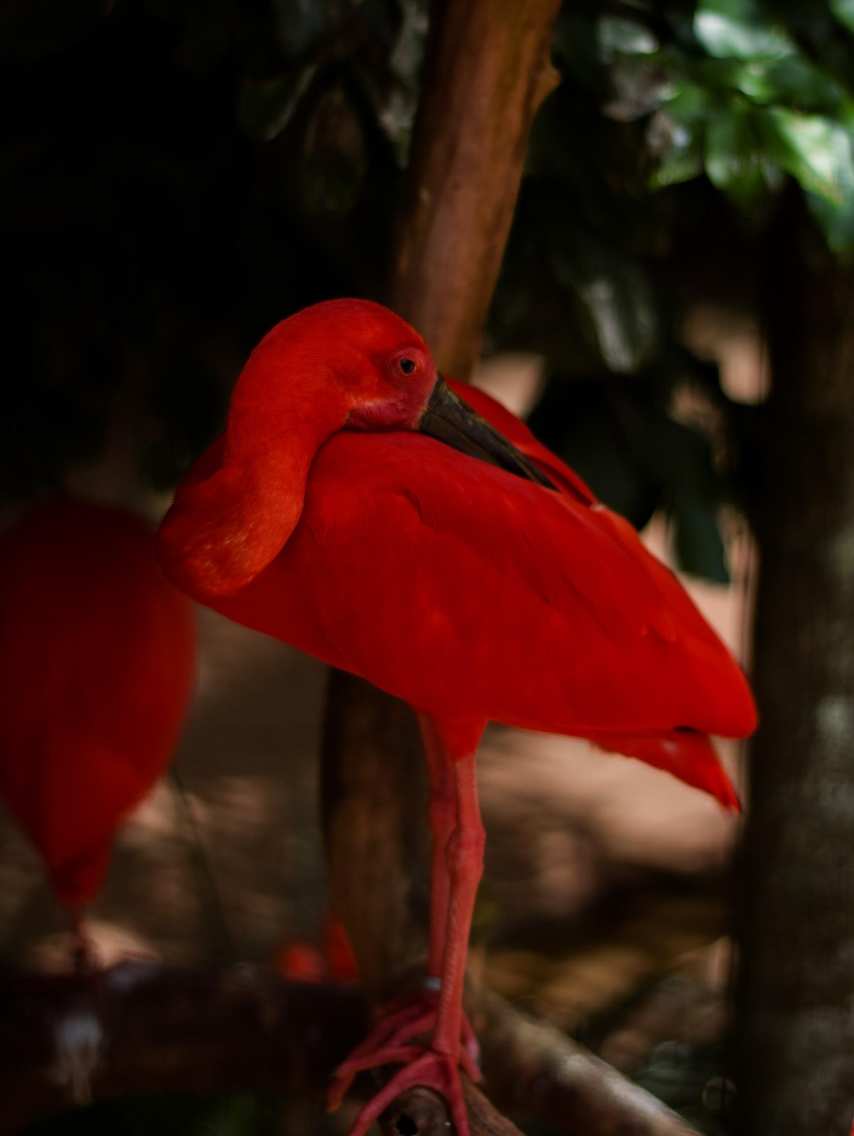
“The Scarlet Ibis”
What can you infer about the character’s state of mind from this key scene?
Photo by Mateus Campos Felipe on Unsplash
Photo by Annie Spratt on Unsplash

Slide 8
“This is Just to Say”
Using this poem as a model, write your own apology poem.
Use the style of the poem as your guide.
Write an apology you need to make.
You can choose to make your poem sincere or insincere.
Notes:
Image Source: aalmeidah (2017, Jan. 19). Plum. Pixabay. https://pixabay.com/illustrations/plum-fruit-fruits-orchard-nature-1992429/

Slide 9
Brother’s Apology Letter
If Brother could apologize, what would he say?
Write an apology letter to Doodle from Brother.
Use text evidence to support your apology.
Use an appropriate tone for your letter.
Make sure your letter includes proper characterization.

