Slide 2
The Great Domain
Domain and Range Notations

Slide 3
Essential Question
How can you represent and describe a function in relation to its domain and range?

Slide 4
Lesson Objective
Write domain and range using algebraic, interval, and set notations.

Slide 5

Always, Sometimes, or Never True
Determine if the following statement is:
  Always true
  Sometimes true
  Never true
If the statement is sometimes or
never true, then provide a counterexample.
Notes:
K20 Center. (n.d.). Always, Sometimes, or Never True. Strategies. https://learn.k20center.ou.edu/strategy/145

Slide 6
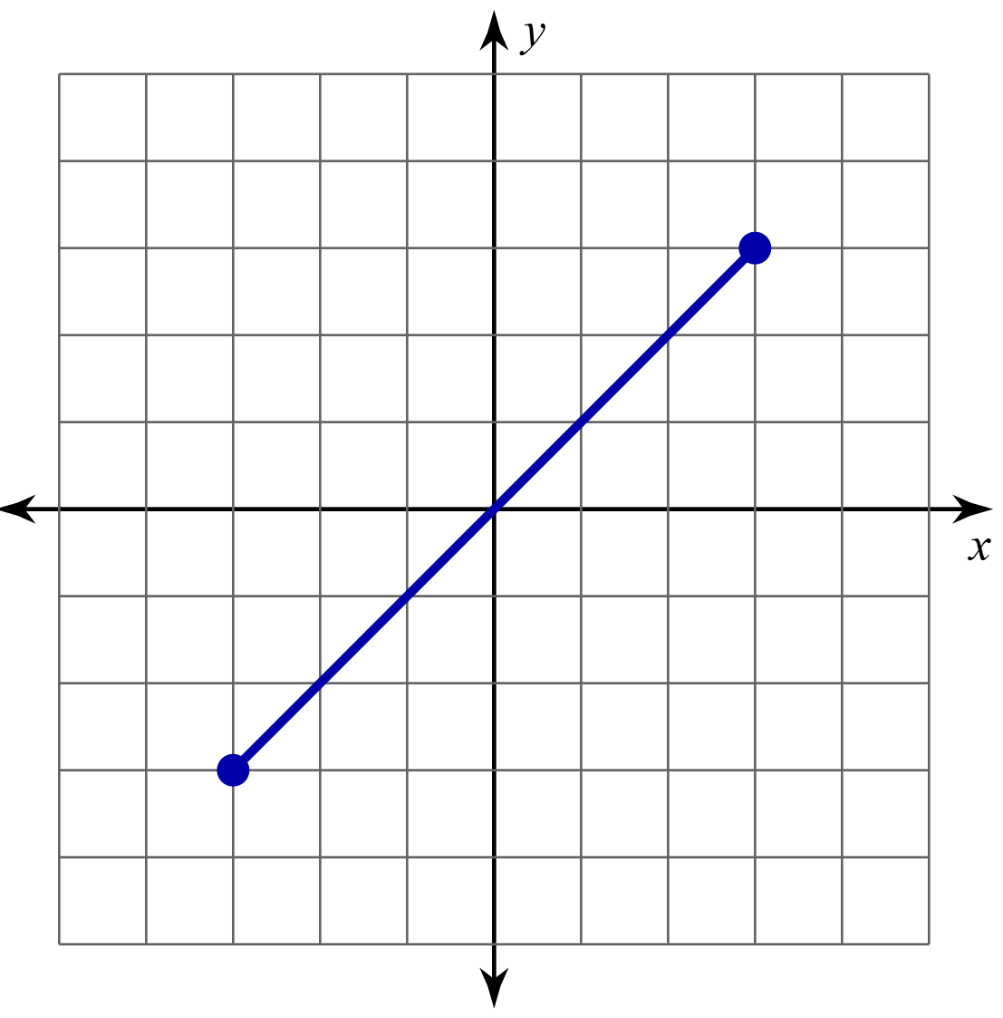
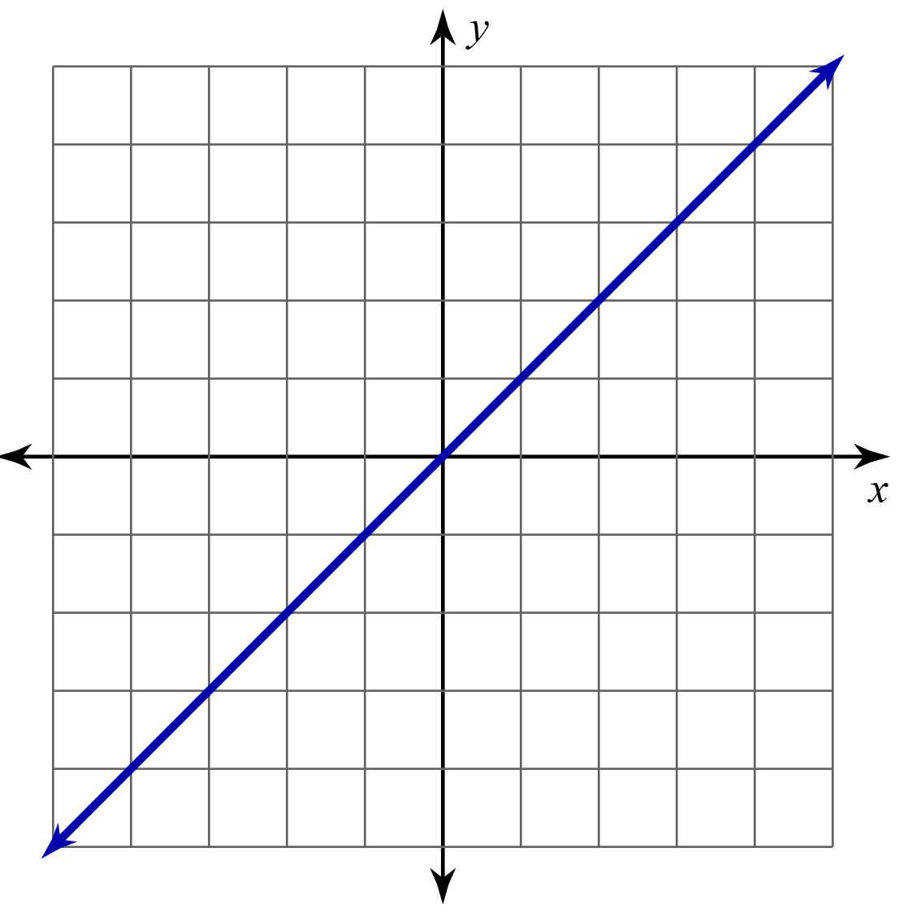
Bounded vs. Unbounded
Bounded
Unbounded

Slide 7
Always, Sometimes, or Never True
Domains are y-values and
bounded by the graph.
Notes:
K20 Center. (n.d.). Always, Sometimes, or Never True. Strategies. https://learn.k20center.ou.edu/strategy/145

Slide 8
Always, Sometimes, or Never True
Ranges are y-values and
bounded by the graph.
Notes:
K20 Center. (n.d.). Always, Sometimes, or Never True. Strategies. https://learn.k20center.ou.edu/strategy/145

Slide 9
Always, Sometimes, or Never True
Domain or range can be
represented as
“All real numbers except 5.”
Notes:
K20 Center. (n.d.). Always, Sometimes, or Never True. Strategies. https://learn.k20center.ou.edu/strategy/145

Slide 10

I Think / We Think
I THINK: Work independently to find
the domain and range for each graph.
  Do your best. This is the time to share what you know.
WE THINK: Share with your partner what you wrote under the “I Think…” once everyone has shared, record your group’s common understanding in the “We Think…” column.
Notes:
K20 Center. (n.d.). I Think / We Think. Strategies. https://learn.k20center.ou.edu/strategy/141

Slide 11
Guided Notes
Let’s complete the Guided Notes together.

Slide 12
Guided Notes: Notation
Algebraically | Graphically | Interval Notation

Slide 13
Guided Notes: Example
Algebraically | Set-Builder Notation | Interval Notation

Slide 14
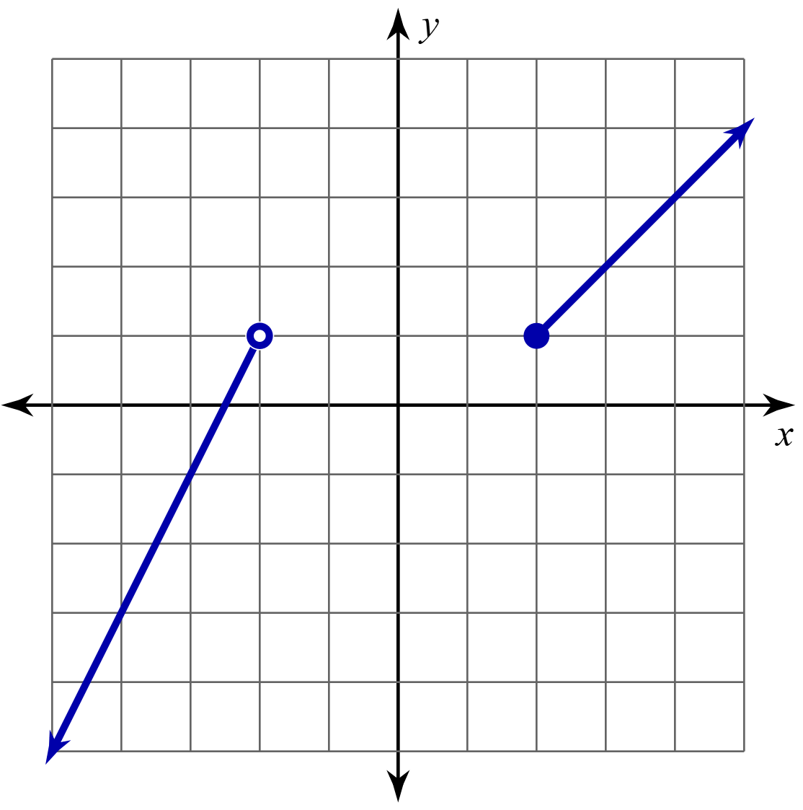
Guided Notes: Frayer Model
Example | Algebraic Notation
Interval Notation | Set Notation
Domain & Range
Notation

Slide 15
Wrangle Up Domain and Range
Independently complete questions 1-2 on your handout.
Create a graph for each given domain and range.

Slide 16
Wrangle Up Domain and Range: Reflection
Compare you graphs with a partner.
What is the same about your graphs? What is different?
Is there more than one graph that is correct?
What is important to consider about the domain?
What is important to consider about the range?

Slide 17
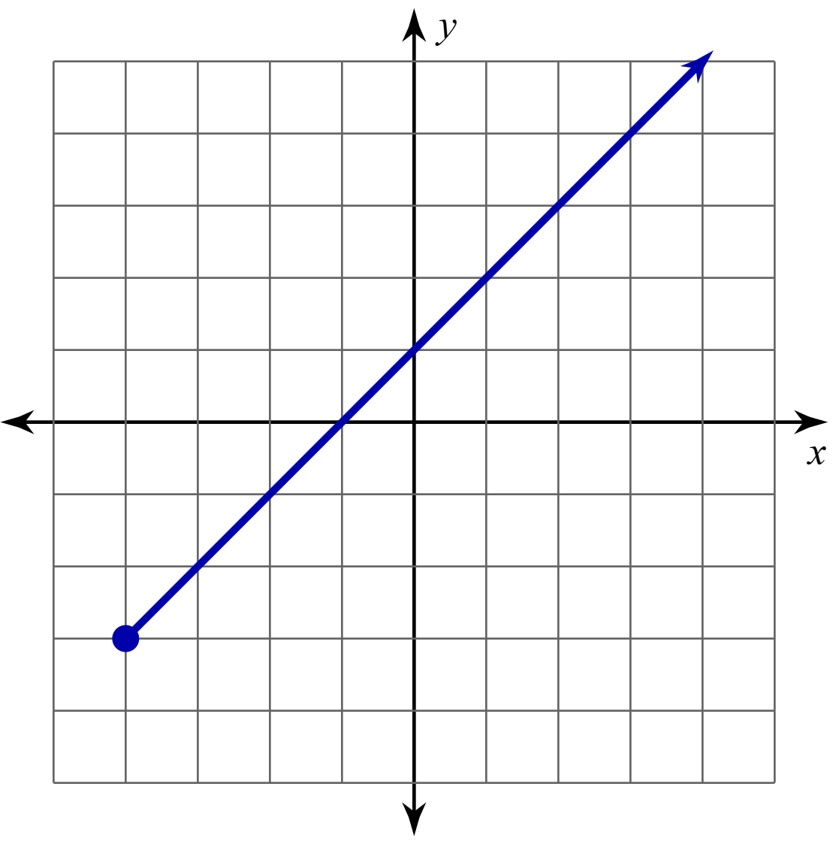
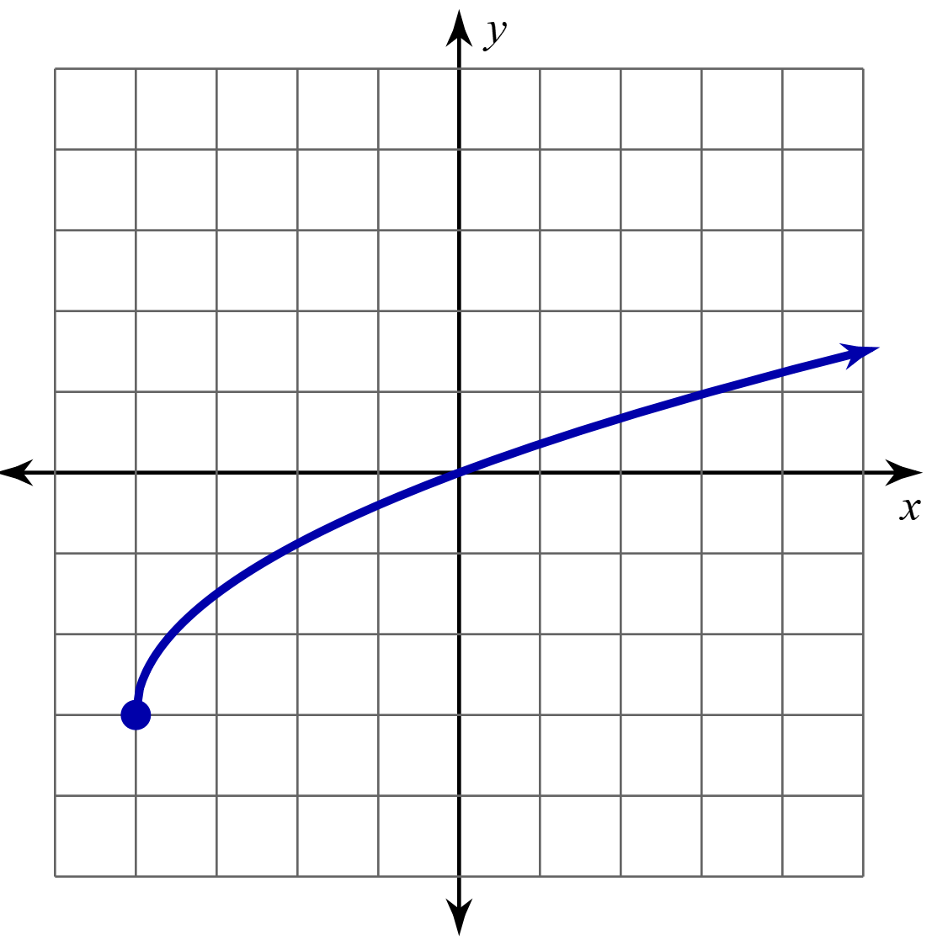
Wrangle Up Domain and Range: Question 1

Slide 18
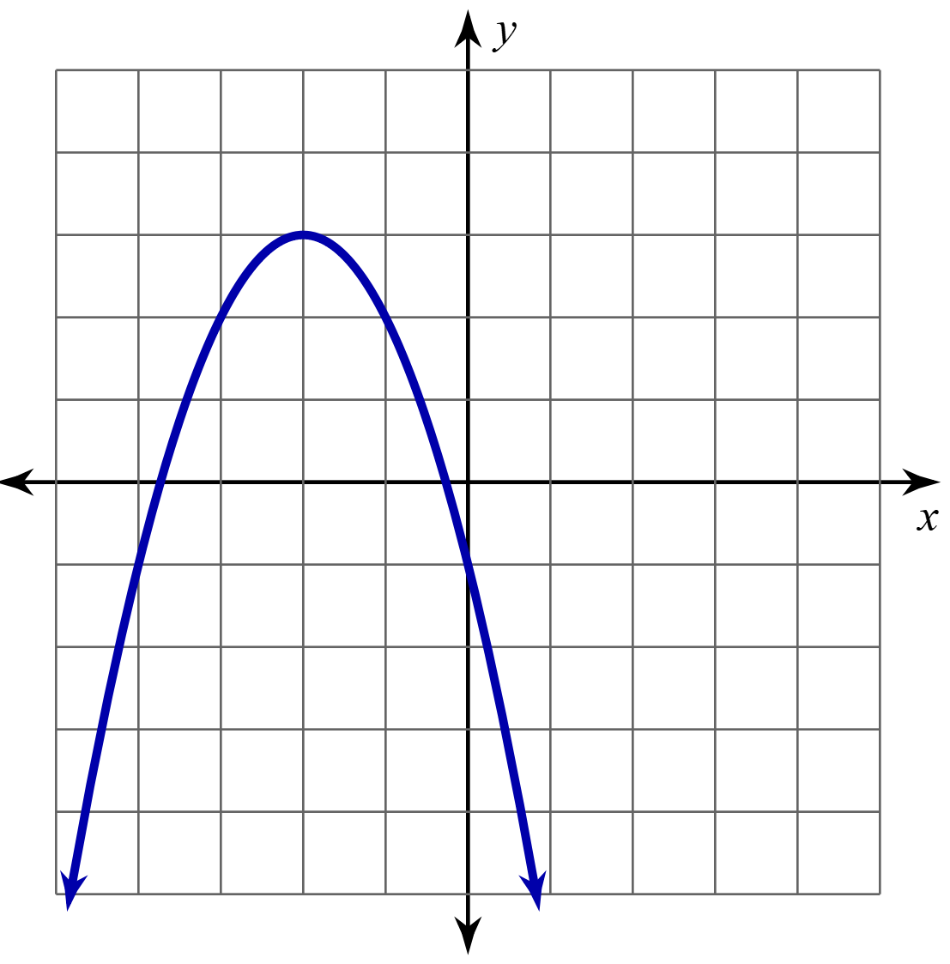
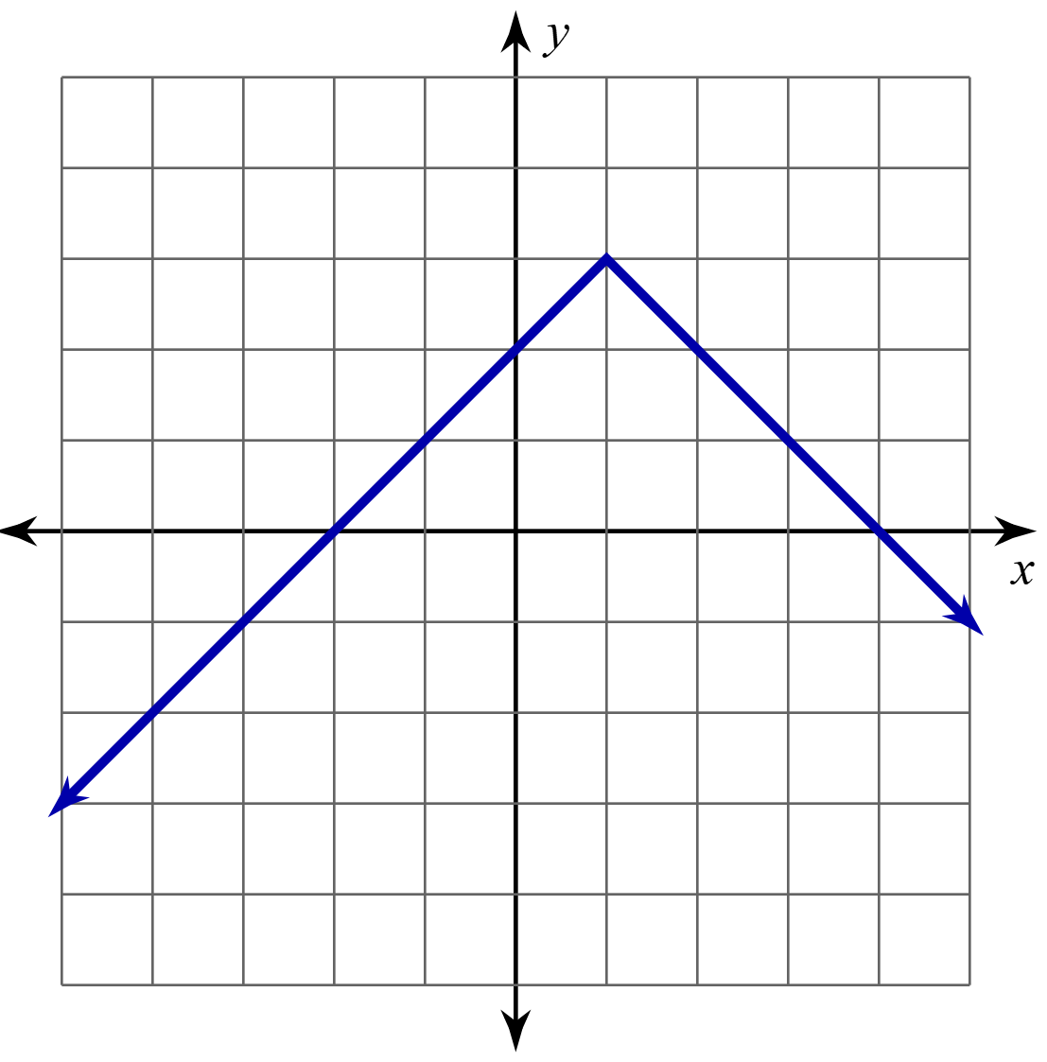
Wrangle Up Domain and Range: Question 2

Slide 19
Wrangle Up Domain and Range
Work with your partner to complete question 3.
Create a graph for the given domain and range.

Slide 20
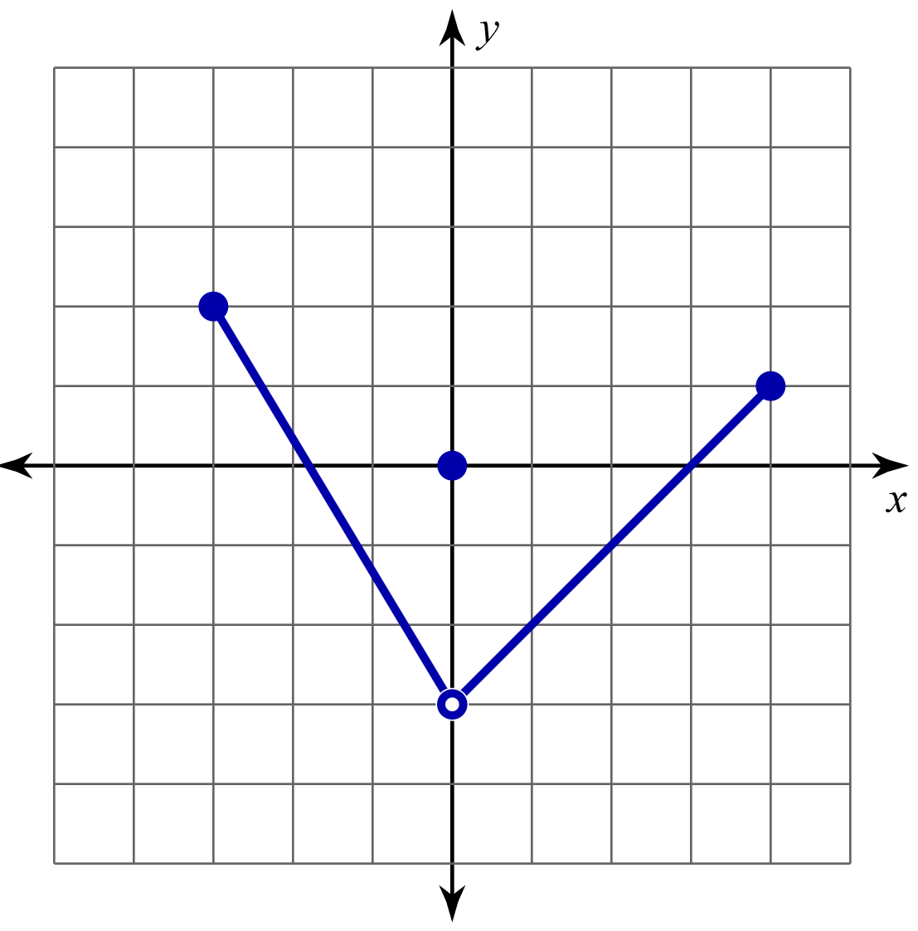
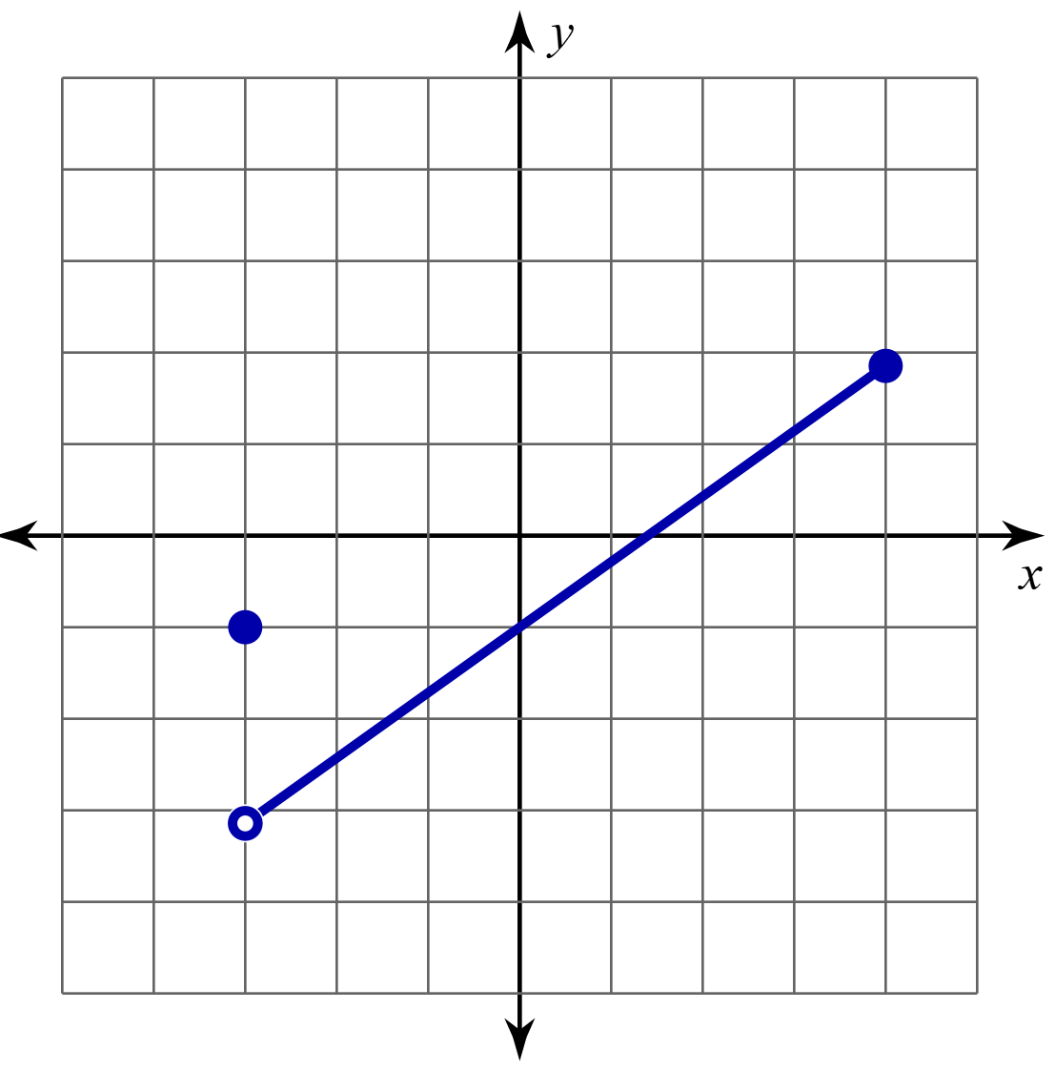
Wrangle Up Domain and Range: Question 3

Slide 21
Wrangle Up Domain and Range: Reflection
What is the same about your graphs? What is different?
Is there more than one graph that is correct?
What is important to consider about the domain?
What is important to consider about the range?
What was difficult and what was easy about creating the graph?

Slide 22

Muddiest Point
Crystal Clear
  What do you think is the clearest (easiest) part of writing domains and ranges using different notations?
Muddiest Point
  What do you think is the muddiest (most confusing) part of writing domains and ranges using different notations?
Notes:
K20 Center. (n.d.). Muddies Point. Strategies. Retrieved from https://learn.k20center.ou.edu/strategy/109

