Slide 2
You Take and You Take
Imperialism in Africa

Slide 3
I Notice, I Wonder
Examine the 1914 map of Africa on the next slide.
Then, examine the small inset map that shows Africa in 1878.
Write your observations and questions on the handout.
Notes:
Strategy:
K20 Center. (n.d.). I Notice, I Wonder. Strategies. https://learn.k20center.ou.edu/strategy/180

Slide 4
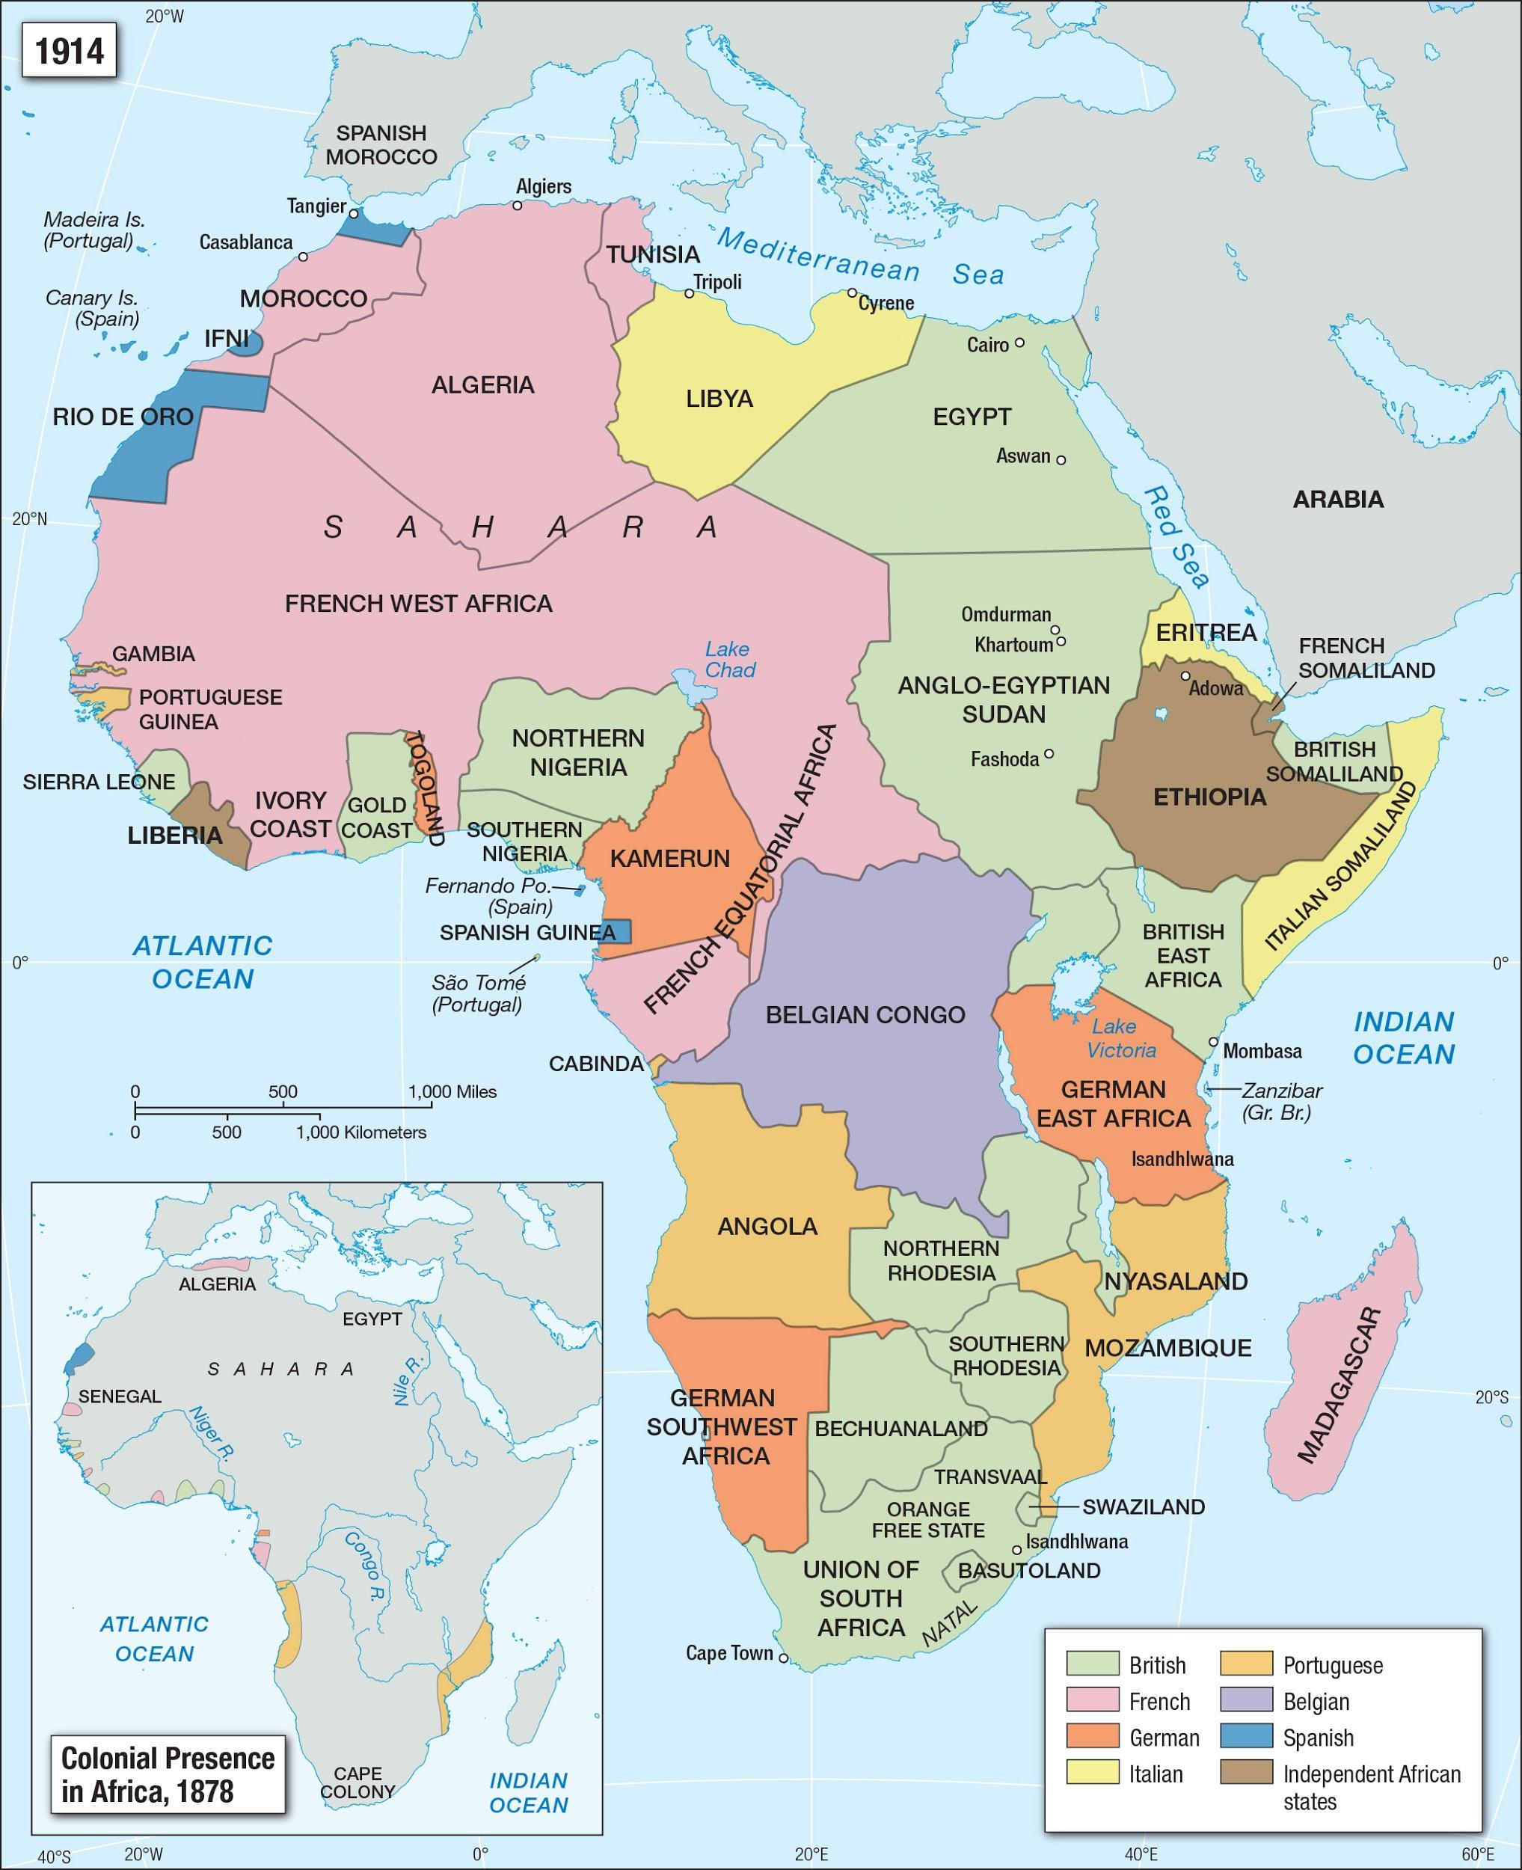
Notes:
Image source:
Facing History and Ourselves. (n.d.). Colonial presence in Africa [Map]. Facing History and Ourselves. https://www.facinghistory.org/resource-library/image/colonial-presence-africa

Slide 5
I Notice, I Wonder: Discussion
What are the differences between the 1914 map and the inset 1878 map?
Where are the countries listed in the map key located?
How do the countries listed in the key compare with the continent shown on the 1914 map?
What historical events occurred that led to the changes in the two maps?

Slide 6
Essential Question
How did imperialism affect Africa?

Slide 7
Lesson Objective
Explain the causes and consequences of imperialism throughout the continent of Africa.

Slide 8
Picture Deconstruction
View the images on the following slides.
Look at only one quadrant at a time.
For each quadrant, list specific parts of the image that you notice, including:
Any words you know,
Any symbols you recognize, and
Any people you see.
Notes:
Strategy:
K20 Center. (n.d.). Photo or picture deconstruction. Strategies. https://learn.k20center.ou.edu/strategy/140

Slide 13
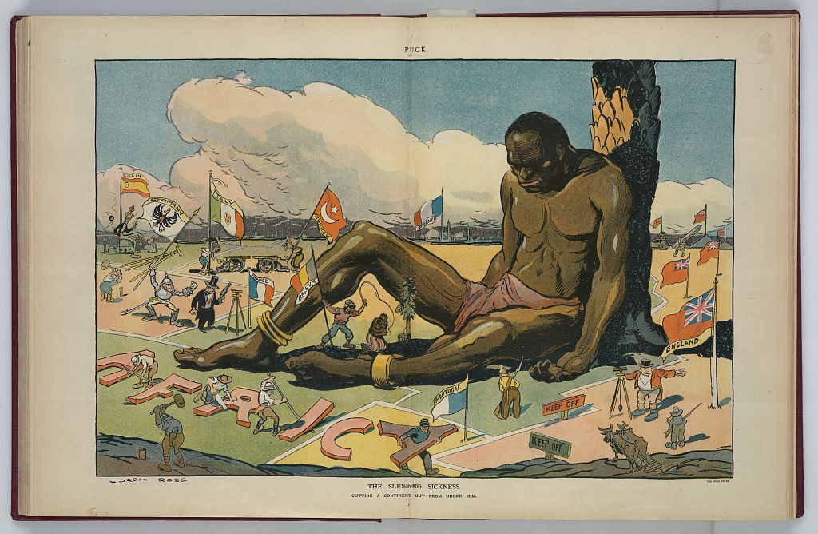
Notes:
Image source:
Ross, G. (1911). The sleeping sickness [Digital print]. U.S. Library of Congress. https://www.loc.gov/resource/ppmsca.27783/

Slide 14
Picture Deconstruction: Reflection
Compare this illustration to the maps you’ve analyzed.
What does this illustration have in common with the maps?
If needed, return to the previous slide to review the entire image.
Think about the image’s title: “The Sleeping Sickness.”
On your handout, write what you think the word imperialism means and explain how it relates to the title of the illustration.

Slide 15
H-chart: Video
On the following slide, watch the video titled “European Imperialism in Africa.”
Summarize the information you learn from the video on the right side of your H-chart.
Notes:
Strategy:
K20 Center. (n.d.). Paired text H-charts. Strategies. https://learn.k20center.ou.edu/strategy/132

Slide 16
Notes:
To play the video, click on the image on the slide or go to the following link: https://youtu.be/OJe1W_HIWmA
Video source:
HistoryTubeTV. (2009, February 16). European imperialism in Africa [Video]. YouTube. https://www.youtube.com/watch?v=OJe1W_HIWmA

Slide 17
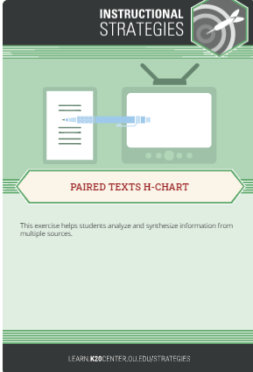
H-chart: Reading
Carefully read the article about imperialism in Africa.
Highlight, circle, or underline three main ideas as you read.
Summarize what you learn from the reading on the left side of your H-chart.
Notes:
Strategy:
K20 Center. (n.d.). Paired text H-charts. Strategies. https://learn.k20center.ou.edu/strategy/132

Slide 18
Analyzing Political Cartoons
Examine the political cartoons on the next three slides.
Use the acronym T.A.C.O.S. to analyze each:
Time and Place: Make estimated guesses about the time frame and region where the cartoon takes place.
Action: Describe what is happening in the cartoon.
Caption: If there is a caption, write it down.
Objects/People: List any people, objects, and/or symbols shown.
Summary: Explain the meaning of the cartoon in one sentence.
Notes:
Strategy:
K20 Center. (n.d.). T.A.C.O.S. Strategies. https://learn.k20center.ou.edu/strategy/1196

Slide 19
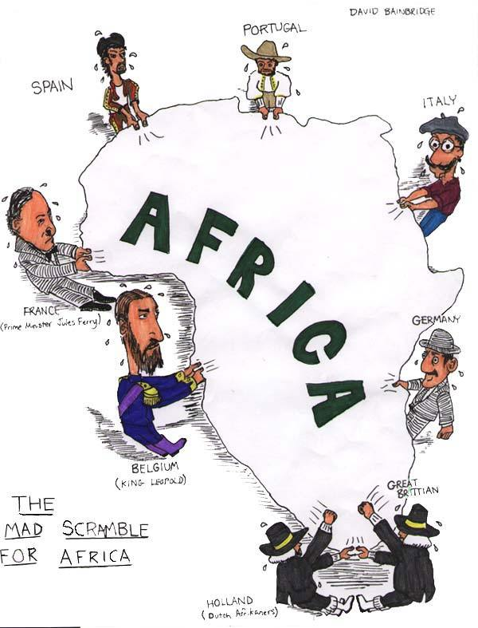
Notes:
Image source:
Bainbridge, D. (n.d.). The mad scramble for Africa [Cartoon]. Colormefree. Tumblr. https://colormefree.tumblr.com/post/4681580543/legallypresent-the-mad-scramble-for-Africa

Slide 20
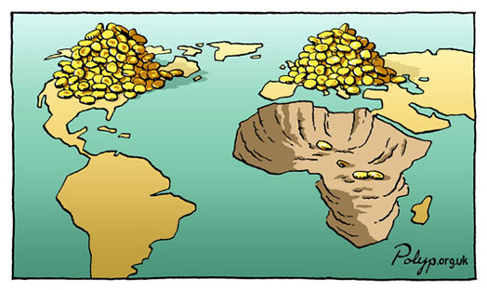
Notes:
Image source:
Polyp the cartoonist. (n.d.). Africa, unfair trade, mining minerals, gold [Cartoon]. Polyp. https://polyp.org.uk/cartoons/wealth/polyp_cartoon_africa_unfair_trade_mining_minerals_gold.jpg

Slide 21
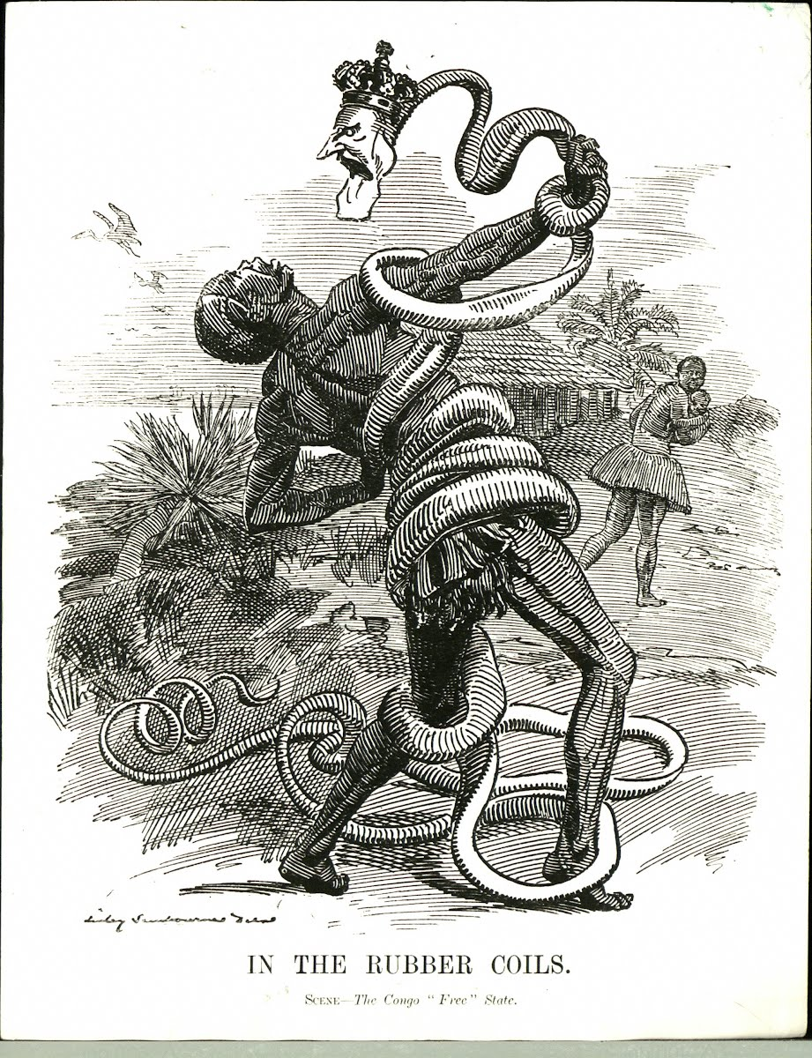
Notes:
Image source:
Sambourne, E. L. (1906). In the rubber coils. Scene—The Congo “free” state [Cartoon]. Wikimedia Commons. https://commons.wikimedia.org/wiki/File:Punch_congo_rubber_cartoon.jpg

Slide 22
How did imperialism affect Africa?
Revisit your H-chart and review your summaries of the video and reading.
Using those summaries and your political cartoon analyses, complete the middle section of your H-chart by answering the essential question:
How did imperialism affect Africa?

