Slide 2
You Take and You Take
Imperialism in Africa

Slide 3
Picture Deconstruction
View the images on the following slides.
Look at only one quadrant at a time.
For each quadrant, list specific parts of the image that you notice, including:
Any words you know,
Any symbols you recognize, and
Any people you see.
Notes:
Strategy:
K20 Center. (n.d.). Photo or picture deconstruction. Strategies. https://learn.k20center.ou.edu/strategy/140

Slide 8
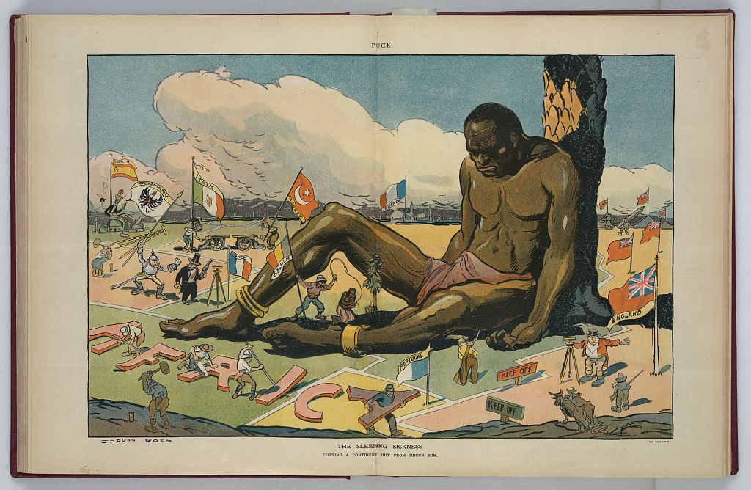
Notes:
Image source:
Ross, G. (1911). The sleeping sickness [Digital print]. U.S. Library of Congress. https://www.loc.gov/resource/ppmsca.27783/

Slide 9
Picture Deconstruction: Reflection
Compare this illustration to the maps you’ve analyzed.
What does this illustration have in common with the maps? Go to the Padlet board to share your thoughts.
If needed, return to the previous slide to review the entire image.
Think about the image’s title: “The Sleeping Sickness.”
In your Padlet post, write what you think the word imperialism means and explain how it relates to the title of the illustration.

