Slide 2
The Power of Poetry
ELA

Slide 3
Essential Question
How can poetry be a vehicle for change?

Slide 4
Lesson Objectives
Compare and contrast texts written on the same subject by different authors.
Evaluate how one’s point of view may contribute to the meaning of a text.

Slide 5
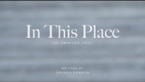
In This Place: An American Lyric

Slide 6
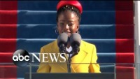
The Hill We Climb

Slide 7
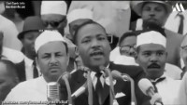
I Have a Dream

Slide 8
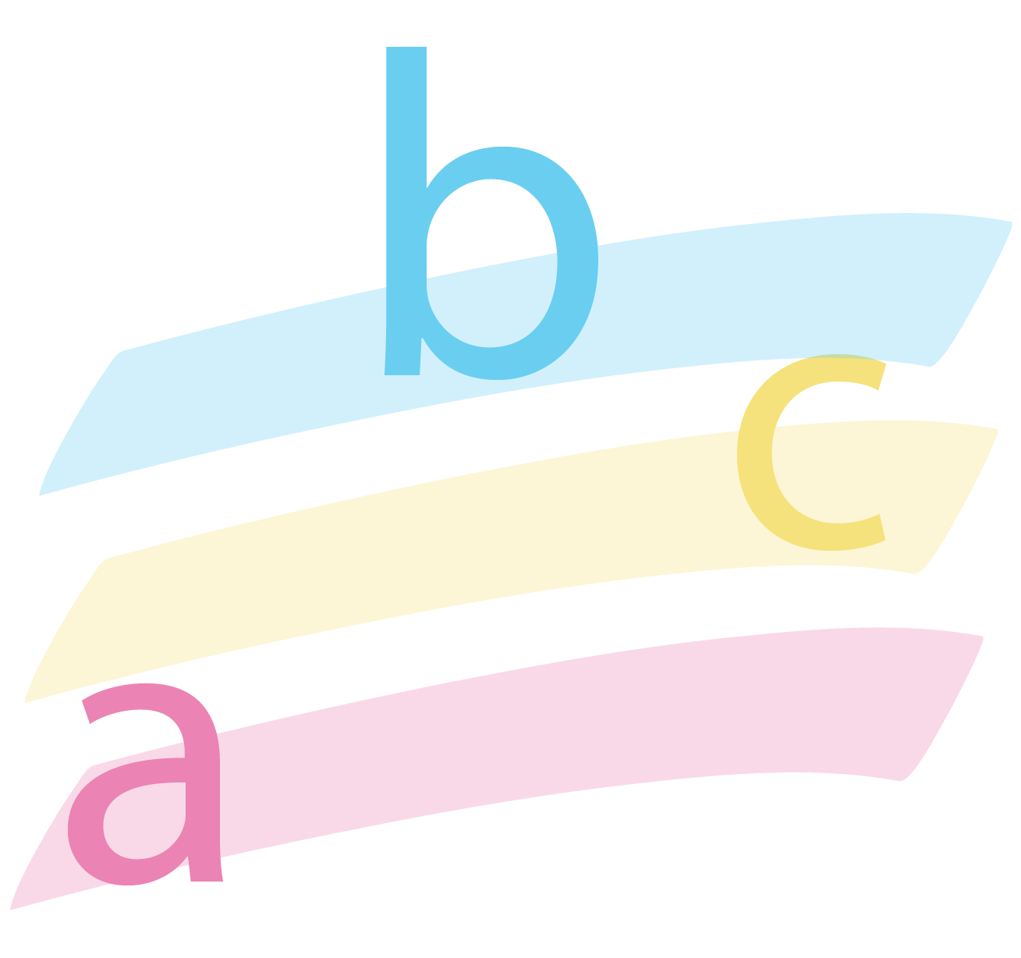
Categorical Highlighting
Alliteration is a device frequently used in poetry or rhetoric (speechmaking) where words starting with the same consonant are used in close proximity.
Allusion is an indirect reference to a work of literature (not explicit) that assumes the reader is familiar with the work referred to.
Internal rhyme, known also as middle rhyme, is rhyme that occurs within a single line of verse, or between internal phrases across multiple lines. By contrast, rhyme between line endings is known as end rhyme.
Repetition is repeating words, phrases, lines, or stanzas to emphasize a feeling or idea, create rhythm, and/or develop a sense of urgency.

Slide 9
Discussion
What makes a piece of writing poetry?

Slide 10
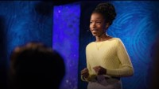
Using your voice is a political choice.

Slide 11
Discussion
Do you agree with Ms. Gorman? Is poetry/art political?
Explain your reasoning.

Slide 12
Blackout Poem
Read through Abraham Lincoln’s speech excerpt.
Go back through the speech and lightly circle words that seem most significant to the piece or convey the most meaning to you.
Write those words down in order as you read them from top to bottom and left to right.
If you are happy with the words you have chosen and you feel like they represent the piece, take a black permanent marker and place a box around each word. Leave the word itself untouched.
Finally, go back through the piece of writing and black out the rest of the words, leaving only the words you chose untouched.

Slide 13
Gallery Walk
Circulate around the room as you read your classmates’ poems.
As you read the poems, think about these questions:
What do you notice about the poems?
Are they similar or very different?
Did most people choose the same words in their poems?
Why do you think people chose the words they did?
Is there something about the poem that stands out to you?
Leave a sticky note with your thoughts. Remember, you can comment without being critical. Use the questions above to guide your comments.

