Slide 2
We Will Stand With You.
The Oklahoma City Bombing

Slide 3
Essential Questions
How do we respond to tragic events?
What is the Oklahoma Standard?

Slide 4
Lesson Objectives
By the end of this lesson, you will be able to:
Explain the response to the Oklahoma City Bombing.
Define the Oklahoma Standard.

Slide 5
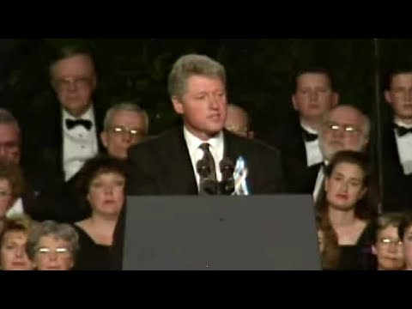
Notes:
AmericanRhetoric.com (Adapter). (2017, November 30). William Jefferson Clinton - Oklahoma bombing memorial (Audio Enhanced) [Video]. Retrieved February 18, 2021, from: https://www.youtube.com/watch?v=--HLij3R3e8

Slide 6
Sentence, Phrase, Word
You have lost too much, but you have not lost everything. And you have certainly not lost America, for we will stand with you for as many tomorrows as it takes… If anybody thinks that Americans are mostly mean and selfish, they ought to come to Oklahoma. If anybody thinks Americans have lost the capacity for love and caring and courage, they ought to come to Oklahoma.
-Bill Clinton

Slide 7
Sentence, Phrase, Word
A Sentence | that expresses or captures the main idea.
A Phrase | that moves, engages, provokes, or is meaningful to you.
A Word | that captures your attention, or that you find to be powerful.

Slide 8
Notes:
Image Source: FBI. (2020, April 15). The Oklahoma City bombing: 25 years later [Image]. Retrieved February 18, 2021, from https://www.fbi.gov/news/stories/25-years-after-oklahoma-city-bombing-041520

Slide 9
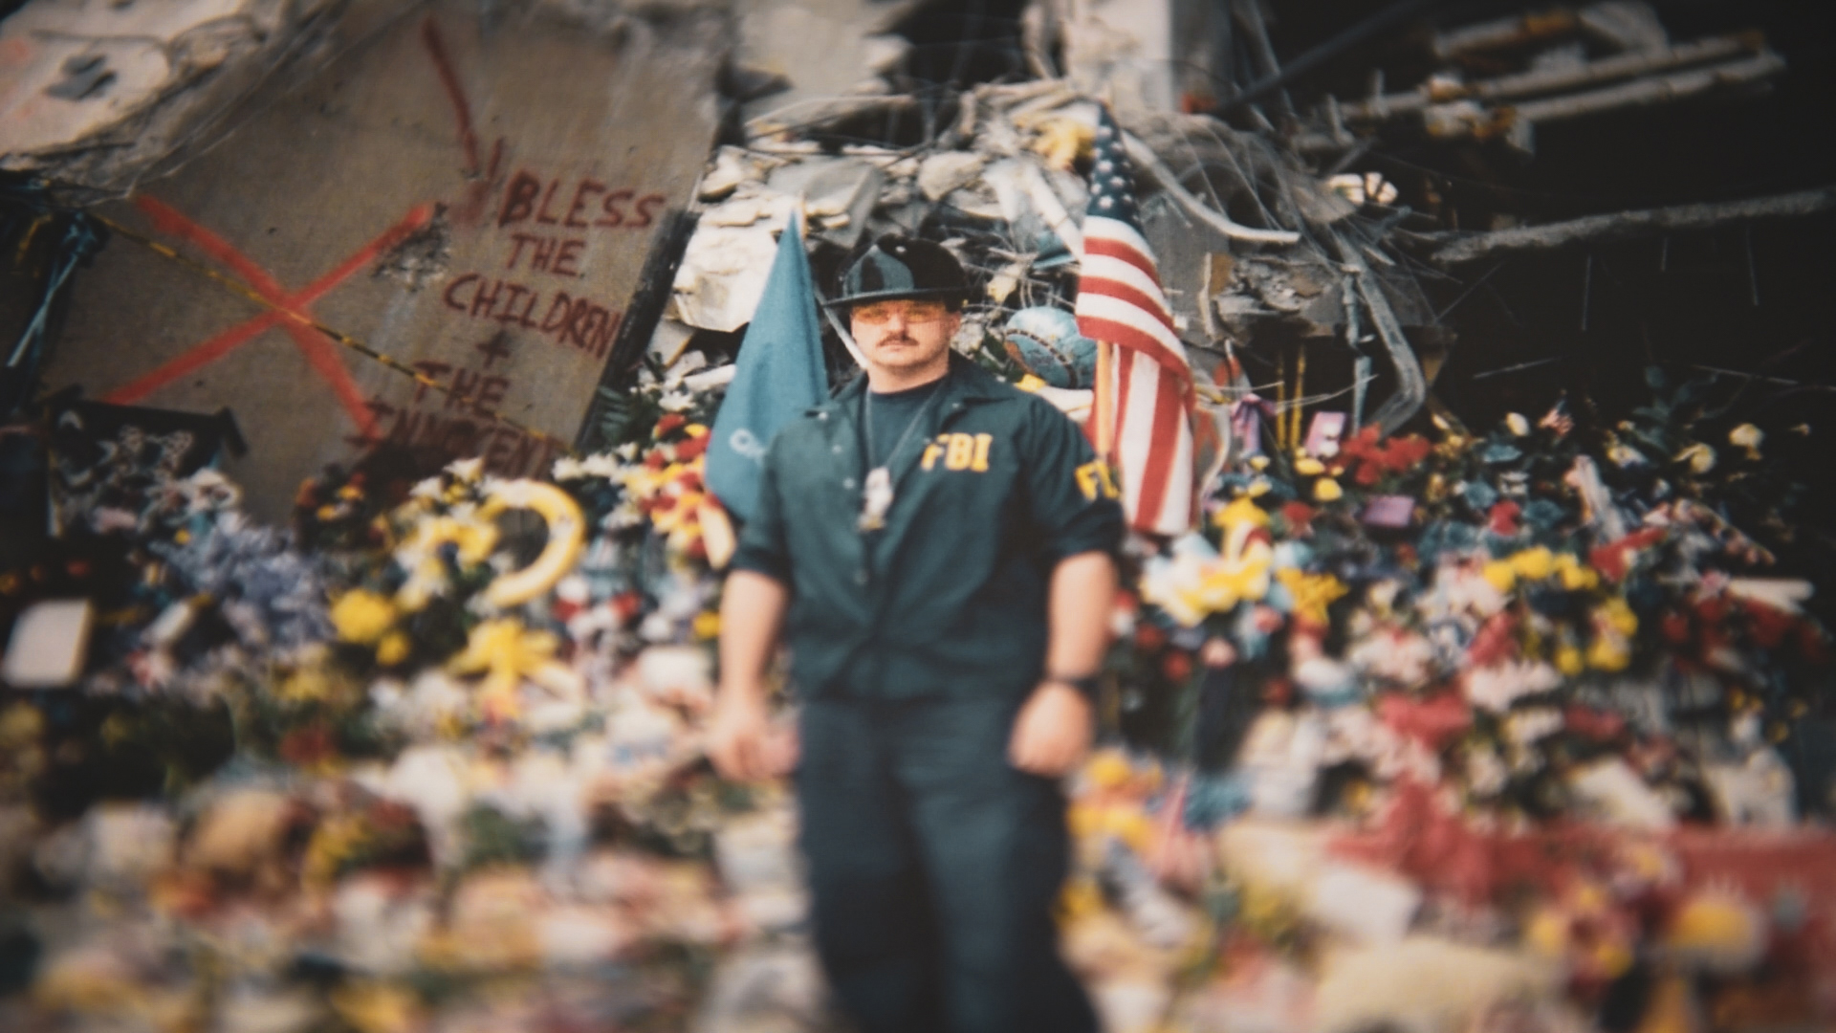
Oklahoma City Bombing
On April 19, 1995, the Alfred P. Murrah Federal Building was subjected to a terrorist attack.
168 people died, adults and children.
600 were injured.
Notes:
Image Source: FBI. (2020, April 15). The Oklahoma City bombing: 25 years later [Image]. Retrieved February 18, 2021, from https://www.fbi.gov/news/stories/25-years-after-oklahoma-city-bombing-041520

Slide 10
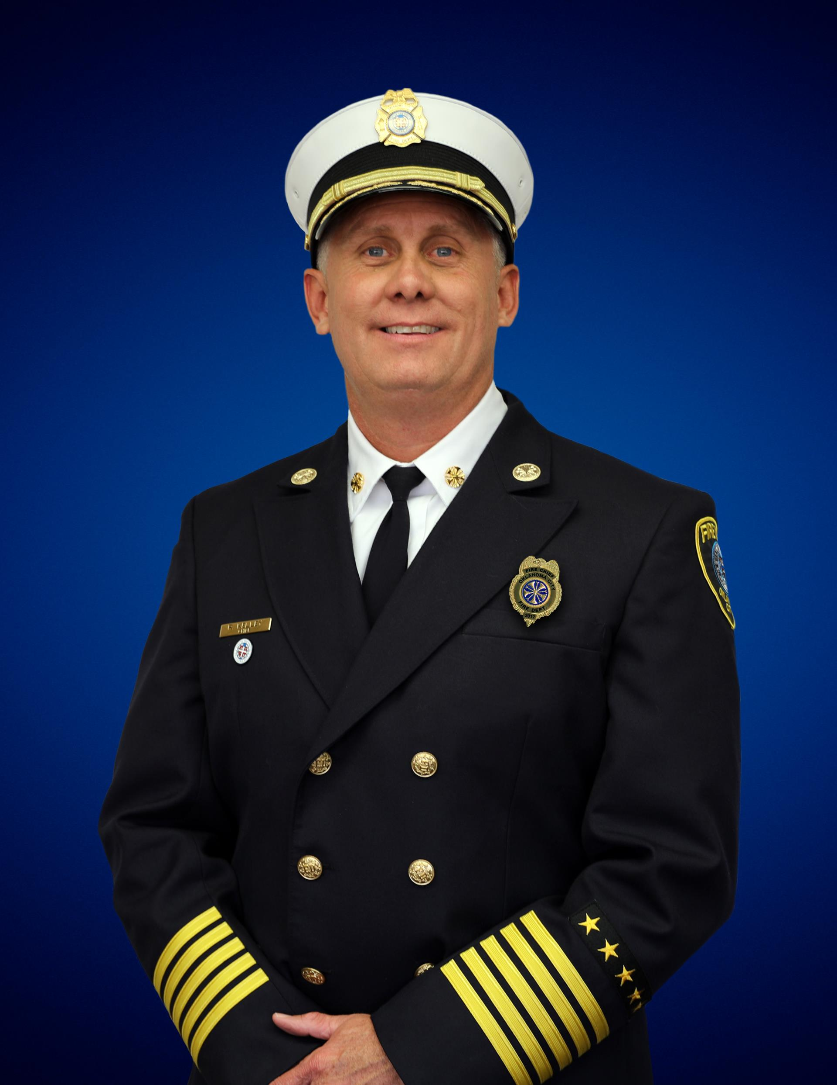
Oklahoma City Fire Chief Richard Kelley
Part of the Oklahoma City Fire Department since 1991
Oklahoma City Fire Chief since September 2017
Completed a degree in Municipal Fire Protection from Oklahoma State University
Notes:
Source: The City of Oklahoma City. (n.d.). Meet the fire chief. https://www.okc.gov/departments/fire/about-us/meet-the-fire-chief

Slide 11
Interview with Oklahoma City Fire Chief Richard Kelley
Notes:
K20 Center. (March 2021). K20 ICAP - We Will Stand With You [video]. YouTube. https://youtu.be/8xSx7OIYY14

Slide 12
Oklahoma City Fire Chief Richard Kelley
Which part of Chief Kelley’s interview stood out the most to you regarding how Oklahomans responded to the crisis?
Notes:
Source: The City of Oklahoma City. (n.d.). Meet the fire chief. https://www.okc.gov/departments/fire/about-us/meet-the-fire-chief

Slide 13
How Am I Feeling? What Am I Thinking?
After watching the video:
How are you feeling about the current topic?
What are some things that you are thinking about?
What questions do you have?
What concerns do you have?

Slide 14
What were some of the types of occupations held by those who responded to the bombing?

Slide 15
Notes:
Image Source: FBI. (2015, April 16). The Oklahoma City bombing: 20 years later. Retrieved February 18, 2021, from https://www.fbi.gov/news/stories/the-oklahoma-city-bombing-20-years-later

Slide 16
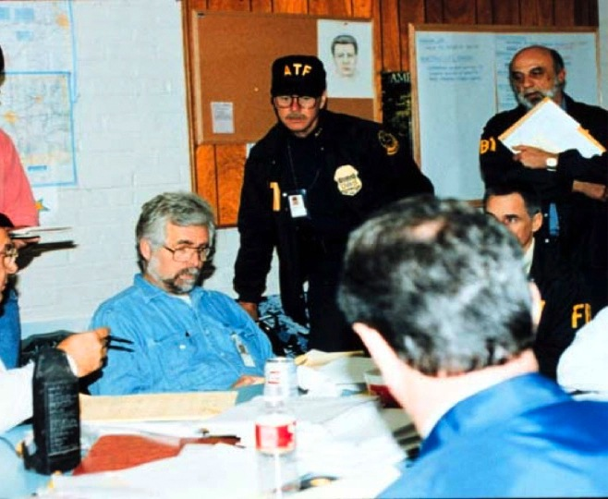
Crisis Response Teams
Crisis Management
Crisis Communication
Crisis Medicine
Crisis Counseling
Crisis Finance
Notes:
Image Source: FBI. (2015, April 16). The Oklahoma City bombing: 20 years later. Retrieved February 18, 2021, from https://www.fbi.gov/news/stories/the-oklahoma-city-bombing-20-years-later

Slide 17
Jigsaw
In your group:
Share your expert information from the reading and videos.
Take notes in your graphic organizer as other experts share information from their reading.

Slide 18
How do the crisis responses you just learned about relate to the excerpt from President Clinton’s speech?

Slide 19
The Oklahoma Standard…
…was born in the aftermath of the Oklahoma City Bombing. In April 1995, Oklahomans dropped everything to assist their friends and neighbors, coworkers and strangers. The response following the blast can only be described as amazing.
-Oklahoma Office of Homeland Security

Slide 20
Two-Minute Paper
Describe or explain any actions you have seen or experienced that you believe exemplify the Oklahoma Standard.

