Slide 2
Dear Mr. President
Contacting Your Elected Officials

Slide 3
Essential Questions
What is civil discourse?
How should you write to your elected officials?
What are the benefits of civil discourse?

Slide 4
Lesson Objectives
We will be able to define civil discourse.
We will be able to create an example of civil discourse through letter writing.

Slide 5
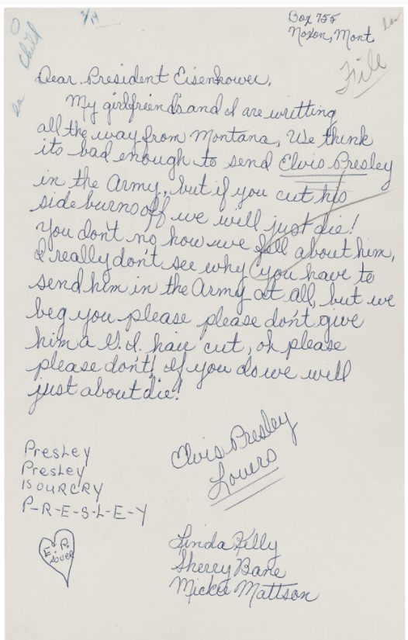
Letters to the President
Notes:
Letter from Linda Kelly, Sherry Bane, and Mickie Mattson to President Dwight D. Eisenhower Regarding Elvis Presley. President (2). Alphabetical Files, 1953-1961. White House Central Files (Eisenhower Administration), 1953-1961. Dwight D. Eisenhower Library (LP-DDE). https://catalog.archives.gov/id/594359

Slide 6
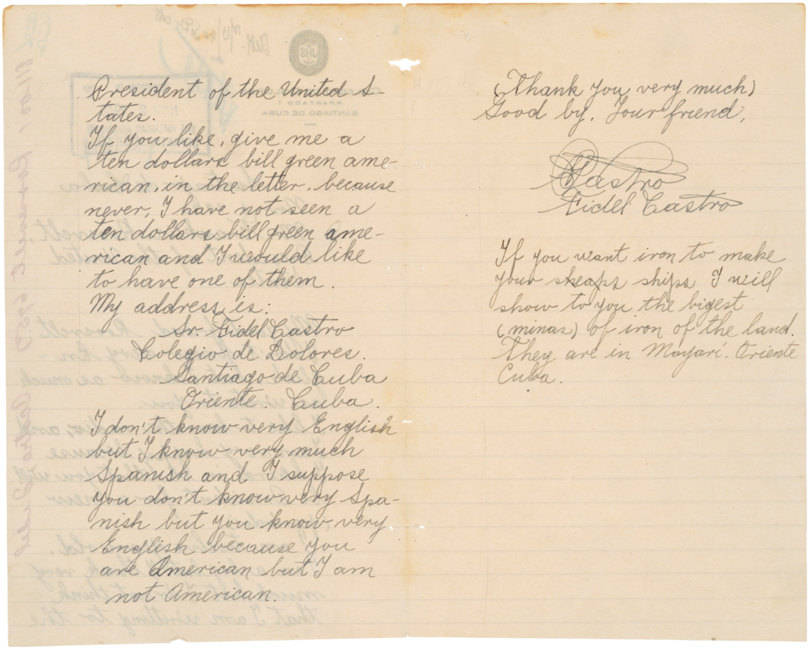
Notes:
Letter from Fidel Castro to President Franklin D. Roosevelt. 1940 Correspondence, Part 12, 800-800.1. General Records, 1936-1961. Records of the Foreign Service Posts of the Department of State, 1788-ca. 1991. National Archives at College Park. https://catalog.archives.gov/id/302040

Slide 7
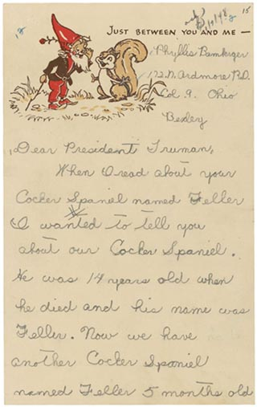
Notes:
Fried, Ellen. (2004). “Just Between You and Me”: Children’s Letters to Presidents. Prologue Magazine. National Archives. (36) 1. https://www.archives.gov/publications/prologue/2004/spring/childrens-letters.html

Slide 8
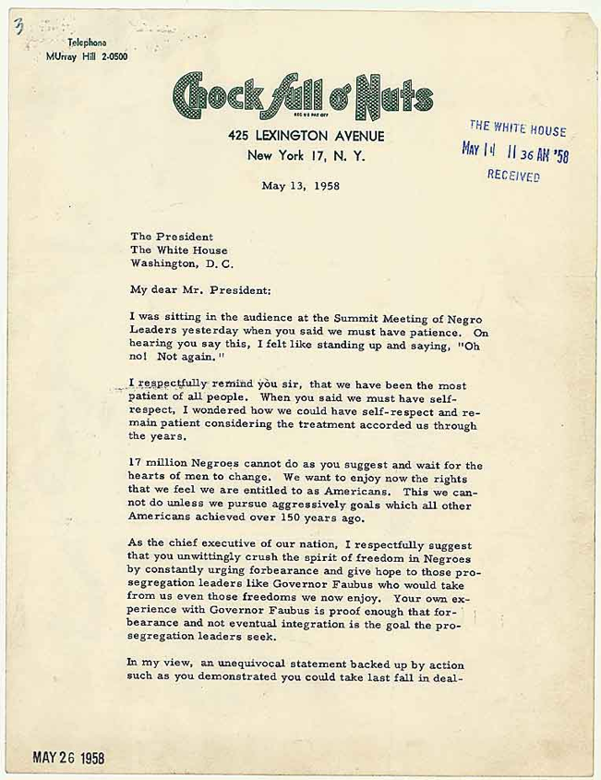
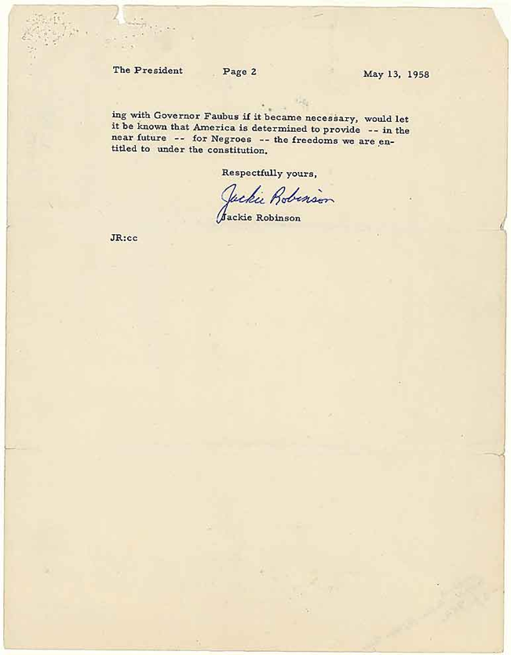
Notes:
Letter from Jackie Robinson to President Eisenhower of May 13, 1958. Negro Matters - Colored Question (6). Official Files, 1953-1961. White House Central Files (Eisenhower Administration), 1953-1961. Dwight D. Eisenhower Library. https://catalog.archives.gov/id/186627?q=jackie%20robinson#.VgWq9gMY1jM.link

Slide 9
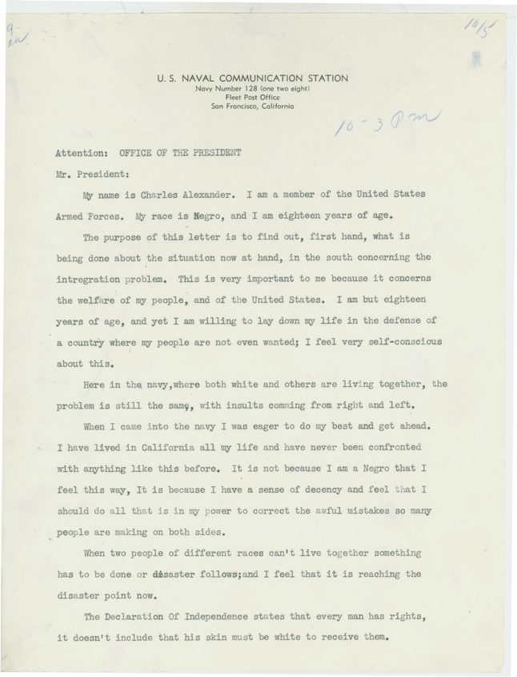
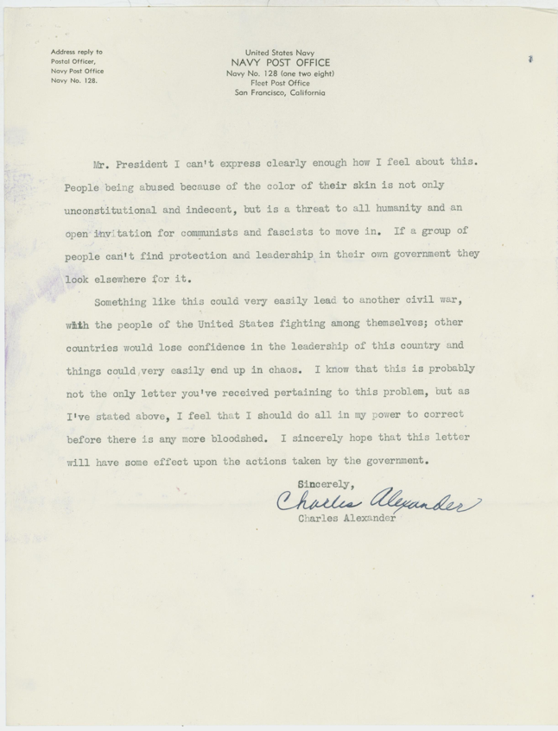
Notes:
Letter to President Dwight D. Eisenhower from Charles Alexander Regarding Integration. Bulk Mail Files, 1953-1961. White House Central Files (Eisenhower Administration), 1953-1961. Dwight D. Eisenhower Library. https://catalog.archives.gov/id/6092843

Slide 10
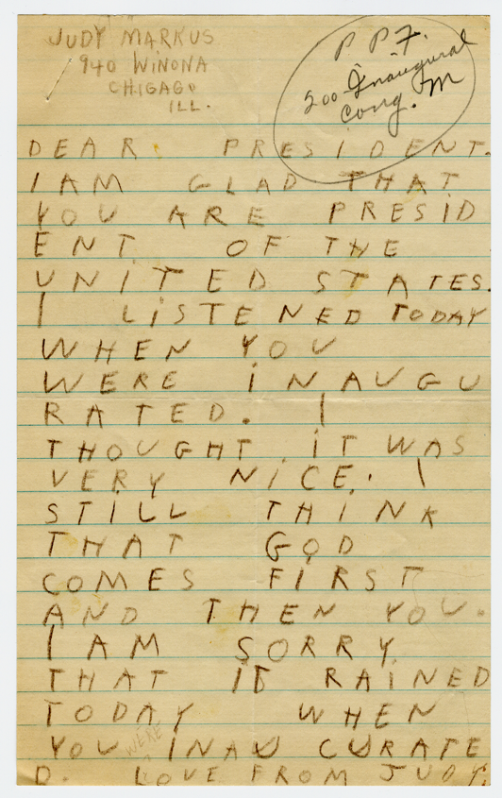
Notes:
Letter to President Franklin D. Roosevelt from a Child. President's Personal Files, 1933-1945. Papers as President, President's Personal File, 1933-1945. Franklin D. Roosevelt Library. https://catalog.archives.gov/id/6728529

Slide 11
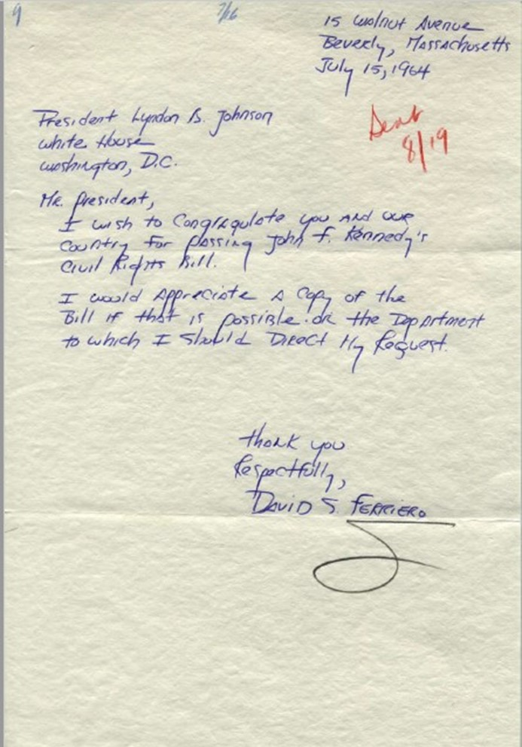
Notes:
Letter to President Lyndon B. Johnson from David S. Ferriero. White House Name Files, 11/22/1963-1/20/1969. White House Central Files (Johnson Administration), 11/22/1963-1/20/1969. Lyndon Baines Johnson Library. https://catalog.archives.gov/id/18482221

Slide 12
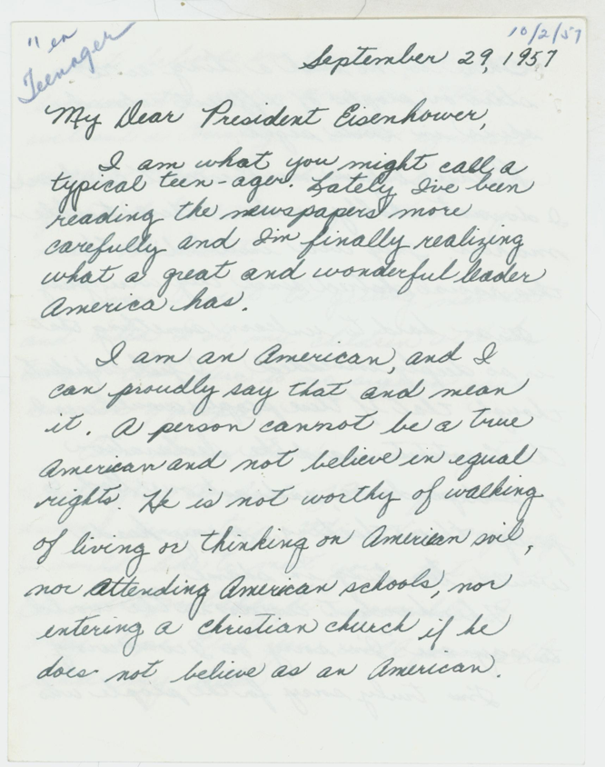
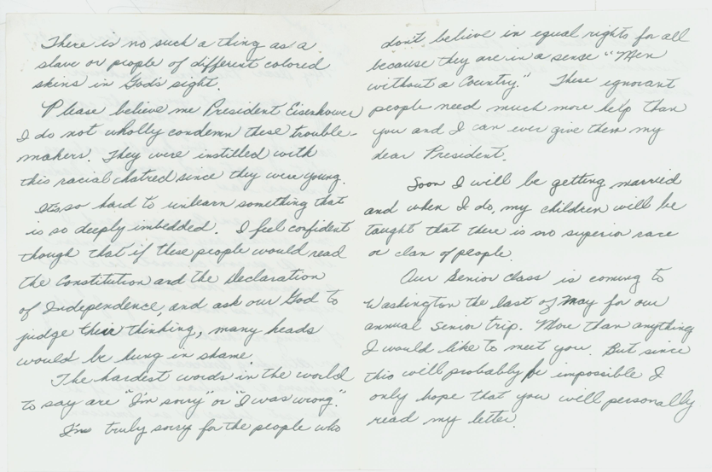
Notes:
Letter to President Dwight D. Eisenhower from Teenager Dana Anderson Regarding Equal Rights. Bulk Mail Files, 1953-1961. White House Central Files (Eisenhower Administration), 1953-1961. Dwight D. Eisenhower Library. https://catalog.archives.gov/id/6092838

Slide 13
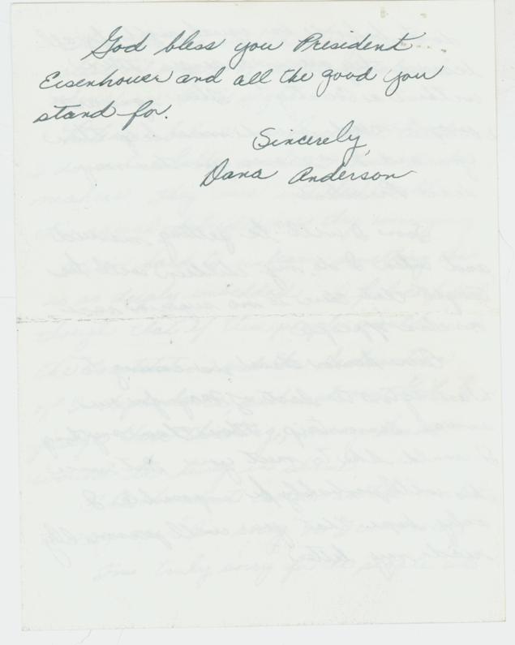
Letters to the President
Notes:
Letter to President Dwight D. Eisenhower from Teenager Dana Anderson Regarding Equal Rights. Bulk Mail Files, 1953-1961. White House Central Files (Eisenhower Administration), 1953-1961. Dwight D. Eisenhower Library. https://catalog.archives.gov/id/6092838

Slide 14
Effective Communication
Based on these letters to past presidents, answer the following questions:
What are characteristics of effective communication?
What things do you think should be included in letters to elected officials?
What things should be left out?

Slide 15
Civil Discourse
Based on your understanding of the letters so far,
what is civil discourse?

Slide 16
Card Sort, Part 1
In your Card Sort, there are two types of cards:
elected officials and constituent scenarios.
First, sort the elected officials into three levels of government: city, state, and federal.
Once everyone is finished, we will share out.

Slide 17
Check Your Answers
City: Mayor, City Council
State: Governor, State Representative, State Senator, State Insurance Commissioner
Federal: U.S. Representative, U.S. Senator, Vice President, President

Slide 18
Card Sort, Part 2
Read through each card and determine which elected official (or officials) would be the best choice for addressing the constituent concerns in each scenario.
We will share out our answers and reasoning.
  You may re-sort your cards as you hear your peers’ explanations.

Slide 19
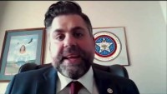
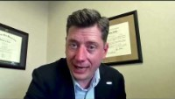
Interview with Rep. Jacob Rosecrants on Civil Discourse
Interview with OKC Mayor
David Holt
Notes:
K20 Center. (March 2021). K20 ICAP - Dear Mr. President [video]. YouTube. https://youtu.be/CQKqFpuGlVw
K20 Center. (June 2021). K20 ICAP-Dear Mr. President- Mayor Holt Interview [video]. YouTube. https://youtu.be/82ZRk_KhHgU

Slide 20
Collective Brainstorming
Let’s brainstorm a list of issues that we may want to address in a letter to one of our elected officials.
City
State
Federal
Tribal

Slide 21
Giving Constructive Peer-to-Peer Feedback
Swap letters and rubrics with a partner.
As you read, ask yourself the following questions about your partner’s letter:
  Where does the writer make a particularly good point?
  If there are any confusing or unclear parts, is there a better word or phrase the writer could use to fix this issue?
  Are there typos or grammatical errors?
  How could the writer improve their letter?

Slide 22
Exit Ticket
On a piece of paper or a sticky note, please respond to the following prompt:
  Explain how your letter reflects civil discourse or is an example of civil discourse.
Notes:
Source: K20 Center. (n.d.). Bell Ringers and Exit Tickets. Strategies. https://learn.k20center.ou.edu/strategy/125

