Slide 2
Woman Crush Wednesday: Terese LaRose
Hierarchical Organization of Multicellular Organisms

Slide 3
Essential Questions
How have female scientists shaped science today?
How do different cells affect specific systems within a multicellular organism?

Slide 4
Learning Objectives
Research and identify the different types of specialized cells.
Create a model that illustrates how parts within a system interact and how systems interact with one another to perform specific functions in multicellular organisms.

Slide 5
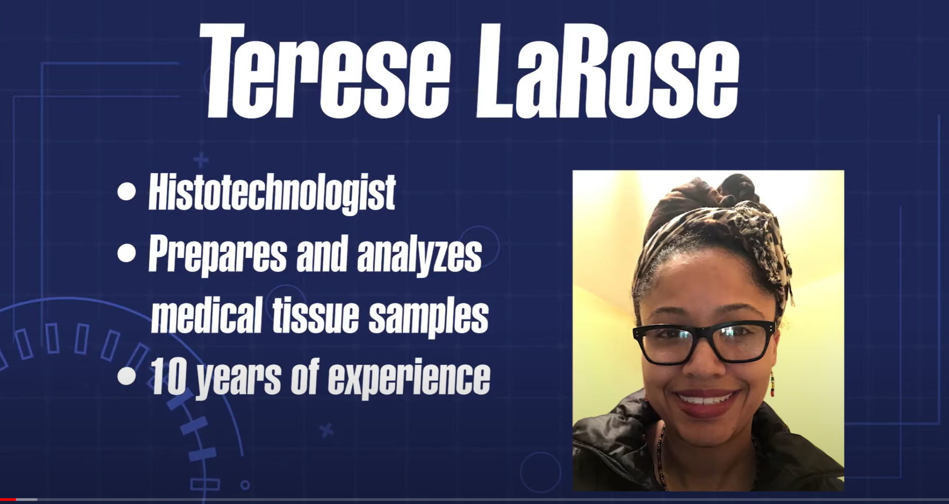
Terese LaRose: Histotechnologist
Notes:
Click the image on the slide to play the video, or paste this link into your web browser: https://www.youtube.com/watch?v=pbP3qazvJy0
K20 Center. (2022). Histotechnologist Terese LaRose ICAP [Video]. YouTube. https://www.youtube.com/watch?v=pbP3qazvJy0

Slide 6
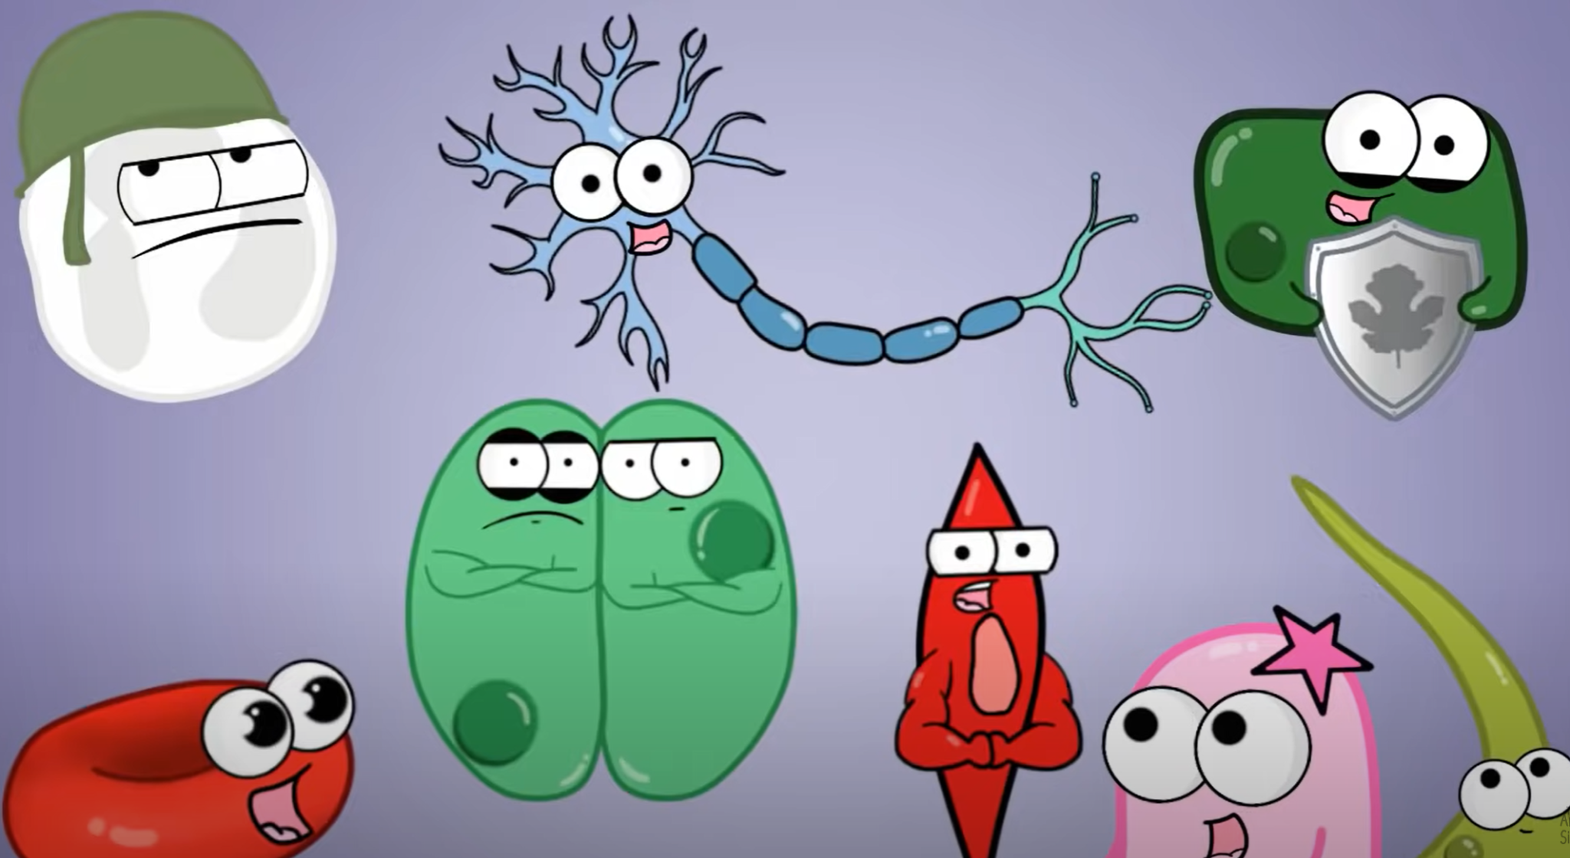
Amoeba Sisters: How Cells Become Specialized
Notes:
Click the image on the slide to play the video, or paste this link into your web browser: https://www.youtube.com/watch?v=t3g26p9Mh_k
Amoeba Sisters. (2017). How cells become specialized [Video]. YouTube. https://www.youtube.com/watch?v=t3g26p9Mh_k

Slide 7
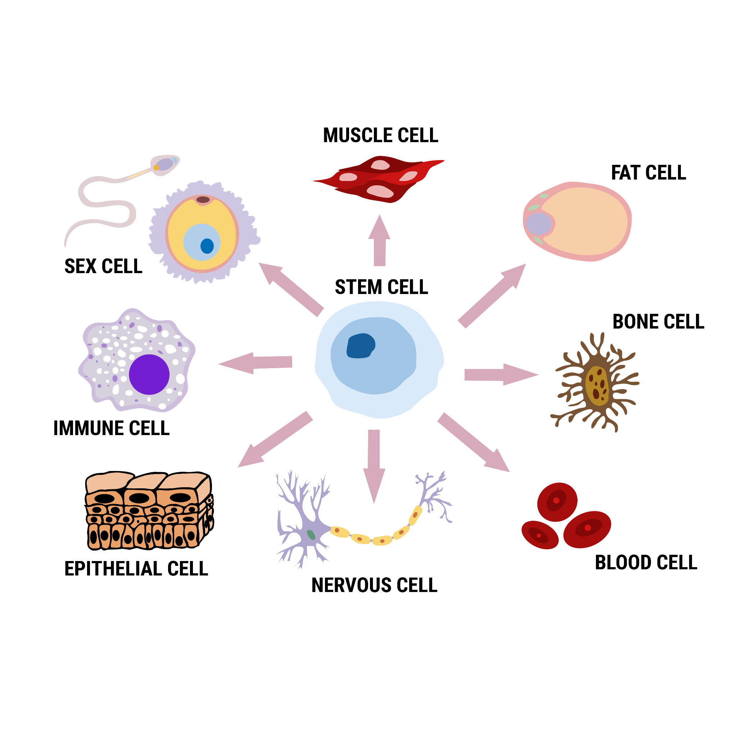
Specialized Cells Speed Dating
Choose one of the seven specialized cells in your group.
Research and fill out the Specialized Cells Speed Dating Profile for your cell.

Slide 8
Specialized Cells Speed Dating
Ready to participate in Speed Dating?
Take 30 seconds to tell your partner about your cell.
Take 30 seconds to collect details about your partner’s cell and record them on your note catcher.
If you come across the same cell,
add new details to your note catcher.

Slide 9
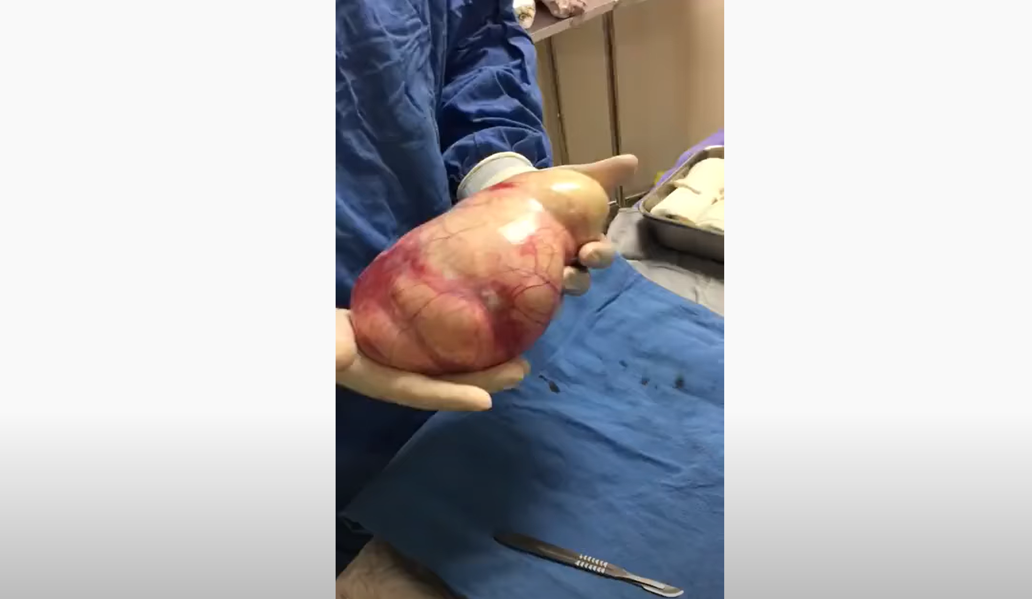
Ovarian Teratoma
Notes:
The following option contains sensitive content, and the URL might be restricted for certain school districts. Please advise any squeamish students to turn away before the 10-second mark. Click the image on the slide to play the video, or paste this link into your web browser: https://www.youtube.com/watch?v=pMua1d5BE4g
Medical Cortex. (2017). Ovarian teratoma [Video]. YouTube. https://www.youtube.com/watch?v=pMua1d5BE4g

Slide 10
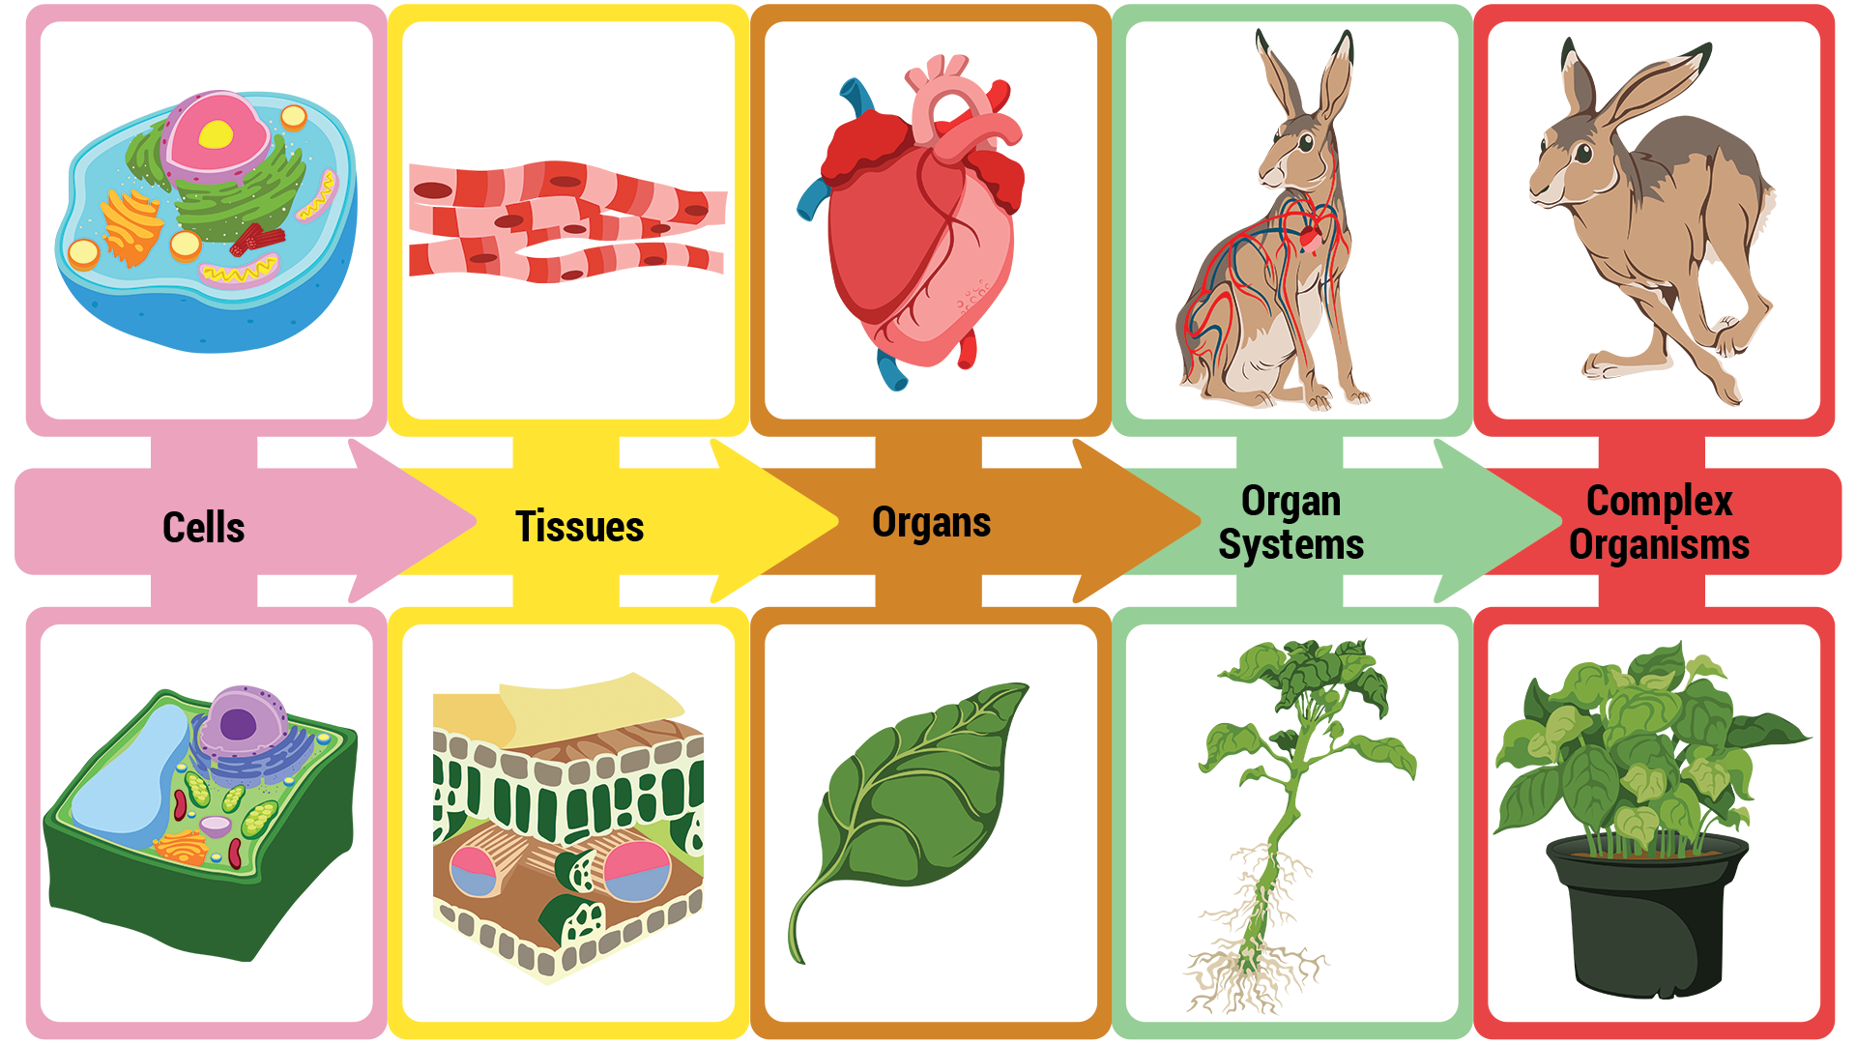
Specialized Cells Presentations
With your partner, research the
effects of a disease from the cellular level to the organism level for an organism of your choosing.
Create a model/poster that represents each of those levels.
Write a 1-page report explaining
the differences between the
healthy vs. the diseased/disordered version of each level.

Slide 11

Presentation Day
Each group member must present a portion of the project.
Be sure to point out each level on your model and discuss how it functions normally and how it functions when diseased.
As an audience member, you may write down any lingering questions you have to ask the presenter/teacher at the end.

Slide 12

Exit Ticket
Write 3–5 sentences answering this question:
How do different cells affect specific systems within a multicellular organism?

